Slide 1
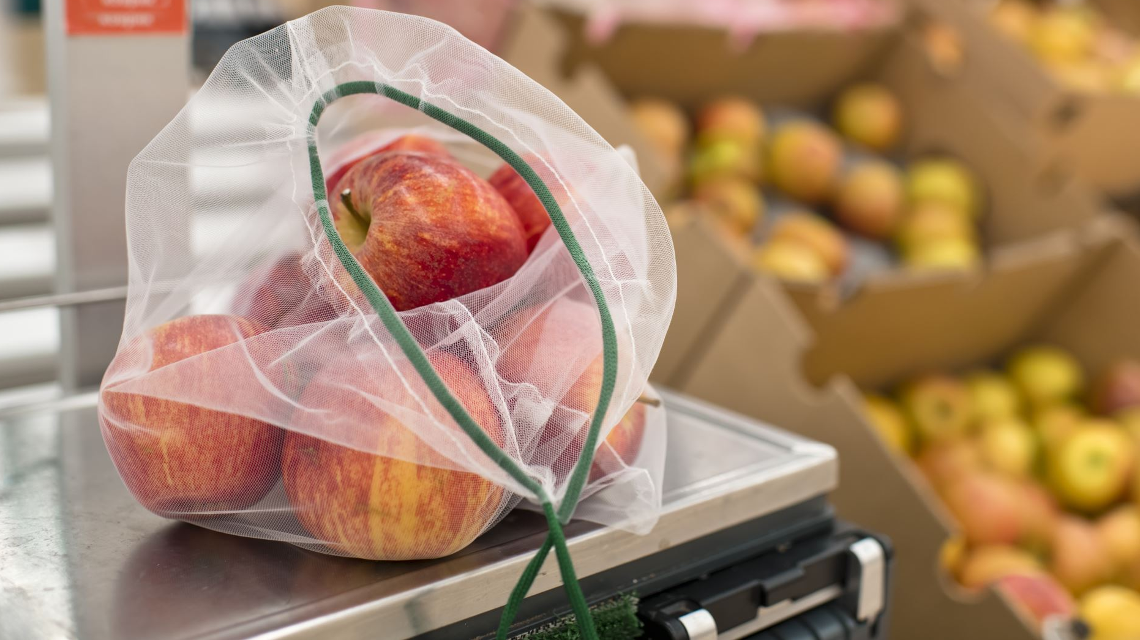
FEED: Food Donation App
Group : ME2

Slide 2

Meet Our Team
Anusigan Sivananthan (20230297)
N. T. Welagedara (20222090)
Lithila Mahagedara (20230176)
M.H.A Daneesha Hansaka (20230229)
Senumi Dahanayake (20230148)

Slide 3
The Problem
Approximately 1.3 billion tons of food is wasted annually (FAO, 2022).
Food wastage occurs at various stages of the supply chain: production, harvesting, distribution, and consumer consumption.
Inefficient farming practices, overproduction, and consumer behavior contribute to food wastage.

Slide 4
The Problem (Continued)
Food wastage leads to another pressing concern: food insecurity, affecting around 690 million people (9.2% of the global population) in 2019.
The actual situation involves a critical imbalance where a significant amount of food is wasted while millions go hungry worldwide.

Slide 5

Target Market
Individual Donors
Restaurants and Food Businesses
Grocery Stores and Supermarkets
Non-Profit Organizations and Charities
Government Agencies

Slide 6
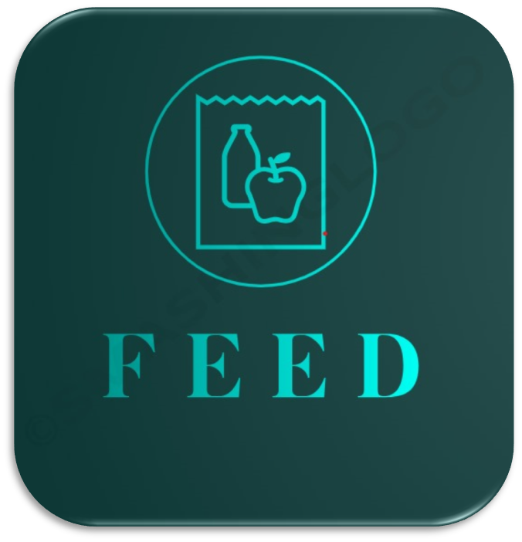
Prototype of Proposed Solution

Slide 7
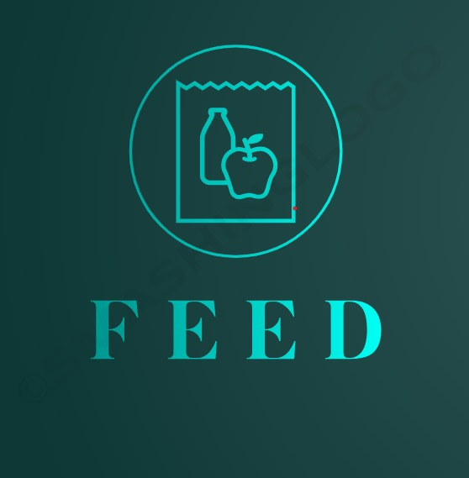
Innovative features of our product
One to one chat features
Real time tracking
Food/Non-food inventory management
Food rescue alerts
Food, grocery, essential items donation feature
Non-profit organization validity verifying feature

Slide 8
Benefits for Donors
Minimize food wastage by easily donating surplus or unsold items.
Potential tax deductions for food donations to charities.
Enhanced Corporate Social Responsibility (CSR) for businesses.

Slide 9

Benefits for Recipients
Access to nutritious food, promoting health and vitality.
Protection from diseases through the donation of nutritious items.
Receipt of not only food but also essential items like stationeries and toiletries.
Data-driven insights to address and manage food insecurity effectively.

Slide 10
Benefits for Corporate Sponsors
Increased publicity and positive reputation.
Eligibility for tax incentives.
Access to valuable data and insights for business development.

Slide 11
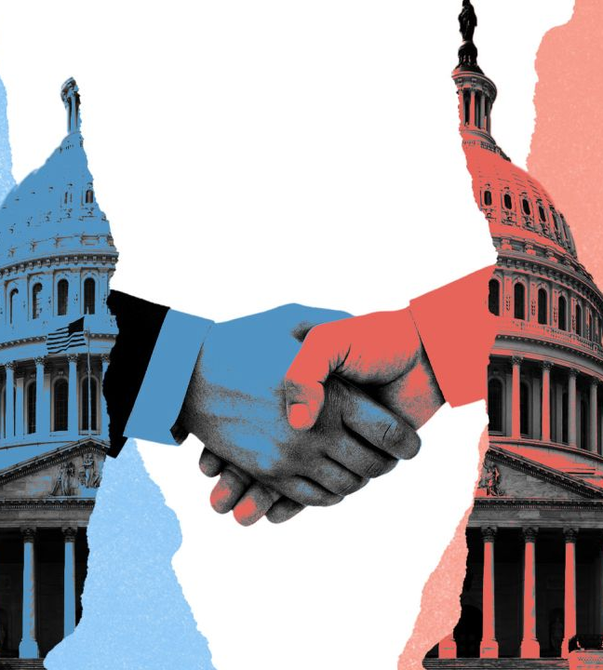
Benefits for Government Agencies
Effective improvement of citizens’ well-being through food initiatives.
Utilization of app data for informed policy-making on food insecurity.
Raised public awareness and civic engagement through government involvement in food donation initiatives.

Slide 12
Social Benefits
Green Practices
Community Well-being
Social Unity
Sustainability
Awareness and Education

Slide 13
Future Enhancements
Geographic Expansion
Community Engagement through Gamification
Foster Sense of Community
Comprehensive Impact

Slide 14
Conclusion
"FEED App: Nourishing Communities, Sustaining Hope”
As a lighthouse of compassion, the FEED app links plates and hearts to fight hunger. We hope to fulfill immediate needs and create a long-lasting influence on communities and the environment by expanding our reach, engaging locally, and including gamification components.
“Alone, we can do so little; together, we can do so much”
-Helen Keller

Slide 15
References
Al-Obadi, M., Ayad, H., Pokharel, S. and Ayari, M.A. (2022). Perspectives on food waste management: Prevention and social innovations. Sustainable Production and Consumption. [online] Available at: https://www.sciencedirect.com/science/article/abs/pii/S235255092200046X
Anon, (n.d.). Blog | Benefits of Food Donation. [online] Available at: https://www.misrii.com/blog/benefits-of-food-donation/#:~:text=Donating%20to%20the%20needy%20is.(Accessed 24th November 2023)
Baglioni, S., De Pieri, B. and Tallarico, T. (2016). Surplus Food Recovery and Food Aid: The Pivotal Role of Non-profit Organisations. Insights From Italy and Germany. VOLUNTAS: International Journal of Voluntary and Nonprofit Organizations. [online] Available at: https://link.springer.com/article/10.1007/s11266-016-9746-8
Breda McCarthy. (2020) Completing the Food Waste Management Loop: Is there market potential for value-added surplus products .[online] Available at: https://www.sciencedirect.com/science/article/abs/pii/S0959652620304820(Accessed 17th October 2023)
Butler, P. and editor, social policy (2012). Breadline Britain: councils fund food banks to plug holes in welfare state. The Guardian. [online] Available at: https://www.theguardian.com/society/2012/aug/21/councils-invest-food-banks-welfare-cuts(Accessed 26th November 2023)
‌European Commission (2023). Food Waste. [online] food.ec.europa.eu. Available at: https://food.ec.europa.eu/safety/food-waste_en.(Accessed 15th October 2023)
Feeding America (2023). What is Food Insecurity? [online] Available at: https://www.feedingamerica.org/hunger-in-America/food-insecurity#:~:text=A%20definition%20of%20food%20insecurity (Accessed 28th October 2023)
Food and Agriculture Organization of the United Nations. (2022). Food and Agriculture Organization of the United Nations. [online] Available at: https://www.fao.org./ (Accessed: 26th October 2023)
Friends of the Earth (2019). Solving the problem of Food waste | Friends of the Earth. [online] Friends of the Earth. Available at: https://friendsoftheearth.uk/food-waste. (Accessed 15th October 2023)
Interaction Design Foundation (n.d.). What is Prototyping? [online] The Interaction Design Foundation. Available at: : https://www.interaction-design.org/literature/topics/prototyping#:~:text=Prototyping%20is%20an%20experimental%20process. (Accessed 24th November 2023)
Jacobi, J. (2009). Between charity and education: orphans and orphanages in early modern times. Paedagogica Historica. [online]Available at: https://doi.org/10.1080/00309230902746396
Katerina Bozhinova (2018). 16 apps helping companies and consumers prevent food waste. [online] Available at: https://www.greenbiz.com/article/16-apps-helping-companies-and-consumers-prevent-food-waste
Montoli, P., Ares, G., Aschemann-Witzel, J., María Rosa Curutchet and Giménez, A. (2023). Food donation as a strategy to reduce food waste in an emerging Latin American country: a case study in Uruguay. [online] Available at: https://doi.org/10.1186/s41110-023-00208-9. (Accessed 20th November 2023)
Muna Al-Obadi. (2022) Perspectives on Food Waste Management: Prevention and Social Innovations, Sustainable Production and Consumption. [online] Available at: https://www.sciencedirect.com/science/article/abs/pii/S235255092200046X (Accessed 17th October 2023)
Niina Sundin. (2022) Surplus food donation: Effectiveness, carbon footprint, and rebound effect, Resources, Conservation and Recycling. Available at: https://www.sciencedirect.com/science/article/pii/S0921344922001197 ( Accessed 17th October 2023)
Sundin, N., Persson Osowski, C., Strid, I. and Eriksson, M. (2022). Surplus food donation: Effectiveness, carbon footprint, and rebound effect. Resources, Conservation and Recycling. [online] Available at: https://www.sciencedirect.com/science/article/pii/S0921344922001197
US EPA (2016). A Call to Action by Stakeholders: United States Food Loss & Waste 2030 Reduction Goal | US EPA. [online] Available at: https://www.epa.gov/sustainable-management-food/call-action-stakeholders-united-states-food-loss-waste-2030-reduction (Accessed 21st November 2023)
Vcm-international.com. (n.d.). Food Waste Publications and Reports | Value Chain Management International Inc. [online] Available at: https://vcm-international.com/food-waste/food-waste-publications/.
Weiss, C. (2023). Orphanage Donation: Make a Difference in the Lives of Orphans. [online]Available at: https://levlalev.com/orphanage-donation/. (Accessed 16th November 2023)
Wikipedia Contributors (2019). Food security. [online] Wikipedia. Available at: https://en.wikipedia.org/wiki/Food_security.

