Slide 1

BANGALORE RAPIDO RIDE SERVICES DATASET

Slide 2

Dataset Overview
This dataset contains comprehensive records of ride services offered by Rapido in Bangalore over a three month period. It includes various service types such as bike, bike lite, cab economy, auto, and parcel services. Each record provides extensive details about the ride, including the journey from a source to a destination, duration, distance, charges, and payment methods. This dataset is ideal for analyzing transportation patterns, service utilization, and ride economics in Bangalore.

Slide 3
Aim Objective
The aim of this study is to analyze the operational and customer trends in Rapido's ride-hailing services in Bangalore, focusing on ride distribution, fare structure, ride durations, cancellation patterns, and payment preferences. This analysis seeks to identify factors influencing service performance, customer behavior, and potential areas for optimization.
The study aims to analyse the fare structure and identify trends in total fares across various service types. It seeks to investigate ride durations and the factors influencing travel time while exploring customer preferences for payment methods and their impact on ride completion. Additionally, the study aims to uncover correlations between distance, fare, duration, and ride status to provide deeper insights into service performance.

Slide 4
Dataset Structure The dataset is organized in a tabular format with 50,000 rows and 13 columns. Each row represents a unique ride, and the columns provide detailed information about each ride.
services | date | time | ride_status | source | destination | duration | ride_id | distance | ride_charge | misc_charge | total_fare | Payment_method
cab economy | 2024-07-15 | 08:30:40.542646 | completed | Balagere Harbor | Harohalli Nagar | 39 | RD3161218751875354 | 27.21 | 764.83 | 31.51 | 796.34 | Amazon Pay
auto | 2024-07-05 | 23:36:51.542646 | completed | Basavanagudi 3rd Block | Bikasipura 1st Stage | 89 | RD8171514284594096 | 34.03 | 314.83 | 49.52 | 364.35 | Paytm
auto | 2024-07-23 | 11:05:37.542646 | cancelled | Babusapalya Cove | Kothaguda Terrace | 25 | RD9376481122237926 | 20.24 | NaN | NaN | NaN | NaN
cab economy | 2024-06-24 | 08:45:10.542646 | completed | Mahadevapura Mews | Kanakapura Arc | 89 | RD3676889143182765 | 31.17 | 484.73 | 15.84 | 500.57 | QR scan
cab economy | 2024-07-15 | 00:26:44.542646 | completed | Ganganagar Cove | Basaveshwaranagar Colony | 95 | RD6639410275948084 | 27.21 | 663.50 | 14.13 | 677.63 | Amazon Pay

Slide 5
Data Cleaning and Preparation
Missing Value Handling
Null values in the dataset appear when the ride status is marked as 'cancelled.' Since these values are connected to the ride status and not due to errors or missing data, removing them would result in losing valuable context. Instead of dropping them, they are filled using fillna( ) method.
Formatting Date and Time
Converting date and time columns into the correct format is crucial in data preprocessing. It ensures that time-related data is properly handled, especially for time-series analysis or models needing date/time features.
Feature Engineering
Added columns for “Day," “Month," and “Distance Category”.

Slide 6
Day: Extracts the day from a date/time column.
Month: Extracts the month from a date/time column.
Distance Category: A categorization of distance values, which could be based on ranges like "Short," "Medium," or "Long."
These columns can help to provide more specific insights or make your data more accessible for analysis.

Slide 7
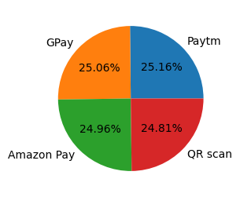
Distribution of different Payment Methods
Analysis
Paytm is the most popular payment method, followed closely by GPay, Amazon Pay, and QR scans, reflecting a strong customer preference for digital payment options. Paytm may have a user-friendly interface or offer special deals that keep users coming back.
payment_method | Count
Paytm | 11315
GPay | 11268
Amazon Pay | 11225
QR scan | 11156

Slide 8
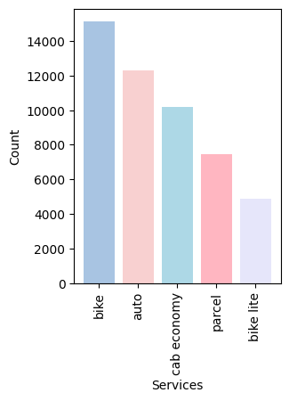
Service Distribution Visualization
Bike and Auto services are the most popular, likely because they’re affordable and convenient for short to medium trips, while Bike Lite is less used, possibly due to limited availability or lower demand. People might prefer Auto services for longer trips as they offer more comfort and space.
Services | count
Bike | 15128
Auto | 12327
Cab Economy | 10202
Parcel | 7459
Bike Lite | 4884

Slide 9
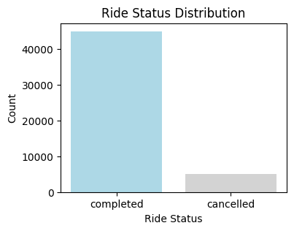
Visualization of Rides by Status
The majority of rides are completed, while a smaller portion is canceled. These cancellations could be due to ride availability or other factors that may need improvement.
ride_status | Count
completed | 44964
cancelled | 5036

Slide 10
Top 5 most common Source and Destination routes
df.groupby(['source', 'destination']).size().nlargest().reset_index()[['source', 'destination']]
 | Source | Destination
0 | Anekal Woods | Yelahanka Complex
1 | Basaveshwaranagar Place | Kalena Agrahara Fork
2 | HSR Layout Crescent | Tavarekere View
3 | Jayanagar Cut | Yelahanka Landing
4 | Kundalahalli 6th Stage | Gottigere 5th Stage
This is the most common source and destination routes appear frequently. These popular routes could signify high-traffic areas or regions where services are in high demand, which could be targeted for better availability.

Slide 11
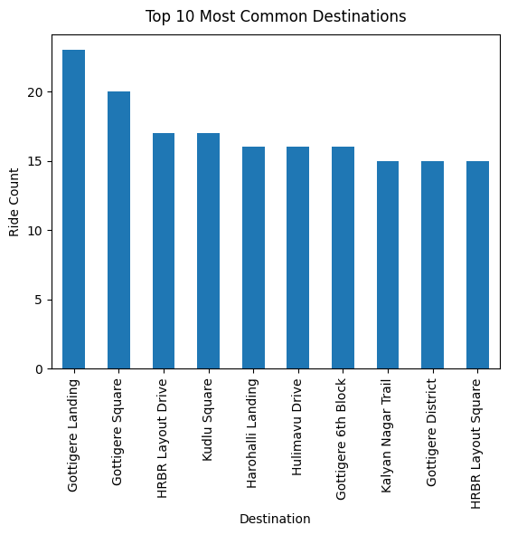
Visualization of top 10 most common Destinations
top_destinations = df['destination'].value_counts().nlargest(10)
top_destinations.plot(kind=‘bar’)
plt.title('Top 10 Most Common Destinations',pad=10)
plt.xlabel('Destination')
plt.ylabel(‘Ride Count’)
plt.xticks(rotation=90)
plt.show()

Slide 12
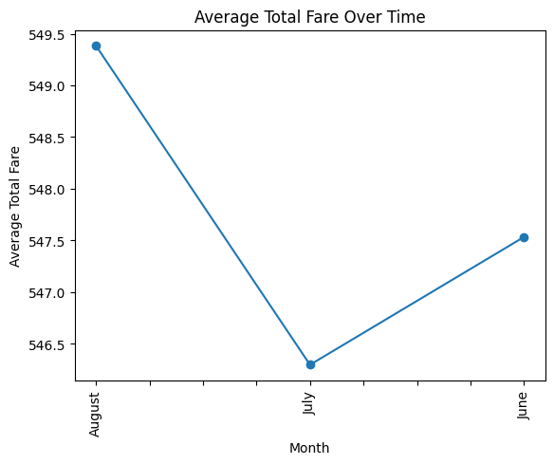
Average Fare Trend Over Time
Fare trends tend to change throughout the months, with noticeable peaks and valleys. These variations are often influenced by factors like seasonal demand, holidays, special events, or shifts in the economy. By analysing these trends, businesses can better understand when to adjust prices, helping to optimize revenue and meet customer demand more effectively.

Slide 13
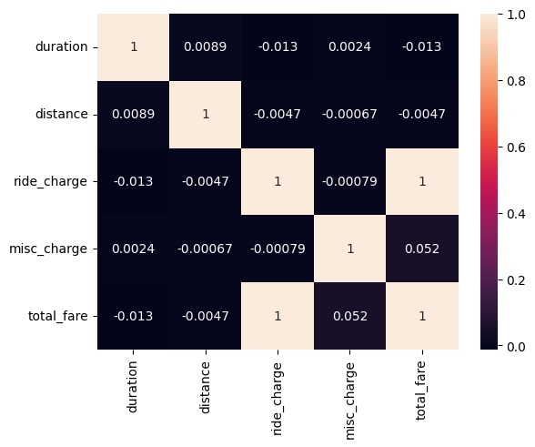
Correlation
Positive Correlations:
Total fare and ride charge have a perfect positive correlation (1), meaning the fare depends heavily on the ride charge. Miscellaneous charges show a slight positive correlation (0.052) with total fare.
Negative Correlations:
Duration has a weak negative correlation with ride charge (-0.013) and total fare (-0.013), indicating minimal influence.

Slide 14
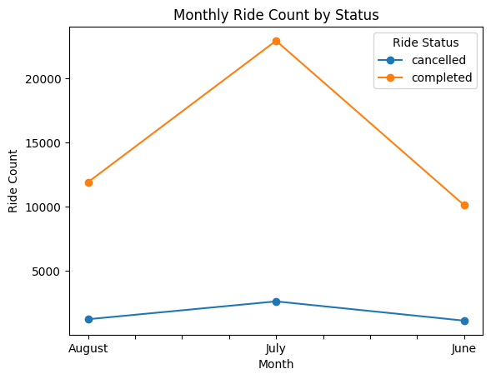
The graph shows that completed rides were highest in July, with June having fewer rides. Cancellations remained low overall, but there was a slight increase in July, probably due to the higher demand. This could be attributed to seasonal factors like school and college openings or rain.
Monthly Ride Count by Status

Slide 15
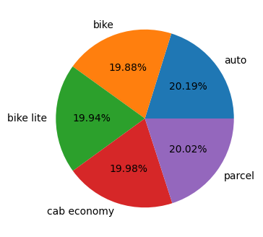
Average Duration Per Service Type.
Most trip durations are similar, averaging around 60-65 minutes, showing that the services are generally consistent. If some services take longer or shorter, it might be due to factors like traffic, customer preferences, or the type of service, which could be looked into for improvement.
services | Duration
auto | 64.916849
bike | 63.925172
bike lite | 64.117936
cab economy | 64.247893
parcel | 64.366001

Slide 16
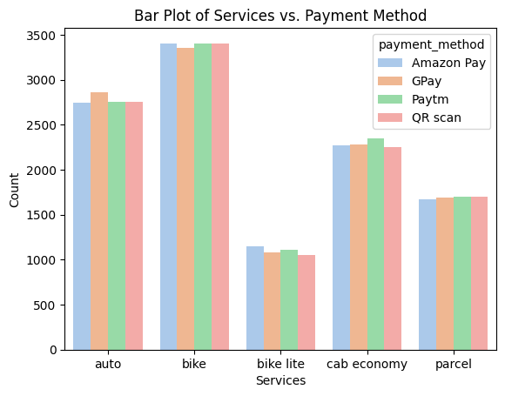
Payment Method Usage Trends
Bike and auto services are the most popular, with high counts for all payment methods.
Cab economy and parcel services have moderate usage, with counts that are slightly lower than bikes or autos.
Bike lite is the least used service, regardless of the payment method.
Across all services, the number of transactions is fairly balanced across the four payment methods, meaning no single payment method dominates.

Slide 17
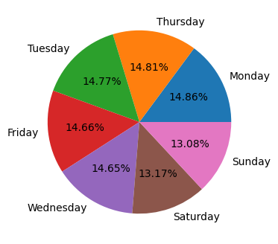
Value Count Per Day
Day | Count
Monday | 7432
Thursday | 7404
Tuesday | 7384
Friday | 7329
Wednesday | 7327
Saturday | 6584
Sunday | 6540

Slide 18
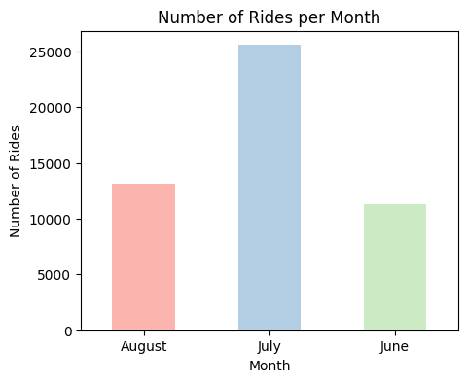
Visualization of Rides Per Month
The chart highlights ride activity over three months, with July being the most active month by a large margin. June had the least number of rides, while August showed a slight increase compared to June but didn’t come close to July’s high.

Slide 19
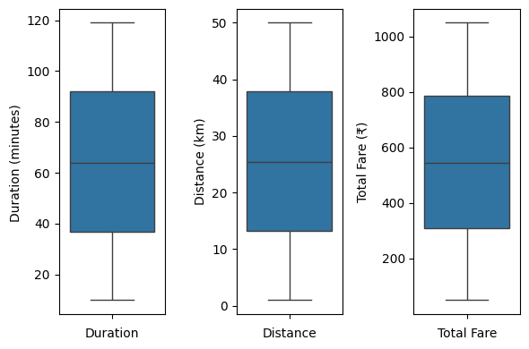
Comparison of Duration, Distance, and Fare Ranges
Duration: Most trips between 40-90 minutes, with a median around 60 minutes.
Distance: Trips typically cover 15-40 km, having a median of just above 25.
Total Fare: Fares range from above 300-800 units, with an average value around 600 units.

Slide 20
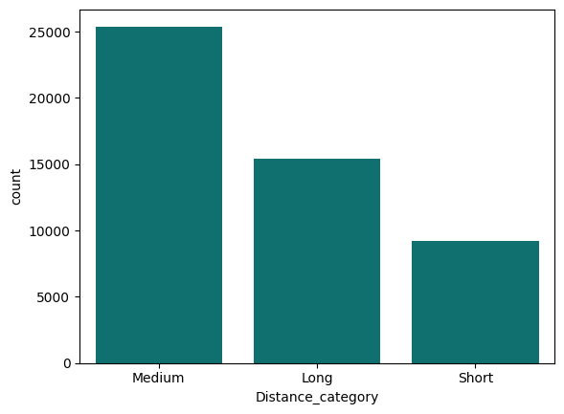
Distance Category
If the distance is less than or equal to 10, it returns “Short”, greater than 10 but less than or equal to 35 returns “Medium”, and greater than 35 return “Long”. From this analysis Medium category have highest count comparing to other.

Slide 21
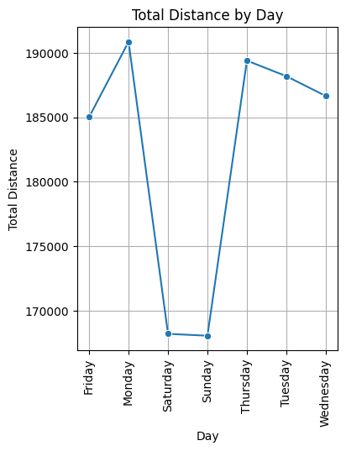
Total Distance by Day
Monday records the highest total distance, peaking above 190,000 units.
Saturday and Sunday show the lowest total distances, dropping below 170,000 units, indicating a significant decline during the weekend.
A sharp rise is observed on Thursday, bringing the total distance back above 185,000 units after the weekend dip.
The total distance gradually declines again after Tuesday and Wednesday, maintaining values slightly below the peak days.

Slide 22
Key Findings
Payment Methods: Paytm emerged as the most popular payment option, followed by GPay, Amazon Pay, and QR scans.
Service Utilization: Bike services dominated the count, followed by autos, cab economy, and parcel services. Bike Lite had the least utilization.
Ride Trends: Most rides occurred in July, with moderate activity in August and a dip in June. Monday and Thursday were the busiest days for rides.
Common Routes : Popular routes included Anekal Woods to Yelahanka Complex and other city locations.
Trip Durations : Average trip duration hovered around 60 minutes, with variations depending on service type.
Fares and Distance : Average fares ranged between 300-800 units, while distances typically spanned 15-40 km.

Slide 23
Conclusion
Weekend Specials : Offering discounts on weekends can encourage more people to ride on slower days like Saturdays and Sundays.
Enhance Long-Distance Services : Focus on long-distance rides by introducing exclusive offers, rewards programs, or premium services to attract high-value customers and maximize revenue generation.
Prioritize Key Locations : Ensure sufficient driver availability in high-demand areas during peak times to minimize wait times and maintain service quality.
Encourage Rides During Quiet Times : Introducing special offers or bonuses for rides during quieter hours can attract more customers and keep drivers busy.

