Slide 1
PINNACLE
Submitted by
Adil Lauraine Morera
Anusree Ravindran

Slide 2
Problem Statement in detail(Education) & solution.

Slide 3
Transforming learning into Amazing e-learning Experiences.
We can add Augmented reality , animations and real time exercises to increase the visual experience.
We can include games to increase engagement because it taps into motivators – recognition , rewards and a sense of competition .
Provide opportunities for self-assessment ,allowing students to take more ownership of their learning . Also allowing students to grade their own discussing post or provide input for their own grade for course participation can prove motivating as students are encouraged by taking responsibility for their own learning experience.

Slide 4
Lack Of Learner Motivation And Engagement.
The trainee should appreciate the students after completing each task which is instructed by the course.
Trainee should include the real time experience he had with the technology which is teaching.
Trainee should monitor each students activity by conducting online assessments .

Slide 5
Staying Up-To-Date With Modern Tech.
The course should be updates when an new technology is been introduced . And also an notification about the same should be send to the students how is currently doing the course as well as students how already completed the course, if the student is interested to learn more then they can learn the updated version of the course.
The syllabus of the course must be available to anyone and everyone can go through the entire syllabus if any new technology is there which is related to the course which not yet included in the syllables then they can suggest the same, then the authority will review the same if it is found to be relevant to current or future industry then they will update the course according to it as well as they give reward to the person who mentioned about the technology.

Slide 6
Measurable learning outcomes.
In addition with the quiz and assignment we need to provide more real time working experience with the technology that they are learn with the help of real time project, internships……etc.
Also provide game type activities ,Form discussion platforms, online presentations . Giving students to self assessment opportunities .
Students should familiar with problem solving case studies.
Students were more motivated to complete their work due to visble progress charts.

Slide 7
Adaptive learner models to accommodate different learner needs.
The better adaptive technique is real time feedback , offering students for feedback system to convey their issues and needs.
Also provide extra helps to each student for a particular concept before continuing to the next topic .

Slide 8
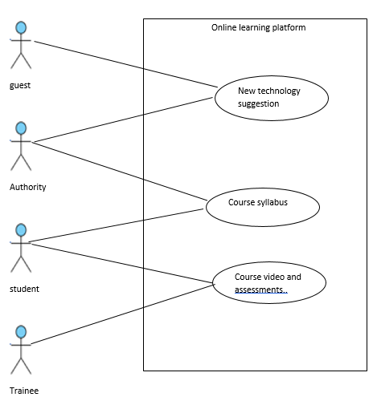
Use case Diagram

Slide 9
Coclusion
We decide to create a website which overcome all these problems .
Website is purely based on php codeignator . Online education website which enables students watch online classes , they can give feedback , grading system is also contain , when students needs help from teachers it also available in this website.
Also very important feature is in this website giving a gaming session , which contain all the study things.
Tranee can monitor all the students individually.

Slide 10
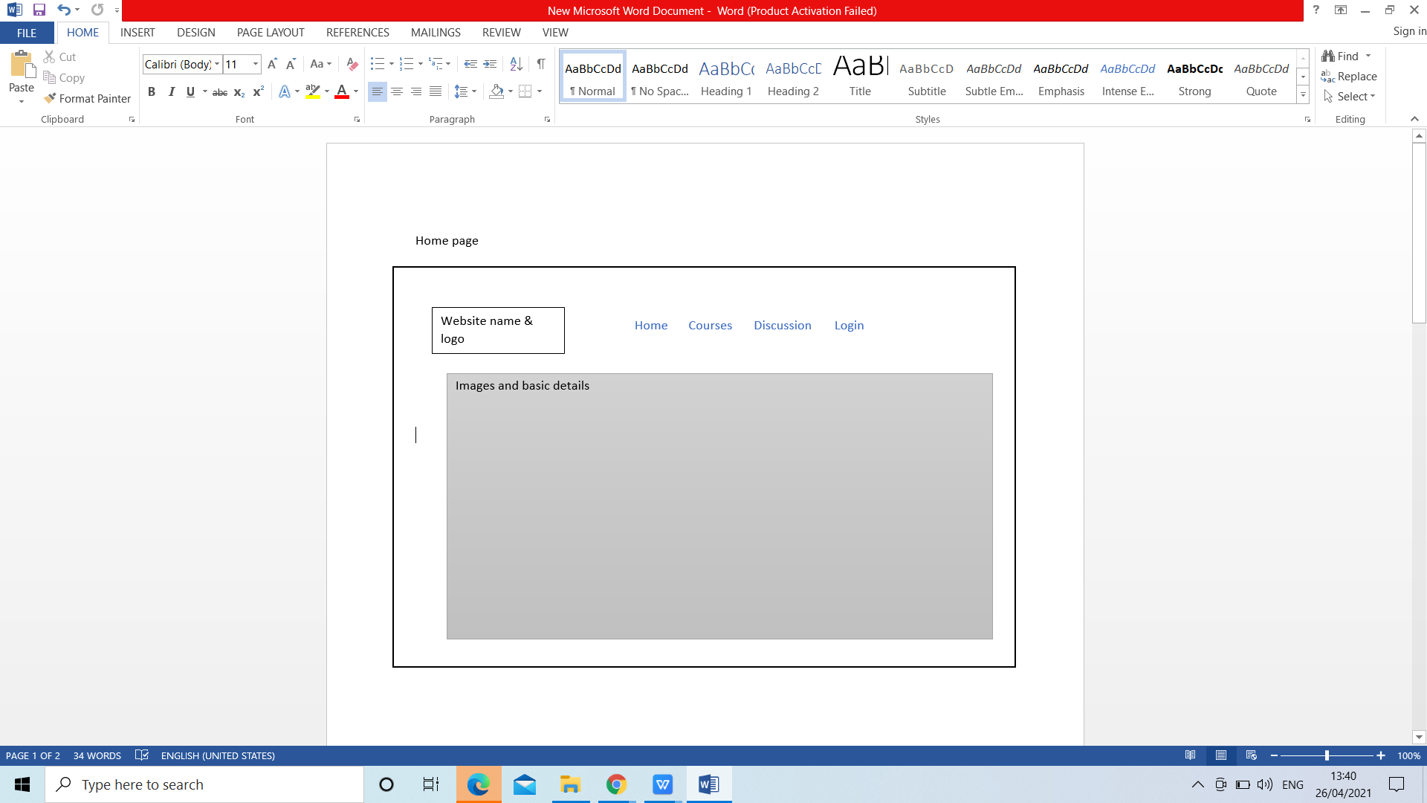
Design part

Slide 11
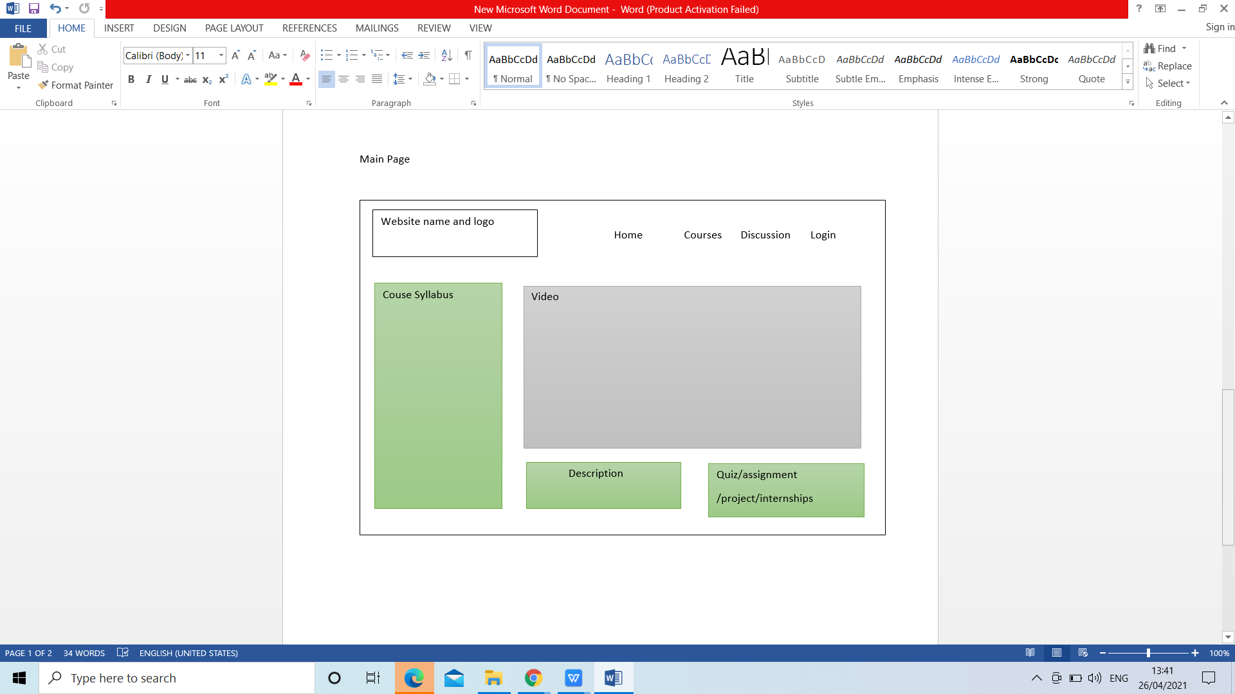

Slide 12
Requirements
Software Interfaces
Development
- Operating System: Windows 8 or above
- Visual Studio Code
- XAMP
Implementation
- Operating System: Windows 8 or above
- Web browser: Microsoft Edge, Mozilla Firefox, or Google Chrome

Slide 13
Specific Hardware
Development
- Pentium or above processor
- 2GB of free hard-drive space
- 2GB of RAM
Implementation
- Computer/mobile/laptop will good internet connectivity
- Web browser

Slide 14
THANK YOU

