Slide 1
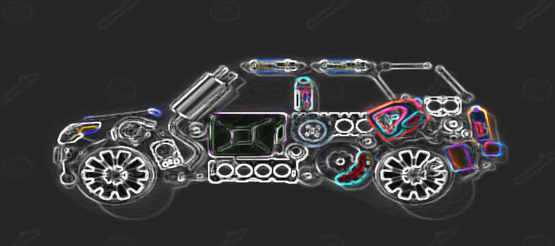

1985 Auto Imports - CAR Specification data
Name: Anusree R
Course: DA & DS (Cohort A)
EDA Project: Milestone 2
Date: 20/12/2024

Slide 2

Project Overview
Data set consists of three types of entities: (a) the specification of an auto in terms of various characteristics,
its assigned insurance risk rating
its normalized losses in use as compared to other cars.
OBJECTIVE:
The primary objective of analyzing the 1985 Automobile Dataset is to explore and understand the relationships between various attributes of automobiles, such as price, engine specifications, fuel efficiency, and design characteristics, to gain insights into factors influencing automobile performance and pricing segmentation.

Slide 3
Data Understanding
Shape of the Dataset: 205 observations & 26 attributes/features
Datatypes: float64(5), int64(5), object(16)
List of attributes in the dataset:
Symboling
normalized-losses
Make
fuel-type
Aspiration
body-style
drive-wheels
engine-location
wheel-base
Length
Width
Height
price
Curb-weight
Engine-type
Num-of-cylinders
engine-size
fuel-system
Bore
Stroke
compression-ratio
Horsepower
peak-rpm
city-mpg
highway-mpg
Number of doors

Slide 4

Missing / Invalid Values Handling
Data Quality Issues
There were no column names, created column names manually & updated the dataset
Using Replace method, ‘?' converted into NaN for better handling & to detect missing values.
Used “pd.to_numeric” type conversion inorder to ensure if any value contains non-numeric string type, it will convert into NaN.
After handling '?' with NaN and convert numeric columns to appropriate types,
Using “df.isnull().sum()”, able to identify Missing values in:
normalized-losses : 41
Num-of-doors : 2
Bore: 4
Stroke: 4
Horsepower: 2
Peak-rpm: 2
Price: 4

Slide 5
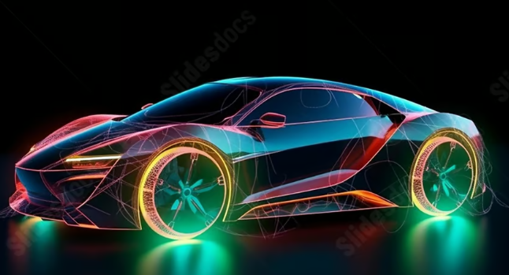
Techniques Used for Handling
Used KDEPlot & df['normalized-losses'].skew() to analyze the distribution of the Data points & its skewness of every Attribute consisting missing values.
Imputation Based on Distribution:
For numerical data, replace missing values with the mean or median depending on the KDE plot's peak.
For categorical data, used mode or the most frequent category
Numerical Assessment of Skewness:
Skewness > 0: Right-skewed.
Skewness < 0: Left-skewed.

Slide 6
Mean Replacement: Numerical data with a normal distribution (symmetrical, no skew).
Advantages: Preserves the overall mean of the data.
Bore - Symmetrical not skewed
Peak-rpm - Symmetrical not skewed
Median Replacement: Numerical data with a skewed distribution (right or left skew) & Data containing outliers.
Advantages: Robust to outliers and better represents the central tendency for skewed data.
Normalized loss - Positively/Right skewed
Stroke - Negatively/Left skewed
Horsepower - Positively/Right skewed
Price - Positively/Right skewed
Mode Replacement: Categorical data (e.g., fuel-type, body-style).Numerical data with many repeated values.
Advantages: Preserves the most frequent category or value, maintaining data consistency.
Num of doors - Does not contribute much to my analysis, Dropped this column

Slide 7
Outlier Handling
Identifying Outliers:
Visually, using Box plot Identified outliers for all the attributes of the existing dataset
Used Z-score method to detect and removes outliers based on Z-scores for numeric columns:
'symboling', 'normalized-losses', 'wheel-base', 'length', 'width', 'height', 'curb-weight', 'bore', 'stroke', 'compression-ratio', 'horsepower', 'peak-rpm', 'city-mpg', 'highway-mpg', 'price‘
cleaned_df = df[(z_scores < threshold).all(axis=1)] - Original Data Frame altered to include only the rows where all Z-scores are below the threshold(3)
Dataset shape after removing outliers via Z-score method: (182, 25)
Using IQR method to detect and remove outliers in 'engine-size’:
outliers = (df['engine-size'] < (Q1 - 1.5 * IQR)) | (df['engine-size'] > (Q3 + 1.5 * IQR))
Dataset shape after removing outliers via IQR method: (195, 25)

Slide 8
Derived Metrics
Power-to-Weight Ratio → Derived from “horsepower” and “curb-weight”
Fuel Efficiency Ratio → Derived from “city-mpg” and “highway-mpg”
Price per Horsepower → Derived from “price” and “horsepower”
Weight-to-Engine Size Ratio → Derived from “curb-weight” and “engine-size”

Slide 9
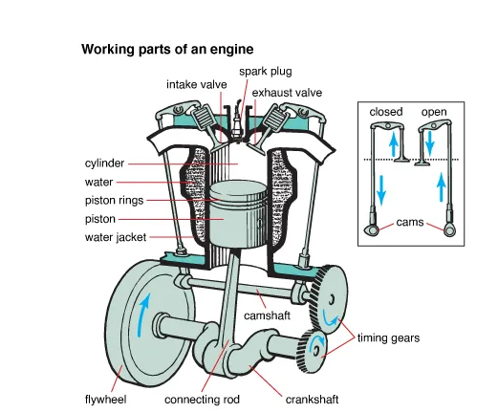
Overall understanding of car mechanism with the Attributes
Aspiration
Fuel System
Cylinders
Bore and Stroke
Horsepower
Peak RPM
Compression Ratio

Slide 10
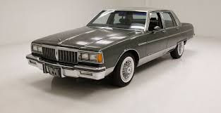
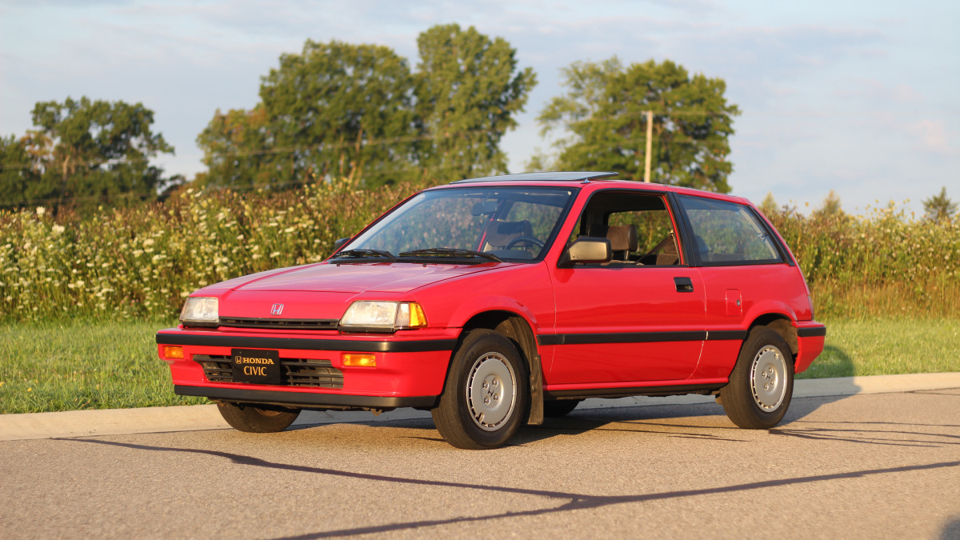
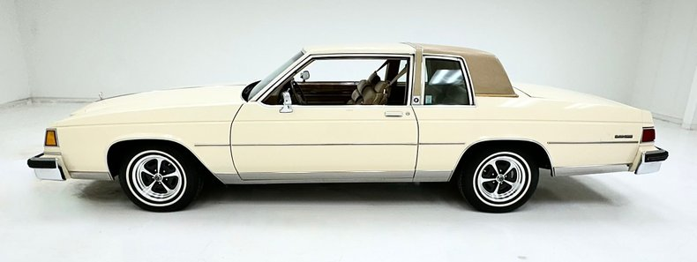
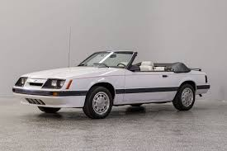
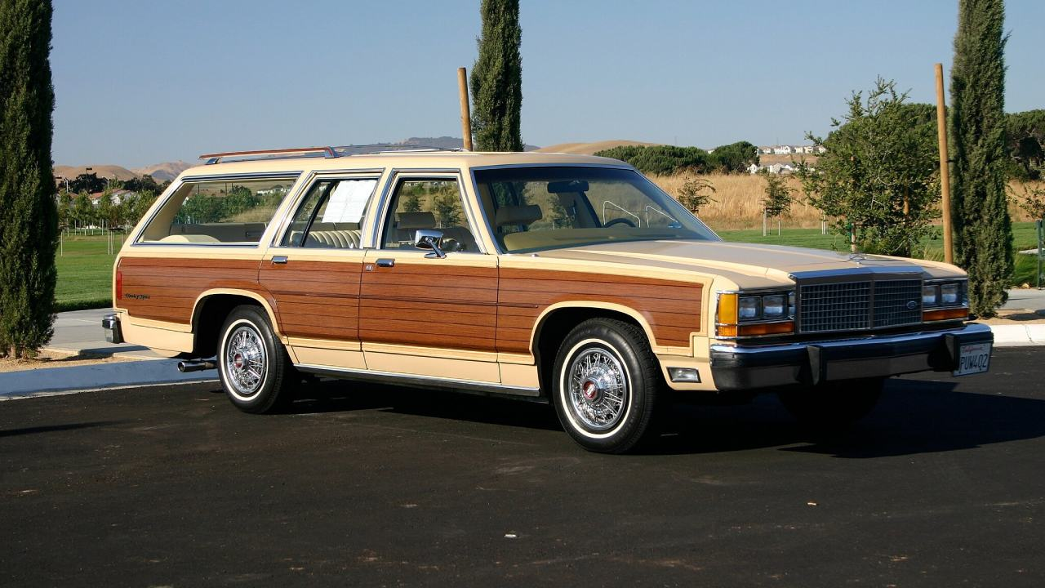
Different Body STYLES
Sedan
Hatchback
Hardtop
Convertible
Wagon

Slide 11
Data Visualization
Univariate Analysis:
Visualize the distribution of price.
Analyze the count of fuel-type.
Make: Distribution of car makes
Insights:
Car prices which are ranged from 5000 to 10000, are most purchased. Car price ranging from 30,000 to 35,000 are least purchased.
Gas based cars are more preferred than Diesel
Toyota, Nissan & Mazda are most manufactured during the year 1985 compared to other cars.

Slide 12

Bivariate Analysis:
Explore relationships between:
Price and Engine size
Average Price vs Car make
Symboling vs Risk
Drive-wheels vs Fuel Efficiency ratio
Peak-rpm vs Horsepower
Fuel-system vs body-style
Fuel-system vs Car Make

Slide 13
Insights
Price of the car Vs Engine hold positive correlation & directly proportional to each other
Mercedes-Benz and Porsche→ Highly priced (Luxury & Performance Focus, Brand Prestige, Higher Production Costs & Target Audience. Whereas, Plymouth, Dodge, and Chevrolet → Low priced(Economy and Accessibility, Utility and Practicality, Market Competition & Cost-Effective Production
Higher Symboling values usually indicate vehicles with higher risk levels
Drive wheels: FWD→ More fuel efficient: 62 % RWD→ Less fuel efficient than FWD: 33.1% 4WD / All WD→ Least fuel efficient: 4.8%

Slide 14
Higher peak RPMs are often associated with higher horsepower, especially in engines designed for performance, whereas Economy-focused engines deliver peak horsepower at lower RPMs to optimize fuel efficiency.
Simpler Systems (1BBL, SPFI, 2BBL): Align with practical and economical body styles like Hatchbacks, Sedans, and Wagons. Performance-Oriented Systems (4BBL, MFI, SPDI): Pair with sporty and premium body styles like Convertibles, Hardtops, and high-performance Sedans. Diesel Systems (IDI): Suit utility-focused body styles like Wagons and durable Sedans.
MPFI preferred in all kinds of car makes, coz of more fueling & performance factors. SPFI fuel system is seen only in isuzu, as its less manufactured in the year 1985. This fuel system involved newer technology, high production costs & new for consumer practice.

Slide 15

Multivariate Analysis:
Explore relationships between price, engine size, horsepower, and fuel type using pair plots.
How City-mpg vs Highway-mpg vary based on the fuel-system?
Distribution of city-mpg and curb-weight for each body-style
Comparing horsepower, weight, engine size across price segments

Slide 16
Insights
1.
Metric | Petrol | Diesel
Price | Budget to luxury, varies widely | Higher initial cost, better fuel efficiency
Engine Size | Smaller engines for economy, larger for power | Larger engines prioritize torque
Horse Power | High horsepower for performance | Moderate horsepower, torque-focused
3.
Highest City MPG rating seen in : Hatchback & then in Sedan type of Body Style. Lowest City MPG rating seen in: Convertible type of Body Style
Highest Curb Weight rating seen in: Wagon & then in Sedan type of Body Style. Lowest Curb Weight rating seen in: Convertible type of Body Style
Luxury Cars Like Porche, Mercedes, BMW, Audi & Volvo had higher curb weight, Horsepower & Engine size comparing to high priced & mid-ranged vehicles like Alfa-Romero, Mercury, Peugot, Saab, & Mazda, Nissan, Honda, Isuzu, Dodge etc. Horsepower & Engine Size are seen to be Directly proportional to each other.
4.

Slide 17
2.
Fuel System | City-mpg | Highway-mpg | Variation Gap | Remarks
1BBL | Low | Moderate | Large | Inefficient in city; steady speeds improve performance.
2BBL | Slightly better than 1BBL | Moderate to good | Moderate | Improved airflow compared to 1BBL, better highway mpg.
MPFI | High | Excellent | Small | Optimized fuel delivery ensures efficiency in all conditions.
SPFI | Moderate | Good | Moderate | Better than carburetors but less precise than MPFI.
4BBL | Low | Moderate to good | Large | Designed for power, not efficiency.
IDI | Low | Better | Moderate | Energy loss in pre-combustion chambers affects efficiency.
MFI | Moderate | Good | Moderate to large | Mechanically controlled, less precise than MPFI.
SPDI | High | Excellent | Small | Real-time optimization makes it highly efficient.

Slide 18
Hypothesis Testing: T-Test
Independent two sample T-test done to check if there is a significant difference in horsepower between high-risk and low-risk cars.
Results:
μ high-risk​ =μ low-risk​
p-value > significance level (e.g., 0.05), indicating insufficient evidence to reject 𝐻0
The conclusion is correct and statistically valid: there is no evidence to support a difference in horsepower between the two groups.

Slide 19

Conclusion
The 1985 automobile market reflected a balance between performance and cost, with advanced technologies emerging to improve fuel efficiency. While larger, more powerful cars dominated the high-price segments, there was a growing demand for more efficient and economical vehicles in the mid-range and low-price categories.
Target audience insights suggest that high-risk vehicles cater to performance enthusiasts, while low-risk vehicles are designed for cost-conscious, safety-focused consumers.

Slide 20


