Slide 1
UML
Presented by,
Anusree G K

Slide 2
UML
UML stands for Unified Modeling Language.
UML is a standard language for specifying, visualizing, constructing, and documenting the artifacts of software systems.
Created by the Object Management Group (OMG) and UML 1.0 specification draft was proposed to the OMG in January 1997.
Pictorial language used to make software blueprints.

Slide 3
UML
The building blocks of UML can be defined as −
Things
Relationships
Diagrams
Things
Things are the most important building blocks of UML. Things can be −
Structural
Behavioral
Grouping
Annotational

Slide 4
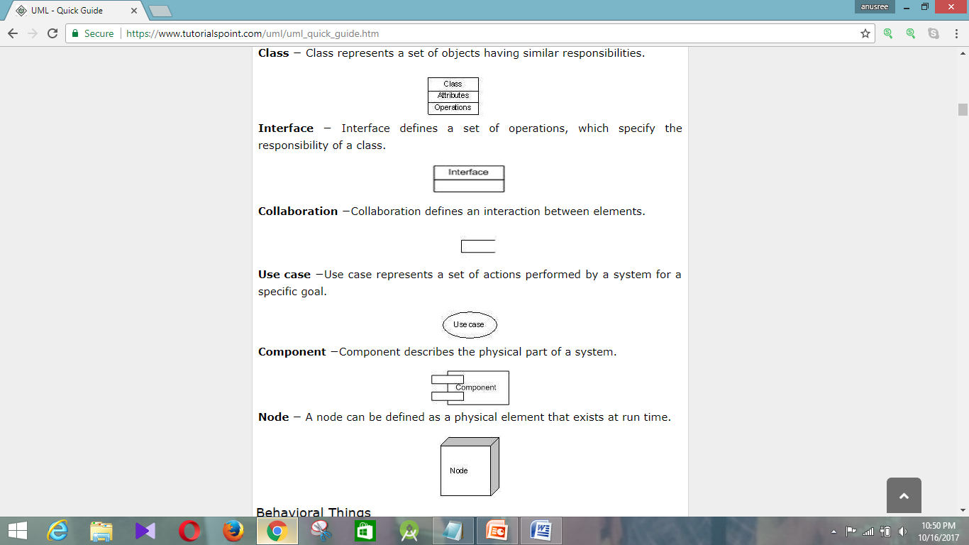
UML
Structural Things
Structural things define the static part of the model. They
represent the physical and conceptual elements.
Class − Class represents a set of objects having similar responsibilities.

Slide 5
UML
Interface − Interface defines a set of operations, which specify the responsibility of a class.
Collaboration −Collaboration defines an interaction between elements.
Use case −Use case represents a set of actions performed by a system for a specific goal.

Slide 6
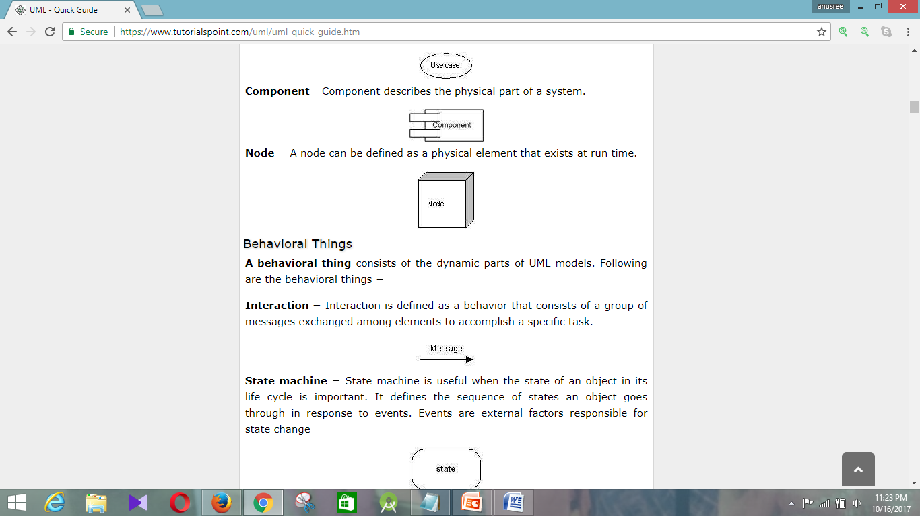
UML
Component −Component describes the physical part of a system
Behavioral Things
A behavioral thing consists of the dynamic parts of UML
models. Following are the behavioral things:
Interaction − Interaction is defined as a behavior that consists of a group of messages exchanged among elements to accomplish a specific task.

Slide 7
UML
State machine − State machine is useful when the state of an object in its life cycle is important. It defines the sequence of states an object goes through in response to events. Events are external factors responsible for state change

Slide 8
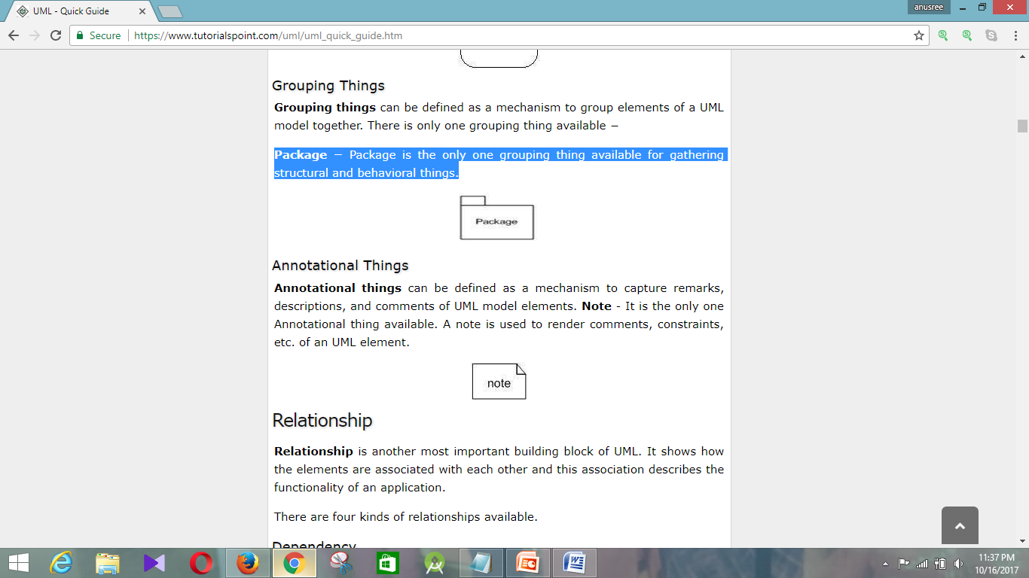
UML
Grouping Things
Grouping things can be defined as a mechanism to group
elements of a UML model together.
Package − Package is the only one grouping thing available for gathering structural and behavioral things.
Annotational things
can be defined as a mechanism to capture remarks, descriptions, and comments of UML model elements.

Slide 9
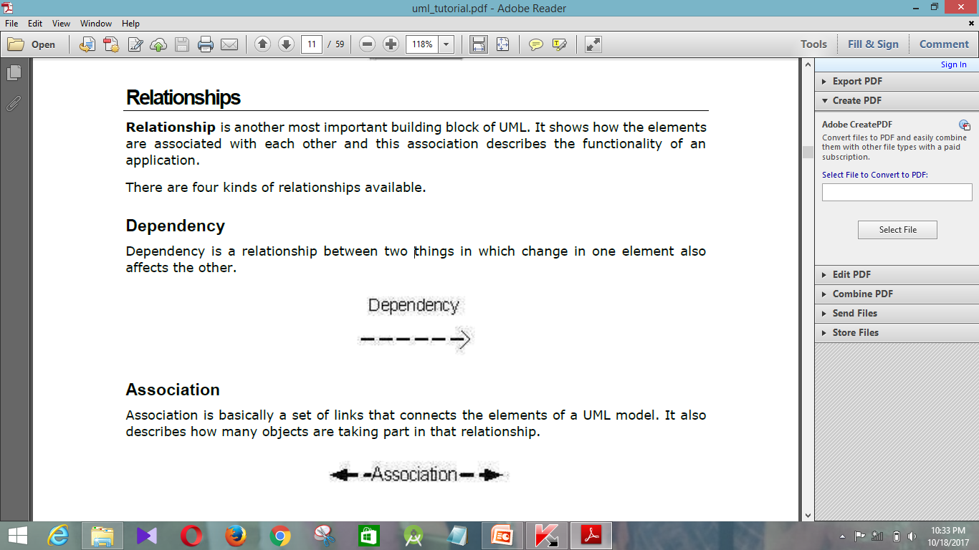
UML
Relationship
How the elements are associated with each other.
Dependency -is a relationship between two things in which change in one element also affects the other.

Slide 10
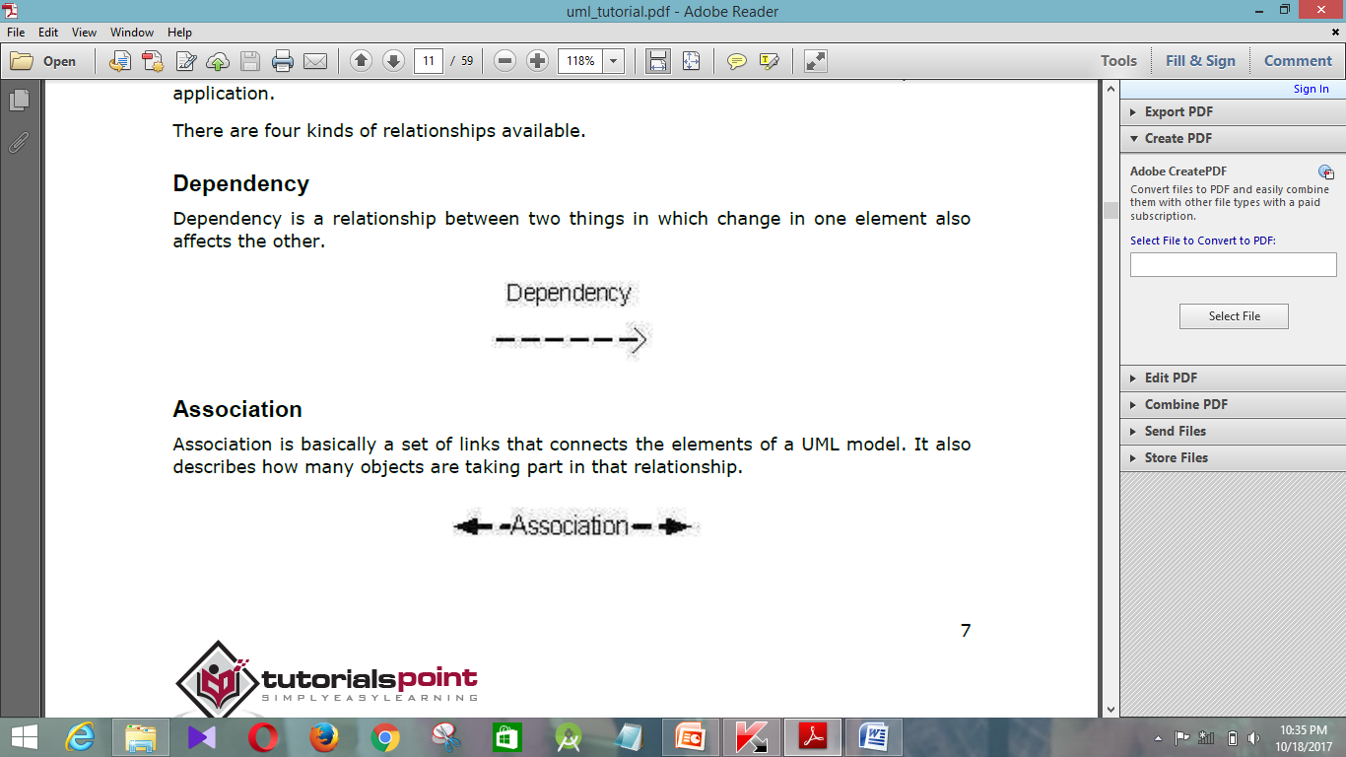
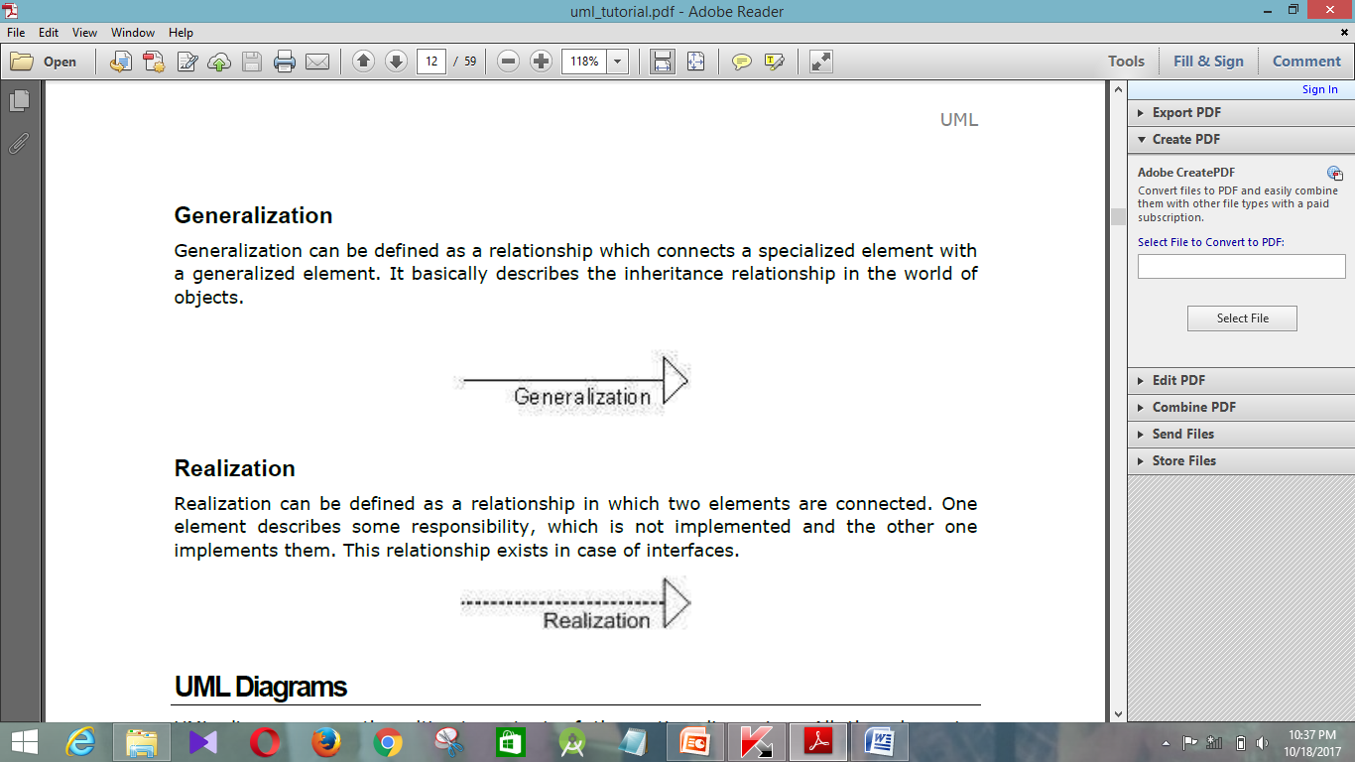
UML
Association- is basically a set of links that connects the elements of a UML model. It also describes how many objects are taking part in that relationship.
Generalization -can be defined as a relationship which connects a specialized element with a generalized element. It basically describes the inheritance relationship in the world of objects.

Slide 11
UML
Realization
Realization can be defined as a relationship in which two elements are connected.
One element describes some responsibility, which is not implemented and the other one implements them.

Slide 12
UML
Diagrams
1.Structural Modeling
Structural modeling captures the static features of a
system. They consist of the following −
Classes diagrams
Objects diagrams
Deployment diagrams
Package diagrams
Composite structure diagram
Component diagram

Slide 13
UML
2.Behavioral Modeling
Behavioral model describes the interaction in the system.
They consist of the following −
Activity diagrams
Interaction diagrams
Use case diagrams

Slide 14
Structural Modeling

Slide 15
Class Diagram
Class diagram is a static diagram.
Class diagram describes the attributes and operations of a class and also the constraints imposed on the system.
Class diagram shows a collection of classes, interfaces, associations, collaborations, and constraints. It is also known as a structural diagram.

Slide 16
Class Diagram
The purpose of the class diagram as
Analysis and design of the static view of an application.
Describe responsibilities of a system.
Base for component and deployment diagrams.
Forward and reverse engineering.
A collection of class diagrams represent the whole system.

Slide 17
Class Diagram
The following points should be remembered while
drawing a class diagram
The name of the class diagram should be meaningful to describe the aspect of the system.
Each element and their relationships should be identified in advance.
Responsibility (attributes and methods) of each class should be clearly identified

Slide 18
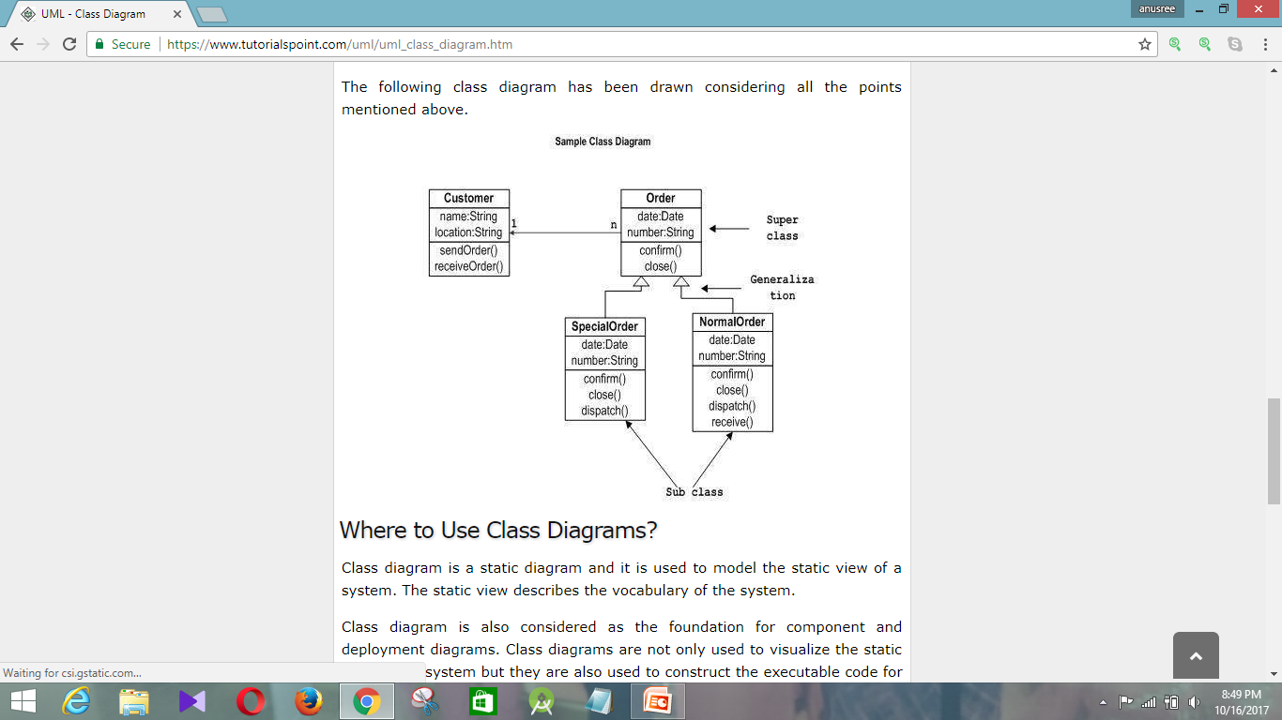
Class Diagram
The following diagram is an example of an Order System of an application. It describes a particular aspect of the entire application.

Slide 19
Object Diagrams
Object diagrams are derived from class diagrams so object diagrams are dependent upon class diagrams.
Object diagrams represent an instance of a class diagram.
Object diagrams show snapshot of the system at a particular moment.

Slide 20
Object Diagrams
The purpose of the object diagram as −
Forward and reverse engineering.
Object relationships of a system
Static view of an interaction.
Understand object behavior and their relationship from practical perspective

Slide 21
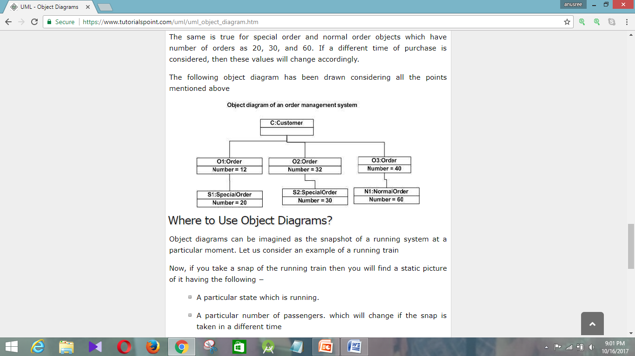
Object Diagrams
The following diagram is an instance of the system at a particular time of purchase.

Slide 22
Component Diagrams
Component diagram is a special kind of diagram in UML.
The purpose is also different from all other diagrams discussed so far.
It does not describe the functionality of the system but it describes the components used to make those functionalities.
Component diagrams are used to visualize the physical components in a system.
These components are libraries, packages, files, etc.

Slide 23
Component Diagrams
The purpose of the component diagram as −
Visualize the components of a system.
Construct executables by using forward and reverse engineering.
Describe the organization and relationships of the components.

Slide 24
Component Diagrams
Before drawing a component diagram, the
following artifacts are to be identified clearly
Files used in the system.
Libraries and other artifacts relevant to the application.
Relationships among the artifacts.

Slide 25
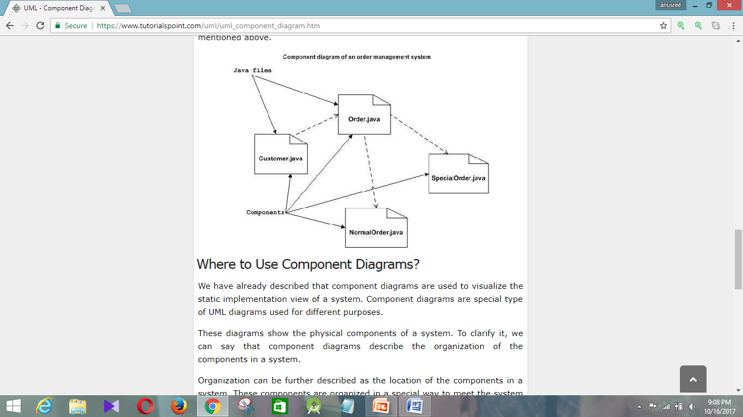
Component Diagrams
The following component diagram has been drawn
considering all the points mentioned above.

Slide 26
Deployment Diagrams
Deployment diagrams are used for describing the hardware components, where software components are deployed.
Component diagrams and deployment diagrams are closely related.
Deployment diagrams are made to focus on the hardware topology of a system.
Deployment diagrams are used by the system engineers.

Slide 27
Deployment Diagrams
The purpose of deployment diagrams can be described as −
Visualize the hardware topology of a system.
Describe the hardware components used to deploy software components.
Describe the runtime processing nodes.

Slide 28
Deployment Diagrams
An efficient deployment diagram is very
important as it controls the following
parameters −
Performance
Scalability
Maintainability
Portability

Slide 29
Deployment Diagrams
Before drawing a deployment diagram, the following
artifacts should be identified −
Nodes
Relationships among nodes

Slide 30
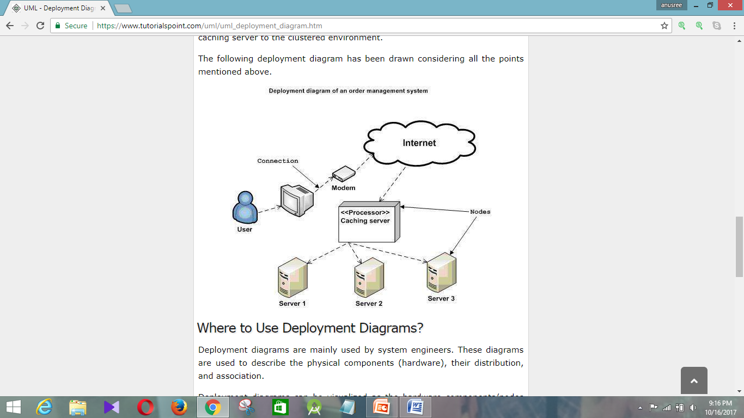
Deployment Diagrams

Slide 31
Behavioral Modeling

Slide 32
Use Case Diagrams
The purposes of use case diagrams can be said
to be as follows −
Used to gather the requirements of a system.
Used to get an outside view of a system.
Identify the external and internal factors influencing the system.
Show the interaction among the requirements are actors.

Slide 33
Use Case Diagrams
To draw a use case diagram, we should have
the following items identified.
Functionalities to be represented as use case
Actors
Relationships among the use cases and actors.

Slide 34
Use Case Diagrams
we have to use the following guidelines to draw an efficient
use case diagram
The name of a use case is very important. The name should be chosen in such a way so that it can identify the functionalities performed.
Give a suitable name for actors.
Show relationships and dependencies clearly in the diagram.
Do not try to include all types of relationships, as the main purpose of the diagram is to identify the requirements.
Use notes whenever required to clarify some important points.

Slide 35
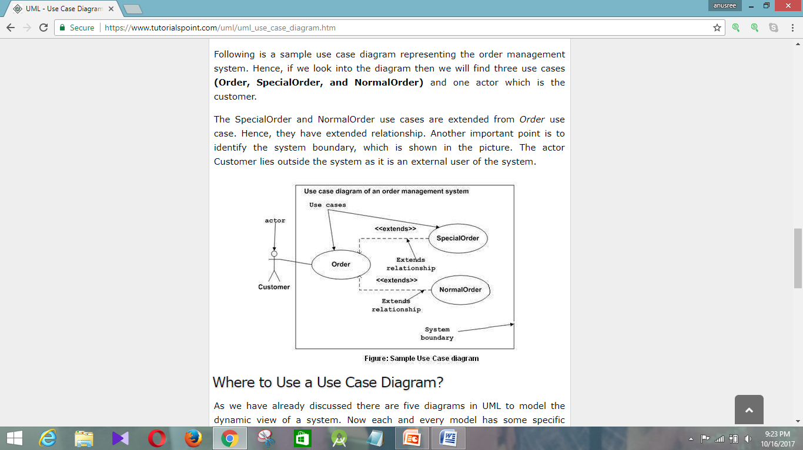
Use Case Diagrams
Following is a sample use case diagram representing the order management system.

Slide 36
Interaction Diagrams
Interaction diagrams is to visualize the interactive behavior of the system.
The purpose of interaction diagram is −
To capture the dynamic behaviour of a system.
To describe the message flow in the system.
To describe the structural organization of the objects.
To describe the interaction among objects.

Slide 37
Interaction Diagrams
We have two types of interaction diagrams in UML.
Sequence Diagram
Collaboration Diagram.
The sequence diagram captures the time sequence of the message flow from one object to another.
The collaboration diagram describes the organization of objects in a system taking part in the message flow.

Slide 38
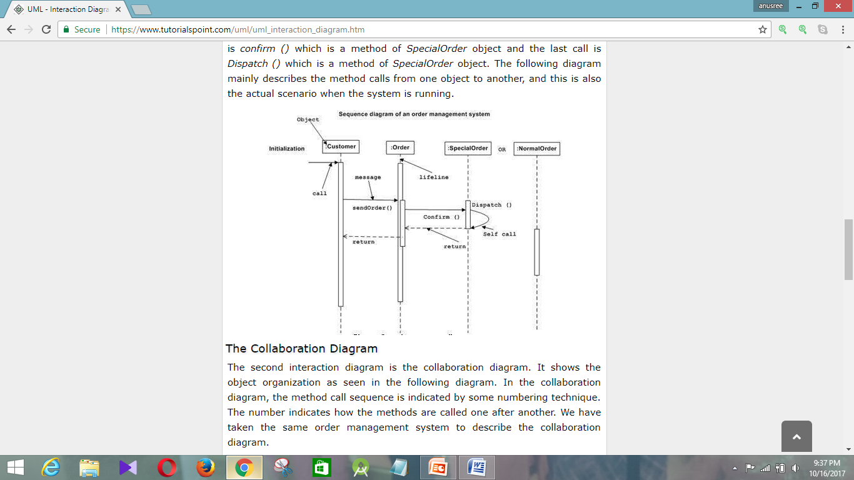
Sequence Diagram

Slide 39
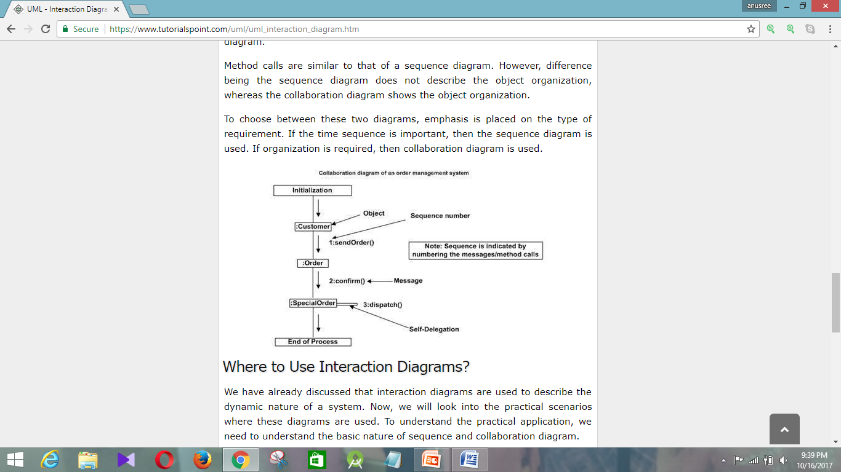
Collaboration Diagram
It shows the object organization as seen in the following diagram.

Slide 40
Statechart Diagrams
Statechart diagram is one of the five UML diagrams used to model the dynamic nature of a system.
They define different states of an object during its lifetime and these states are changed by events.
Statechart diagrams are useful to model the reactive systems.
Reactive systems can be defined as a system that responds to external or internal events.
The most important purpose of Statechart diagram is to model lifetime of an object from creation to termination.

Slide 41
Statechart Diagrams
Following are the main purposes of using
Statechart diagrams −
To model the dynamic aspect of a system.
To model the life time of a reactive system.
To describe different states of an object during its life time.
Define a state machine to model the states of an object.

Slide 42
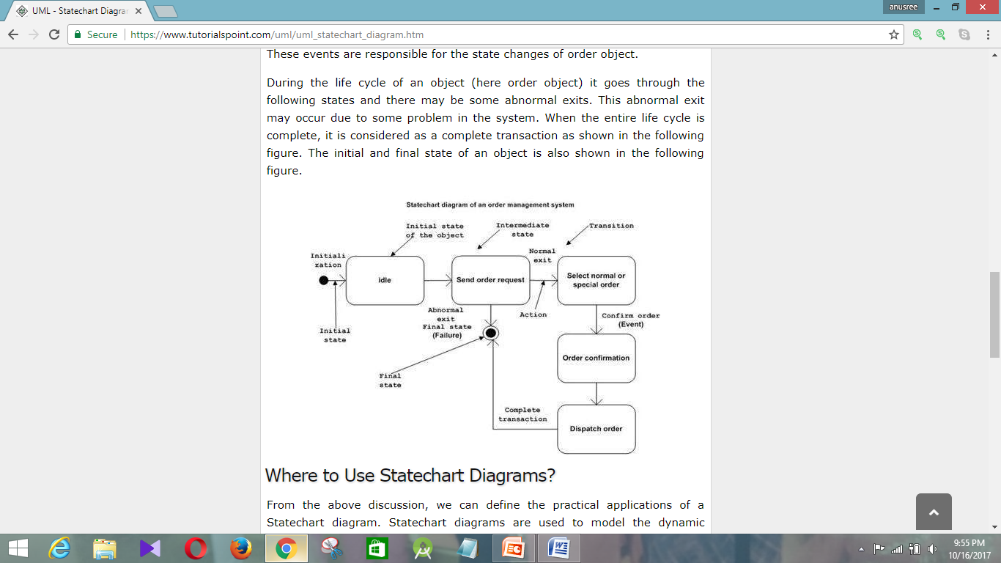

Slide 43
Activity Diagrams
Activity Diagram captures the dynamic behavior of the system.
Other four diagrams are used to show the message flow from one object to another.
Activity Diagram is used to show message flow from one activity to another.
Activity is a particular operation of the system.
Before drawing an activity diagram, we should
identify the following elements −
Activities
Association
Conditions
Constraints

Slide 44
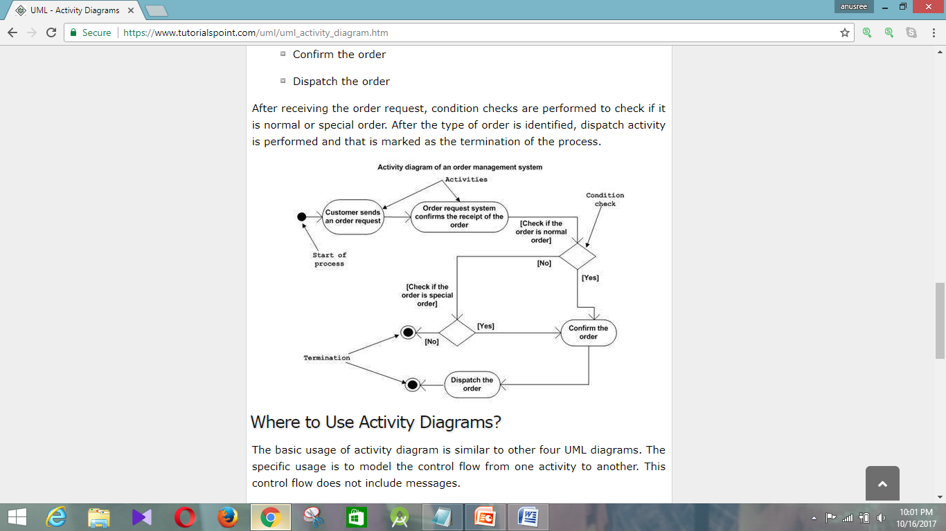
Activity Diagrams

Slide 45


