Slide 1
Correlated vs. Noncorrelated Subqueries
Noncorrelated subqueries:
Do not depend on data from the outer query
Execute once for the entire outer query
Correlated subqueries:
Make use of data from the outer query
Execute once for each row of the outer query
Can use the EXISTS operator

Slide 2
Correlated subqueries
A Correlated subquery uses a value from the main query as part of the inner query
Data from each row in the main query is “passed” to the subquery for processing
Typically a processing-intensive operation
Subquery must be re-run with new value(s) for each row

Slide 3
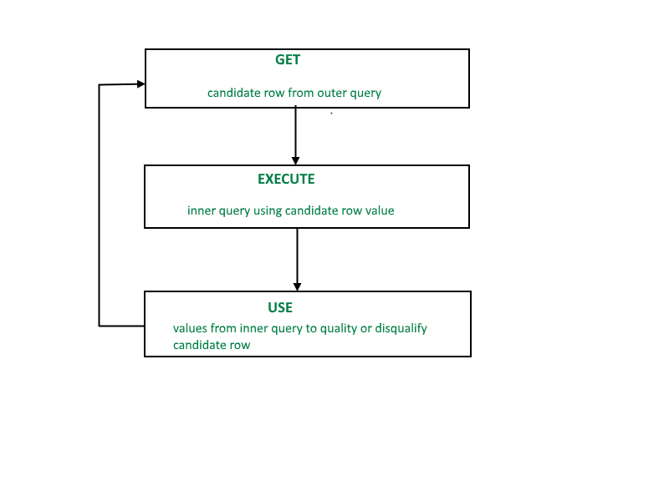
Correlated subquery

Slide 4
CORRELATED SUBQUERY
SELECT *
FROM t1
WHERE column1 = ANY (SELECT column1 FROM t2
WHERE t2.column2 = t1.column2);

Slide 5
Correlated subquery
List down the employees whose salary is greater than average of their department
Select eid, name
From emp as E
Where sal > (Select Avg(sal)
from emp
where dep=E.dep);
eid | name | sal | dept
1 | A | 2000 | CSE
2 | B | 3000 | EC
3 | C | 3000 | CSE
4 | D | 4000 | EC

Slide 6
EXISTS / NOT EXISTS
The EXISTS operator is a Boolean operator that returns either true or false.
The EXISTS operator is often used to test for the existence of rows returned by the subquery.
SELECT
select_list
FROM
a_table
WHERE
[NOT] EXISTS(subquery);

Slide 7
EXISTS / NOT EXISTS
If the subquery returns at least one row, the EXISTS operator returns true, otherwise, it returns false.
In addition, the EXISTS operator terminates further processing immediately once it finds a matching row, which can help improve the performance of the query.
The NOT operator negates the EXISTS operator. In other words, the NOT EXISTS returns true if the subquery returns no row, otherwise it returns false.
Note that you can use SELECT *, SELECT column, SELECT a_constant, or anything in the subquery. The results are the same because MySQL ignores the select list appeared in the SELECT clause.

Slide 8
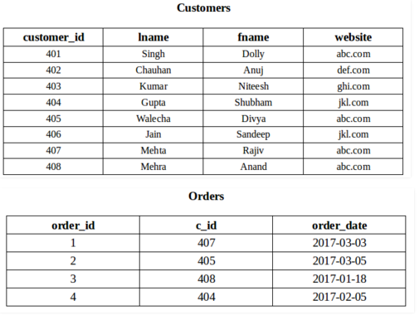
To fetch the first and last name of the customers who placed atleast one order.
SELECT fname, lname
FROM Customers
WHERE EXISTS (SELECT *
FROM Orders
WHERE Customers.customer_id = Orders.c_id);

Slide 9
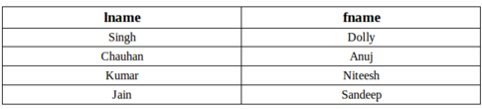
Fetch last and first name of the customers who has not placed any order
SELECT lname, fname
FROM Customer
WHERE NOT EXISTS (SELECT *
FROM Orders
WHERE Customers.customer_id = Orders.c_id);

Slide 10
Delete the record of all the customer from Order Table whose last name is ‘Mehra’
DELETE
FROM Orders
WHERE EXISTS (SELECT *
FROM customers
WHERE Customers.customer_id = Orders.cid AND Customers.lname = 'Mehra');

Slide 11
Correlated subquery
Find all employees details who work in a department
Select *
From emp
Where exists (select * from dept
where dept.eid=emp.eid);
Eid | Name | Address
1 | A | Delhi
2 | B | Pune
3 | A | Chennai
4 | B | Delhi
5 | C | Pune
6 | D | Mumbai
7 | E | Hyd
Did | DName | Eid
1 | A | Delhi
2 | B | Pune
3 | A | Chennai
4 | B | Delhi
5 | C | Pune
6 | D | Mumbai
7 | E | Hyd

Slide 12
Exercise Question on non-correlated and correlated query

Slide 13
Example Database
Sailors
Boats
sid | sname | rating | age
1 | Fred | 7 | 22
2 | Jim | 2 | 39
3 | Nancy | 8 | 27
bid | bname | color
101 | Nina | red
102 | Pinta | blue
103 | Santa Maria | red
Reserves
sid | bid | day
1 | 102 | 9/12
2 | 102 | 9/13

Slide 14
Non - Correlated subquery
Names of sailors who’ve reserved boat #103:
SELECT S.sname
FROM Sailors S
WHERE S.sid IN (SELECT R.sid
FROM Reserves R
WHERE R.bid=103)
Sailors
Reserves
sid | sname | rating | age
sid | bid | day

Slide 15
Find sailors whose rating is greater than that of some sailor called Horatio:
SELECT *
FROM Sailors S
WHERE S.rating > ANY (SELECT S2.rating
FROM Sailors S2
WHERE S2.sname=‘Horatio’)
Sailors
sid | sname | rating | age

Slide 16
Names of sailors who’ve not reserved boat #103:
SELECT S.sname
FROM Sailors S
WHERE S.sid NOT IN (SELECT R.sid
FROM Reserves R
WHERE R.bid=103)
Sailors
Reserves
sid | sname | rating | age
sid | bid | day

Slide 17
Correlated Subquery
Names of sailors who’ve reserved boat #103:
SELECT S.sname
FROM Sailors S
WHERE EXISTS
(SELECT *
FROM Reserves R
WHERE R.bid=103 AND S.sid=R.sid)
Sailors
Reserves
sid | sname | rating | age
sid | bid | day

Slide 18
REFERENCES
https://javarevisited.blogspot.com/2012/07/subquery-example-in-sql-correlated-vs.html#ixzz6FhwRaPs2
https://www.geeksengine.com/database/subquery/return-single-value.php
https://www.geeksforgeeks.org/sql-exists/

