Slide 1


WEARABLE TEXTILE PATCH ANTENNA WITH AMC BACKING
DEPARTMENT OF ELECTRONICS ENGINEERING
MIT CAMPUS, ANNA UNIVERSITY
EC23501 – Antennas and Wave propagation (LIT)
MINI PROJECT – R2023 (5/8)
Team members:
1. S ANUSREE
2. R RESHMI
3. B FAZIYA
4. M THANUJA

Slide 2
ABOUT OUR IDEA
Wearable antennas play a vital role in modern wireless communication systems, supporting applications like health monitoring, smart textiles, and IoT devices.
The microstrip patch antenna is preferred for wearable use due to its compact size, low profile, lightweight design, and easy fabrication.
It is compatible with flexible and textile-based materials, making it ideal for integration into clothing or smart fabrics.
In wearable conditions, antennas face challenges such as bending, body absorption, and detuning effects due to proximity to the human body.
The wearable microstrip patch antenna ensures a reliable communication link while maintaining comfort, flexibility, and durability for on-body wireless operation.

Slide 3
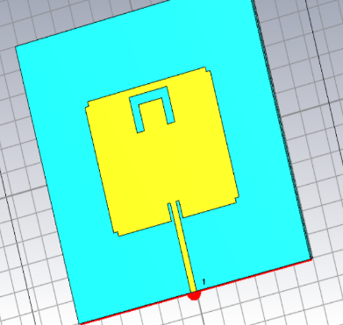
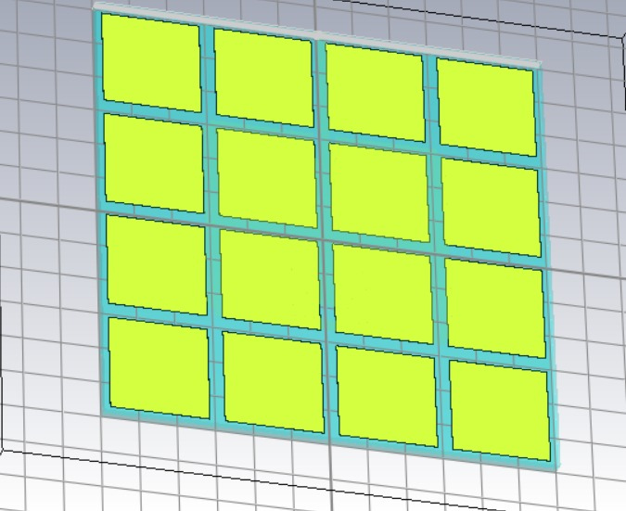
ANTENNA DESIGN - CST

Slide 4
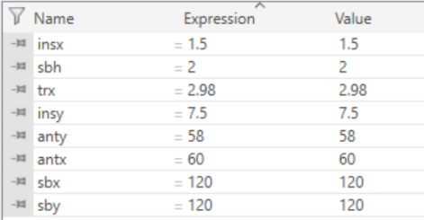
PARAMETERS
Parameter | Symbol | Value | Unit | Description
Center Frequency | — | 1.95 | GHz | Design frequency
Substrate Material | — | Textile (εr = 1.7, tan δ = 0.02) | — | Flexible dielectric
Substrate Size | — | 120 × 120 | mm | Length × Width
Substrate Thickness | h | 2 | mm | Height of substrate
Patch Dimensions | W × L | 60 x 57 | mm | Radiating element
Feed Type | — | Inset microstrip | — | For impedance matching
Inset Distance | d | 10 | mm | From patch edge
AMC Layer | — | 4 × 4 array (26 × 26 mm cell) | — | In-phase reflective surface

Slide 5
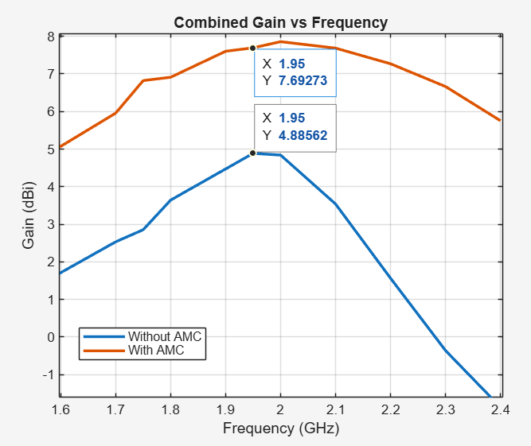
Comparison (Without and With AMC)
Comparison of Gain Plot

Slide 6


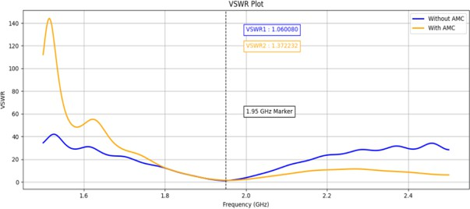
Comparison (Without and With AMC)
Comparison of VSWR Plot

Slide 7
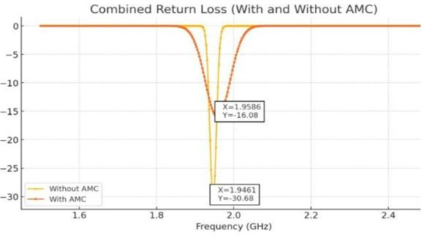
Comparison (Without and With AMC)
Comparison of Return Loss Characteristics

Slide 8
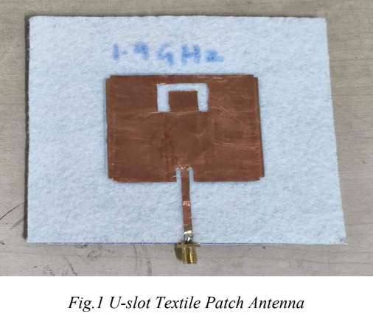
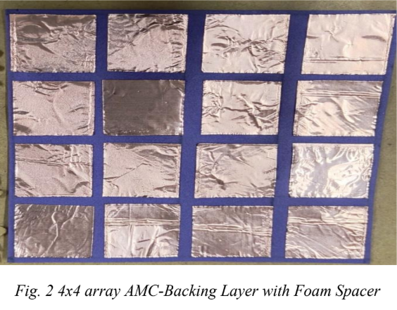
FABRICATED ANTENNA

Slide 9
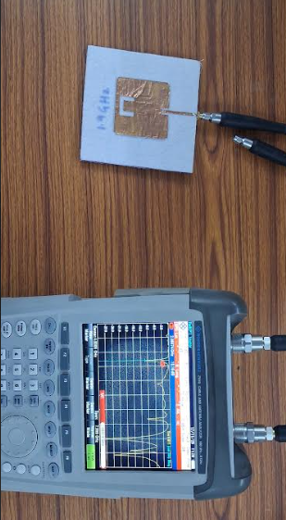
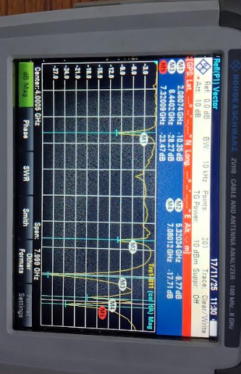
MEASURED S11 OUTPUT

Slide 10
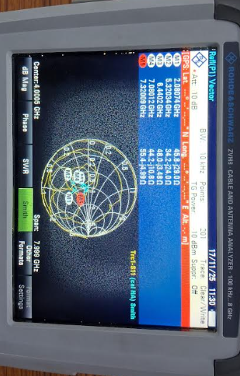
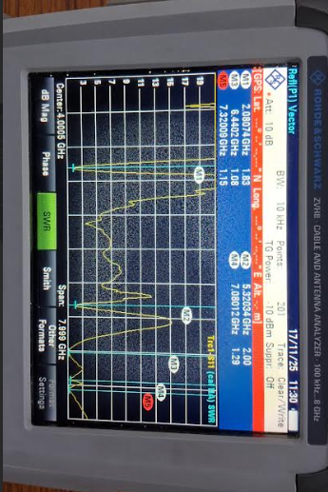
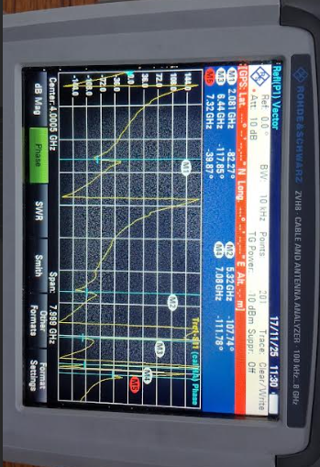
VSWR & OTHER OUTPUTS

Slide 11
THANK YOU.

