Slide 1
MEDIA STREAMING USING IBM CLOUD VIDEO STREAMING
Submitted By
S.Anusri
Dept. of Electronics and Communication Engineering
Anna University Regional Campus Coimbatore

Slide 2
PROBLEM STATEMENT
The objective of this project is to provide a scalable, cloud-based online video platform that is an end-to-end solution for live or on-demand content to external audiences using IBM Video Streaming that supports both ease-of-use and complex setups while being able to scale through built-in multi-CDN support.

Slide 3
WHAT IS MEDIA STREAMING?
Streaming media refers to multimedia, such as video or audio, that is delivered over the internet in compressed form. Users can play such media content immediately without the need to save or download it to their hard drive first. Users can pause, rewind, or fast-forward the streaming video or audio just like they can with a downloaded media file.
Another modern term related to streaming media is OTT (Over-the-Top) media service. OTT is essentially any streaming service that provides media content over the internet. Examples of OTT services include Netflix, Hulu, and Spotify. We’ll dig deeper into these later.

Slide 4
PROPOSED SOLUTION
1. Content Ingestion:
Use IBM Cloud Video Streaming APIs or SDKs to ingest both live and on-demand video content.
Implement authentication and authorization mechanisms to ensure that only authorized users or devices can upload content.
Optionally, integrate with content management systems (CMS) to organize and catalog media assets efficiently.

Slide 5
2. Video Encoding and Transcoding:
Utilize IBM Cloud Video Streaming's built-in encoding and transcoding capabilities.
Transcode the video content into multiple quality levels and formats (e.g., HLS, DASH) to support adaptive bitrate streaming (ABR). This ensures optimal viewing experiences for users on various devices and network conditions.
Implement video analysis tools to extract metadata, such as captions, subtitles, and thumbnails.
3. Content Storage:
Store ingested and transcoded video content in a scalable and durable storage solution, such as IBM Cloud Object Storage or a database.
Implement data redundancy and backup strategies to ensure data availability and durability.

Slide 6
4. Content Delivery:
Utilize IBM Cloud Content Delivery Network (CDN) or third-party CDNs for efficient content delivery to end-users.
Employ geographically distributed CDN edge locations to reduce latency and improve content availability worldwide.
5. Security and Access Control:
Implement security measures such as encryption (HTTPS) for content in transit and at rest.
Enforce access control policies to restrict unauthorized access to video assets.
Employ tokenization or signed URLs for temporary and secure access to protected content.

Slide 7
6. User Authentication and Authorization:
Implement user authentication mechanisms, such as OAuth or Single Sign-On (SSO), to manage user access to content.
Define roles and permissions to control user privileges, such as viewing, uploading, or managing content.
7. Scalability and High Availability:
Design the architecture to be horizontally scalable, allowing for increased capacity during peak usage.
Implement load balancing and auto-scaling to ensure high availability and fault tolerance.

Slide 8
8. Compliance and Regulations:
Ensure compliance with content licensing agreements, copyright laws, and data privacy regulations (e.g., GDPR).
9. Disaster Recovery and Backup:
Implement disaster recovery plans and regular data backups to protect against data loss.

Slide 9
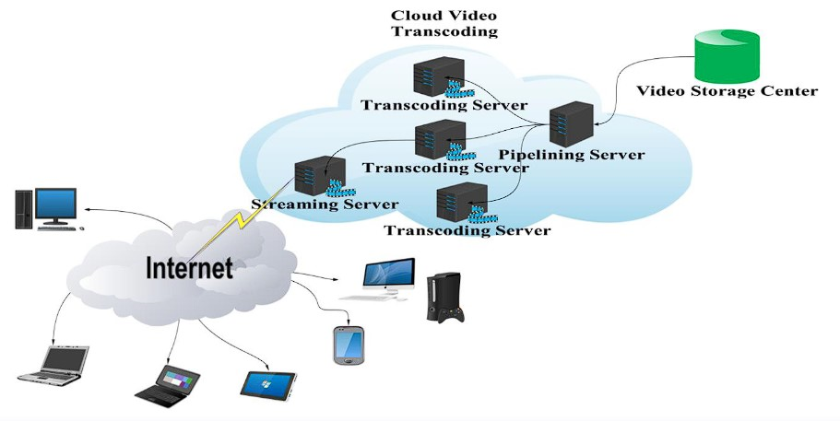
ARCHITECTURAL DESIGN

