Slide 1
Protocols
By Shabaz

Slide 2
Protocols
A protocol is a standard set of rules that allow electronic devices to communicate with each other.
These rules include what type of data may be transmitted, what commands are used to send and receive data, and how data transfers are confirmed.
You can think of a protocol as a spoken language.

Slide 3
Types of communication
Wired communication
Wireless communication

Slide 4
Wired Communication
Parallel communication
Serial communication

Slide 5
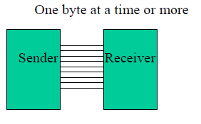
Parallel communication
Fast, but distance cannot be great.
Expensive.
Eg:Printer

Slide 6
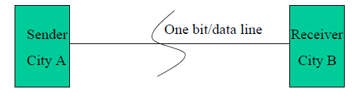
Serial Communication
Long distance
Cheaper
Eg: Telephone

Slide 7
Asynchronous vs. Synchronous
Two methods of Serial Communication
Synchronous: Transfer block of data (characters) at a time.
Asynchronous: Transfer a single byte at a time.
You could write S/W to use either of these methods, but the programs can be tedious and long. So, H/W is developed instead.

Slide 8
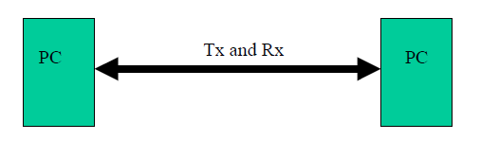
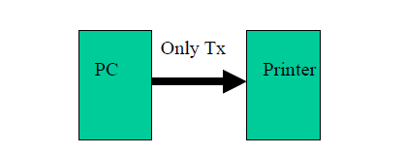
Duplex vs. Simplex

Slide 9
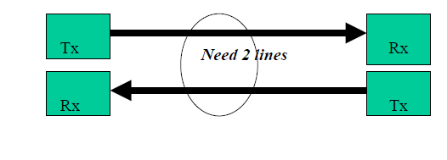
Full Duplex: Data is transmitted both way at the same time.

Slide 10
Half Duplex: Data is transmitted one way at a time.

Slide 11
Asynchronous serial communication is widely used for character-oriented (1 byte) transmissions.
Synchronous serial communication is widely used for block oriented(multiple bytes) transmissions.

Slide 12
RS232 Protocol
RS232 is one of the most widely used techniques to interface external equipment with computers.
RS232 is a Serial Communication Standard developed by the Electronic Industry Association (EIA) and Telecommunications Industry Association (TIA).

Slide 13
RS232 defines the signals connecting between DTE and DCE.
Here, DTE stands for Data Terminal Equipment and an example for DTE is a computer.
DCE stands for Data Communication Equipment or Data Circuit Terminating Equipment and an example for DCE is a modem.

Slide 14
RS232 uses serial communication, where one bit of data is sent at a time along a single data line.
This is contrast to parallel communication, where multiple bits of data are sent at a time using multiple data lines.
The main drawback of RS232 standard is data rate and length of cable. RS232 supports a maximum baud rate of 19200 bps and the maximum length of the cable is 20 meters.

Slide 15
RS232 was defined way before TTL logic and hence, it is not unexpected that RS232 doesn’t use the TTL specific 5V and GND logic levels.
The logic ‘1’ in RS232 is described as being in the voltage range of -15V to -3V and logic ‘0’ is described as the voltage range of +3V to +15V i.e. low level voltage is logic ‘1’ and high level voltage is logic ‘0’.

Slide 16
Typically, the logic ‘1’ in RS232 will be -12V and logic ‘0’ will be +12V. All the above mentioned voltages are with respect to a common ground ‘GND’ pin. Any voltage between -3V and +3V is considered to be an undefined logic state.
Historically, logic ’1’ (-15V to -3V) is referred to as Marking and logic ‘0’ (+3V to +15V) is referred to as Spacing.

Slide 17
In RS232, the data is transmitted serially in one direction over a single data line. In order to establish two way communication, we need at least three wires (RX, TX and GND) apart from the control signals. A byte of data can transmitted at any time provided the previous byte has already been transmitted.
RS232 follows asynchronous communication protocol i.e. there is no clock signal to synchronize transmitter and receiver. Hence, it uses start and stop bits to inform the receiver when to check for data.

Slide 18
There is a delay of certain time between the transmissions of each bit. This delay is nothing but an inactive state i.e. the signal is set to logic ‘1’ i.e. -12V (if you remember, logic ‘1’ in RS232 is -12V and logic ‘0’ is +12V).
First, the transmitter i.e. the DTE sends a Start bit to the receiver i.e. the DCE to inform it that data transmission starts from next bit. The Start bit is always ‘0’ i.e. +12V. The next 5 to 9 characters are data bits.

Slide 19
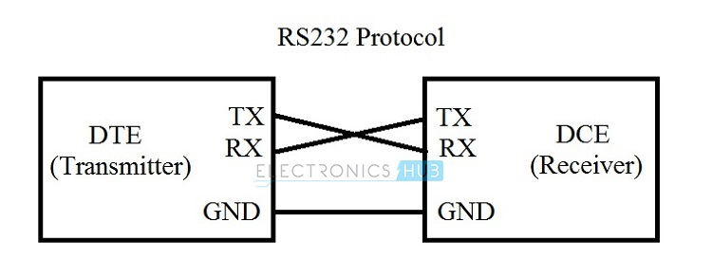

Slide 20
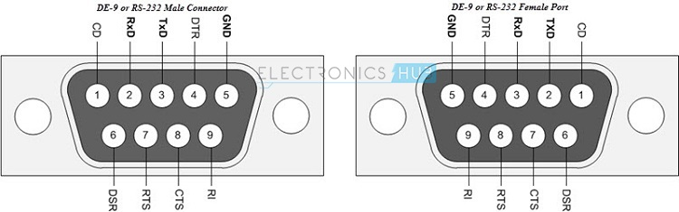

Slide 21
Limitations of RS232
RS232 Protocol requires a common ground between the transmitter (DTE) and receiver (DCE). Hence, the reason for shorter cables between DTE and DCE in RS232 Protocol.
The signal in the line is highly susceptible to noise. The noise can be either internal or external.
If there is an increase in baud rate and length of the cable, there is a chance of cross talk introduced by the capacitance between the cables.
The voltage levels in RS232 are not compatible with modern TTL or CMOS logics. We need an external level converter.

Slide 22
Applications
Though RS232 is a very famous serial communication protocol, it is now has been replaced with advanced protocols like USB.
Previously they we used for serial terminals like Mouse, Modem etc.
But, RS232 is still being used in some Servo Controllers, CNC Machines, PLC machines and some microcontroller boards use RS232 Protocol.

Slide 23
UART
UART: Universal Asynchronous Receiver Transmitter
UART is a simple half-duplex, asynchronous, serial protocol.
Simple communication between two equivalent nodes.
Any node can initiate communication.
Since connection is half-duplex, the two lanes of communication are completely independent.

Slide 24
What makes it ‘universal’ ?
Its parameters (format,speed ..) are configurable.
Why ‘asynchronous’ ?
It doesn’t have a clock
Baud Rate:
No. of bits transmitted/received per second = _____bits/sec.

Slide 25
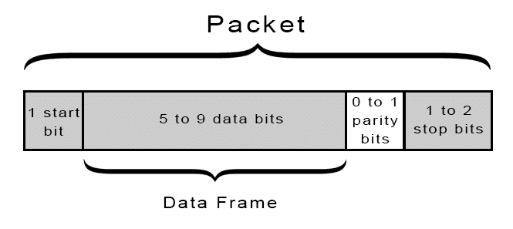
UART Frame

Slide 26
START BIT
The UART data transmission line is normally held at a high voltage level when it’s not transmitting data.
To start the transfer of data, the transmitting UART pulls the transmission line from high to low for one clock cycle.
When the receiving UART detects the high to low voltage transition, it begins reading the bits in the data frame at the frequency of the baud rate.

Slide 27
DATA FRAME
The data frame contains the actual data being transferred.
It can be 5 bits up to 8 bits long if a parity bit is used.
If no parity bit is used, the data frame can be 9 bits long.
In most cases, the data is sent with the least significant bit first.

Slide 28
PARITY
Parity describes the evenness or oddness of a number. The parity bit is a way for the receiving UART to tell if any data has changed during transmission.
Bits can be changed by electromagnetic radiation, mismatched baud rates, or long distance data transfers.
After the receiving UART reads the data frame, it counts the number of bits with a value of 1 and checks if the total is an even or odd number.
If the parity bit is a 0 (even parity), the 1 bits in the data frame should total to an even number.

Slide 29
If the parity bit is a 1 (odd parity), the 1 bits in the data frame should total to an odd number.
When the parity bit matches the data, the UART knows that the transmission was free of errors.
But if the parity bit is a 0, and the total is odd; or the parity bit is a 1, and the total is even, the UART knows that bits in the data frame have changed.

Slide 30
STOP BITS
To signal the end of the data packet, the sending UART drives the data transmission line from a low voltage to a high voltage for at least two bit durations.

Slide 31
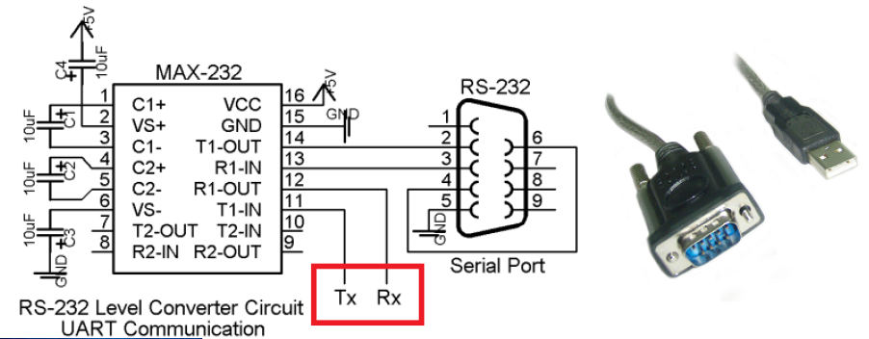

Slide 32
ADVANTAGES
Only uses two wires
No clock signal is necessary
Has a parity bit to allow for error checking
The structure of the data packet can be changed as long as both sides are set up for it
Well documented and widely used method

Slide 33
DISADVANTAGES
The size of the data frame is limited to a maximum of 9 bits
Doesn’t support multiple slave or multiple master systems
The baud rates of each UART must be within 10% of each other

Slide 34
UART Registers
SCON - Serial Control Register
TCON - Timer Control Register for Baud Rate Generator
TMOD - Timer Mode Control for Baud Rate Generator
SBUFF - Serial Buffer holds the data to be transmitted and the data received

Slide 35
SCON
7 | 6 | 5 | 4 | 3 | 2 | 1 | 0
SM0 | SM1 | SM2 | REN | TB8 | RB8 | TI | RI
SM0 | SM1 | Operation | Description Baud Rate Source
0 | 0 | Mode 0 | UART 1/12 the quartz frequency
0 | 1 | Mode 1 | UART Determined by the timer 1
1 | 0 | Mode 2 | 9-bit UART 1/32 the quartz frequency
1 | 1 | Mode 3 | 9-bit UART Determined by the timer 1

Slide 36
SM2 - Serial port mode 2 bit, also known as multiprocessor communication enable bit.When set, it enables multiprocessor communication in mode 2 and 3, and eventually mode 1. It should be cleared in mode 0.
REN - Reception Enable bit enables serial reception when set. When cleared, serial reception is disabled.
TB8 - Transmitter bit 8. Since all registers are 8-bit wide, this bit solves the problem of transmitting the 9th bit in modes 2 and 3. It is set to transmit a logic 1 in the 9th bit.
RB8 - Receiver bit 8 or the 9th bit received in modes 2 and 3. Cleared by hardware if 9th bit received is a logic 0. Set by hardware if 9th bit received is a logic 1.

Slide 37
TI - Transmit Interrupt flag is automatically set at the moment the last bit of one byte is sent. It's a signal to the processor that the line is available for a new byte to transmit. It must be cleared from within the software.
RI - Receive Interrupt flag is automatically set upon one-byte receive. It signals that byte is received and should be read quickly prior to being replaced by a new data. This bit is also cleared from within the software.

Slide 38
The main criteria for UART communication is its baud rate. Both the devices Rx/Tx should be set to same baud rate for successful communication.
For the 8051 the Timer 1' is used to generate the baud rate in Auto reload mode.

Slide 39
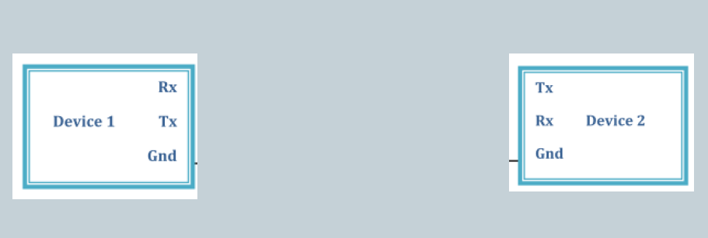
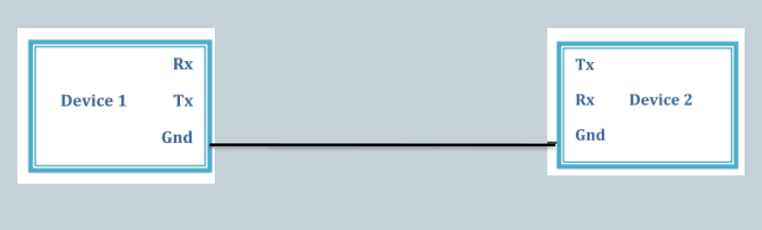
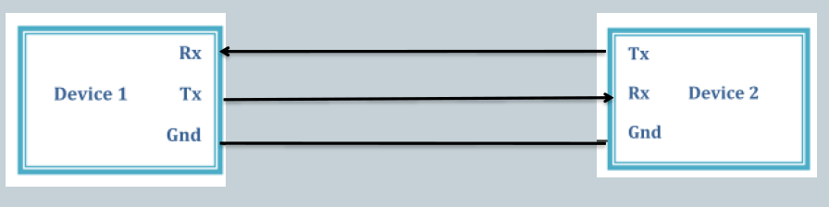

Slide 40
The End

