Slide 1
Color-Based Hand Motion Recognition with OpenCV
NAME: ANUSUYA S
NM-ID:au21CSA64
KGiSL Institute Of Technology
3/21/2024 Annual Review

Slide 2
PROJECT TITLE
Color-Based Hand Motion Recognition with OpenCV
3/21/2024 Annual Review

Slide 3


AGENDA
Problem Statement.
Project Overview.
End Users.
Our Solution and Proposition.
Key Features.
Modelling Approach
Results and Evaluation
3/21/2024 Annual Review

Slide 4

PROBLEM STATEMENT
Facilitates live hand gesture recognition through color detection utilizing OpenCV in Python. By identifying variations in colors within a real-time video stream, the code monitors hand gestures and depicts their paths on the display.
3/21/2024 Annual Review

Slide 5

PROJECT OVERVIEW
Hand gesture recognition serves as a vital component in human-computer interaction, applicable across various domains such as virtual reality gaming and sign language translation. Leveraging OpenCV, a widely-used computer vision library, this project detects and monitors hand movements by establishing predefined color thresholds.
Hand gesture recognition serves as a vital component in human-computer interaction, applicable across various domains such as virtual reality gaming and sign language translation. Leveraging OpenCV, a widely-used computer vision library, this project detects and monitors hand movements by establishing predefined color thresholds.
3/21/2024 Annual Review

Slide 6

WHO ARE THE END USERS?
The primary end users for this application are presenters who want to incorporate a more dynamic and interactive element into their presentations. This could include:
Business Professionals: They can use it to create engaging presentations for clients, colleagues, or investors.
Educators: Teachers, lecturers, and professors can leverage it to explain concepts in a visually stimulating way, fostering student engagement.
Trainers and Workshop Leaders: They can use it to create interactive workshops where participants can contribute ideas by "writing in the air."
YouTubers and Content Creators: This can be a unique tool to visually explain concepts in their videos, increasing audience retention.
3/21/2024 Annual Review

Slide 7

YOUR SOLUTION AND ITS VALUE PROPOSITION
Value Proposition:
Enhanced audience engagement: Move beyond static slides and capture attention with dynamic writing that appears as you move your hand.
Improved information retention: Visual elements and interaction can enhance audience focus and understanding of key points.
Increased presenter control: Emphasize important information through hand gestures like underlining or circling.
Creative freedom: Illustrate concepts with drawings or diagrams directly on the screen, fostering a visually stimulating experience.
Cost-effective and accessible: Leverages free and open-source tools (Python, OpenCV) for a budget-friendly solution.
3/21/2024 Annual Review

Slide 8

THE WOW IN YOUR SOLUTION
Picture this: Entrance your audience by literally scripting in mid-air! Bid farewell to the monotonous clicker and projector routine – presentations have transcended into the future.
Live enchantment: Witness your concepts materialize on screen as your hand orchestrates. Imagine a digital canvas that mirrors your every movement.
Enhanced engagement: Say goodbye to mundane slideshows. This innovation metamorphoses presentations into interactive journeys, ensuring your audience remains captivated and actively involved throughout.
3/21/2024 Annual Review
8

Slide 9
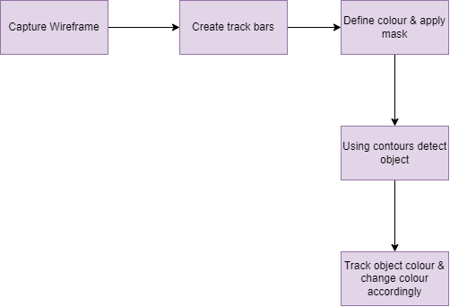
MODELLING
3/21/2024 Annual Review
9

Slide 10
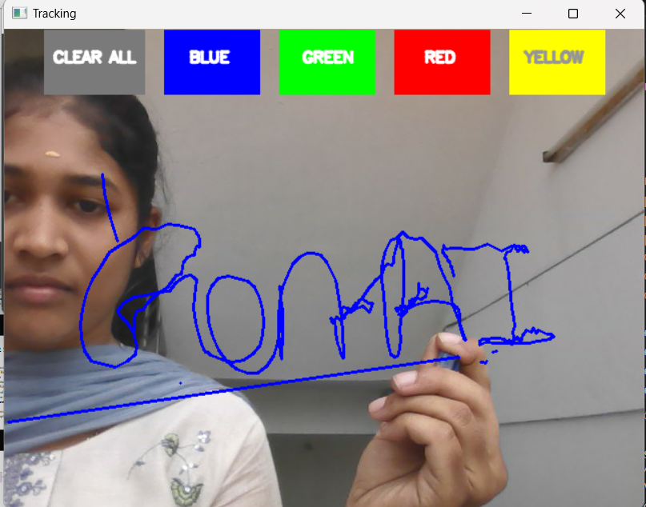
RESULTS
3/21/2024 Annual Review
10

