Slide 1


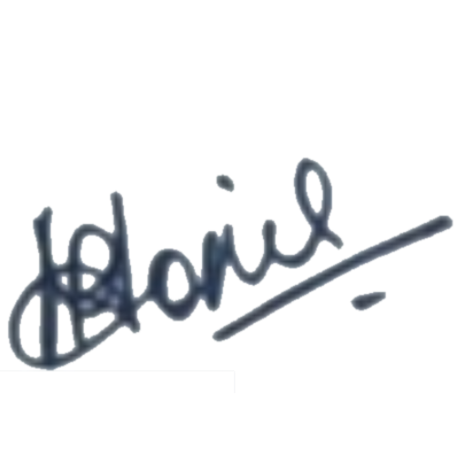
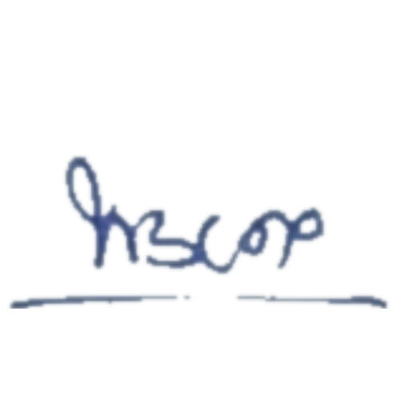
Shri Madhwa Vadiraja Institute of Technology & Management
Organised by Hobby project club & Co-curricular Committee
Certificate of completion
{{full name}}
For the successful completion of the AppMaster workshop by acquiring essential skills in Java, XML and Android studio which are fundamental for App development.
DR RENTA SHRON MONTS PROF. DR. THIRUMALESHWARA BHAT
Co-Curricular Coordinator Principal

