Slide 1
Machine Learning - Research

Slide 2
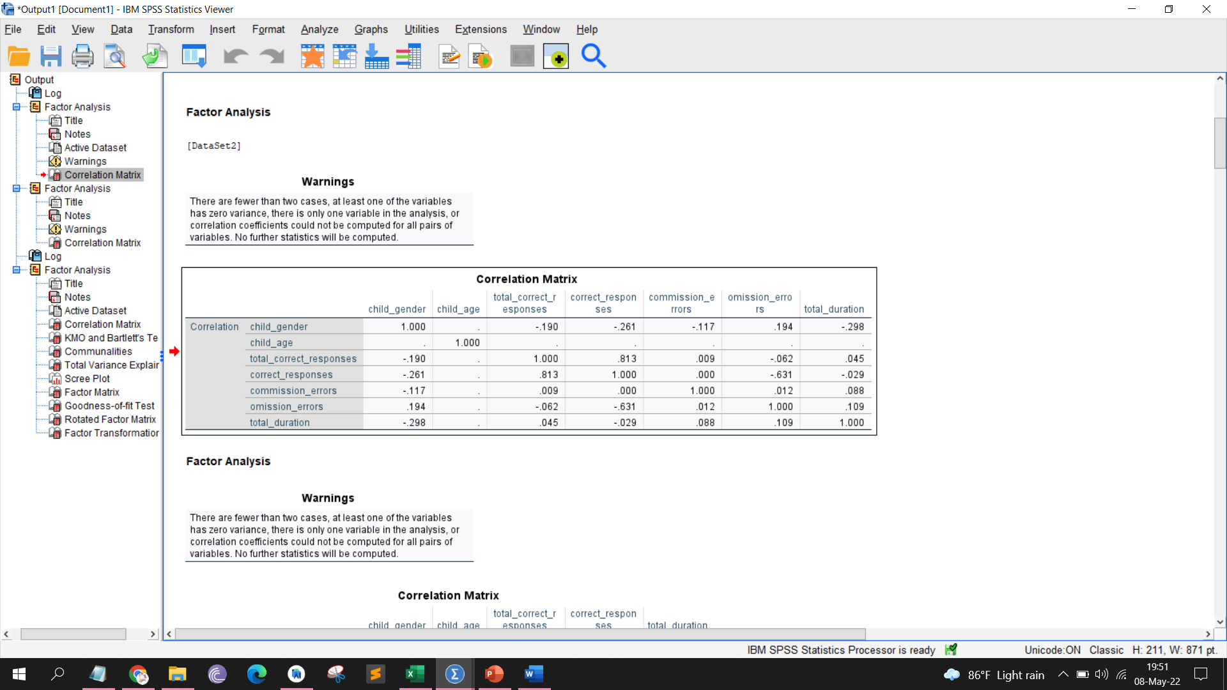

Slide 3
Supervised Learning |  | Unsupervised Learning
Regression | Classification | Clustering
Not suitable because we cannot give an exact prediction like “Yes or No” & “Typical or Atypical” | Difficulty to collect data from children with attention impairments. Time Restrictions | Grouping categories (excellent, good, okay, poor). Input data does not need to be labelled.

Slide 4
Machine Learning
Unsupervised Learning
Clustering
Reinforcement Learning
Association
Density-Based Methods
Hierarchical Based Methods
Supervised Learning
Centroid-Based Methods
Grid-based Methods
OPTICS
BIRCH
K-Means
Distribution Model-Based
Mean-Shift
Notes:
https://scikit-learn.org/stable/modules/clustering.html#
Density - These algorithms can face difficulty in clustering the data points if the dataset has varying densities and high dimensions.

Slide 5
Evaluation Metrics
Evaluation Metrics for Clustering Models
Silhouette Coefficient
Calinski-Harabasz Index
Purity
Rand index
Normalized mutual information
Davies-Bouldin Index
Extrinsic Measures
Intrinsic Measures
Require ground truth labels
Do not require ground truth labels
Notes:
https://scikit-learn.org/stable/modules/clustering.html#clustering-performance-evaluation
https://towardsdatascience.com/clustering-evaluation-strategies-98a4006fcfc
The higher Silhouette Coefficient & CH is, the better the clusters are separated from each other.
Smaller the DB index is, the better the cluster separation is.
CH index is NOT recommended to be used to the density based methods, such as mean-shift clustering, DBSCAN, OPTICS, etc..
Silhouette Coefficient
As one of the most used clustering evaluation metrics, Silhouette coefficient summarizes the intra/inter cluster distance comparison to a score between -1 to 1.
A value close to 1 indicates a super good clustering result, where the inter-cluster distances are much larger that the intra-cluster distances; whereas a value close to -1 means a totally wrong cluster assignment, where the inter-cluster distances are not even comparable to the intra-cluster distances.
Calinski-Harabasz Index
The Calinski-Harabasz index (also known as the Variance Ratio Criterion) is defined as a ratio of the squared inter-cluster distance sum and the squared intra-cluster distance sum for all clusters. The sum of squared distance is corrected by the degree of freedom.
Davies-Bouldin Index
Davies-Bouldin index is similar to the CH index, but the inter/intra cluster distance ratio calculation is reverse to that of CH index. In the calculation of Davies-Bouldin index, there’s a concept, similarity score, that measures how similar two clusters are to each other
Extrinsic Measures which require ground truth labels. Examples are Adjusted Rand index, Fowlkes-Mallows scores, Mutual information based scores, Homogeneity, Completeness and V-measure.
Purity
Purity is quite simple to calculate. We assign a label to each cluster based on the most frequent class in it. Then the purity becomes the number of correctly matched class and cluster labels divided by the number of total data points.
Normalized mutual information (NMI)
NMI is related to the information theory. Normalized mutual information (NMI) gives us the reduction in entropy of class labels when we are given the cluster labels.
Rand index
Rand index is a measure of similarity between two clusterings. We can use it to compare actual class labels and predicted cluster labels to evaluate the performance of a clustering algorithm.

Slide 6
Evaluation of Clustering Models – Focused
Clustering Model | Silhouette Coefficient | Calinski-Harabasz Index | Davies-Bouldin Index
K-Means | 0.518 | 53.732 | 0.797
Mean-Shift | 0.361 | 25.252 | 0.833
BIRCH | 0.401 | 41.707 | 0.932
OPTICS | 0.264 | 20.552 | 0.917
Notes:
The higher Silhouette Coefficient & CH is, the better the clusters are separated from each other.
Smaller the DB index is, the better the cluster separation is.

Slide 7
Evaluation of Clustering Models – Selective
Clustering Model | Silhouette Coefficient | Calinski-Harabasz Index | Davies-Bouldin Index
K-Means | 0.429 | 105.317 | 0.853
Mean-Shift | 0.416 | 27.590 | 0.519
BIRCH | -0.120 | 17.204 | 4.550
OPTICS | 0.218 | 13.270 | 1.512
Notes:
The higher Silhouette Coefficient & CH is, the better the clusters are separated from each other.
Smaller the DB index is, the better the cluster separation is.
Limits & explanation *********************
Clustering method*****************

