Slide 1
Development of a Mobile Application to Screen Attention Impairments in Young Children and Facilitate Interventions.
DATA ANALYSIS & VISUALIZATION
Keshari Anuththara Jayakody
14th July 2022

Slide 2
Analyzing Factors
Test Variables | % of Correct Responses | Commission Errors | Omission Errors | Mean Reaction Time | Total Duration
Alternating Attention
Divided Attention
Sustained Attention
Focused Attention
Selective Attention

Slide 3
Models
Model 1 - Percentage of Correct Responses
Model 2 - Mean Reaction Time
Model 3 - Total Duration – Separately for Selective Attention
Model 4 - % of CE
Model 5 - % of OE

Slide 4
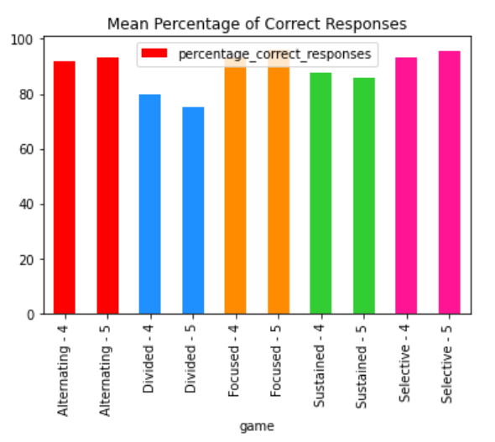
Percentage of correct Responses
Increases with age *
Alternating Attention
Focused Attention
Selective Attention
Decreases with age
Divided Attention
Sustained Attention

Slide 5
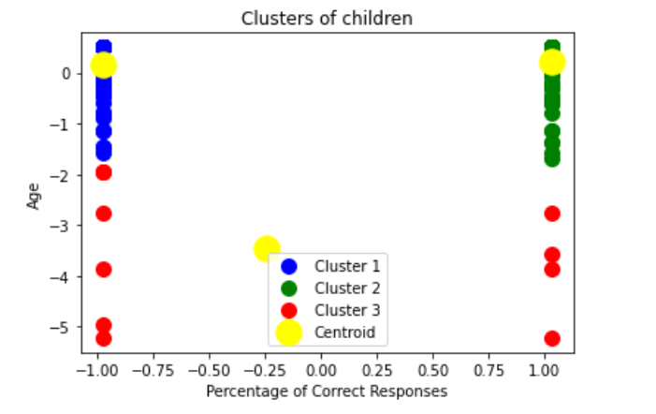
Clustering - Percentage of correct Responses
No. of Clusters = 3
Cluster | No. of students | %
1 | 104 | 68.42 – 100 Age 4
2 | 101 | 66.67 – 100 Age 5
3 | 11 | 12.5 – 62.5

Slide 6
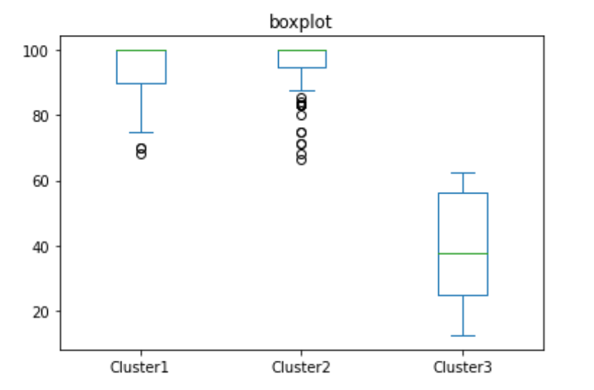
Clustering - Percentage of correct Responses

Slide 7
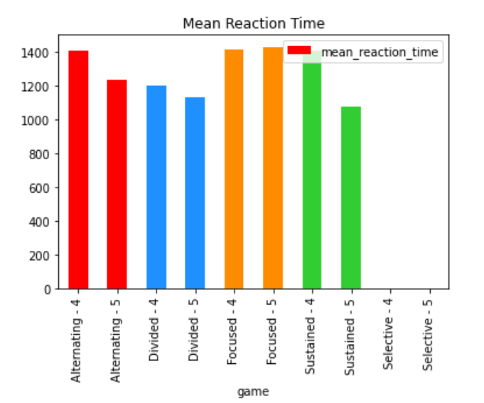
Mean reaction time (except selective attention)
Decreases with age *
Alternating Attention
Divided Attention
Sustained Attention
Increases with age
Focused Attention

Slide 8
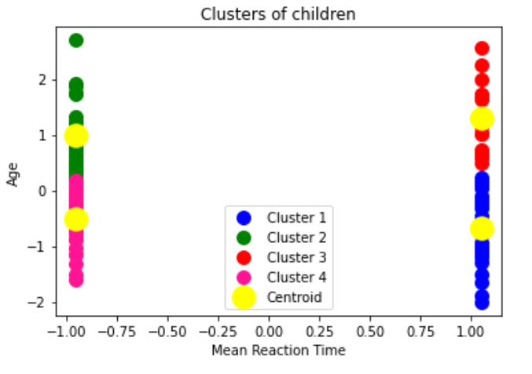
*Clustering - Mean reaction time (except selective attention)
No. of Clusters = 4
Cluster | No. of students | MRT
1 | 37 | 823 - 1396 Age 5
2 | 24 | 1404 - 2032 Age 4
3 | 14 | 1462 – 1998 Age 5
4 | 32 | 928 – 1384 Age 4

Slide 9
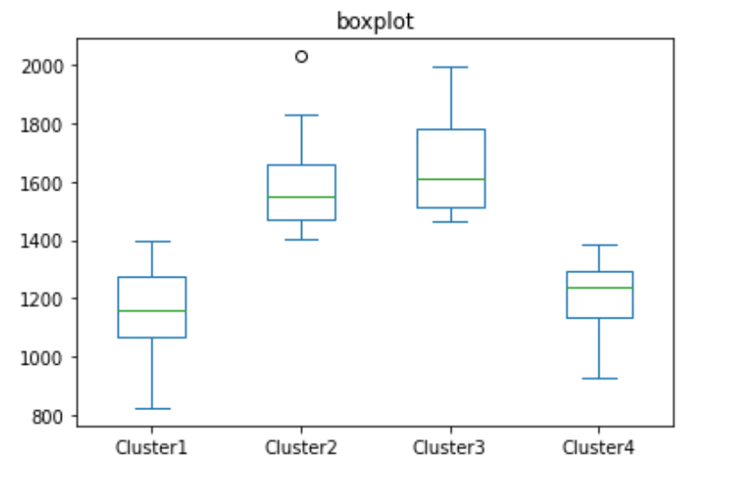
Clustering - Mean reaction time (except selective attention)

Slide 10
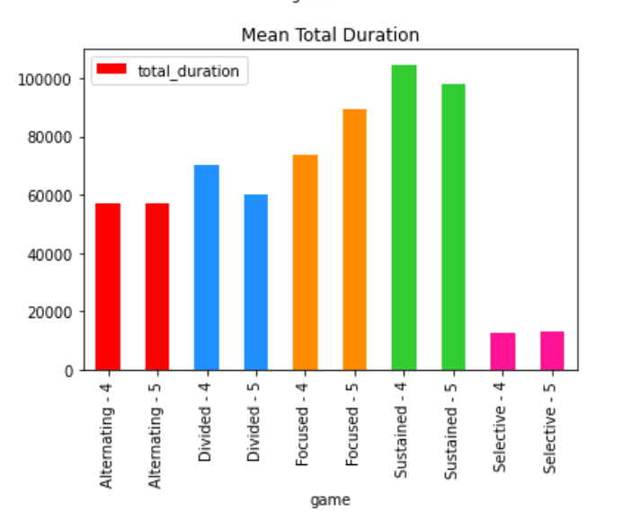
TOTAL DURATION (FOR selective & SUSTAINED attention)
Increases with age - Selective Attention
Decreases with age - Sustained Attention
Remove unnecessary ones

Slide 11
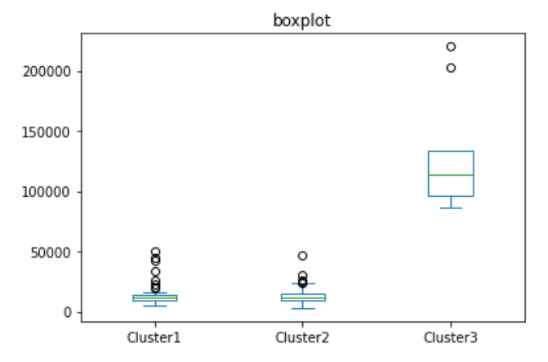
Clustering – Total duration (FOR selective & SUSTAINED attention)

Slide 12
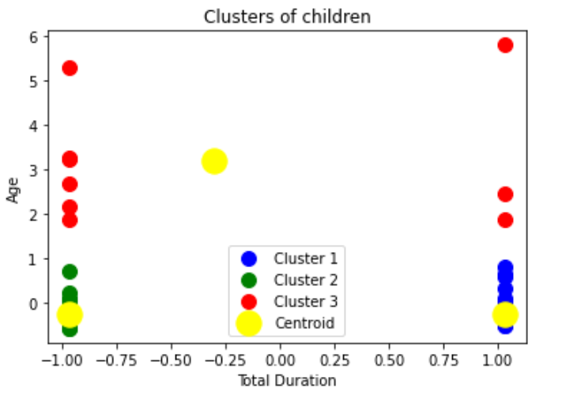
Clustering – Total duration (FOR selective & SUSTAINED attention)
No. of Clusters = 3
Cluster | No. of students | MRT
1 | 56 | 5112 - 50461 Age 5
2 | 57 | 3000 - 46708 Age 4
3 | 9 | 86043 - 220070

Slide 13
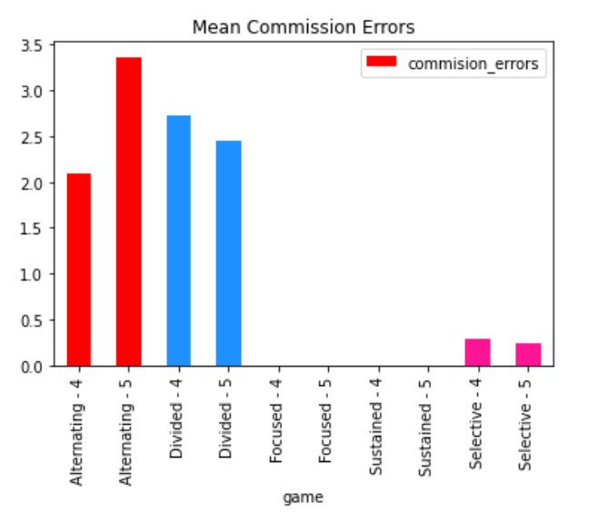
commission Errors (Except SUSTAINED & Focused attention)
Decreases with age *
Divided Attention
Selective Attention
Increases with age
Alternating Attention

Slide 14
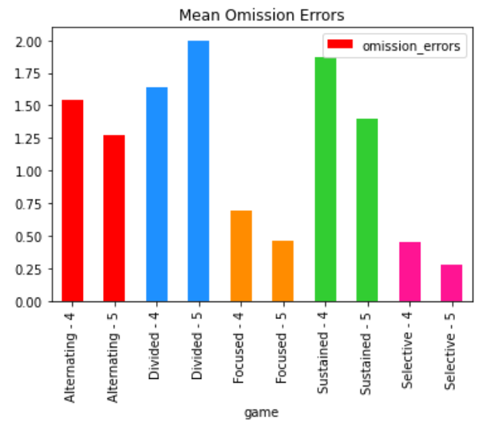
Omission Errors
Decreases with age *
Alternating Attention
Sustained Attention
Focused Attention
Selective Attention
Increases with age
Divided Attention

Slide 15
Clustering – OER & CER (Except SUSTAINED & Focused attention)
Cluster | No. of students | OER & CER
1 | 42 | CER → 0.5 - 1.0 OER → 0.0 - 0.5
2 | 42 | CER – 0, OER - 0 Age 5
3 | 40 | CER – 0, OER - 0 Age 4
4 | 27 | CER → 0.0 - 0.4 OER → 0.6 - 1.0
No. of Clusters = 4

Slide 16
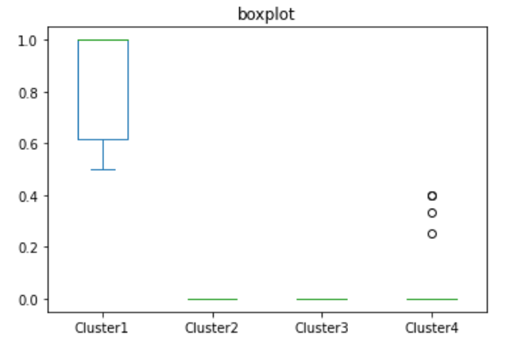
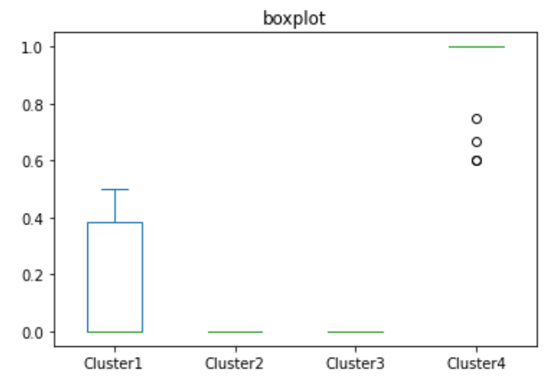
Clustering – OER & CER (Except SUSTAINED & Focused attention)
CER OER

Slide 17
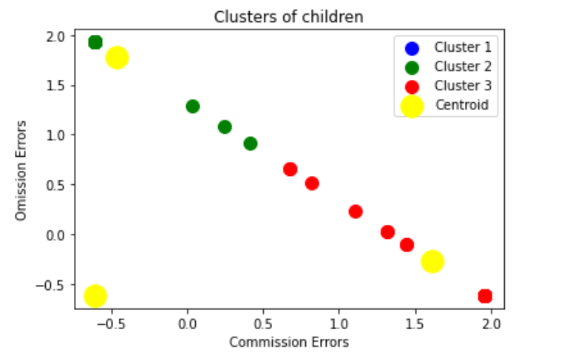
AGE 4 - Clustering – OER & CER (Except SUSTAINED & Focused attention)
No. of Clusters = 3 check again
Cluster | No. of students | OER & CER
1 | 40 | CER – 0, OER - 0
2 | 17 | CER → 0.0 – 0.4 OER → 0.6 – 1.0
3 | 20 | CER → 0.5 – 1.0 OER → 0.0 – 0.5

Slide 18
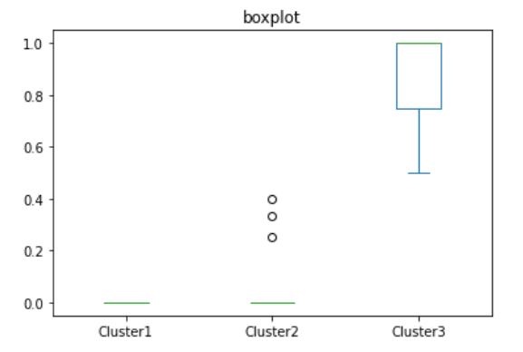
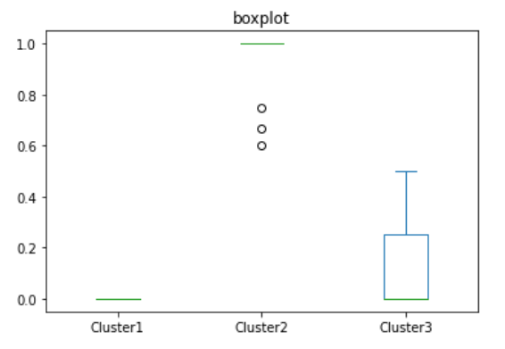
AGE 4 - Clustering – OER & CER (Except SUSTAINED & Focused attention)
CER OER

Slide 19
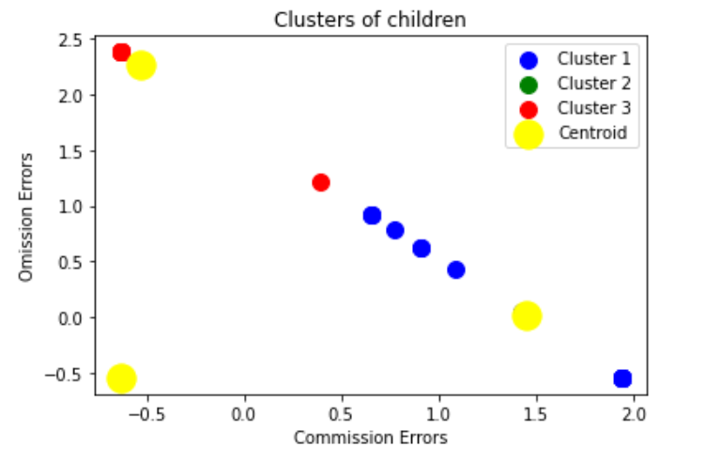
AGE 5 - Clustering – OER & CER (Except SUSTAINED & Focused attention)
No. of Clusters = 3
Cluster | No. of students | OER & CER
1 | 22 | CER → 0.5 – 1.0 OER → 0.0 – 0.5
2 | 42 | CER – 0, OER - 0
3 | 10 | CER → 0.0 – 0.4 OER → 0.6 – 1.0

Slide 20
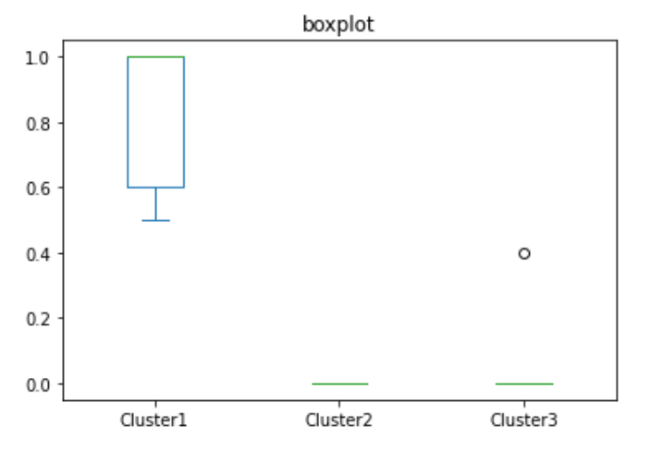
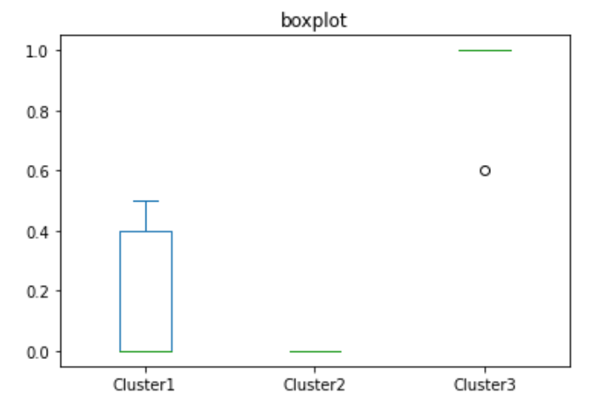
AGE 5 - Clustering – OER & CER (Except SUSTAINED & Focused attention)
CER OER

Slide 21
APPENDIX

Slide 22
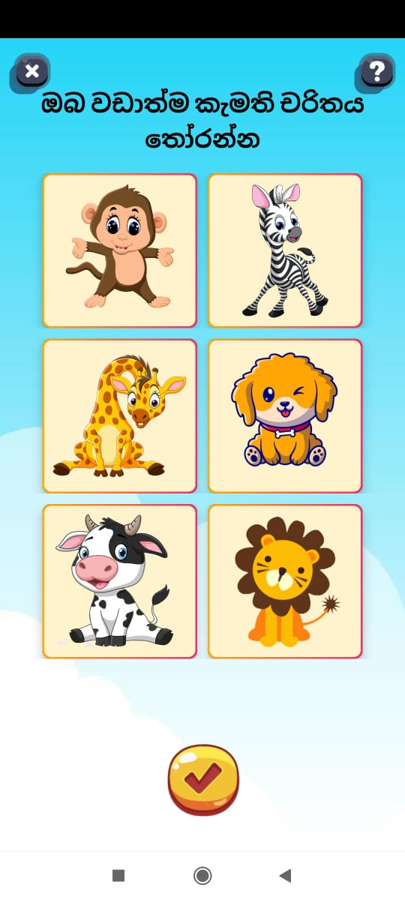
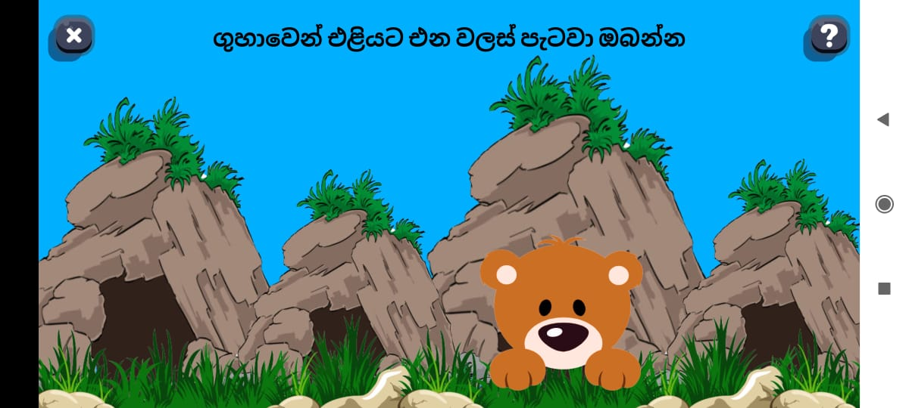
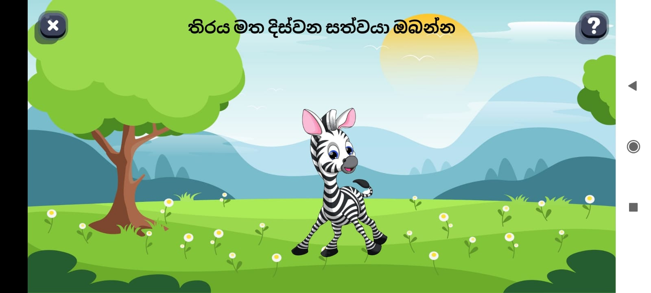
Focused Attention Assessment

Slide 23
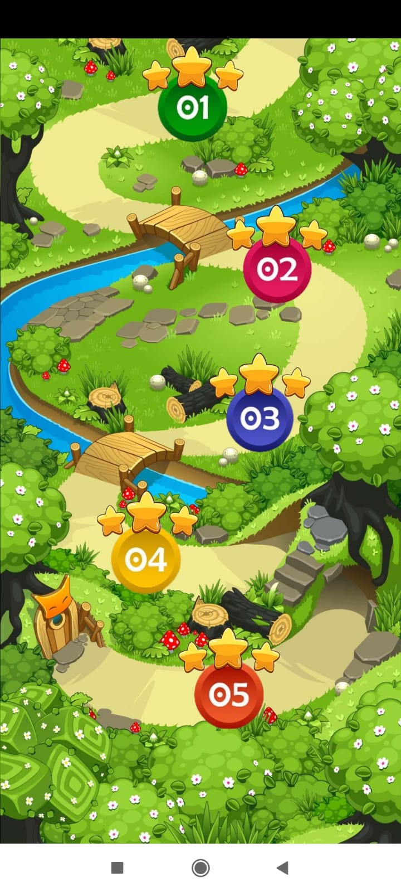
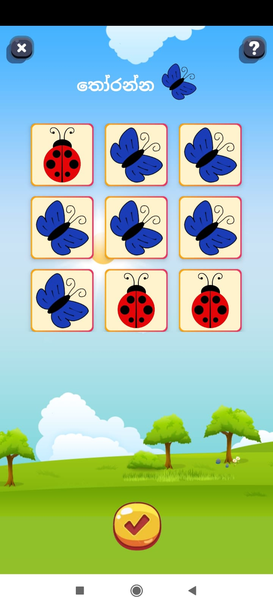
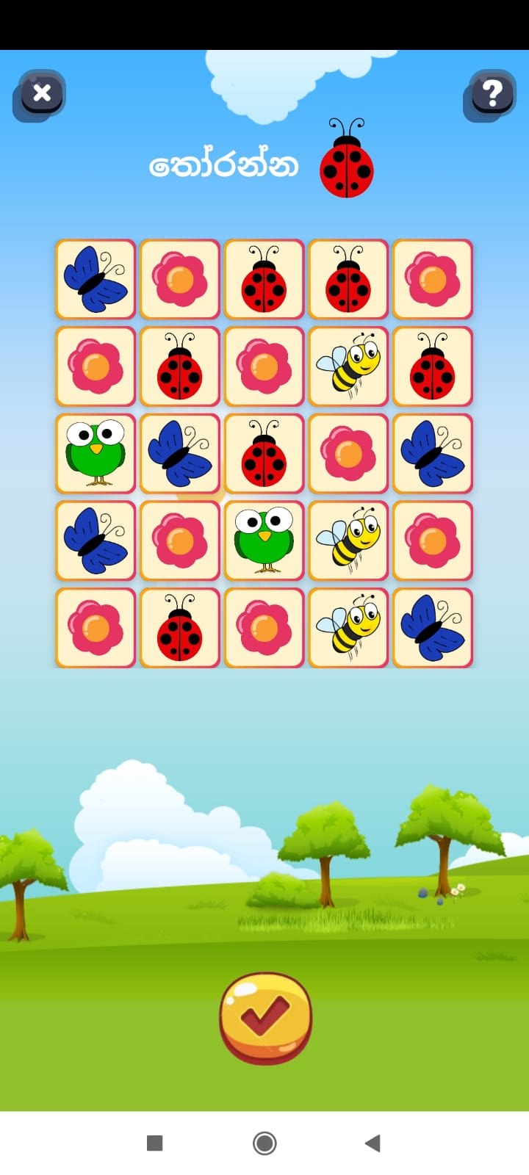
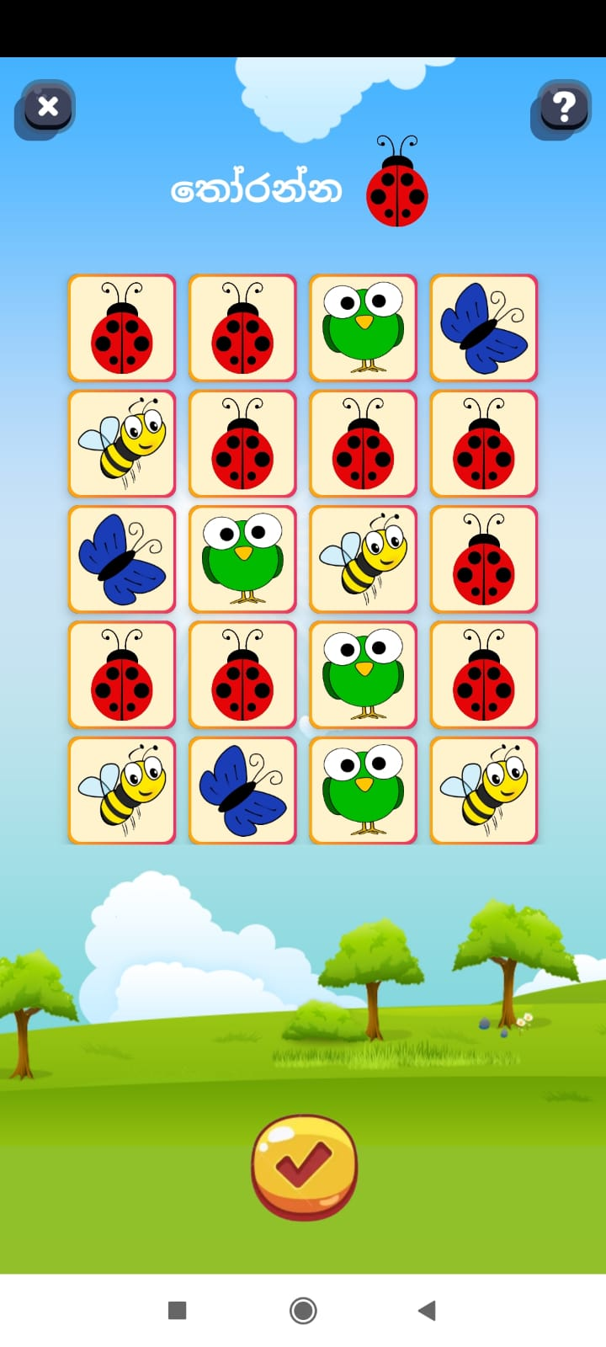
Selective Attention Assessment

Slide 24


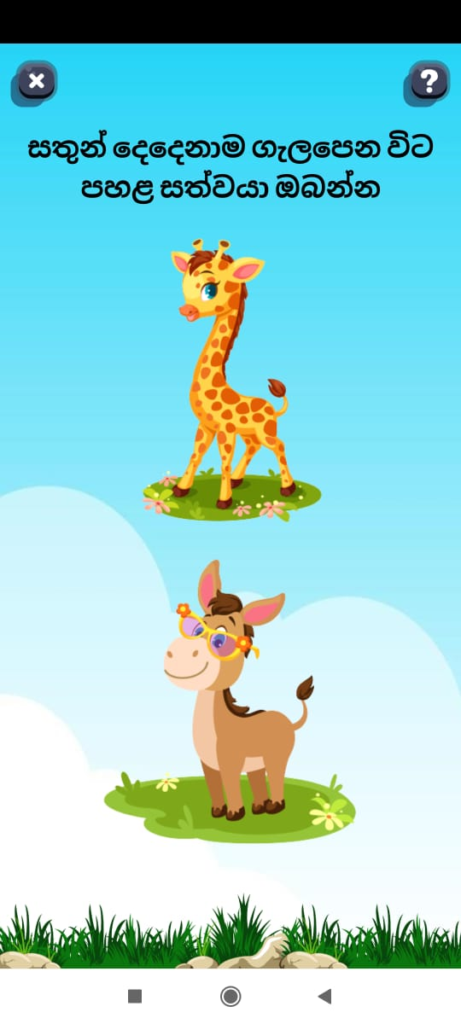
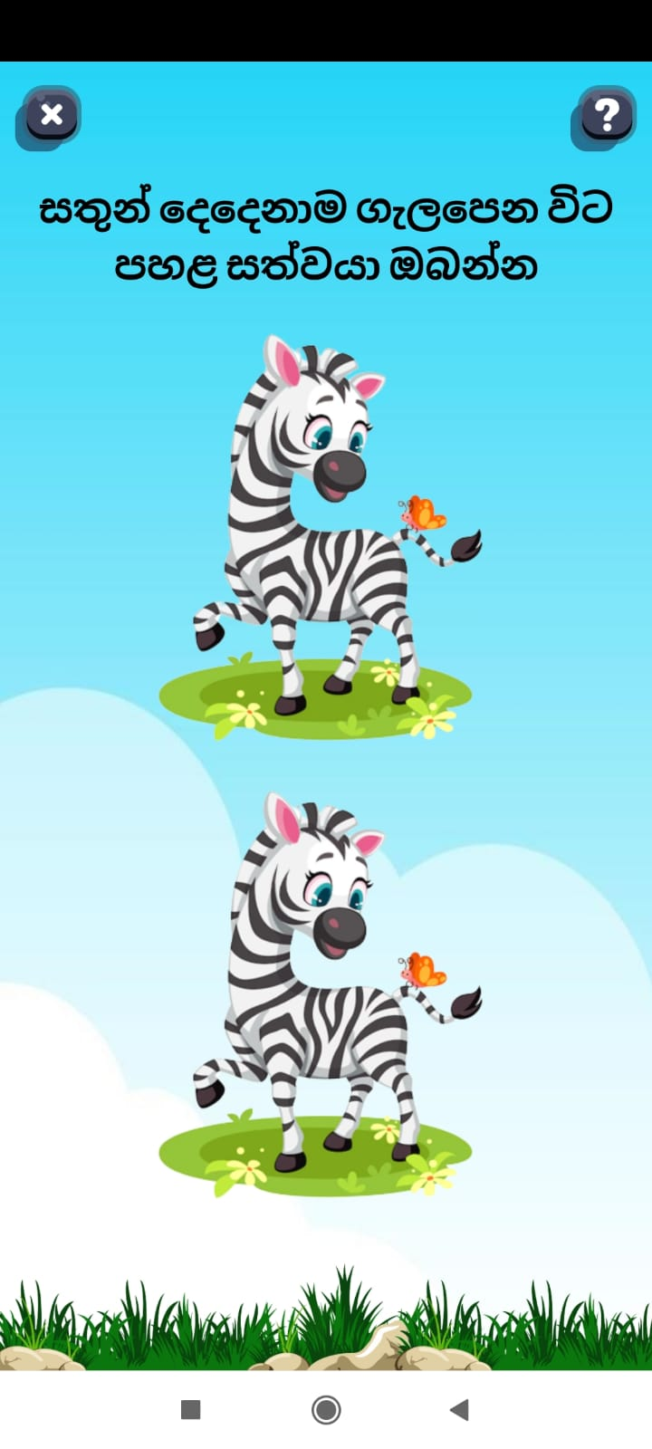
Divided Attention Assessment

Slide 25
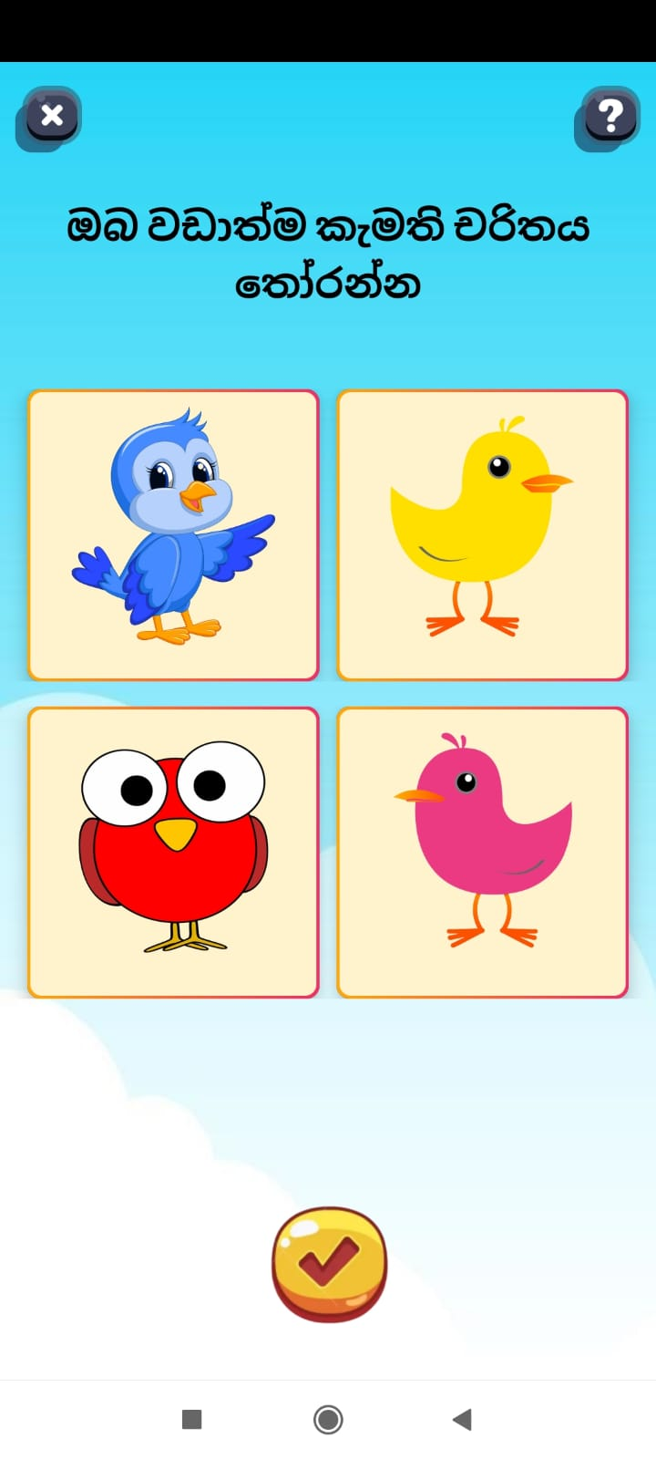
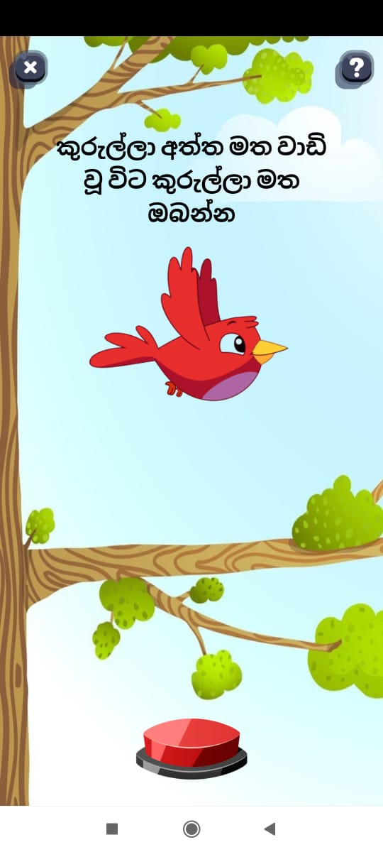
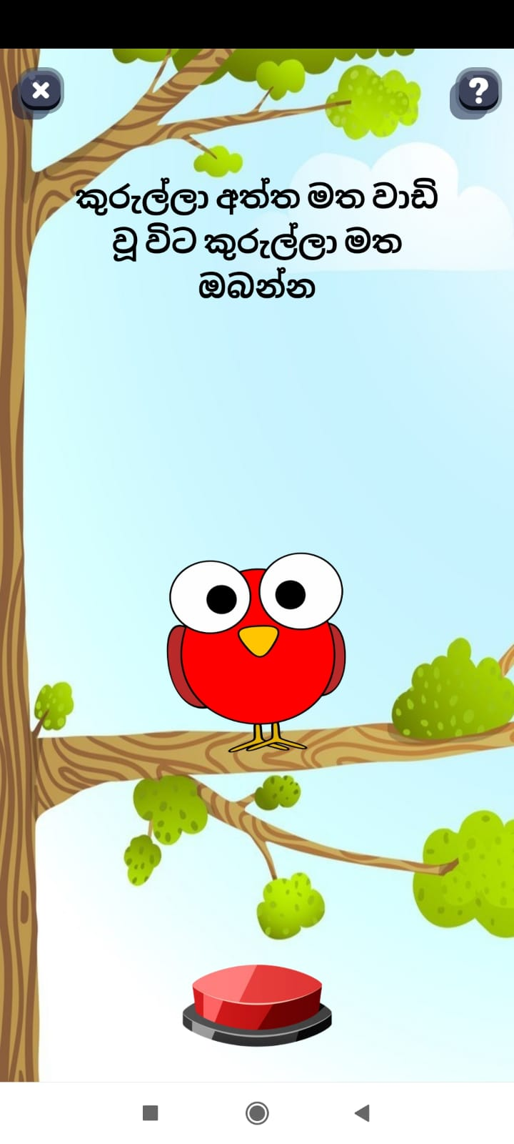
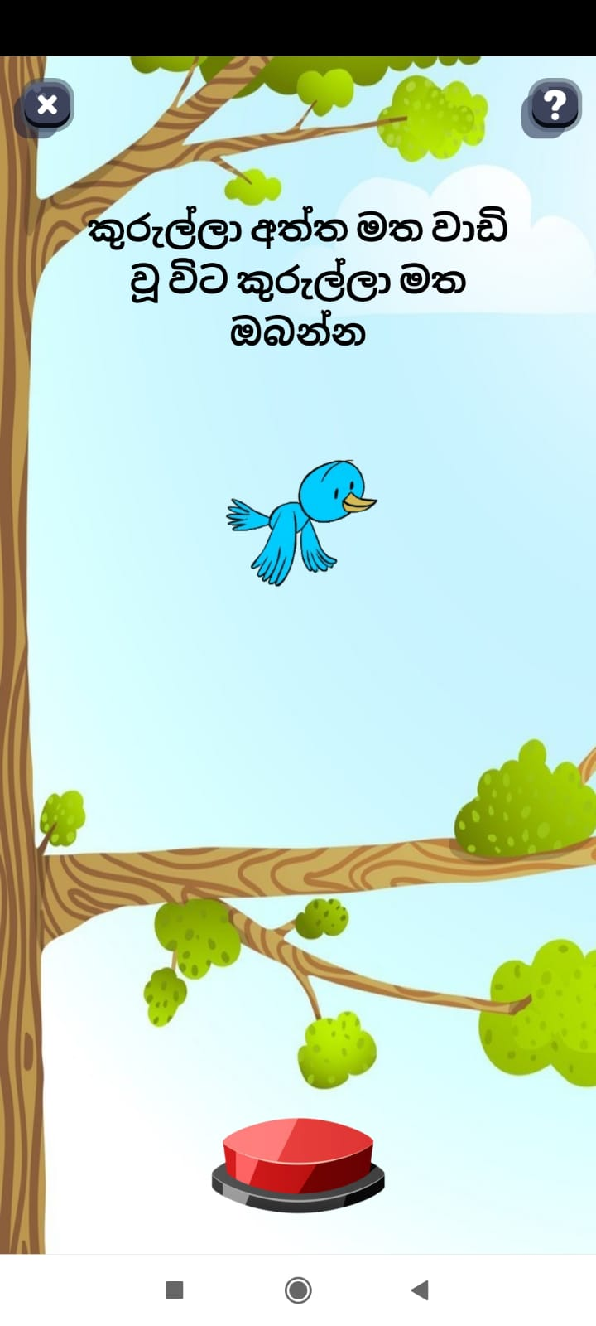
Sustained Attention Assessment

Slide 26
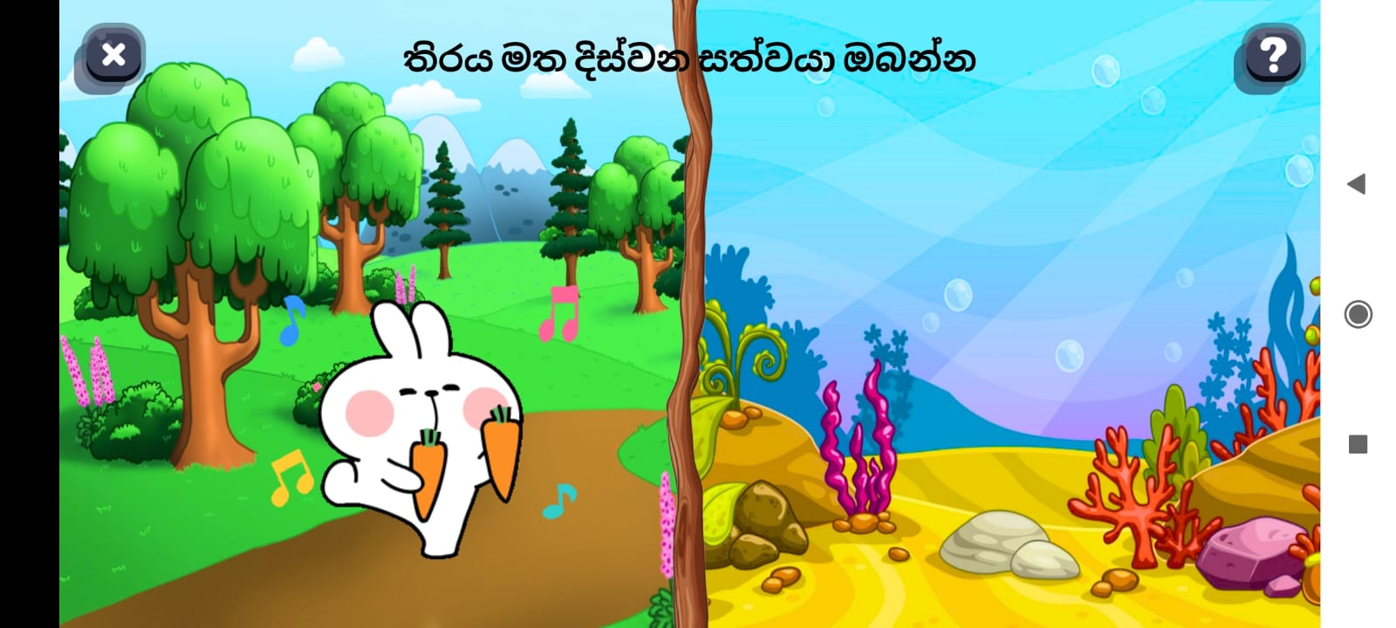
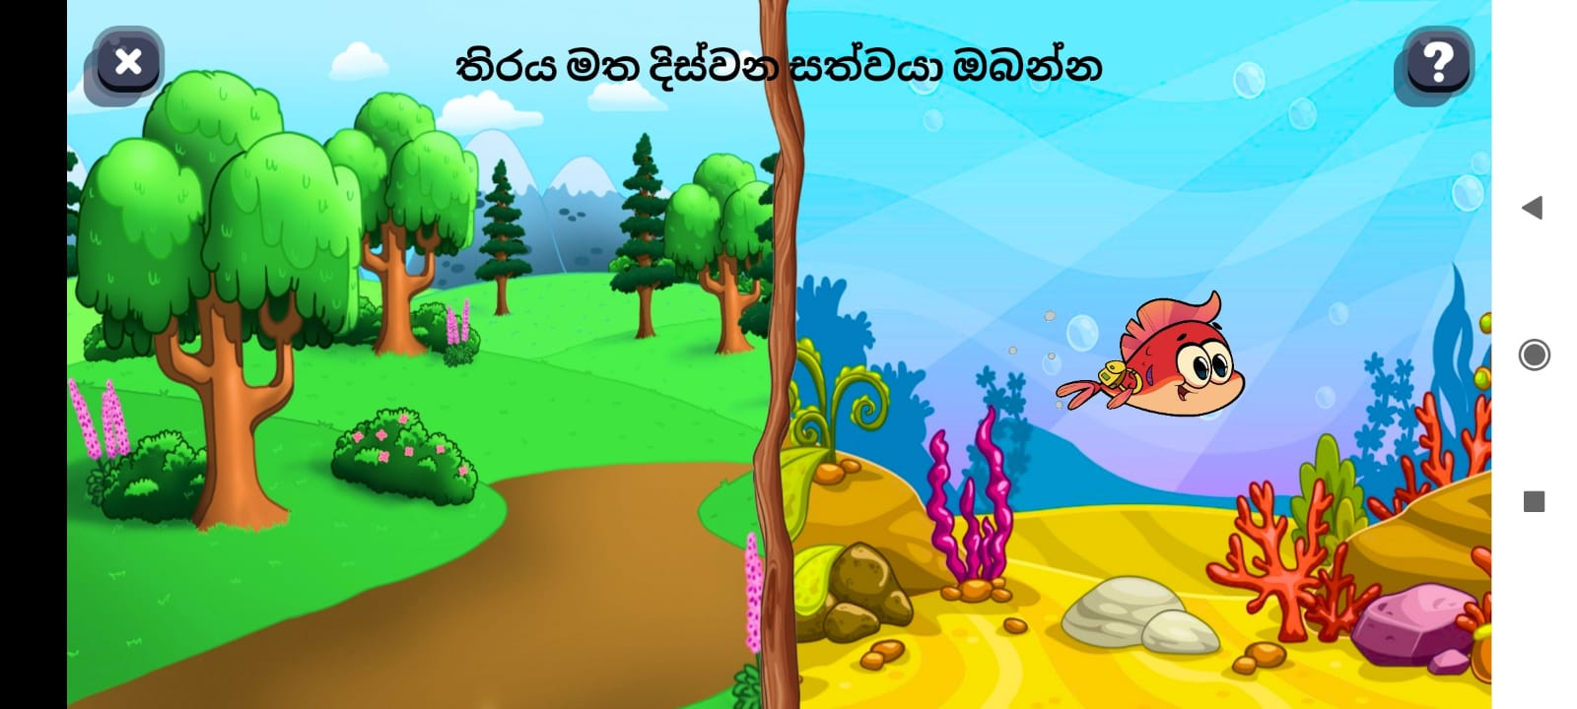
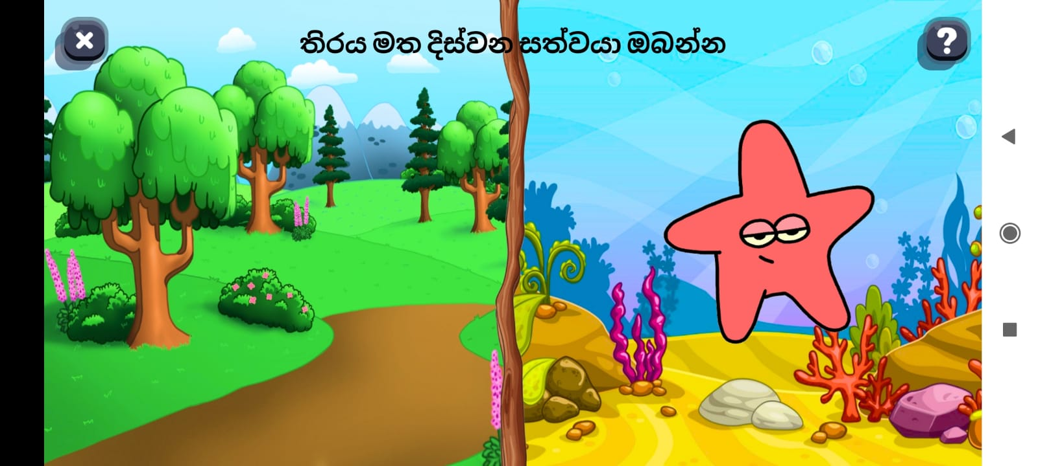
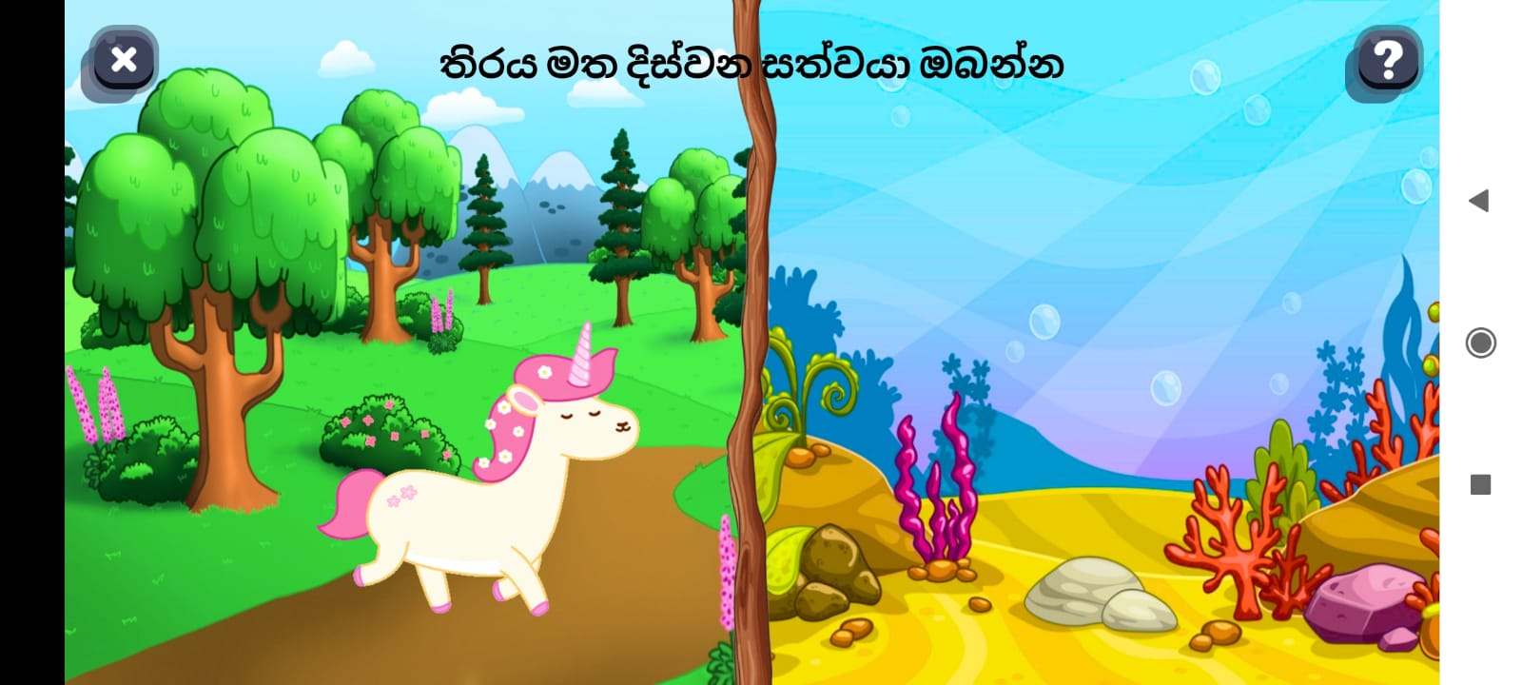
Alternating / Shifting Attention Assessment

Slide 27
Problem Definition & Solution
Development of a model to assess the attention of the child through the selected tasks.
Main Objective
Identifying a series of tasks to assess and train the different aspects of visual attention in young children.
Development of a mobile application to screen for attention impairments in young children and facilitate interventions.
Assessing the aspects of attention of young children using the developed model.
Providing awareness about attention disorders and preliminary guidance via the mobile application.

Slide 28
Problem Definition Cont.
Focused Attention
Focusing on a single visual stimuli
Divided Attention
Focusing a part of their attention on multiple items at the same time.
Selective Attention
Focusing on a specific stimuli while filtering out distactions.
Alternating Attention
Sustained Attention
Shifting attention between two stimuli.
Focusing on a task for a continuous stretch of time.

Slide 29
Thank You!

Slide 30
Data count
Game | 4 years old |  |  | 5 years old
 | Total | Male | Female | Total | Male | Female
Alternating Attention | 11
Divided Attention | 11
Sustained Attention | 8
Focused Attention | 26
Selective Attention | 55

