Slide 1

SMART INDIA HACKATHON 2026
TITLE PAGE
Problem Statement ID – 26006
Problem Statement Title – Development of an Intelligent Freight Forecasting Model for Optimized Vessel Chartering and Bulk Cargo Procurement from overseas to East Coast of India
Theme – Transportation & Logistics
PS Category – Software
Team ID – 153339
Team Name (Registered on portal) – SINISTER SIX

Slide 2
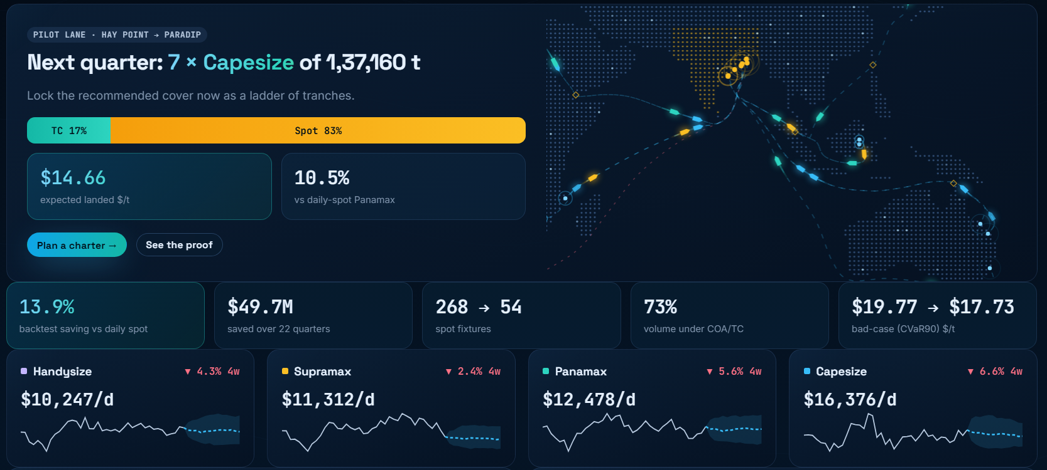
FreightSaarthi
Forecast-driven “Charter Ladder” for SAIL’s coal imports to India’s East Coast
SINISTER
SIX
Proposed Solution (Describe your Idea/Solution/Prototype)
Detailed explanation of the proposed solution
How it addresses the problem
Working prototype (live cockpit)
Forecasts Capesize, Panamax, Supramax & Handysize freight 1–26 weeks ahead as calibrated P10–P50–P90 bands
Checks every ship against load-port, discharge-port and strait limits → real parcel size + binding constraint
Translates forecasts into landed $/t for all 10 origins × 7 East-Coast ports (freight + demurrage + stockyard + lighterage)
Optimises contract mix (COA / period TC / timed spot) and entry timing under risk: min E[cost] + λ·CVaR
Protects operations: idle-time & ballast planning, early warnings for volatility, congestion, cyclones, Red Sea
Delivers a working web app: decision cockpit, 35-endpoint API, audit ledger, real-data upload & retrain
 | Today (daily spot) | With FreightSaarthi
Market entry | Reactive, daily market exploration | Forecast-timed windows, re-solved weekly
Contracts | 268 single spot fixtures | 54 spot; 73% on multi-voyage COA/TC
Vessel type | Habit (Panamax) | Draft-aware optimum per port pair
Idle time | Unplanned waits, ballast legs | Congestion forecast, laycan spacing, relet / JIT
Risk | Surprises after fixing | Early warnings + CVaR-capped exposure
Overview page: next-quarter plan for the pilot lane Hay Point → Paradip, backtest KPIs and class forecasts (FastAPI + SQLite + JS cockpit)
Innovation and uniqueness of the solution
1
Physics-informed freight translator
2
CVaR “Charter Ladder”
3
Draft–Tide–Monsoon twin
4
Honest, decision-focused evidence
5
Broker Quote X-ray + idle manager
6
Audit-ready & real-data-ready
Only 4 class TCEs + bunker are forecast; any lane’s $/t = A·TCE + B·bunker + C → new routes work from day one.
Two-stage stochastic LP decides how much COA / time charter to lock each week (±10% MOLCHOPT, dead-freight, ≤35% per tranche).
Load, discharge & strait drafts (Torres 12.2 m, Suez), LOA/beam, berth DWT, stockyard, lighterage, two-port discharge.
Tuned on money saved, not MAE; walk-forward backtest, placebo market shows no fake edge, bootstrap CIs.
Percentile of any broker quote in the fair-value band; triangulation, relet, JIT slow-steaming, laycan spacing.
Hash-stamped decision ledger + printable charter notes (CVC/CAG); upload SAIL history → full retrain in ~35 s.

Slide 3
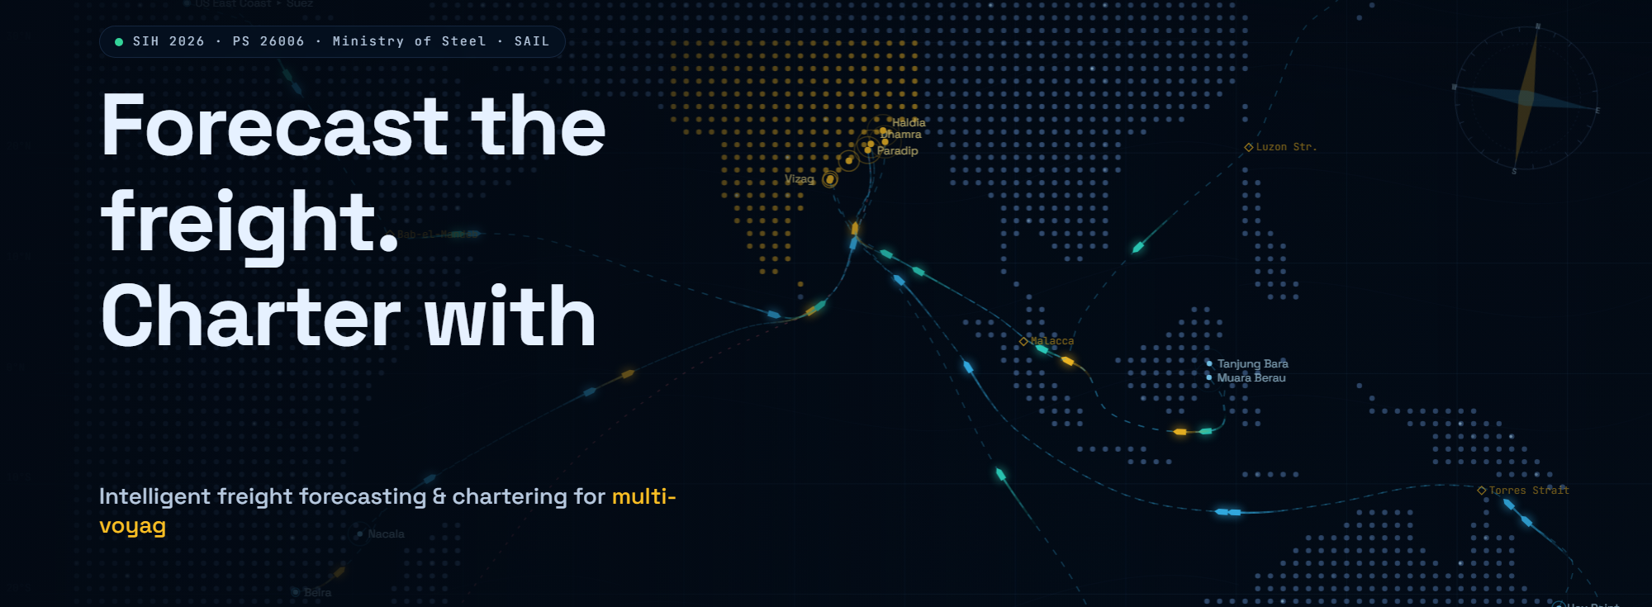
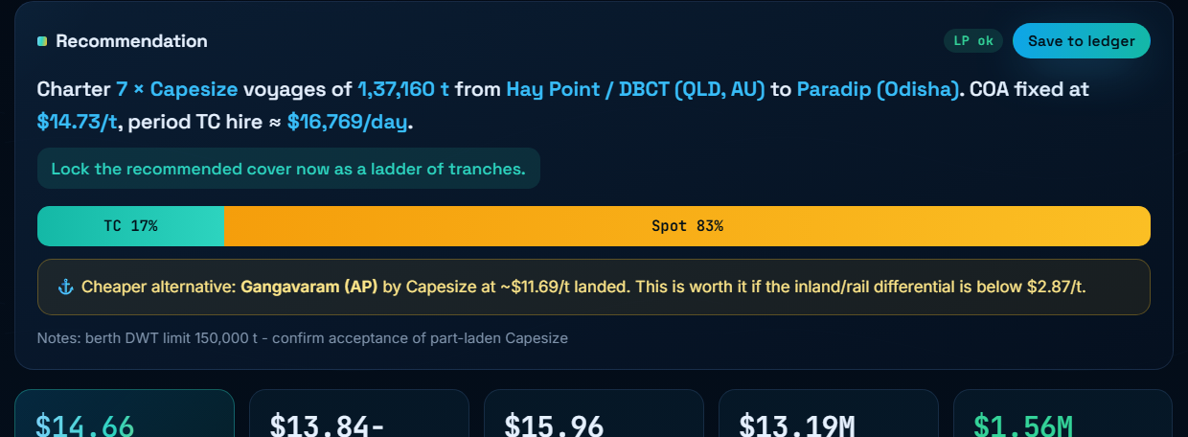
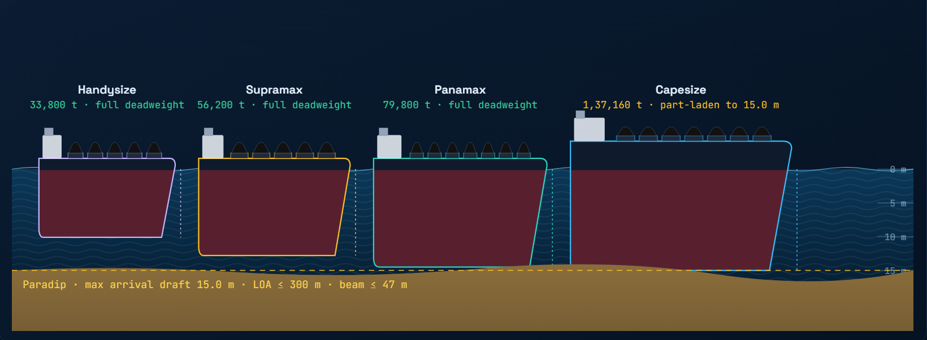
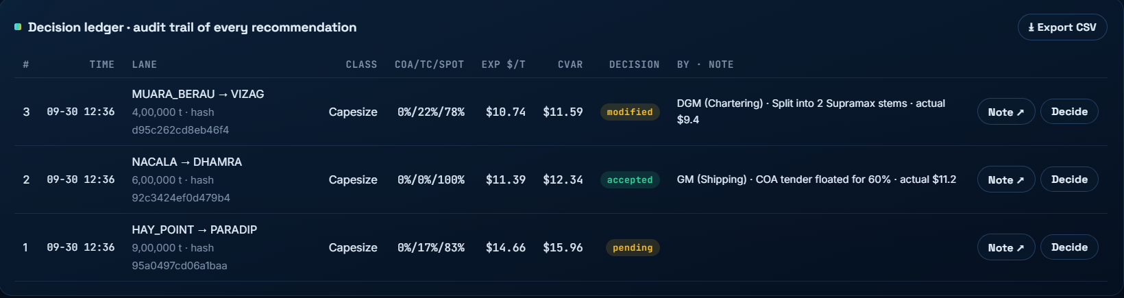
TECHNICAL APPROACH
SINISTER
SIX
Methodology and process for implementation (Flow Charts/Images/ working prototype)
1 DATA
2 FORECAST
3 SCENARIOS
4 FEASIBILITY
5 CHARTER LADDER
6 COCKPIT & LEDGER
Class TCE indices (4 sizes)
Bunker, coal price, China PMI
AIS ballasters, port waiting days
IMD / news events
Port & vessel register
LightGBM quantile (global)
Structural ridge + random walk
Inverse-pinball ensemble
Online conformal (CQR) bands
1–26 wk, refit every 13 wk
Gaussian-copula paths
52 weeks × 4 classes
Bunker & congestion paths
Programme-volume risk
150–300 scenarios
cargo = DWT − TPC·100·ΔT − const
LOA / beam / berth DWT
Torres, Suez, Malacca drafts
Monsoon & stockyard limits
→ landed $/t per lane
2-stage LP (SciPy HiGHS)
min E[cost] + λ·CVaR90
COA / period TC / spot split
Tolerance & dead-freight
≤35% lock per week
Plan, compare, what-if
Broker Quote X-ray
Alerts & idle manager
SQLite audit ledger
Charter note (PDF)
Feedback loop: walk-forward backtest + decision-focused tuning set λ (risk), δ (stopping) and ladder step on a validation period; ledger outcomes (actual fixed rates) recalibrate owner premiums; LP re-solved every week.
Technologies to be used (e.g. programming languages, frameworks, hardware)
Working prototype – screens from the running application
Layer | Technology | Used for
Languages | Python 3.14, JavaScript (ES2020), SQL | Models, API, cockpit
Data & ML | pandas, NumPy, LightGBM, scikit-learn | Quantile GBM, ridge, features
Optimisation | SciPy + HiGHS linear programming | CVaR ladder LP in ~30 ms
Backend | FastAPI, Uvicorn, Pydantic, SQLite | 35 REST endpoints, audit DB
Frontend | HTML5 Canvas / SVG, Plotly.js | Cockpit, lane map, fit simulator
AI (optional) | Claude API structured output; Chronos / TimesFM | News → events; extra member
Hardware | Any laptop / on-prem server, no GPU | Offline, data stays in SAIL
Quality | Automated API test suite (httpx) | 11/11 test groups passing
Landing: live coal lanes, ports & chokepoints
Plan a Charter: vessel, parcel, mix, ladder
Port feasibility: ships settle to port draft
Decision ledger: hash-stamped audit trail

Slide 4
FEASIBILITY AND VIABILITY
SINISTER
SIX
Analysis of the feasibility of the idea
Technical
PROVEN
Data
READY
Full prototype built & tested: 35 endpoints, 11/11 test groups, LP solves in ~30 ms, whole pipeline retrains in 35 s–15 min on a laptop.
Every input has a real or public proxy (IMF PortWatch, World Bank, IMD); CSV upload retrains on SAIL’s own fixture history.
Economic
LOW COST
Operational
FITS PROCESS
Open-source stack, no licence cost except optional Baltic data. Backtest: $49.7 M saved on one 900 kt/quarter lane.
Matches the weekly chartering cadence and tender route: outputs vessel size, tenure, volume and laycan spacing for tenders.
80% band coverage 79–85% (target 80%) · DM test p<0.05 at 1–4 weeks · placebo-market skill ≈ 0 (-2.0 to +1.0%)
Potential challenges and risks → Strategies for overcoming these challenges
# | Challenge / risk | What could go wrong | Strategy for overcoming it
1 | Freight indices are licensed; SAIL history not yet shared | Model trained on proxy data only | Data Hub: validated CSV upload + automatic retrain; public proxies (IMF PortWatch, World Bank); proxy-filled columns labelled
2 | Freight is hard to predict beyond 8–12 weeks | Over-confident lock-ins | Calibrated conformal bands, CVaR penalty, ≤35% per ladder tranche, weekly re-solve, placebo & ablation checks
3 | Port limits change (dredging, tides, monsoon) | Wrong vessel, part cargo, idle berth | Constraint register with confidence + ‘verify_with’ source, monsoon draft deltas, congestion & draft alerts
4 | COA / TC availability and owner premiums | Quoted price differs from model | Quotes modelled as distributions; ledger records actual fixed rates to learn real premiums
5 | PSU procurement & audit rules | Recommendations not actionable | Outputs tender specifications, not bypasses; hash-stamped ledger + printable charter notes for CVC/CAG
6 | Desk trust and change management | Tool ignored in practice | Shadow mode first, ‘why this recommendation’ explanations, what-if levers, one-click scenario comparison

Slide 5
IMPACT AND BENEFITS
SINISTER
SIX
13.9%
$49.7 M
268 → 54
$20.6 → $17.7
lower landed freight vs daily spot
90% CI 11.4–16.3%
saved over 22 quarters on one 900 kt/quarter lane
67% of perfect-foresight saving
single spot fixtures (−80%)
73% of volume on multi-voyage COA/TC
bad-quarter freight, $/t (CVaR90)
cheaper than today in 100% of quarters
Walk-forward backtest, Hay Point (Queensland) → Paradip, test period 2021–mid 2026, synthetic market data: demonstrates the method, not realised SAIL savings.
Potential impact on the target audience
Stakeholder | Impact
Chartering desk | From daily market-chasing to a weekly plan; Quote X-ray strengthens every negotiation
Head of Shipping / Procurement | Multi-voyage COA/TC strategy with tender timing, tenure and volume specifications
Finance / CFO | Predictable freight budgets; freight per t of hot metal ($11.43) and CVaR as KPIs
Steel plants (Bokaro, Rourkela, Bhilai…) | Reliable coal arrivals, fewer stock-outs and demurrage days
Ports (Paradip, Dhamra, Haldia…) | Laycan spacing avoids berth bunching and anchorage queues
Auditors (CVC / CAG) | Every recommendation stored with input hash, data version and officer decision
Benefits of the solution (social, economic, environmental, etc.)
Economic
Social & governance
Environmental
Lower and steadier $/t freight; fewer demurrage and idle days
Freight-adjusted FOB break-even sharpens origin choice for procurement
Scales to every origin × East-Coast port with no route-specific model
Transparent, auditable PSU decisions (charter notes, ledger)
In-house analytics capability (Aatmanirbhar), no vendor lock-in
Supports National Steel Policy 2017 target of 300 MTPA by 2030-31
JIT slow-steaming ≈ 380 t fuel & ≈ 1,180 t CO2 saved per 6-day Capesize idle window
Right-sized parcels and fewer ballast legs cut emissions per tonne
Supports IMO CII (carbon-intensity) compliance of chartered ships

Slide 6
RESEARCH AND REFERENCES
SINISTER
SIX
Details / Links of the reference and research work
Methods & research
[1] Rockafellar, R.T. & Uryasev, S. (2000). Optimization of Conditional Value-at-Risk. Journal of Risk 2(3), 21–41. CVaR ladder
[2] Romano, Y., Patterson, E. & Candès, E. (2019). Conformalized Quantile Regression. NeurIPS. arxiv.org/abs/1905.03222 calibrated bands
[3] Ke, G. et al. (2017). LightGBM: A Highly Efficient Gradient Boosting Decision Tree. NeurIPS. quantile GBM
[4] Diebold, F.X. & Mariano, R.S. (1995). Comparing Predictive Accuracy. J. Business & Economic Statistics 13(3). DM test
[5] Elmachtoub, A. & Grigas, P. (2022). Smart “Predict, then Optimize”. Management Science 68(1). decision-focused tuning
[6] Huangfu, Q. & Hall, J.A.J. (2018). Parallelizing the dual revised simplex method. Math. Prog. Computation 10 (HiGHS). LP solver
[7] Ansari, A.F. et al. (2024). Chronos, arxiv.org/abs/2403.07815; Das, A. et al. (2024). TimesFM, arxiv.org/abs/2310.10688 foundation plug-in
[8] Stopford, M. (2009). Maritime Economics, 3rd ed. Routledge. freight economics
Data & domain sources
[9] Baltic Exchange dry-bulk indices (BCI, BPI, BSI, BHSI): balticexchange.com freight
[10] IMF PortWatch, AIS-based port calls & disruptions: portwatch.imf.org congestion
[11] World Bank Commodity Price Data (Pink Sheet): worldbank.org/en/research/commodity-markets coal prices
[12] India Meteorological Department, RSMC New Delhi cyclone bulletins: mausam.imd.gov.in cyclone alerts
[13] Paradip Port Authority (paradipport.gov.in); SMP Kolkata-Haldia, Dhamra, Gangavaram, Vizag port handbooks draft/LOA limits
[14] Ministry of Steel, National Steel Policy 2017: steel.gov.in · [15] IMO Fourth GHG Study 2020 & CII rules: imo.org policy / emissions
Our work
[16] FreightSaarthi source code, design document, demo script & API: github.com/Anuttaman216/PS2 prototype
Data provenance used in the prototype
Input | Real source | Prototype status
Class TCE indices | Baltic Exchange / brokers | Synthetic → CSV upload
Bunker, coal, PMI | Ship & Bunker, World Bank, NBS | Synthetic, proxy-ready
Port congestion | IMF PortWatch, port reports | Synthetic, proxy-ready
Port / vessel limits | Port handbooks, Equasis | Assumption, flagged
Weather / news | IMD RSMC, news feeds | Rule / LLM extraction
Every assumed number carries a confidence tag and a ‘verify_with’ source in the constraint register; real data replaces synthetic through the Data Hub without code changes.

