Slide 1
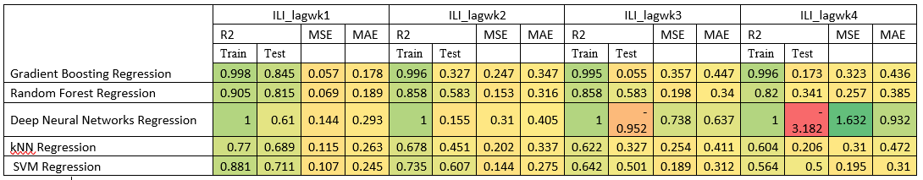
Summary STAT
Summary Table 1. r_score(R2), Mean Squared Error(MSE), Mean Absolute Error(MAE) with all 133 features vectors

Slide 2
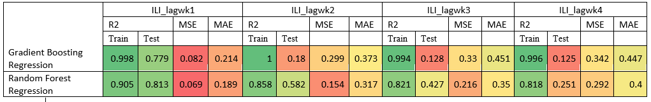
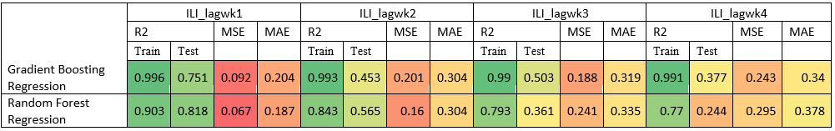
Summary STAT
Summary Table 1. R_score, MSE, MAE with all 74 features vectors
Summary Table 1. R_score, MSE, MAE with all 20 features vectors

Slide 3
If we had more time

Slide 4
If we have more time
Creating an ensemble learners
Ensemble models in machine learning combine the decisions from multiple models to improve the overall performance.
Make the learner we have got better

Slide 5
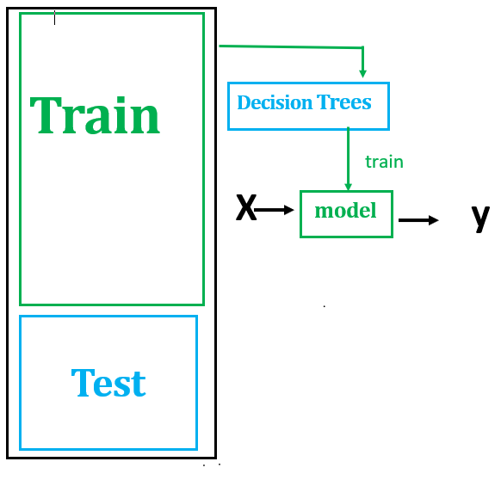
If we have more time
Its not create a new algorithm
but instead assembling together several different algorithms/several different models to create an ensemble learner.
What this means
we create 1 learner first

Slide 6
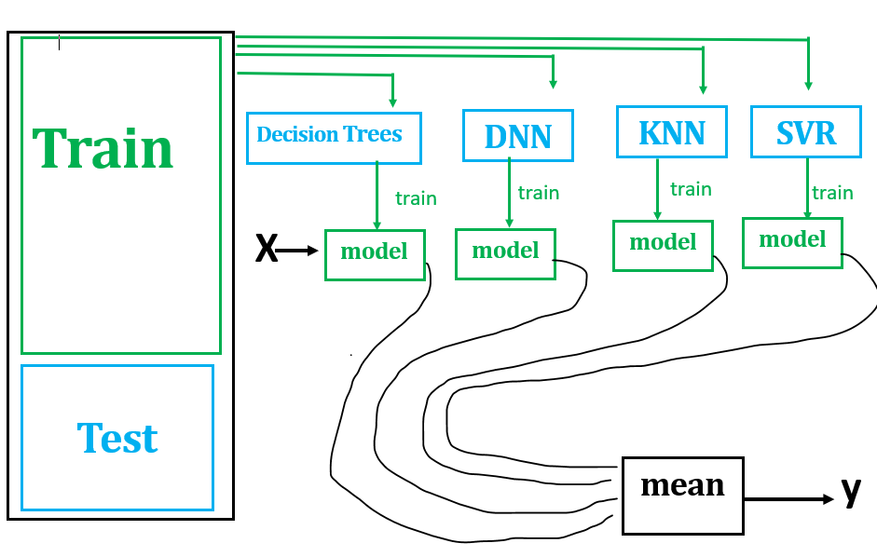
If we have more time
We have 5 different learners/models
To query this ensemble of learners we query each model by itself and combine the answers
To do this we plugged each model with the same X and then we got our ys (ILI lag weeks in our case)
We have the y output for each models

Slide 7
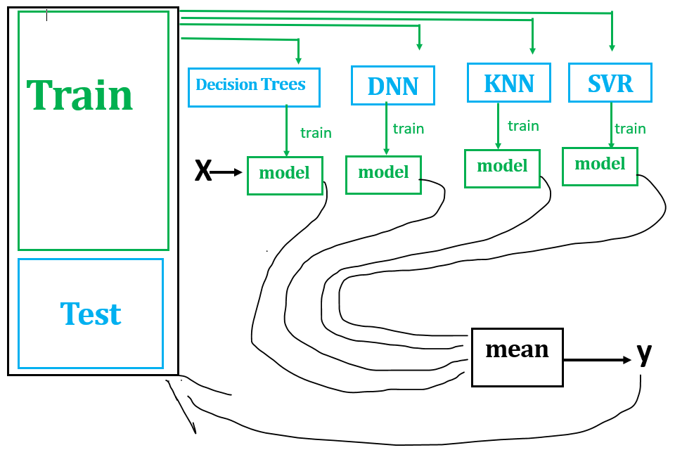
If we have more time
How do we combine them
Classification:- make each of these vote on what is it.
➔But we did regression
Typical thing to do here is to take the results of this ensemble learner(mean ➔ y).
We can test this overall ensemble learner using this test data we set aside.
Make learners vote on one another and select the best model.

