Slide 1
Its all about Influenza
flu

Slide 2
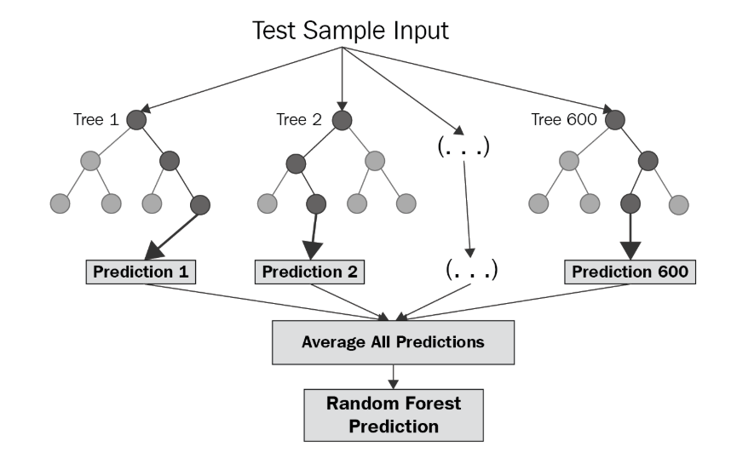
random forest regression
ddddddddddddddddd

Slide 4
random forest regression
ddddddddddddddddd

Slide 5
Gradian Boost regression
random

Slide 6
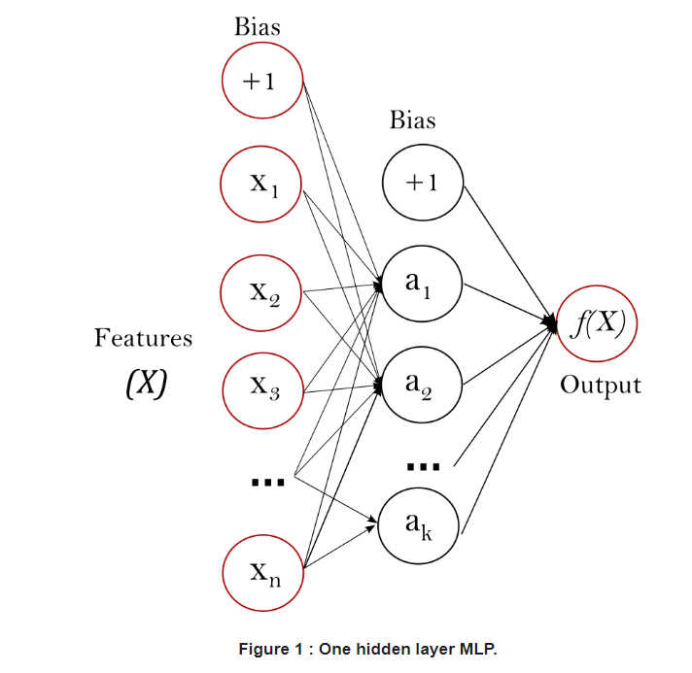
Neural network: Multi-layer Perceptron (MLP)
The leftmost layer, known as the input layer
consists of a set of neurons {xi|x1,x2,...,xm} representing the input features.
Each neuron in the hidden layer transforms the values from the previous layer with a weighted linear summation w1x1+w2x2+...+wmxm,
followed by a non-linear activation function g(⋅):R→R - like the hyperbolic tan function.
The output layer receives the values from the last hidden layer and transforms them into output values.

Slide 7
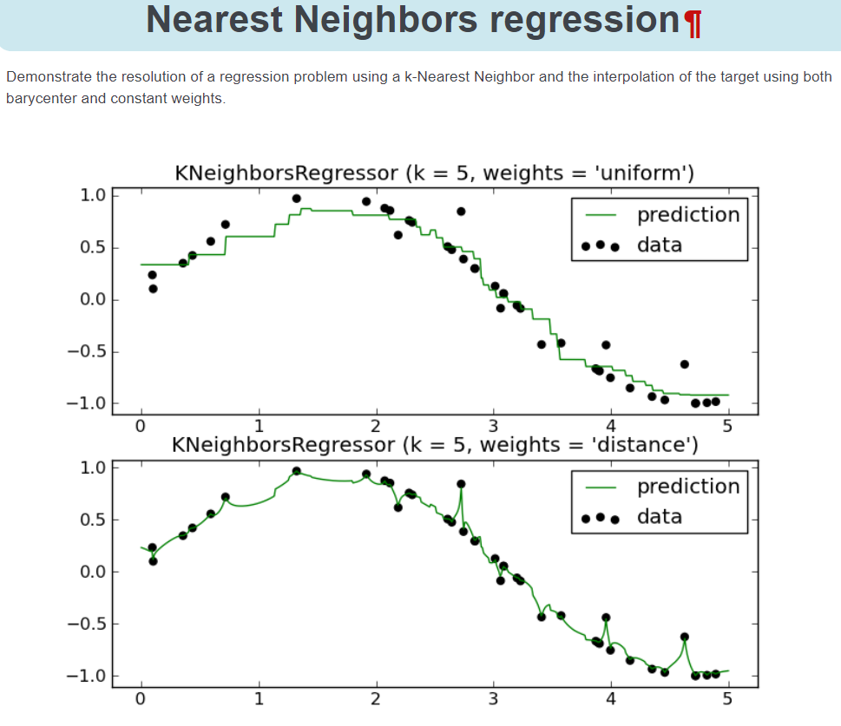
K-Nearest Neighbors (KNN)
is a non-parametric, lazy learning method used for classification and regression.
non-parametric, it means that it does not make any assumption of the data distribution
lazy learning is a learning method in which generalization of the training data is delayed until a query is made to the system. In other words, there is no explicit training stage, or it is very minimal, which also means that training is very fast in KNN.
Toutput
majority vote (for classification)
mean (or median, for regression) of the k-nearest neighbors in the feature space

Slide 9
If we have more time

Slide 10
If we have more time
Creating an ensemble learners
Ensemble models in machine learning combine the decisions from multiple models to improve the overall performance.
Make the learner we have got better

Slide 11
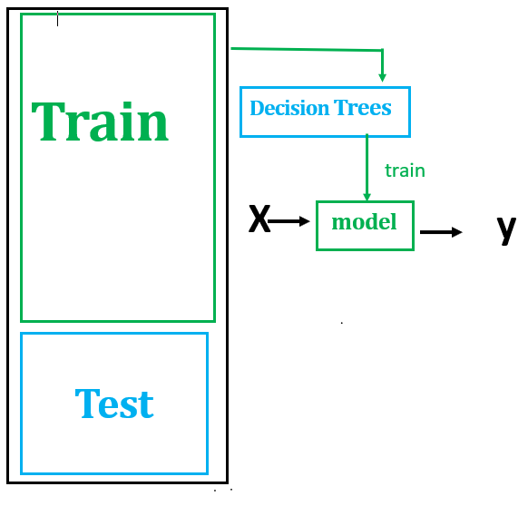
If we have more time
Its not create a new algorithm
but instead assembling together several different algorithms/several different models to create an ensemble learner.
What this means
we create 1 learner first

Slide 12
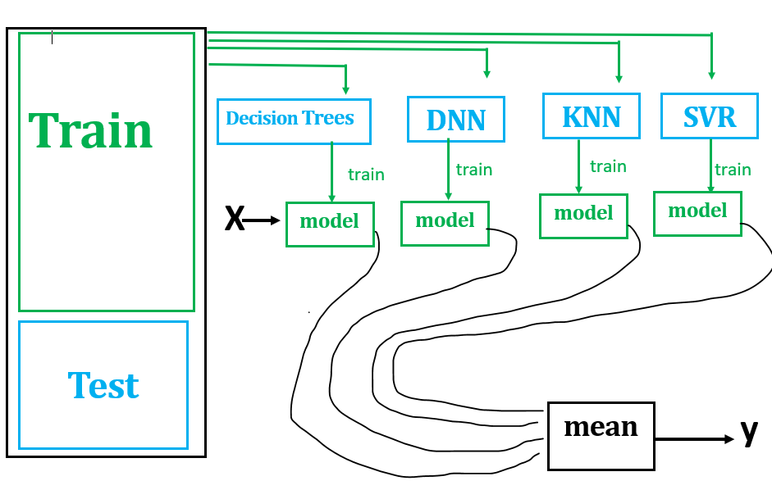
If we have more time
We have 5 different learners/models
To query this ensemble of learners we query each model by itself and combine the answers
To do this we plugged each model with the same X and then we got our ys (ILI lag weeks in our case)
We have the y output for each models

Slide 13
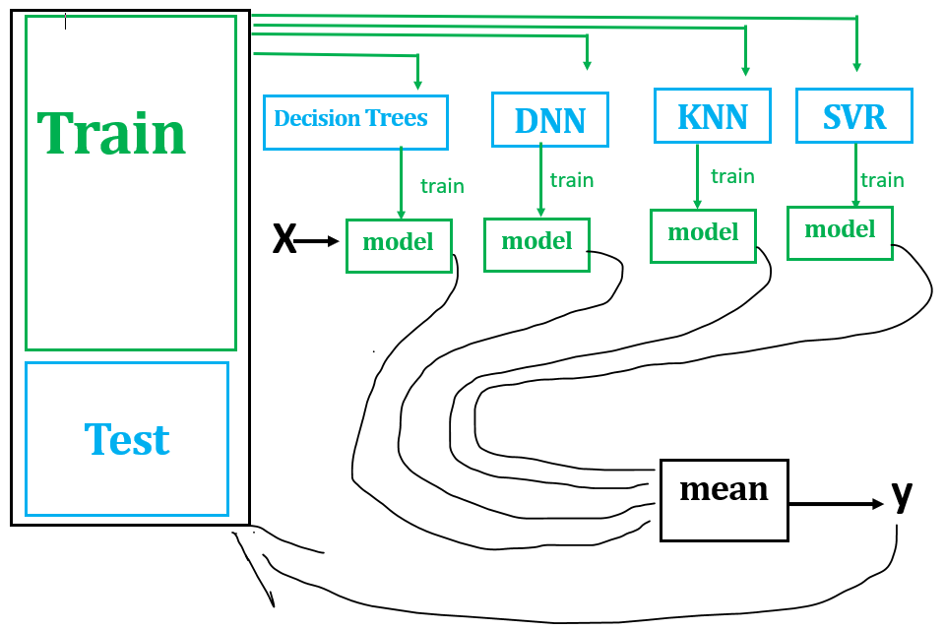
If we have more time
How do we combine them
Classification:- make each of these vote on what is it.
➔But we did regression
Typical thing to do here is to take the results of this ensemble learner(mean ➔ y).
We can test this overall ensemble learner using this test data we set aside.
Make learners vote on one another and select the best model.

