Slide 1
INHA University IN Tashkent Department of cse & ice 3020 – operating systems auction
Team Leader:
Bokhodir Urinboev U1610249
Members:
Anvarjon Yusupov U1610026
Boburjon Iskandarov U1610054
Dostonjon Sukhrobov U1610064
Oybek Amonov U1610176
Rakhmatjon Khasanov U1610183

Slide 2
OUtline
Abstract U1610249
Introduction U1610026
Project Overview U1610054
Requirements definition U1610176
Project Design & Implementation U1610064
Results & Discussions U1610183
Conclusion U1610249
Future Work U1610249
References

Slide 3
abstract
Automation and changing the process to the digital world makes everything easier to handle. So, now let’s see what happens beyond the cover of the system.
Our system mainly handles the process of auction, like the work of the organizers are handled by server-side and clients are supported in client-side of the software. Server-side mainly handles the database manipulation, connection with clients, process input from clients, send/receive responds, and of course money transaction and process it. Client-side is much plain to understand in our software, as it handles only connection, process responds from server, send/receive responds, money transaction.
In other words, the admin (in our case, there is only server who covers for an admin) get request for the auction to the specific good, he/she adds the good to the database and server sets up the date for the auction and notifies the client about this. So the auction begins then starting price is announced, then users raise the price and wait till the end of the process. And so it goes on.
We can claim that we can use our software in real world as nowadays even auctions and tenders are held on-line without going out the house. This is just demo version, further we can extend to the real alpha product adding additional features and improve the stability and performance.

Slide 4
introduction
From the period of 1995 to 2000 online auctions gone from nothing to the functional methods used by the millions of people from various industries. The factual example of the development of this system was introduced by the information list provided by Yahoo in 1998 which explained that the number of the automatized auctions were about the 90 and in comparison to the number in current time the list is much bigger than existed ones.
Auctions made great success among the other forms of electronic commerce methods which is used in the industry. The functions that does exist in online auctions has obvious advantages over the local off-line ones as their functional process does not follow with automatized steps and highly vulnerable for the simple human factors and auction process physical destructions.
The online environment is conductive for the auctions in an online environment because of the following properties. The network supports dynamic communication which makes the management of the protocols involving unknown number of participants. Unlike physical concentration of misunderstandings and shout at the room made by the traders the network auction mediator can have direct access on the information of the participant and control with the process within the auction rules.

Slide 5
introduction
The case with online auctions make the process to be running in a real-time as in sense that off-line auctions tend to be which makes the identification of the participant easier and faster broadcast of the bids message (multicast communication protocols) Therefore, the widespread of the online auction protocols are not surprising in current moment.
All the functions including the participants’ identification in the beginning of the auction and the message notification while bid accepted or rejected by the participants and real – time monitoring control over the process of the auction procedures included in the system of the application that our team presenting in this report.

Slide 6
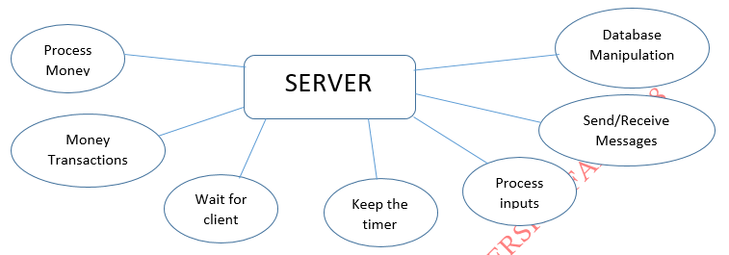
Project Overview

Slide 7
Project Overview
Database Manipulation - all the information on the goods are stored in server database. When the session starts all information is accessed and be ready to process. We used SQL server to hold the database. The database has the following tables: visa_card(for money transactions operation journaling), bid(for recording information on successful biddings and the bidders), lot(information on lots are stored in this table), and client(information on clients are stored here).
Wait for client – as soon as server is in running state, it will wait for client connection. As in auction new client can come at any time, wait for client function will always wait for new clients.
Send/Receive Messages – our application will be working on messaging concept, all the time server will receive responds from users, and send new requests for users on new prize(bids), acknowledgement about auction process and goods.
Process inputs – as soon as server receives responds from user, it processes the input, validate it (if new prize is more than previous), if no new prize is not proposed this prize is accepted.
Keep the timer – when prize is proposed by client, time is now checked. If no increase in prize is received by server, the good will be sold.
Money transactions – as soon as the good is sold, money transaction process starts, server will wait for the right client to send money.
Process money - when received, the money will be processed in server side, taking some interest rate, and send to good owner.

Slide 8
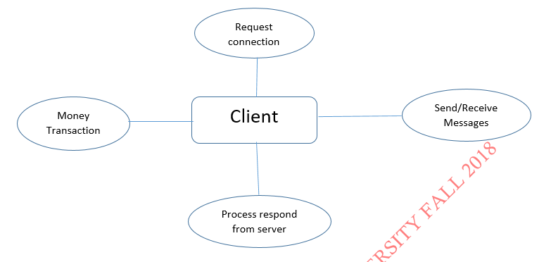
Project Overview

Slide 9
Project Overview
Request connection – to participate in auction user has to get connected to the server first, to do that request connection to server.
Send/Receive Messages – client listens to the server to receive about auction acknowledgement, prizes, goods information and etc.
Process responds from server – when information is received, it should be displayed to the user, and process the respond back to the server as soon as client decides to accept/refuse to buy the good
Money Transaction – if client buys the good, money should be sent to the server-side so the money is delivered to the good owner.

Slide 10
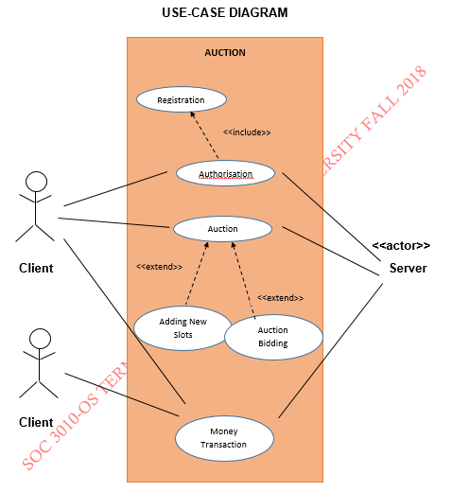
Requirements definition
The use-case diagram above describes main features and operations of our system called AUCTION. So, there are only 5 main functionalities that has to be carried out. They are Authorisation (Registration included and Login), Money Transaction, and Auction(Adding new lots and Auction Bidding) itself. Authorisation has two actors namely CLIENT and SERVER. The Authorisation use-case describes the process of the logging into the application. However, we all know that in all application one can register themselves as customer. Thus, we need a registration as well, so Authorisation includes into it the Registration too. The Auction use-case has the same, CLIENT and SERVER, actors. Auction use-case includes ADDING NEW LOTS and AUCTION BIDDING into it. The last use-case MONEY TRANSACTION has three actors, two clients OWNER, AUCTION PARTICIPANT, and SERVER.

Slide 11
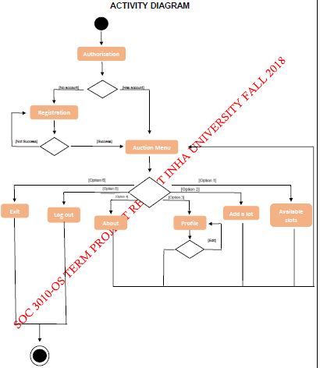
Requirements definition
The activity diagram describes the whole process where a client is offered the services we provided. Firstly, client has to pass the authorisation part. Assuming client has an account, he/she can successfully pass the authorisation part. A client can choose to register unless they do not have an account. A registration process will last until a client can register successfully. Registration may fail if the username of a new client is already existing in the database. After a successful authorisation, client is taken to the main menu, where user has 6 options. User can choose either to ask for available lots, adding a lot, see a profile, or a ABOUT part, and to LOG OUT or EXIT. Choosing first option user can see all lot for sale and can participate if wish. And, later come back to the main menu again. Option 2 offers the users to add their lots for sale, they are asked to provide some information on that and confirm the request. User is then taken to main menu again as in previous option. Option 3 enables the capability of showing the user their profile information which is requested from the server if chosen this option. User can either go back to main menu or choose to edit their profile information. Option 4 is given to see information on the organization and developer’s team. Last two options, namely 5 and 6, are given to come out the application. Choosing LOG OUT, user is logged out and taken to AUTHORISATION window. When a user chooses the EXIT option, application is to be terminated.

Slide 12
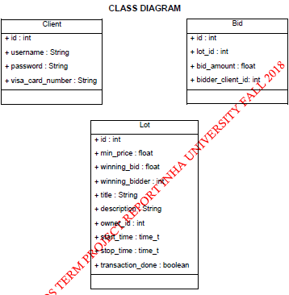
Requirements definition
The class diagrams show the structure we used to define our real-world entities. In our auction software, we work with clients, their lots, and the information on bids. So we have created above defined structures to store them. Client has own id, username, password, and visa card to pay for the lot they bought. When it comes to bidding, we need to know the which lot is being sold, its price, and who offers the price. The biggest entity in our diagram is lot itself, as you can see above. When a lot considered, it has its own id, minimum price, price of selling, who offered the price, information on lot (title, description, time for auction), and whether money transaction has been made after the auction.

Slide 13
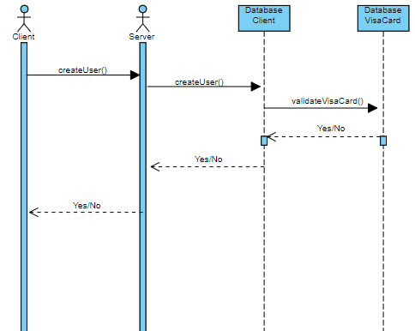
Requirements definition
The diagram on the right depicts the behaviour of the client and server when a new user is to be created. Client requests the server to accept it as a new user. Server in turn checks the database for ambiguity between username, and whether the card of the user is valid. Then, Server responds to the client accordingly.

Slide 14
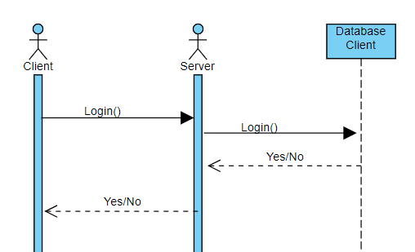
Requirements definition
The diagram is for logging in process. User inserts the login information, and requests for the login. Server checks for the existence of the user, and responds to client accordingly.

Slide 15
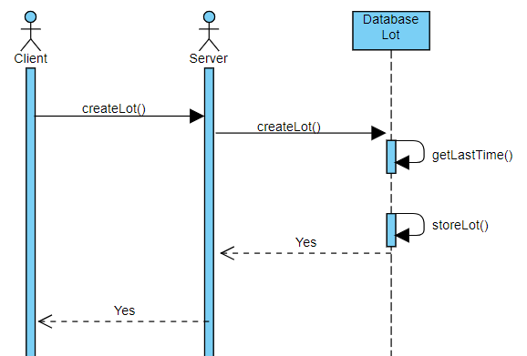
Requirements definition
Sequential diagram below describes the behavior while creating a new lot. Client requests for accepting the lot, and server takes the lot information and assigns the lot time according to the earliest possible time after checking the last auction time.

Slide 16
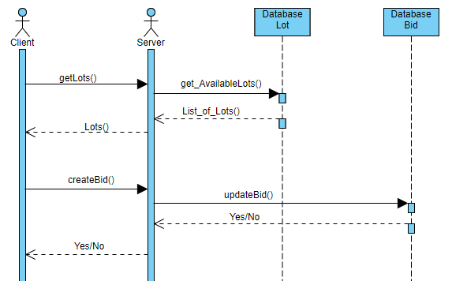
Requirements definition
The behavioural diagram below shows the sequence of operations performed while actual auction happens. User asks for the available lots to choose. After choosing the lot, user takes part in an auction and possibly bids. Server handles the bidding after getting the request from the client

Slide 17
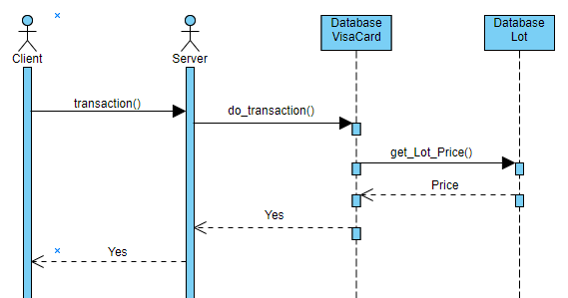
Requirements definition
The diagrams describes the process of money transaction between a server and a client after an auction. User requests server for the transaction to occur. And, server does the job by accessing the database and calculating the money to be transferred to the lot owner and the amount to be charged

Slide 18
Project Design & Implementation
Design of the project was made with a help of GLADE and GTK (graphical toolkit). The graphical user interface of the application of the client side was fully written in C language and was linked with CSS (stylistic user interface scripting language) standard. The utilization of the GTK (graphical toolkit) was realized thanks to the libraries that does exist in documentation of the toolkit. The functionality of the client side gives an opportunity for the users to control over the processes of the lot availability and their personal information.
The first side that users face while using the application is the identification window. This step of identification is divided in two parts from which the first is “Login” part which is used for checking the registration of the existing user information.

Slide 19
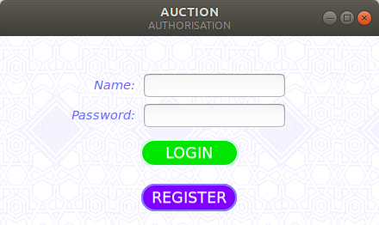
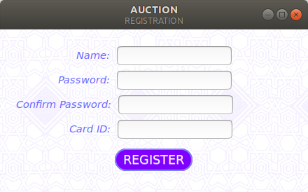
Project Design & Implementation
The “Authorization” window gives two input boxes for the user one is “Name” and the second is “Password” where the user enters the information which is required for the authorization of the existing user (only in case of the user’s choice in “Login”).
In case of the choice with “Register” button the user will be asked to enter the information for adding it to the database.

Slide 20
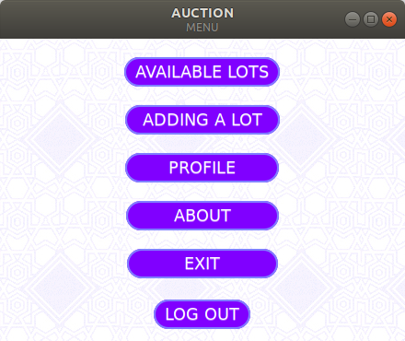
Project Design & Implementation
In case “Login” is successful by already registered user, the new window of the “Menu” window will be opened. The menu window consist of “Available lots” ,”Adding a lot”, “Profile”, ”About”, “Exit” and “Log out”.

Slide 21
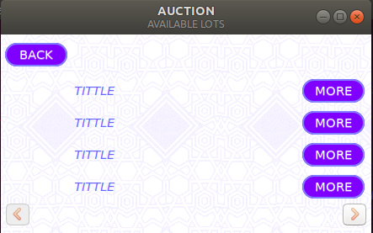
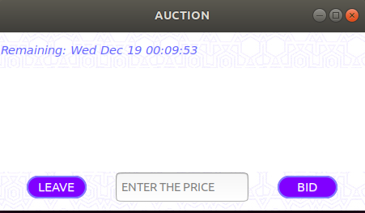
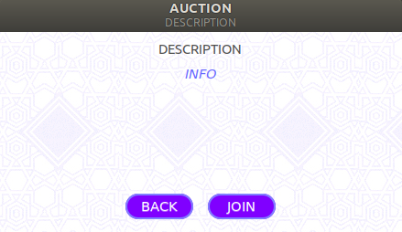
Project Design & Implementation
“Available lots” give the user an opportunity for controlling the process over the availability checking within the process of auction. And, assuming the client chooses this option, all lots for auction are received from the server and displayed on the screen as a list.

Slide 22
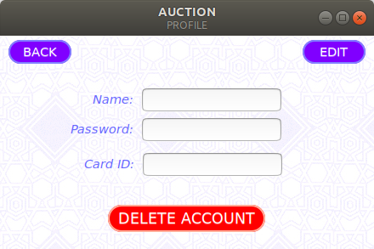
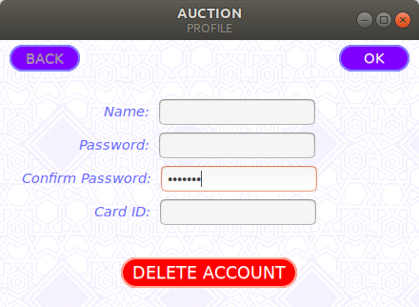
Project Design & Implementation
In the “Profile” section of the “Menu” user is able to check the information which was provided by the user himself/herself beforehand. In this window the user is able to modify, add or delete the information of the user.

Slide 23
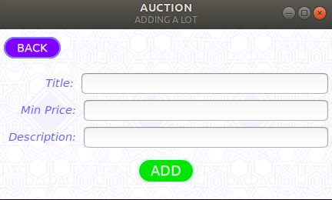
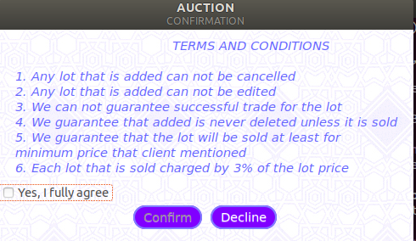
Project Design & Implementation
The window on the right is the GUI for an adding lot option of the main menu. User can input the required fields and press ADD button. And, user is taken to CONFIRMATION window, where a user is asked to confirm the operation after getting familiar with the TERMS & CONDITIONS.

Slide 24
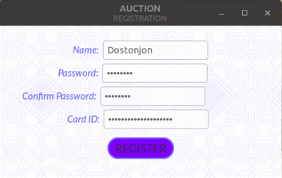
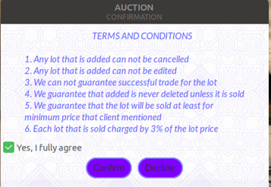
Results & Discussions
From now on we will look at the what our team has achieved after weeks’ of implementing the system.
In the picture on the right , a user with name Dostonjon wants to register himself. He provided the required information, and presses the REGISTER button.
Afterwards, he is taken to the CONFIRMATION window, where TERMS&CONDITIONS is listed. User can either accept the terms or decline it. In case declining, user is not registered.
However, if user accepts, his information is first checked for ambiguity among users and visa card validity. Above information was not in the database, and client is new, also he has a valid visa card.
Thus, he is successfully registered and taken to the Main Menu.

Slide 25
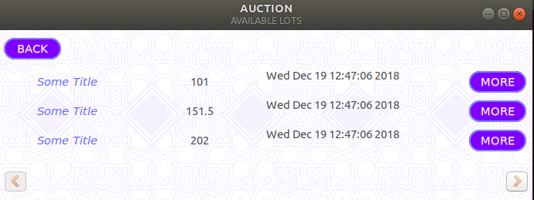
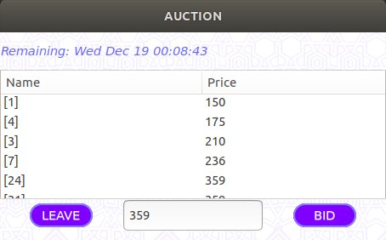
Results & Discussions
Assuming that user wants to participate in an auction, he can choose the AVAILABLE SLOTS and the above picture will appear with all available slots. User can choose to see more on the offered lot by clicking the MORE button and join the auction.
The below picture depicts the actual auction bidding process. Each client connected to server is given an ID, it is in column name in brackets. And, next to the name column there is a price column where each client gives a bid. The rule for bidding is that only when a client offers a price which is greater than previous bid, the current bid is accepted otherwise it is not accepted.

Slide 26
Conclusion
In our discussion part, we consider to be right only to discuss the main functionalities. Other parts, we are going to discuss in the Demo part of our presentation.
In the end of the project’s team work, we have made complete working auction which does have fully functional application based functions and features on the open source operating system Linux Ubuntu and all the tools related with it additionally a combination of C language, MYSQL and CSS
The GUI and the client side is also fully functional with presenting the user to monitor the availability of the lots and also giving the opportunity to add their own lot for the beginning of the new auction.
The overall result is good enough for even its release as we are quite confident for its functionality and overall operational work.

Slide 27
Future Work
For the upcoming years our team together is going to continue developing this technology toward the high industrial standard for making it to be ready for the utilization in the open market
The principal issue that we have currently is that the absence of the multi-thread synchronization system in work.
We planned to connect the application to the existing money transaction system while we could not manage time for the realization of this functionality and therefore decided to plan this part of the application for the future implementation.
Also, we planned to connect the application to the existing money transaction systems like PayPal, Payme or Click. Unfortunately, we could not manage time for the realization of this functionality and therefore decided to include this part of the application for the future implementation.

Slide 28
references
[1]. http://dev.mysql.com
[2]. https://www.w3schools.com/colors/colors_picker.asp
[3]. https://stackoverflow.com/questions/5141960/get-the-current-time-in-c
[4]. https://stackoverflow.com/questions/8352027/gtk-timer-how-to-make-a-timer-within-a-frame
[5]. https://www.geeksforgeeks.org/socket-programming-in-cc-handling-multiple-clients-on-server-without-multi-threading/
[6]. https://gist.github.com/oleksiiBobko/43d33b3c25c03bcc9b2b
[7]. https://www.relationaldbdesign.com/extended-database-features/module1/course-database-project.php
[8]. https://developer.gnome.org/gtk3/stable/GtkListStore.html
[9]. https://habr.com/post/116268/
[10]. https://prognotes.net/2015/07/gtk-3-glade-c-programming-template/
[11]. https://prognotes.net/2016/03/gtk-3-c-code-hello-world-tutorial-using-glade-3/
[12]. https://ubuntuforums.org/archive/index.php/t-1176046.html
[13]. https://developer.gnome.org/gtk3/stable/TreeWidget.html

