Slide 1
HDD ( hard (magnetic) disk drive)
Secondary memory storage device
By Anvar Adylov

Slide 2
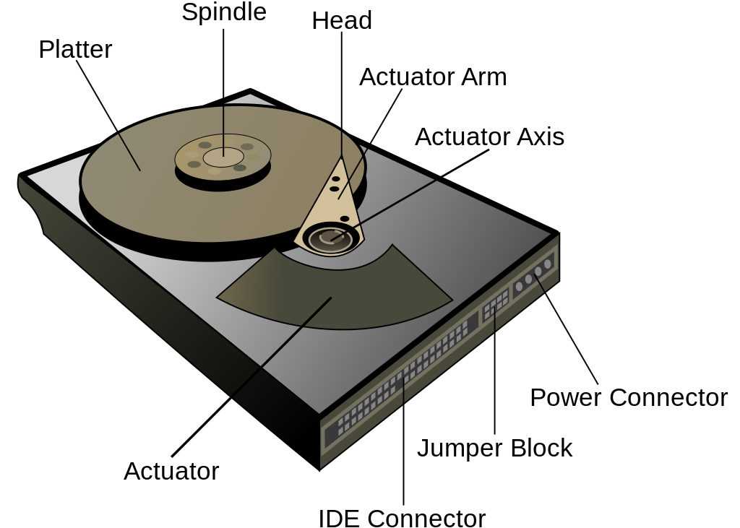
HDD major components

Slide 3
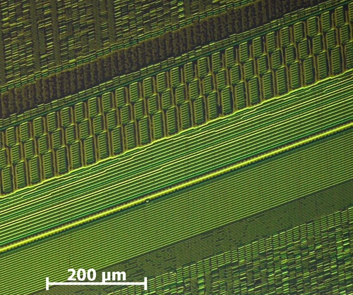
200MB HDD under microscope

Slide 4
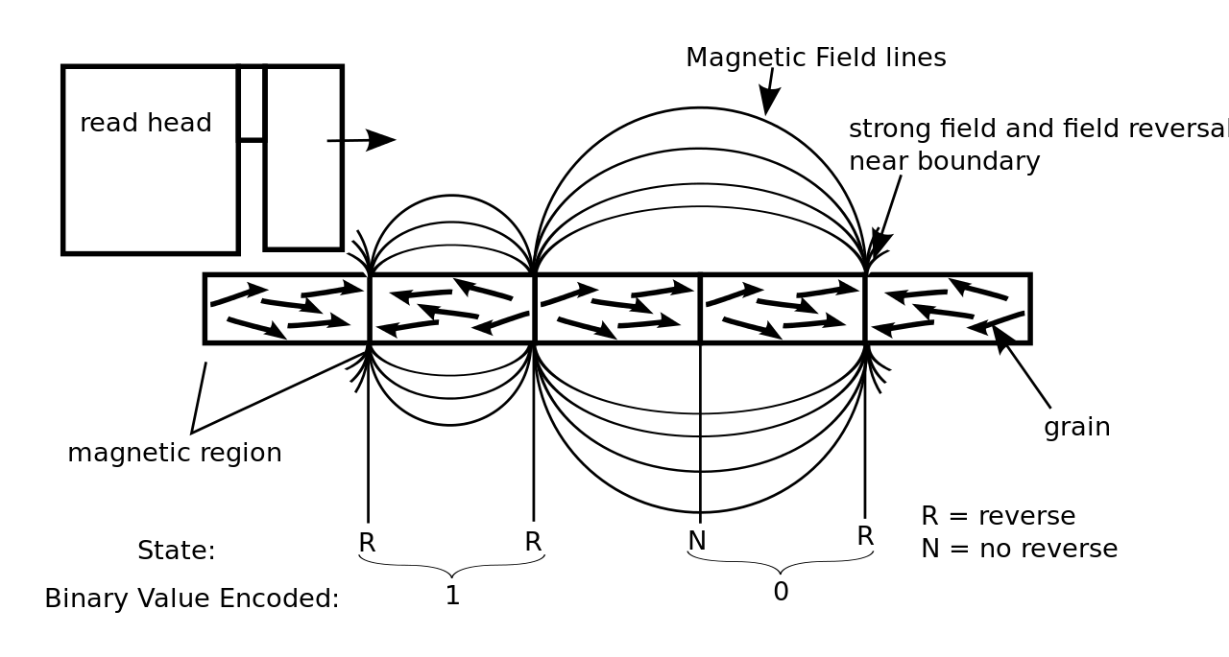
How data is read out of the HDD on platter

Slide 5
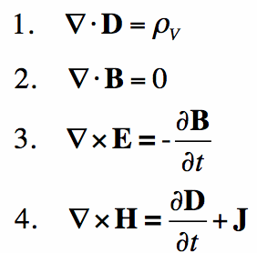
Thank you for your attention

Slide 6
Reference list
Kean, David W., "IBM San Jose, A quarter century of innovation", 1977.
Arpaci-Dusseau, Remzi H.; Arpaci-Dusseau, Andrea C. (2014). "Operating Systems: Three Easy Pieces, Chapter: Hard Disk Drives" (PDF). Arpaci-Dusseau Books.
Patterson, David; Hennessy, John (1971). Computer Organization and Design: The Hardware/Software Interface. Elsevier. p. 23. ISBN 9780080502571.
Domingo, Joel. "SSD vs. HDD: What's the Difference?". PC Magazine UK. Retrieved March 21, 2018.
Mustafa, Naveed Ul; Armejach, Adria; Ozturk, Ozcan; Cristal, Adrian; Unsal, Osman S. (2016). "Implications of non-volatile memory as primary storage for database management systems". 2016 International Conference on Embedded Computer Systems: Architectures, Modeling and Simulation (SAMOS). IEEE. pp. 164–171. doi:10.1109/SAMOS.2016.7818344. hdl:11693/37609. ISBN 978-1-5090-3076-7.
"IBM Archives: IBM 350 disk storage unit". Retrieved October 19, 2012.
"Validating the Reliability of Intel Solid-State Drives" (PDF). Intel. July 2011. Retrieved February 10, 2012.
Fullerton, Eric (March 2018). "5th Non-Volatile Memories Workshop (NVMW 2018)" (PDF). IEEE. Retrieved April 23, 2018.
Handy, James (July 31, 2012). "For the Lack of a Fab..." Objective Analysis. Retrieved November 25, 2012.
Hutchinson, Lee. (June 25, 2012) How SSDs conquered mobile devices and modern OSes. Ars Technica. Retrieved January 7, 2013.
Santo Domingo, Joel (May 10, 2012). "SSD vs HDD: What's the Difference?". PC Magazine. Retrieved November 24, 2012.
Hough, Jack (May 14, 2018). "Why Western Digital Can Gain 45% Despite Declining HDD Business". Barron’s. Retrieved May 15, 2018.
"Time Capsule, 1956 Hard Disk". Oracle Magazine. Oracle. July 2014. Retrieved September 19, 2014. IBM 350 disk drive held 3.75 MB
"Ultrastar Hs14". HGST. Retrieved October 7, 2017.
15,000,000,000,000 divided by 3,750,000.
"Toshiba Storage Solutions – MK3233GSG".
68 x 12 x 12 x 12 divided by 2.1 .
910,000 divided by 62.
600 divided by 2.5 .
Ballistic Research Laboratories "A THIRD SURVEY OF DOMESTIC ELECTRONIC DIGITAL COMPUTING SYSTEMS," March 1961, section on IBM 305 RAMAC (p. 314-331) states a $34,500 purchase price which calculates to $9,200/MB.
John C. McCallum (May 16, 2015). "Disk Drive Prices (1955–2015)". jcmit.com. Archived from the original on July 14, 2015. Retrieved July 25, 2015.
9,200,000 divided by 0.032 .
"Magnetic head development". IBM Archives. Retrieved August 11, 2014.
Shilov, Anton (March 19, 2018). "Unlimited 5 Year Endurance: The 100TB SSD from Nimbus Data". AnandTech. Retrieved December 24, 2018.
1,300,000,000,000 divided by 2,000.
"Ultrastar DC HC500 Series HDD". Hgst.com. Retrieved February 20, 2019.
2,500,000 divided by 2,000.
"IBM Archives: IBM 350 disk storage unit". IBM. January 23, 2003. Retrieved July 26, 2015.
"IBM Archives: IBM 1301 disk storage unit". ibm.com. January 23, 2003.
"DiskPlatter-1301". computermuseum.li. Archived from the original on March 28, 2015.
Microsoft Windows NT Workstation 4.0 Resource Guide 1995, Chapter 17 – Disk and File System Basics
P. PAL Chaudhuri, P. Pal (April 15, 2008). Computer Organization and Design (3rd Edition). PHI Learning Pvt. Ltd. p. 568. ISBN 978-81-203-3511-0.
Mott, Nathaniel (November 7, 2018). "Seagate Wants to Ship 100TB HDDs by 2025". Tomshardware.com. Retrieved February 20, 2019.
Kanellos, Michael (January 17, 2006). "Flash goes the notebook". CNET. Retrieved May 15, 2018.
"Industry Life Cycle - Encyclopedia - Business Terms | Inc.com". Inc Magazine. Retrieved May 15, 2018.
"Farming hard drives: how Backblaze weathered the Thailand drive crisis". blaze.com. 2013. Retrieved May 23, 2014.
New Paradigms in Magnetic Recording
"Hard Drives". escotal.com. Retrieved July 16, 2011.
"What is a "head-crash" & how can it result in permanent loss of my hard drive data?". data-master.com. Retrieved July 16, 2011.
"Hard Drive Help". hardrivehelp.com. Archived from the original on September 3, 2011. Retrieved July 16, 2011.
Elert, Glenn. "Thickness of a Piece of Paper". hypertextbook.com. Archived from the original on June 8, 2017. Retrieved July 9, 2011.
CMOS-MagView is an instrument that visualizes magnetic field structures and strengths.
Blount, Walker C. (November 2007). "Why 7,200 RPM Mobile Hard Disk Drives?" (PDF). Archived from the original (PDF) on April 19, 2012. Retrieved July 17, 2011.
Kozierok, Charles (October 20, 2018). "Hard Drive Spindle Speed". The PC Guide. Retrieved May 26, 2019.
"Choosing High Performance Storage is not about RPM any more". Seagate. Retrieved July 25, 2015.
Hayes, Brian. "Terabyte Territory". American Scientist. p. 212.
"Press Releases December 14, 2004". Toshiba. Retrieved March 13, 2009.
"Seagate Momentus 2½" HDDs per webpage January 2008". Seagate.com. October 24, 2008. Retrieved March 13, 2009.
"Seagate Barracuda 3½" HDDs per webpage January 2008". Seagate.com. Retrieved March 13, 2009.
"Western Digital Scorpio 2½" and Greenpower 3½" HDDs per quarterly conference, July 2007". Wdc.com. Archived from the original on March 16, 2009. Retrieved March 13, 2009.
D. Suess; et al. (2004). "Exchange spring recording media for areal densities up to 10Tbit/in2". J. Magn. Mag. Mat.
R. Victora; et al. (2005). "Composite media for perpendicular magnetic recording". IEEE Trans. Mag. Mat.
Kozierok, Charles (November 25, 2018). "Hard Drive Error Correcting Code (ECC)". The PC Guide. Retrieved May 26, 2019.
Curtis E. Stevens (2011). "Advanced Format in Legacy Infrastructures: More Transparent than Disruptive" (PDF). idema.org. Retrieved November 5, 2013.
"Iterative Detection Read Channel Technology in Hard Disk Drives", Hitachi
"2.5-inch Hard Disk Drive with High Recording Density and High Shock Resistance, Toshiba, 2011
MjM Data Recovery Ltd. "MJM Data Recovery Ltd: Hard Disk Bad Sector Mapping Techniques". Datarecovery.mjm.co.uk. Archived from the original on February 1, 2014. Retrieved January 21, 2014.
Kozierok, Charles. "Hard Drive Sector Format and Structure". The PC Guide. Retrieved May 26, 2019.
"Enterprise Performance 15K HDD: Data Sheet" (PDF). Seagate. 2013. Retrieved October 24, 2013.
"WD Xe: Datacenter hard drives" (PDF). Western Digital. 2013. Retrieved October 24, 2013.
"3.5" BarraCuda data sheet" (PDF). Seagate. June 2018. Retrieved July 28, 2018.
"WD Red Desktop/Mobile Series Spec Sheet" (PDF). Western Digital. April 2018. Retrieved July 28, 2018.
David S. H. Rosenthal (October 1, 2010). "Keeping Bits Safe: How Hard Can It Be?". ACM Queue. Retrieved January 2, 2014.
Byrne, David (July 1, 2015). "Prices for Data Storage Equipment and the State of IT Innovation". The Federal Reserve Board FEDS Notes. p. Table 2. Retrieved July 5, 2015.
"Gallium Arsenide". PC Magazine. March 25, 1997. Retrieved August 16, 2014. Gordon Moore: ... the ability of the magnetic disk people to continue to increase the density is flabbergasting--that has moved at least as fast as the semiconductor complexity.
Dubash, Manek (April 13, 2010). "Moore's Law is dead, says Gordon Moore". techworld.com. Archived from the original on July 6, 2014. Retrieved August 17, 2014. It can't continue forever. The nature of exponentials is that you push them out and eventually disaster happens.
John C. McCallum (2017). "Disk Drive Prices (1955–2017)". Retrieved July 15, 2017.
Gary M. Decad; Robert E. Fontana Jr. (July 6, 2017). "A Look at Cloud Storage Component Technologies Trends and Future Projections". ibmsystemsmag.com. p. Table 1. Retrieved July 21, 2014.
Mellor, Chris (November 10, 2014). "Kryder's law craps out: Race to UBER-CHEAP STORAGE is OVER". theregister.co.uk. UK: The Register. Retrieved November 12, 2014. The 2011 Thai floods almost doubled disk capacity cost/GB for a while. Rosenthal writes: 'The technical difficulties of migrating from PMR to HAMR, meant that already in 2010 the Kryder rate had slowed significantly and was not expected to return to its trend in the near future. The floods reinforced this.'
Dave Anderson (2013). "HDD Opportunities & Challenges, Now to 2020" (PDF). Seagate. Retrieved May 23, 2014. 'PMR CAGR slowing from historical 40+% down to ~8-12%' and 'HAMR CAGR = 20-40% for 2015–2020'
Plumer, Martin L.; et al. (March 2011). "New Paradigms in Magnetic Recording". Physics in Canada. 67 (1): 25–29. arXiv:1201.5543. Bibcode:2012arXiv1201.5543P.
"Seagate Delivers On Technology Milestone: First to Ship Hard Drives Using Next-Generation Shingled Magnetic Recording" (Press release). New York: Seagate Technology plc. seagate.com. September 9, 2013. Archived from the original on October 9, 2014. Retrieved July 5, 2014. Shingled Magnetic Technology is the First Step to Reaching a 20 Terabyte Hard Drive by 2020
Jake Edge (March 26, 2014). "Support for shingled magnetic recording devices". LWN.net. Retrieved January 7, 2015.
Jonathan Corbet (April 23, 2013). "LSFMM: A storage technology update". LWN.net. Retrieved January 7, 2015. A 'shingled magnetic recording' (SMR) drive is a rotating drive that packs its tracks so closely that one track cannot be overwritten without destroying the neighboring tracks as well. The result is that overwriting data requires rewriting the entire set of closely-spaced tracks; that is an expensive tradeoff, but the benefit‍—‌much higher storage density‍—‌is deemed to be worth the cost in some situations.
"State of the Union: Seagate's HAMR Hard Drives, Dual-Actuator Mach2, and 24 TB HDDs on Track". Anandtech.com. Retrieved February 20, 2019.
"Will Toshiba's Bit-Patterned Drives Change the HDD Landscape?". PC Magazine. August 19, 2010. Retrieved August 21, 2010.
Mallary, Mike; et al. (July 2014). "Head and Media Challenges for 3 Tb/in2 Microwave-Assisted Magnetic Recording". IEEE TransMag. IEEE. 50 (7): 3001008.
Li, Shaojing; Livshitz, Boris; Bertram, H. Neal; Schabes, Manfred; Schrefl, Thomas; Fullerton, Eric E.; Lomakin, Vitaliy (2009). "Microwave assisted magnetization reversal in composite media" (PDF). Applied Physics Letters. 94 (20): 202509. Bibcode:2009ApPhL..94t2509L. doi:10.1063/1.3133354.
Wood, Roger (October 19, 2010). "Shingled Magnetic Recording and Two-Dimensional Magnetic Recording" (PDF). ewh.ieee.org. Hitachi GST. Retrieved August 4, 2014.
Coughlin, Thomas; Grochowski, Edward (June 19, 2012). "Years of Destiny: HDD Capital Spending and Technology Developments from 2012–2016" (PDF). IEEE Santa Clara Valley Magnetics Society. Retrieved October 9, 2012.
All-Heusler giant-magnetoresistance junctions with matched energy bands and Fermi surfaces
"Perpendicular Magnetic Recording Explained - Animation".
Mark Re (August 25, 2015). "Tech Talk on HDD Areal Density" (PDF). Seagate. Retrieved January 2, 2016. 15–30% CAGR (est.) 2015 through early 2020s; HAMR, TDMR, BPM
Raymond, Robert M. (September 9, 2013). "Current and Emerging Storage Technologies iCAS2013" (PDF). In Mahoney III, William P (ed.). Storage Technologies Areal Density Trends. International Computing for the Atmospheric Sciences Symposium (iCAS2013). Annecy, France: ORACLE Corp. at National Center for Atmospheric Research under sponsorship from the U.S. National Science Foundation. page 11: Areal Density (Gbits/in^2) HDD Products 2010–2022 10-20%/year?
Fontana, R.; Decad, G.; Hetzler, S. (September 20, 2012). "Technology Roadmap Comparisons for TAPE, HDD, and NAND Flash: Implications for Data Storage Applications" (PDF). digitalpreservation.gov. Washington D.C.: The Library of Congress. p. 18. Retrieved July 5, 2014. Annual Areal Density Growth Rate Scenarios: HDD 20%/yr 2012–2017
Kaur, Simran (September 15, 2014). "Seagate treads safely in uncertain demand environment; narrow moat has negative trend". Morningstar. Retrieved September 26, 2014. a slowing areal density curve … that slowed around 2010 and will advance areal density 25% annually till 2020.
Christoph Vogler; Claas Abert; Florian Bruckner; Dieter Suess; Dirk Praetorius (December 14, 2015). "Areal density optimizations for heat-assisted-magnetic recording of high density bit-patterned media". Journal of Applied Physics. 119 (22): 223903. arXiv:1512.03690. doi:10.1063/1.4953390.
HAMR: the Next Leap Forward is Now
Anton Shilov (December 18, 2015). "Hard Disk Drives with HAMR Technology Set to Arrive in 2018". Retrieved January 2, 2016. Unfortunately, mass production of actual hard drives featuring HAMR has been delayed for a number of times already and now it turns out that the first HAMR-based HDDs are due in 2018. ... HAMR HDDs will feature a new architecture, require new media, completely redesigned read/write heads with a laser as well as a special near-field optical transducer (NFT) and a number of other components not used or mass produced today.
Information technology – Serial Attached SCSI – 2 (SAS-2), INCITS 457 Draft 2, May 8, 2009, chapter 4.1 Direct-access block device type model overview, The LBAs on a logical unit shall begin with zero and shall be contiguous up to the last logical block on the logical unit.
ISO/IEC 791D:1994, AT Attachment Interface for Disk Drives (ATA-1), section 7.1.2
"LBA Count for Disk Drives Standard (Document LBA1-03)" (PDF). IDEMA. June 15, 2009. Retrieved February 14, 2016.
"How to Measure Storage Efficiency – Part II – Taxes". Blogs.netapp.com. August 14, 2009. Archived from the original on July 20, 2011. Retrieved April 26, 2012.
"Low-Level Formatting". Archived from the original on June 4, 2017. Retrieved June 28, 2010.
"Storage Solutions Guide" (PDF). Seagate. October 2012. Archived from the original (PDF) on June 20, 2013. Retrieved June 8, 2013.
"MKxx33GSG MK1235GSL r1" (PDF). Toshiba. Archived from the original (PDF) on November 22, 2009. Retrieved January 7, 2013.
"650 RAMAC announcement".
Mulvany, R.B., "Engineering Design of a Disk Storage Facility with Data Modules". IBM JRD, November 1974
Introduction to IBM Direct Access Storage Devices, M. Bohl, IBM publication SR20-4738. 1981.
CDC Product Line Card, October 1974.
Apple Support Team. "How OS X and iOS report storage capacity". Apple, Inc.
"df(1) – Linux man page". linux.die.net. Retrieved July 18, 2015.
"Western Digital Settles Hard-Drive Capacity Lawsuit, Associated Press June 28, 2006". Fox News. March 22, 2001. Retrieved May 24, 2019.
October 26, 2007 by Phil Cogar (October 26, 2007). "Seagate lawsuit concludes, settlement announced". Bit-tech.net. Retrieved April 26, 2012.
"Western Digital – Notice of Class Action Settlement email". Xtremesystems.org. Retrieved April 26, 2012.
"Hard Drive Cost Per Gigabyte". Backblaze. Retrieved May 26, 2019.
Emerson W. Pugh, Lyle R. Johnson, John H. Palmer IBM's 360 and early 370 systems MIT Press, 1991 ISBN 0-262-16123-0, page 266.
Flash price fall shakes HDD market, EETimes Asia, August 1, 2007. Archived February 1, 2008, at the Wayback Machine
In 2008 Samsung introduced the 1.3-inch SpinPoint A1 HDD but by March 2009 the family was listed as End Of Life Products and new 1.3-inch models were not available in this size. Archived February 11, 2009, at the Wayback Machine
Kearns, Dave (April 18, 2001). "How to defrag". ITWorld.
Broida, Rick (April 10, 2009). "Turning Off Disk Defragmenter May Solve a Sluggish PC". PCWorld.
"Speed Considerations". Seagate. Archived from the original on February 10, 2011. Retrieved January 22, 2011.
"GLOSSARY of DRIVE and COMPUTER TERMS". Seagate. Retrieved August 4, 2018.
Albrecht, Thomas R.; Arora, Hitesh; Ayanoor-Vitikkate, Vipin; Beaujour, Jean-Marc; Bedau, Daniel; Berman, David; Bogdanov, Alexei L.; Chapuis, Yves-Andre; Cushen, Julia; Dobisz, Elizabeth E.; Doerk, Gregory; He Gao; Grobis, Michael; Gurney, Bruce; Hanson, Weldon; Hellwig, Olav; Hirano, Toshiki; Jubert, Pierre-Olivier; Kercher, Dan; Lille, Jeffrey; Zuwei Liu; Mate, C. Mathew; Obukhov, Yuri; Patel, Kanaiyalal C.; Rubin, Kurt; Ruiz, Ricardo; Schabes, Manfred; Lei Wan; Weller, Dieter; et al. (2015). "Bit Patterned Magnetic Recording: Theory, Media Fabrication, and Recording Performance". IEEE Transactions on Magnetics. HGST, a Western Digital Company. 51 (5): 1–42. arXiv:1503.06664. Bibcode:2015ITM....5197880A. doi:10.1109/TMAG.2015.2397880.
"Reed Solomon Codes – Introduction". Archived from the original on July 8, 2011.
Mueler, Scott. "Micro House PC Hardware Library Volume I: Hard Drives". Macmillan Computer Publishing. Retrieved May 24, 2019.
"Ruggedized Disk Drives for Commercial Airborne Computer Systems" (PDF). Archived from the original (PDF) on May 4, 2012.
Grabianowski, Ed. "How To Recover Lost Data from Your Hard Drive". HowStuffWorks. pp. 5–6. Retrieved October 24, 2012.
"Everything You Know About Disks Is Wrong". Storagemojo.com. February 22, 2007. Retrieved May 24, 2019.
Eduardo Pinheiro; Wolf-Dietrich Weber; Luiz André Barroso (February 2007). "Failure Trends in a Large Disk Drive Population" (PDF). Google Inc. Retrieved December 26, 2011.
Investigation: Is Your SSD More Reliable Than A Hard Drive? – Tom's Hardware long term SSD reliability review, 2011, "final words"
Anthony, Sebastian. "Using SMART to accurately predict when a hard drive is about to die". ExtremeTech. Retrieved August 25, 2015.
"Consumer hard drives as reliable as enterprise hardware". Alphr. Retrieved August 25, 2015.
Beach, Brian. "Enterprise Drives: Fact or Fiction?". Backblaze. Retrieved August 25, 2015.
"16 TB MAMR Hard Drives in 2019: Western Digital".
"Enterprise-class versus Desktop class Hard Drives" (PDF). Intel. Retrieved September 25, 2013.
Seagate Cheetah 15K.5 Data Sheet
Martin K. Petersen (August 30, 2008). "Linux Data Integrity" (PDF). Oracle Corporation. Archived from the original (PDF) on January 9, 2015. Retrieved January 23, 2015. Most disk drives use 512-byte sectors. [...] Enterprise drives (Parallel SCSI/SAS/FC) support 520/528 byte 'fat' sectors.
"2018 Hard Disk Drive Results". Forbes. Retrieved May 26, 2019.
Anton Shilov (March 2, 2016). "Hard Drive Shipments Drop by Nearly 17% in 2015". Retrieved July 5, 2016.
Overview (January 31, 2019). "Samsung SSD 970 EVO | Samsung V-NAND Consumer SSD". Samsung.com. Retrieved February 20, 2019.
"Intel Optane SSD 900P Series Review". StorageReview.com. March 16, 2018. Retrieved February 20, 2019.
Alcorn, Paul (March 19, 2018). "Need A 100TB SSD? Nimbus Data Has You Covered With The ExaDrive DC100". Tomshardware.com. Retrieved February 20, 2019.
"You won't be able to afford Samsung's record-setting 30TB SSD". Bgr.com. February 20, 2018. Retrieved February 20, 2019.
Circuit Breaker. "Samsung unveils world's largest SSD with whopping 30TB of storage". The Verge. Retrieved February 20, 2019.
"Advantages". Nimbus Data. Retrieved February 20, 2019.
"Scalable SSDs". Nimbus Data. Retrieved February 20, 2019.
"Samsung's massive 15TB SSD can be yours - for about $10K". Computerworld. July 27, 2016. Retrieved February 20, 2019.
Bedford, Tom (December 4, 2018). "Seagate reveals world's largest, and most ludicrous 16TB HDD". Alphr. Retrieved December 24, 2018.
Coughlin, Tom (June 7, 2016). "3D NAND Enables Larger Consumer SSDs". forbes.com. Retrieved July 4, 2016.
"Seagate Backup Plus External Hard Drive Review (8TB)". storagereview.com. Retrieved July 20, 2015.
"Back Up Your Important Data to External Hard disk drive | Biometric Safe | Info and Products Reviews about Biometric Security Device –". Biometricsecurityproducts.org. July 26, 2011. Archived from the original on May 25, 2012. Retrieved April 26, 2012.
"Western Digital My Passport, 2 TB". hwigroup.net. Retrieved January 11, 2014. Example of a pre-assembled external hard disk drive without its enclosure that cannot be used internally on a laptop or desktop due to the embedded interface on its printed circuit board
Sebean Hsiung (May 5, 2010). "How to bypass USB controller and use as a SATA drive". datarecoverytools.co.uk. Retrieved January 11, 2014.

