Slide 1


Electric Vehicle Analysis

Slide 2
Introduction
Welcome to our analysis of the Electric Vehicle Population Data from Washington State, USA.
With the global shift toward sustainable energy and the increasing adoption of electric vehicles (EVs), understanding market dynamics has never been more crucial. This project focuses on exploring EV trends, analyzing consumer preferences, and identifying key factors driving adoption.
Using advanced data analysis techniques and tools like Python, Pandas, Seaborn, and Matplotlib, we’ve delved deep into the dataset to uncover valuable insights. Our objective is to provide a comprehensive overview of EV adoption patterns, focusing on vehicle types, electric range, and the influence of policies like Clean Alternative Fuel Vehicle (CAFV) eligibility.
This presentation will walk you through our methodology, results, and the actionable insights derived from this rich dataset.

Slide 3
Methodology
Objective: Outline the approach and tools used to analyze the electric vehicle dataset.
Key Sections:
Data Collection
Data Preprocessing
Exploratory Data Analysis (EDA)
Data Visualization
Tools and Libraries
Interpretation and Insights

Slide 4
Methodology
Data Collection
Source: Dataset provided by [e.g., Washington State Department of Licensing].
Content: Includes attributes like:
Model year
Make and model
Electric range
Eligibility for clean alternative fuel incentives

Slide 5
Methodology
2. Data Preprocessing
Handling Missing Values:
Imputed or removed based on significance.
Data Type Corrections:
Ensured correct data types (e.g., numeric for electric range).
Filtering:
Focused on vehicles eligible for clean fuel incentives or specific model years.
Outlier Detection:
Identified anomalies using boxplots and z-scores.

Slide 6
Methodology
3. Exploratory Data Analysis (EDA)
Descriptive Statistics:
Calculated mean, median, mode, and standard deviation.
Correlation Analysis:
Analyzed relationships (e.g., electric range vs MSRP) using correlation matrices.

Slide 7
Methodology
4. Data Visualization
Histograms & Boxplots:
Visualized distribution of electric range and MSRP.
Bar Charts:
Displayed popularity of electric vehicle makes and models.
Scatter Plots:
Showed the relationship between electric range and MSRP.
Line Charts:
Tracked trends in electric vehicle adoption over time.

Slide 8
Methodology
5. Tools and Libraries
Primary Tools:
Python (Analysis)
Jupyter Notebook (Documentation and presentation)
Libraries Used:
Pandas (Data manipulation)
Matplotlib & Seaborn (Data visualization)

Slide 9
Methodology
6. Interpretation and Insights
Key Insights:
Adoption trends over time
Variations in electric vehicle range and price
Impact of clean alternative fuel eligibility
Outcome:
Comprehensive understanding of the electric vehicle landscape.

Slide 10
Result & Analysis

Slide 11
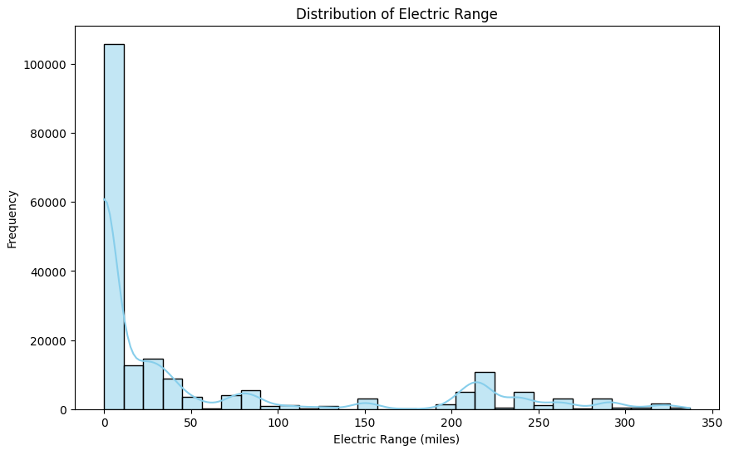
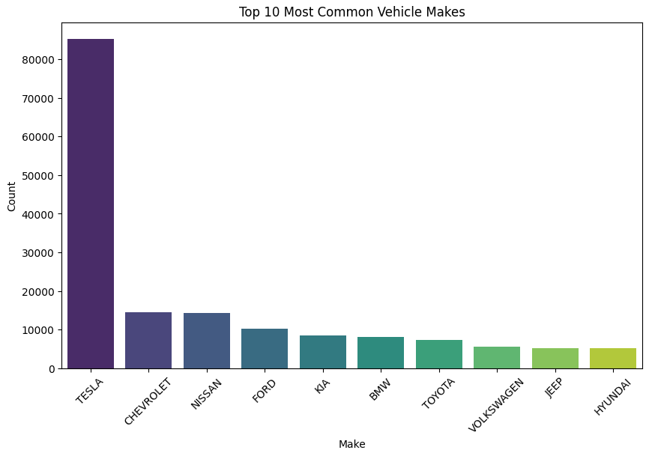

Slide 12
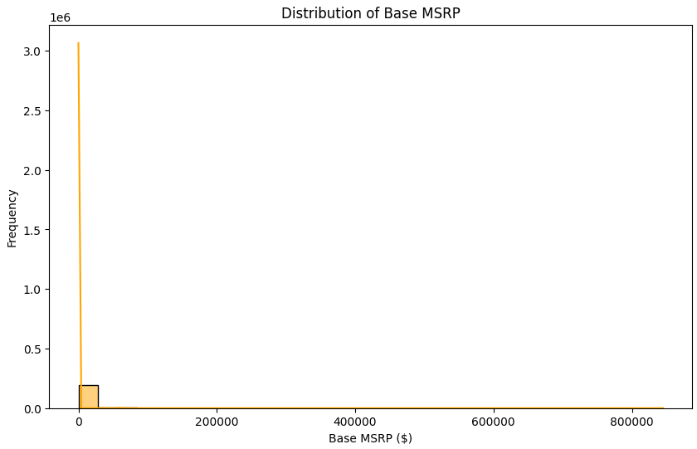
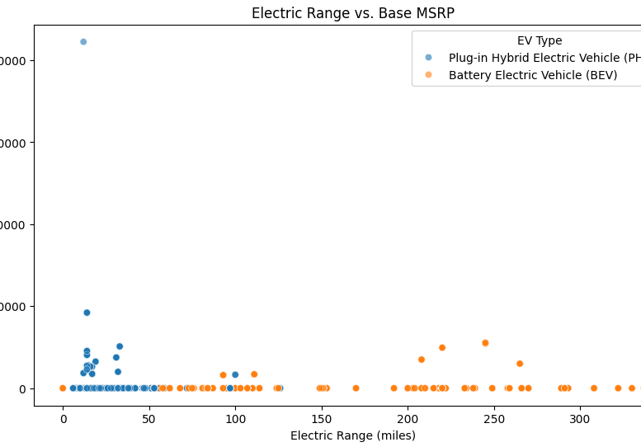

Slide 13
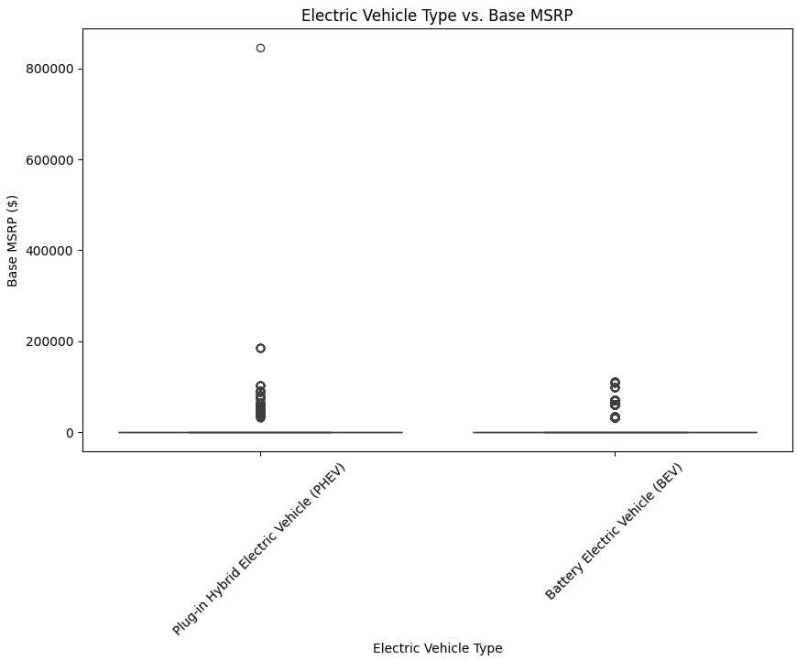
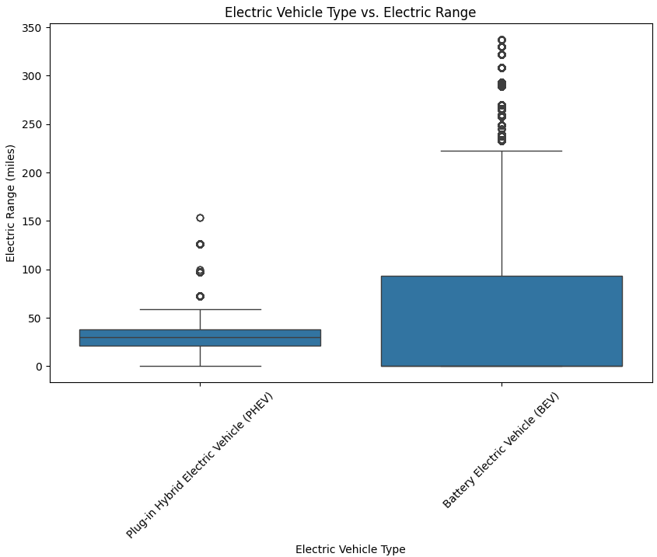

Slide 14
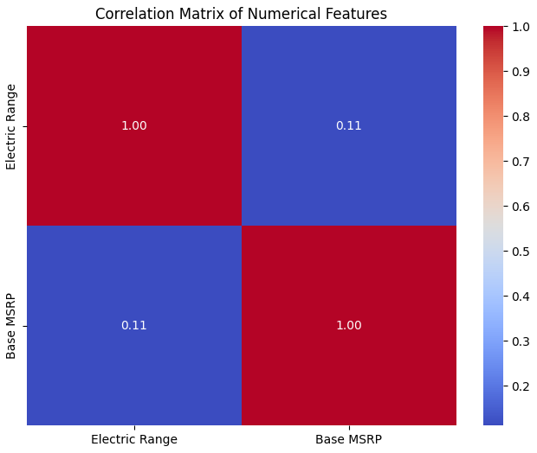
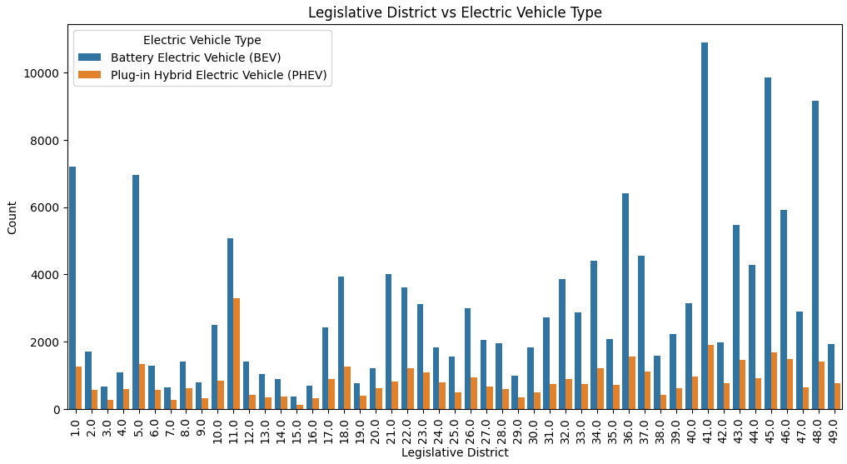

Slide 15
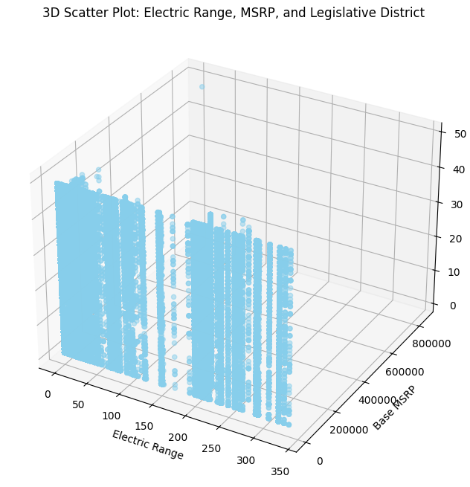
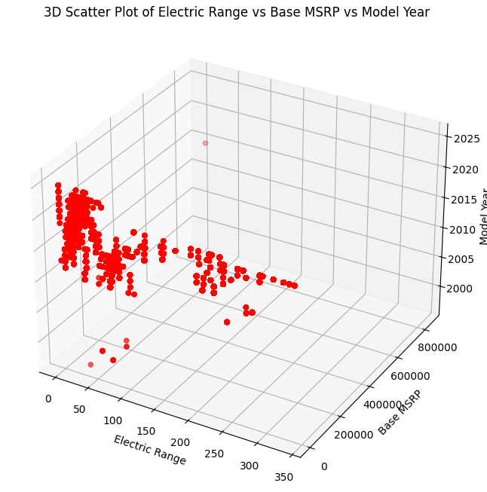

Slide 16
References
Kaggle(Dataset)
Visual studio (code)

Slide 17
Thank You!

