Slide 1
Tiny Machine Learning
Project: “Road Signs Classification”
By
Sardar Karan Singh
Anvesh Avirneni
Praneeth Aluru
Narsimha Athreya

Slide 2
Project Aim
Goals of this project:
To develop a model that can predict different road signs accurately.
Compress the model and run it in the Portenta micro controller.
Road sign image detection using portenta camera and classification of the road sign image.

Slide 3
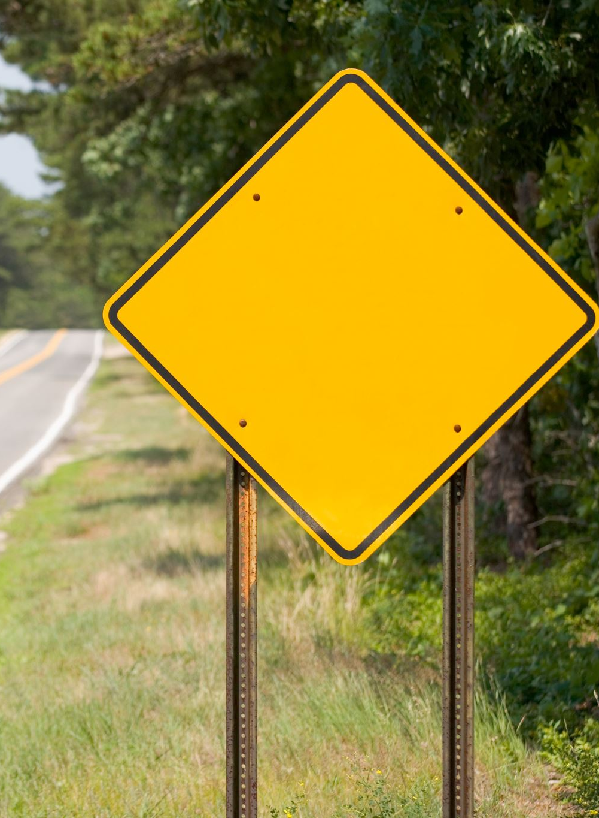
Data Collection
We have collected 8 Road Signs
1.Merging Lane
2.Divided Highway
3.Keep Left
4.Keep Right
5.Lane Drop
6.Slippery when wet
7.Two Way Traffic
8.Winding Road

Slide 4



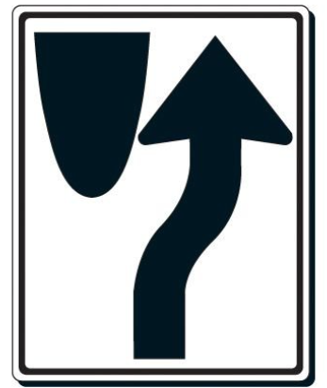
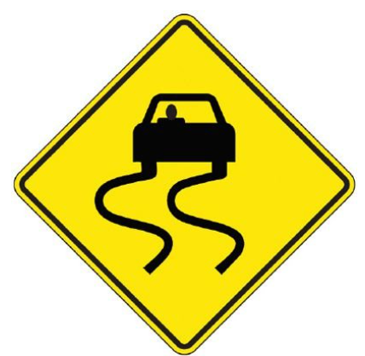



Symbols
Merging Lane
Divided Highway
Keep Left
Keep Right
Lane Drop
Slippery When Wet
Two-way traffic
Winding Road
Source: google

Slide 5

Dataset
Using Portenta captured images of 8 signs of 500 with total of 4000 images
We have Nomalized images using image data set generator function
Built Data generators for training and validation
The image resolution is 320X240

Slide 6
Model
Initially we have used traditional machine learning models like Logistic Regression, Decision trees and Random forest classifiers for the dataset.
Later we tried Deep Learning models like MLPs and later added Convolution Layers , Dense Layers, and Max Pooling.
Performed Pruning to reduce the weights of neural network of the model to make it compressed.
Performed Quantization basically to covert the float values to integers and make the module light weighted.

Slide 7
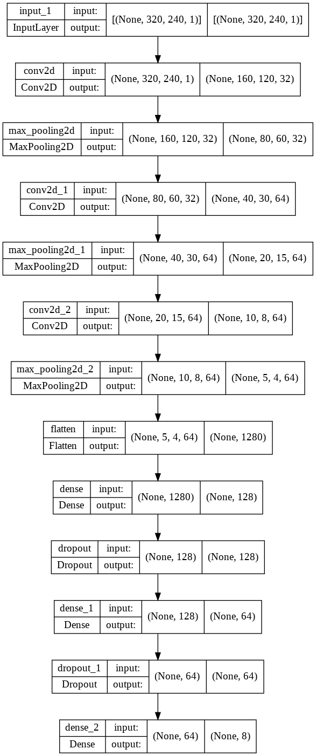
Model

Slide 8
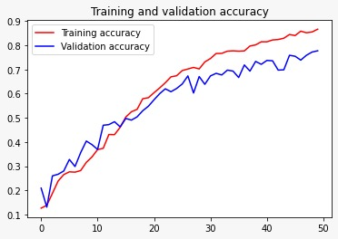
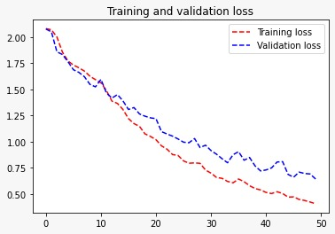
PLOTS for training and validation

Slide 9
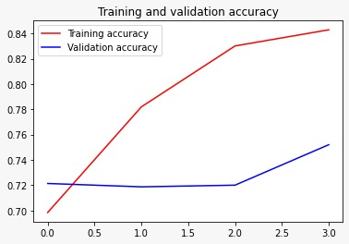
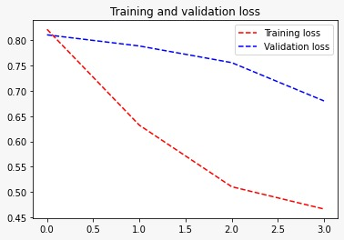
PLOTS for PRUNED training and validation

Slide 10
Accuracy of models
Model accuracy
Pruned model accuracy
Pruned

Slide 11
FURTHER IMPROVEMENTS
Could achieve more accurate results when added a greater number of images for training data.
Could increase accuracies if used different models with different architectures.

Slide 12

Thank you

