Slide 1
M.TECH CYBER SECURITY — MID-SEMESTER DISSERTATION EVALUATION
AI-Assisted Detection of LOLBin-Based
Privilege Escalation
Phase 1 of 2: Generic Behavioral Detection Foundation
PRESENTER
Anvesh Dhiraj Shivhare
M.Tech Cyber Security, Semester III
INSTITUTION
School of Cyber Security & Digital Forensics
National Forensic Sciences University, Gandhinagar
RESEARCH TRACK
Defensive EDR / Host Behavioral Anomaly Detection
Unsupervised Learning + Zero-Shot Explainability
SUBMISSION CONTEXT
October 2026
Academic Year 2026–2027 (Mid-Semester Panel)
AI-Assisted Detection of LOLBin-Based Privilege Escalation | NFSU M.Tech Cyber Security
Slide 1 of 12

Slide 2
◆ THREAT MODEL & STRATEGIC PIVOT
Problem Formulation: The Living-off-the-Land Threat
Why legitimate dual-use administrative binaries evade signature-based AV and static EDR
1. Adversarial Abuse of Dual-Use Utilities (LOLBins / GTFOBins)
Modern threat actors avoid compiling custom malware binaries. Instead, they weaponize pre-installed, digitally signed system utilities (e.g., powershell.exe, certutil.exe, find, awk, tar, sudo) for post-exploitation and privilege escalation (PrivEsc).
2. Failure of Static Signatures & Crippling Rule Fatigue
Because LOLBins inherit valid OS signatures and run from trusted system paths, traditional signature-based AV is ineffective. Static EDR rules face an irreconcilable tradeoff: either trigger severe False Positive alert fatigue on routine administration or permit intrusions.
3. The Defensive Research Gap (Our Strategic Pivot)
Offensive AI automation (auto-exploitation, LLM payload mutation) is saturated in literature (PentestGPT, hackingBuddyGPT). Detecting subtle dual-use commands via unsupervised behavioral anomaly detection paired with zero-shot LLM explainability is an open, defensible gap.
4. The Sequence Blind Spot (Isolated vs. Chained Execution)
A dual-use utility (e.g., 'whoami' or 'id') looks completely benign in isolation. Malicious intent only manifests across consecutive command transitions within an attack session, requiring sequence-aware behavioral analysis rather than isolated inspection.
AI-Assisted Detection of LOLBin-Based Privilege Escalation | NFSU M.Tech Cyber Security
Slide 2 of 12

Slide 3
◆ LITERATURE TAXONOMY (IEEE / APA CITATIONS)
Theoretical & Literature Foundation
Mapping peer-reviewed foundational literature directly to each architectural design decision
Isolation Forest Algorithm
Anchor: Liu, Ting, Zhou (IEEE ICDM 2008)
Exploits fundamental property: 'anomalies are few and different'. Isolates anomalies via random recursive partitioning without requiring labeled attack training traces.
Why Unsupervised Learning
Anchor: Stamp (2022, arXiv:2208.12836)
Demonstrates severe scarcity of labeled malicious LOLBin data. Proves supervised models overfit to seen syntax and collapse when facing novel post-exploitation techniques.
Anomaly Detector + LLM Pairing
Anchor: Ali & Kostakos (2023, HuntGPT)
Establishes architectural precedent combining statistical ML anomaly detection with zero-shot LLM explainability to translate mathematical deviations into actionable SOC triage.
LLM Grounding & Hallucination Guard
Anchor: Houssel et al. (2024, arXiv:2408.04342)
Defines methodology for strictly grounding LLM reasoning in empirical feature deviations and z-scores, prohibiting ungrounded external assumptions.
Sliding-Window Command Context
Anchor: Springer (2026)
Proves empirically that evaluating a sliding window of consecutive commands significantly outperforms isolated single-command inspection on Linux endpoint telemetry.
Anomaly Weakness on Stealth / Obfuscation
Anchor: Systematic Literature Review (SLR 2026)
Exhaustive review establishing that Isolation Forest excels on overt anomalies but exhibits known degradation on stealthy/obfuscated intrusions—grounding our Tier 3 test.
AI-Assisted Detection of LOLBin-Based Privilege Escalation | NFSU M.Tech Cyber Security
Slide 3 of 12

Slide 4
◆ END-TO-END PIPELINE ARCHITECTURE
System Architecture: Behavioral Detection Pipeline
End-to-end ingestion, feature representation, unsupervised scoring, and grounded LLM attribution
1. Telemetry Ingestion
2. Feature Engineering
3. Anomaly Detection
4. SOC Explainability
AuditdTelemetrySource
• Ingests raw Linux auditd streams
• Correlates SYSCALL, EXECVE, PATH, CWD
• Decodes hex proctitles into plaintext
• Extensible adapter architecture
TelemetryFeatureExtractor
• Lineage rarity (parent-child co-occurrence)
• Shannon entropy & special char ratio
• Sensitive path touch & privilege flags
• Sliding Command Window (N=3)
Isolation Forest (Unsupervised)
• 150 Isolation Trees (contamination=0.025)
• Trained strictly on benign baseline
• Continuous standardized feature space
• Calibrated decision boundary = 0.50
LLM Attribution & Triage
• Zero-shot Tier-3 SOC analyst prompt
• Consumes JSON feature anomaly payload
• Outputs ATT&CK ID & confidence score
• Deterministic offline fallback engine
➔
➔
➔
REAL DATA (auditd)
& Synthetic Adapter
Real Fitted Statistics
(Zero Retraining)
Real Auditd Baseline
(25,495 Events)
Architecture Validated
(No Label Leakage)
Data Provenance Distinction: Detection & Feature Pipeline is trained and evaluated on REAL Ubuntu auditd telemetry. Multi-tier adversarial benchmarking (Tiers 1–3) was validated against synthetic lab streams
during architectural development.
AI-Assisted Detection of LOLBin-Based Privilege Escalation | NFSU M.Tech Cyber Security
Slide 4 of 12

Slide 5
◆ PROJECT MILESTONES & RIGOROUS SCOPING
Implementation Status: Phase 1 Scope & Boundary
Transparent accounting of what is delivered and operational vs. synthetic and Phase 2 targets
BUILT & OPERATIONAL ON REAL DATA
Phase 1 Delivered (Verified on Linux Host)
SYNTHETIC-ONLY (BENCHMARK VALIDATION)
Development Architecture Testing
PHASE 2 ROADMAP (DISSERTATION TA2)
Future Work & Engineering Upgrades
• Real Linux auditd ingestion parser correlating SYSCALL, EXECVE, PATH, and CWD records into unified event objects.
• Fitted baseline Isolation Forest on 17,846 real events (70% of 25,495 Ubuntu dataset) with persistent joblib model bundle.
• Standalone inference engine (predict.py) scoring fresh endpoint telemetry with ZERO retraining or refitting.
• Real attack script executions captured and evaluated against live VM auditd logs (find, python3, tar, awk GTFOBins).
• Three-tier attack complexity matrix (Tier 1 overt, Tier 2 chained, Tier 3 obfuscated) evaluated on synthetic dataset.
• Supervised vs. unsupervised generalization experiment reproducing Stamp (2022) with SMOTE comparators.
• Sliding-window size ablation study across N=3, 4, 5 on synthetic multi-step sequences.
• Zero-shot LLM attribution tested across synthetic scenario payloads.
• LOLBin argument semantic embeddings & AST-level parsing to eliminate blind spots on subtle syntax (e.g., awk).
• Sequence transition-gradient features (binary_changed, entropy_delta) to detect low-signal reconnaissance chains.
• Real-data capture for multi-step chained and obfuscated attacks executed directly inside isolated lab VMs.
• Cross-OS Windows Sysmon adapter integration (EventID 1 process creation, EventID 11 file creation).
AI-Assisted Detection of LOLBin-Based Privilege Escalation | NFSU M.Tech Cyber Security
Slide 5 of 12

Slide 6
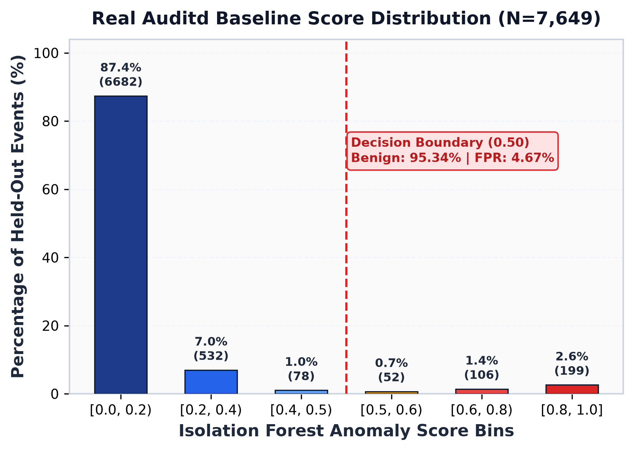
● REAL TELEMETRY: LINUX AUDITD (UBUNTU BASELINE)
Real Data Result: Baseline Validation & FPR Calibration
Unsupervised Isolation Forest evaluation on 25,495 captured Linux auditd telemetry events
Held-Out Baseline Score Distribution (N = 7,649)
• Total Telemetry Captured: 25,495 correlated auditd events (Ubuntu)
• Experimental Split: 70% Train (17,846 ev) / 30% Held-Out Test (7,649 ev)
• Empirical FPR on Held-Out: 4.67% (357 false positives / 7,649 events)
• Median Score (50th %ile): 0.0337 (Deep interior of benign hyperspace)
• 90th / 95th Percentiles: 0.2618 / 0.4564 (Safely below 0.50 threshold)
• Strongly Benign Bins (<0.2): 87.36% (6,682 events) score below 0.20
• Sub-Threshold Normal (<0.5): 95.34% of benign telemetry falls below cutoff
• Sliding Window Advantage: FPR drops from 7.57% (isolated) to 4.67% (window)
Per-Binary Baseline False Positive Discrimination:
• find: 0.0% FPR (0/66) | awk: 0.0% FPR (0/381)
• tar: 4.17% FPR (1/24) | python3: 25.39% FPR (49/193)
AI-Assisted Detection of LOLBin-Based Privilege Escalation | NFSU M.Tech Cyber Security
Slide 6 of 12

Slide 7
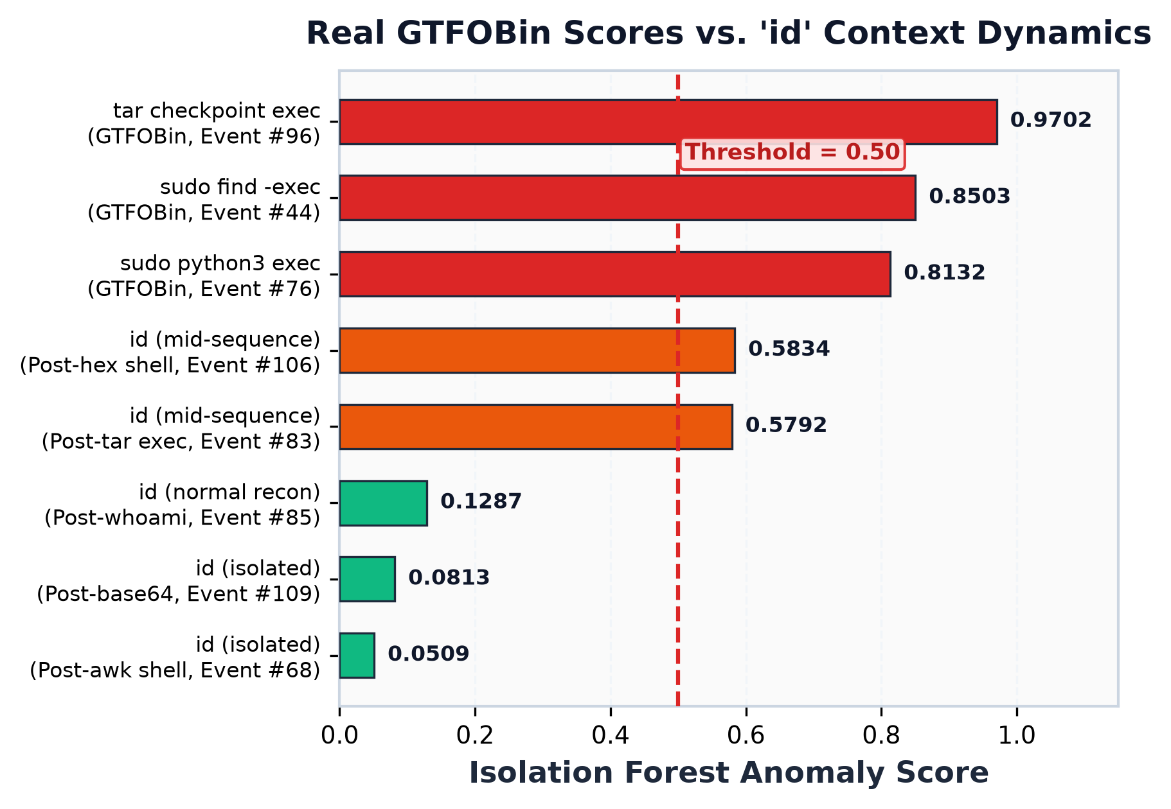
● REAL TELEMETRY: LIVE GTFOBIN EXECUTION AUDITD
Real Data Result: Live GTFOBin Detection & Context Dynamics
Standalone inference (predict.py) flags real GTFOBins and captures sliding-window elevation
Inference on Live Attack Log (data/live-attack-benign.log)
Overt GTFOBin Invocations Successfully Detected:
• sudo find . -exec /bin/sh... ➔ Anomaly Score: 0.7424 – 0.8503 (FLAGGED)
• sudo python3 -c import os... ➔ Anomaly Score: 0.7007 – 0.8132 (FLAGGED)
• tar --checkpoint-action=exec... ➔ Anomaly Score: 0.8036 – 0.9702 (FLAGGED)
The 'id' Command Context Experiment (Springer 2026 Validation):
• Normal / Isolated Context: 'id' executed during benign baseline scores 0.0509 – 0.1287 (Events #68, #80, #85, #109 — Sub-threshold Normal).
• Mid-Attack Sequence: Exactly the same 'id' command executed immediately following tar checkpoint or hex shell jumps to 0.5792 (#83) and 0.5834 (#106) — CROSSING threshold!
• Concrete Proof: The sliding window correctly captures multi-step behavioral elevation rather than isolated command text.
AI-Assisted Detection of LOLBin-Based Privilege Escalation | NFSU M.Tech Cyber Security
Slide 7 of 12

Slide 8
■ HONEST SCIENTIFIC LIMITATION (REAL AUDITD FINDING)
Honest Limitation 1: Undetected GTFOBin (awk)
The awk-based privilege escalation technique scored strictly below 0.50 and evaded detection
Concrete Empirical Finding: sudo awk BEGIN {system(...)} Was Not Detected
During live attack simulation (live-attack-benign.log, Events #57–#66), the awk-based shell spawn technique produced scores between 0.0617 and 0.4928 across all attempts. Every single invocation remained sub-threshold (< 0.50 decision boundary), representing a complete false negative.
1. Benign Distribution Masking
• awk appears 381 times in the held-out benign baseline.
• The model established a strong prior for awk as routine administrative text processing.
• Table 2C shows awk has 0.0000 FPR on benign data; the detector heavily normalizes awk activity.
2. Feature Space Insensitivity
• Syntax 'BEGIN {system(...)}' does not contain explicit exploit tokens like '-exec', 'checkpoint', or 'bypass'.
• Character Shannon entropy remains moderate (~3.2–3.6), indistinguishable from complex sed/awk queries.
• Token hit counter recorded 0 hits.
3. Privilege Signal Latency
• auditd captured the awk process execution under sudo, but the child shell was spawned internally.
• The instantaneous command did not trigger a logged UID change at the primary audit event boundary.
• Generic lineage features failed to detect execution pivot.
Key Academic Takeaway: Generic behavioral features struggle with syntax-subtle LOLBins. Catching awk requires semantic argument modeling and token n-gram embeddings (Phase 2), not just generic command length and entropy.
AI-Assisted Detection of LOLBin-Based Privilege Escalation | NFSU M.Tech Cyber Security
Slide 8 of 12

Slide 9
■ HONEST SCIENTIFIC LIMITATION (SEQUENCE FEATURE GAP)
Honest Limitation 2: Low-Signal Reconnaissance Blind Spot
Multi-step discovery chains evade detection when every command in the chain is individually low-signal
Concrete Empirical Finding: whoami ➔ id ➔ hostname ➔ uname -a Chain Was Missed
In both baseline logs and live simulation, a sequence composed purely of standard discovery utilities (whoami, id, hostname, uname -a, groups, ls, pwd) produced anomaly scores strictly between 0.01 and 0.13. The sliding window failed to trigger an alert despite coherent reconnaissance activity.
Order-Invariant Feature Aggregation
• Current sliding window computes scalar aggregates: max, avg, and sum.
• It lacks transition dynamics (e.g., priv_transition_delta, binary_changed, entropy_gradient).
• The window treats [whoami, id, uname] identically to repeated benign commands.
Dependence on an Overt 'Anchor' Step
• Synthetic Tier 2 chains reached 100% chain interception ONLY because each chain contained at least one overt high-signal step (e.g., sudo tar checkpoint).
• The overt step triggered the window; the window did not detect the subtle reconnaissance steps.
Lack of Sequence Transition Modeling
• Isolation Forest partitions vector coordinates; it does not model Markov state transitions or temporal progression.
• When all steps have 0 token hits and no privilege change, window cumulative sums remain safely below the 0.50 threshold.
Key Academic Takeaway: Unsupervised Isolation Forest cannot infer malicious recon intent from zero-signal commands without explicit sequence transition features (binary_changed, token_acceleration), which form our primary Phase 2 objective.
AI-Assisted Detection of LOLBin-Based Privilege Escalation | NFSU M.Tech Cyber Security
Slide 9 of 12

Slide 10
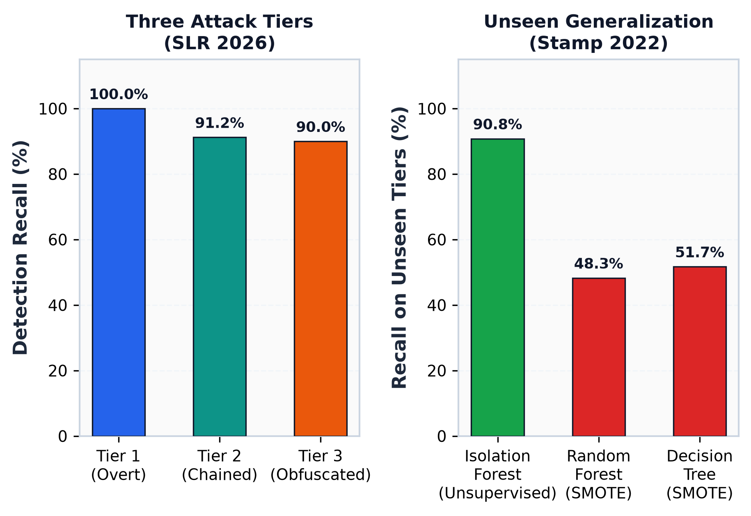
▲ SYNTHETIC DATA: ARCHITECTURE VALIDATION BENCHMARK
Synthetic Validation: Multi-Tier Sensitivity & Overfitting
Controlled architectural experiments conducted during development to validate theoretical models
Controlled Lab Experiments (Synthetic Sysmon + Auditd)
Three Attack Complexity Tiers (SLR 2026 Validation):
• Tier 1 (Overt / Isolated): Recall 100.0%, Precision 0.9901, F1 0.9950 (300 events)
• Tier 2 (Chained Multi-Step): Recall 91.23%, Precision 0.9738, F1 0.9420 (285 events)
• Tier 3 (Obfuscated / Stealthy): Recall 90.00%, Precision 0.9507, F1 0.9247 (150 events)
• Empirical confirmation: Monotonic degradation matches SLR 2026 theorem on obfuscation limits.
Supervised Generalization Failure (Reproducing Stamp 2022):
• Isolation Forest (Unsupervised): 90.80% Recall on unseen Tiers 2 & 3 with ZERO attack labels in training.
• Random Forest (Supervised + SMOTE): Achieves 100% on seen Tier 1, but collapses to 48.28% Recall on unseen Tiers 2 & 3.
• Decision Tree (Supervised + SMOTE): Collapses to 51.72% Recall on unseen Tiers 2 & 3.
• Scientific Validation: Proves supervised classifiers heavily overfit to seen syntax, validating our unsupervised design.
AI-Assisted Detection of LOLBin-Based Privilege Escalation | NFSU M.Tech Cyber Security
Slide 10 of 12

Slide 11
◆ ENGINEERING STACK & LAB ENVIRONMENT
Tools, Technology & Lab Infrastructure
Modular, reproducible engineering stack utilizing standard open-source systems and ML frameworks
Lab Virtualization & Telemetry
Isolated VM Simulation Environment
• Hypervisor: KVM / QEMU managed via virt-manager on Linux.
• Target VM: Ubuntu Server 24.04 LTS (isolated, non-networked).
• Telemetry Sensor: Linux auditd capturing SYSCALL, EXECVE, PATH, CWD.
• Safe Artifacts: bash and powershell simulation scripts decoupled from host.
Machine Learning & Pipeline Core
Unsupervised Anomaly Engine
• Python 3.14 / 3.12 scientific compute environment.
• scikit-learn: IsolationForest (150 estimators), StandardScaler.
• imbalanced-learn: SMOTE used strictly for supervised benchmark comparisons.
• joblib: Standalone pipeline bundle serialization (detector_model.joblib).
Feature Engineering & Windowing
Sequence Behavioral Analytics
• Custom continuous Shannon entropy & character dynamics calculation.
• Sliding Command Window (N=3 to 5) aggregating session context.
• Process lineage rarity mapping (parent-child co-occurrence frequency).
• Dual-OS token dictionaries (Linux GTFOBins & Windows LOLBins).
Explainability & SOC Console
Zero-Shot Cognitive Layer
• LLM API Integration: OpenAI / Anthropic / Groq REST endpoints.
• Strict Zero-Shot Prompt: Constrained to JSON feature anomalies (no hallucination).
• Deterministic Offline SOC Fallback: Full testability without API keys.
• Streamlit Dashboard: Interactive triage console with telemetry toggle.
AI-Assisted Detection of LOLBin-Based Privilege Escalation | NFSU M.Tech Cyber Security
Slide 11 of 12

Slide 12
◆ DISSERTATION ROADMAP (SEMESTER IV PLAN)
Research Roadmap: Transition to Phase 2 (TA2)
Evolving from generic behavioral anomaly detection to LOLBin-specific syntactic modeling
1. LOLBin Argument Semantic Modeling
Objective: Eliminate blind spots like awk — Transition from generic command entropy to semantic token embeddings (Ongun et al. 2021) and AST argument parsing. Distinguish routine text parsing from subshell invocations (e.g., BEGIN {system()}).
2. Sequence Transition-Gradient Features
Objective: Detect low-signal discovery chains — Augment the sliding window with dynamic inter-command features: binary_changed flag, token_acceleration, and session entropy gradients to catch reconnaissance chains before privilege escalation occurs.
3. Multi-Tier Real VM Telemetry Capture
Objective: Replace synthetic benchmark with real VM traces — Execute full Tier 2 (chained sequences) and Tier 3 (obfuscated GTFOBins) attack matrices inside isolated Ubuntu VMs, capturing 100% real auditd logs to validate production generalization.
4. Cross-OS Windows Sysmon Integration
Objective: Dual-OS EDR coverage — Implement a dedicated Windows Sysmon XML/JSON parser (EventID 1 process creation, EventID 11 file creation) and benchmark prevalent Windows LOLBins (certutil, powershell, mshta, rundll32).
AI-Assisted Detection of LOLBin-Based Privilege Escalation | NFSU M.Tech Cyber Security
Slide 12 of 12

