Slide 1
Generative AI-Powered Mobile App for Personalized Healthcare and Insurance Management
Shubham Purwar
2023da04350

Slide 2
Agenda
Overview of HealthAssist
Technology Stack
Architecture
Implementation & Achievement
Future Work & Conclusion
Summary
Notes:
- SANG – 3 mins

Slide 3
Project Overview & Objectives
• Problem: Fragmented medical & insurance records
• Solution: AI-powered app with RAG for personalized healthcare management
• Objectives (100% Achieved):
- Scalable cloud-native architecture
- Secure data ingestion pipeline
- Vector embeddings via Amazon Bedrock
- RAG pipeline for contextual retrieval
- Mobile UI

Slide 4
Managing Medical Documents with Generative AI
People receive and discard hundreds of medical documents throughout their lifetime, creating challenges in storing, organizing, and retrieving crucial healthcare information. Traditional methods are often inefficient, leading to lost or hard-to-find documents. Generative AI offers a solution by allowing individuals to access their personal healthcare data through natural language questions, making information management effortless and empowering better health control.

Slide 5
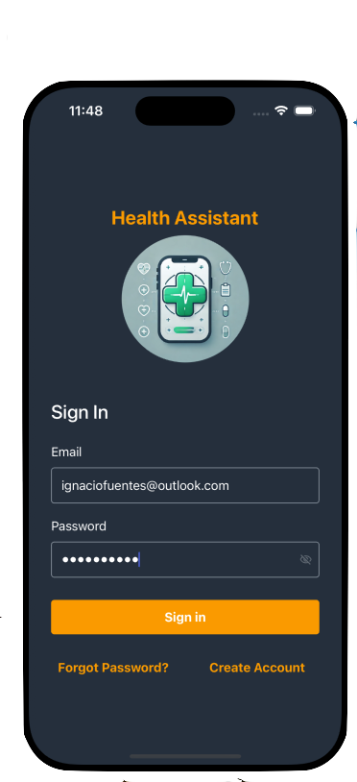




Overview of HealthAssist
Key features and benefits
Security
Resiliency & Scaling
Use cases

Slide 6





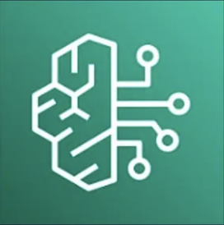
Technology Stack
HealthAssist showcases Generative AI and Amazon technologies, offering essential healthcare data management and personalized assistance features.
Client-Side
(React Native App)
Compute
AWS Lambda: Serverless functions for executing backend logic
AI & ML Services
Amazon Bedrock: Generative AI for real-time insights and responses
React Native: Cross-platform mobile application
AWS Amplify: Simplified configuration and deployment
Security
Amazon Cognito: Secure user authentication with SAML federation
AWS Secrets Manager to keep user secrets
Aurora PostgreSQL row level security for data isolation for multi-tenancy embeddings
API Management
Amazon API Gateway: Managing API requests and responses
Databases and Storage
Amazon Aurora PostgreSQL: Secure, resilient and scalable database with pgvector
Amazon S3: Storage for user-uploaded documents
Amazon DyanamoDB: Fast and flexible NoSQL database for session and metadata

Slide 7







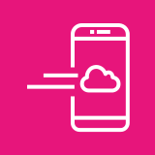
HealthAssist Architecture
AWS Cloud
AWS Cloud
STORAGE
2
3
4
AWS Secrets Manager
Amazon Simple Storage Service (Amazon S3)
Amazon EventBridge
AWS Lambda
5
6
1
7
AUTH
Amazon Bedrock
(Amazon Titan Text Embeddings V2)
Amazon Aurora
(PostgreSQL)
[GET] /channels
1
4
8
AWS Amplify
Amazon Cognito
AWS Lambda
3
Cognito
Authorizer
5
JWT Token
2
9
[GET, POST] /channels/{id}/messages
Amazon Bedrock
(Athropic Claude 3.5 Sonnet)
Amazon DynamoDB
11
6
AWS Console Mobile Application
Amazon API Gateway
AWS Lambda
10

Slide 8
Architecture
• Cloud-Native, Serverless Design (AWS)
• Components:
- Storage: S3, Aurora PostgreSQL (pgvector), DynamoDB
- AI/ML: Amazon Bedrock (Titan Embeddings + Claude 3 Sonnet)
- Compute: AWS Lambda
- Security: Cognito, Secrets Manager
• Flow: Upload → Embedding → Retrieval → AI-powered Response

Slide 9
Implementation & Achievements
• Fully deployed AWS architecture
• Backend: Serverless pipelines with Lambda & EventBridge
• Security Framework:
- Authentication (Cognito)
- Data encryption (in transit & at rest)
- Vector search

Slide 10
Future Work & Conclusion
• Future Enhancements:
- Predictive analytics & proactive health insights
- EHR & wearable integrations
- Multi-language & offline support
• Conclusion:
- HealthAssist proves feasibility of secure AI-driven healthcare management
- Strong foundation for patient-centric digital health ecosystems

Slide 11
Summary
Summary of HealthAssist
Data Management and Security
AI Integration
User Interaction
Key Functionalities
Impact and Benefits
Future Vision
Call to Action

