Slide 1
Scala

Slide 2
Introduction
Modern
Multi-paradigm
Programming language
designed to express common programming patterns in a concise, elegant,
and type-safe way
∫(OOPs, Functional Features)

Slide 3
Scala is Object-Oriented
Every value is object – pure OO
Classes – to define types - templates that can be instantiated into many objects at runtime
Traits – to define behavior – similar to interfaces in java8
Inheritance is there – sub classing is allowed

Slide 4
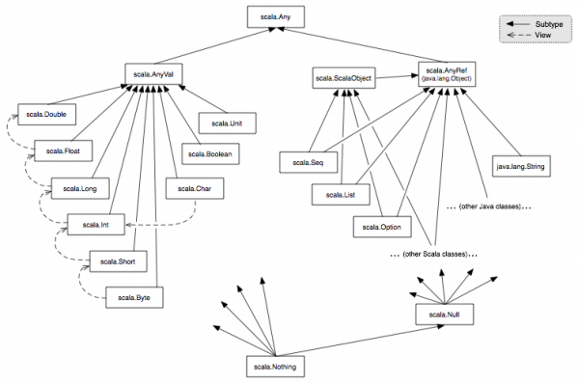
Unified Types
Notes:
In contrast to Java, all values in Scala are objects (including numerical values and functions). Since Scala is class-based, all values are instances of a class. The diagram below illustrates the class hierarchy

