Slide 1
Scala

Slide 2
Introduction
Modern
Multi-paradigm – why ?
Programming language
designed to express common programming patterns in a concise (?), elegant(?),
and type-safe(?) way
∫(OOPs, Functional Features)

Slide 3
Scala is Object-Oriented
Every value is object – pure OO
Classes – to define types - templates that can be instantiated into many objects at runtime
Traits – to define behavior – similar to interfaces in java8
Inheritance is there – sub classing is allowed
Supports mixin-based composition mechanism : a clean replacement for multiple inheritance

Slide 4
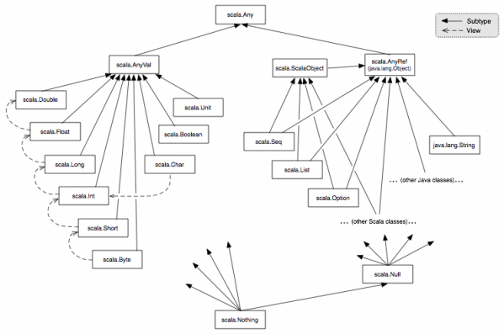
Unified Types
All values in scala are objects : numerical values and functions
Notes:
In contrast to Java, all values in Scala are objects (including numerical values and functions). Since Scala is class-based, all values are instances of a class. The diagram below illustrates the class hierarchy

Slide 5
Scala Class Hierarchy
Super class of all classes : scala.Any
Any –---has two direct sub classes-→ scala.AnyVal and scala.AnyRef
scala.AnyVal represents value classes
scala.AnyRef represents reference classes
All value classes are predefined; they correspond to the primitive types of Java-like languages
All other classes define reference types
User-defined classes define reference types by default i.e. they always (indirectly) subclass scala.AnyRef
Every user-defined class in Scala implicitly extends the trait scala.ScalaObject
Classes from the infrastructure on which Scala is running (e.g. the Java runtime environment) do not extend scala.ScalaObject
scala.AnyRef corresponds to java.lang.Object

