Slide 1

Project Title –Seasonal Agriculture Performance Analysis
Name : Anvi Kanyan
College : UIET, Maharshi Dayanand University, Rohtak
AICTE STU ID : STU669f33d6f31c31721709526

Slide 2
PROBLEM STATEMENT
Core Problem: How does agricultural performance vary across seasons, and what meaningful patterns, relationships, and significant differences can be identified from the available data?
Agricultural performance is influenced by seasonal conditions, environmental factors, resource utilization, crop production, and economic factors. However, raw agricultural data does not clearly reveal how these factors vary across seasons or how they are associated with agricultural outcomes.
This project uses data analytics, visualization, correlation analysis, outlier detection, and statistical techniques to analyze seasonal variations in yield, water efficiency, production, and profit, and to identify meaningful patterns and significant differences across Kharif, Rabi, and Zaid seasons.

Slide 3
Project Description
This project focuses on the data-driven analysis of agricultural activities across different seasons. The dataset contains information related to crop production, yield, environmental conditions, resource utilization, water efficiency, and economic performance across different agricultural conditions.
The project applies data cleaning, exploratory data analysis, statistical analysis, correlation analysis, outlier detection, and data visualization to understand how agricultural performance changes across Kharif, Rabi, and Zaid seasons.

Slide 4
The analysis compares key performance indicators such as crop yield, water efficiency, production, and profit, while examining relationships between relevant agricultural variables. Statistical techniques such as ANOVA are used to determine whether observed seasonal differences are statistically significant.
The final outcome is to transform raw agricultural data into meaningful seasonal insights, evidence-based findings, and practical recommendations that can support better understanding and planning of agricultural activities.

Slide 5
WHO ARE THE END USERS?
The insights generated from this project can be useful to stakeholders involved in agricultural planning, resource management, and decision-making.
Farmers & Farm Managers
Can use seasonal insights on yield, water efficiency, resource usage, and profitability to compare farming performance across seasons and support better crop and resource planning.
Agricultural Departments & Policymakers
Can use aggregated seasonal patterns to understand variations in agricultural performance and support evidence-based planning, resource allocation, and seasonal agricultural policies.

Slide 6
Agribusinesses & Resource Planners
Can use information about production, profitability, and resource utilization to improve operational planning and understand seasonal market and production patterns.
Students & Educational Institutions
Can use th project as an example of applying data analytics, visualization, correlation, outlier detection, and statistical analysis e to a real-world agricultural problem.
Researchers & Analysts
Can use the analyzed relationships, trends, and statistical findings as a basis for further research, predictive modelling, and investigation of factors affecting agricultural outcomes.

Slide 7

Technology Used
Python
  Python was used as the primary programming language for the Seasonal Agriculture Analysis project. It was used throughout the complete data-analysis process, including loading the agricultural dataset, inspecting and cleaning the data, performing numerical calculations, analyzing seasonal variations, generating visualizations, detecting outliers, performing correlation analysis, and conducting statistical tests. Python was selected because it provides a simple and efficient environment for handling large amounts of structured data and has several specialized libraries that support data analysis and statistical computing.

Slide 8
Google Colab
Google Colab was used as the main development and execution environment for the project. It is a cloud-based platform that allows Python code to be written and executed directly in a web browser without requiring extensive local software installation. The complete analysis, including data loading, preprocessing, exploratory data analysis, visualization, statistical calculations, correlation analysis, outlier detection, and ANOVA, was performed in Google Colab. It also allowed the code, output tables, graphs, and explanations to be organized together in notebook format, making the complete analysis easy to execute, document, and present.

Slide 9
Pandas
Pandas was used for data handling and manipulation throughout the project. The agricultural dataset was loaded and represented as a Pandas DataFrame, allowing the data to be organized into rows and columns. Pandas was used to inspect the dataset, examine its structure and variables, check data quality, handle preprocessing requirements, filter records, group observations according to seasons, and calculate statistical summaries. It was particularly important for seasonal analysis because agricultural observations could be grouped into Kharif, Rabi, and Zaid seasons to calculate and compare performance indicators such as yield, water efficiency, and profit.

Slide 10
NumPy
NumPy was used to support numerical and mathematical operations in the project. It provides efficient methods for working with numerical data and arrays and works closely with Pandas and other analytical libraries. Numerical calculations required during data analysis and statistical processing were supported by NumPy. It helped provide the computational foundation required for manipulating numerical agricultural variables and performing mathematical operations efficiently.

Slide 11
Matplotlib
Matplotlib was used for creating graphical representations of the agricultural data. Different charts and plots were generated to make the results easier to understand and compare visually. It was used for presenting seasonal comparisons and other analytical results, including the comparison of average water efficiency across Kharif, Rabi, and Zaid seasons. Graph titles, axis labels, figure sizes, and other presentation elements were also customized to make the visualizations clear and suitable for analysis.

Slide 12
Seaborn
Seaborn was used as a statistical data-visualization library to create informative and easy-to-understand graphical representations. It was used during exploratory data analysis to study distributions, comparisons, and relationships between variables. Seaborn also supported the visualization of correlations between numerical agricultural variables. Its integration with Matplotlib made it possible to create visually clear statistical graphs that helped identify patterns and relationships in the dataset.

Slide 13
SciPy
SciPy was used for statistical analysis and hypothesis testing. In this project, it was particularly important for performing ANOVA, or Analysis of Variance, which was used to statistically compare agricultural performance across different seasons. SciPy provided the statistical calculations required to obtain values such as the F-statistic and p-value. This allowed the project to determine whether observed differences between seasonal groups were statistically significant rather than relying only on visual comparisons.

Slide 14
Data Cleaning and Preprocessing
Data cleaning and preprocessing were performed before the main analysis to ensure that the agricultural dataset was suitable for reliable analysis. The dataset was inspected for data-quality issues such as missing values, duplicate records, incorrect data types, inconsistent values, and other irregularities. The purpose of this stage was to prepare a structured and reliable dataset for exploratory analysis, seasonal comparisons, visualization, correlation analysis, outlier detection, and statistical testing. Proper data cleaning is important because errors in the original data can directly affect analytical results and conclusions.

Slide 15
Exploratory Data Analysis
Exploratory Data Analysis, or EDA, was performed to understand the structure, characteristics, and overall behavior of the agricultural dataset before applying statistical techniques. Numerical variables were examined using descriptive statistics such as mean, median, minimum, maximum, quartiles, and standard deviation. Graphical analysis was also performed to understand distributions, variations, patterns, and unusual observations. EDA provided an initial understanding of the data and helped determine which agricultural variables and relationships required further investigation.

Slide 16
Outlier Detection Using IQR
Outlier detection was performed to identify unusually high or low observations in the yield data. The Interquartile Range, or IQR, method was applied to the Yield_Tonnes_Ha variable. The IQR is calculated as the difference between the third quartile and first quartile, and observations outside 1.5 times the IQR from the quartiles are considered potential outliers. The calculated upper limit was approximately 5.525 tonnes per hectare, and 302 potential yield outliers were detected. These observations were unusually high, but they were not automatically considered errors because they may represent genuine high-performing agricultural conditions.

Slide 17
ANOVA Statistical Analysis
One-way ANOVA, or Analysis of Variance, was used to determine whether differences between seasonal groups were statistically significant. The analysis compared agricultural observations across Kharif, Rabi, and Zaid seasons. ANOVA evaluates whether the variation between group means is sufficiently large compared with variation within the groups. The analysis produces an F-statistic and p-value, which are used to evaluate the null hypothesis that the group means are equal. A significance level of 0.05 was used for interpretation. This statistical technique strengthened the project by providing mathematical evidence for seasonal differences rather than depending only on graphs and average values.

Slide 18
Data Visualization
Data visualization was used throughout the project to communicate analytical results in a clear and understandable form. Charts and graphs were created to compare seasons, study distributions, identify variations, examine relationships, and present important findings. Visualization makes complex numerical information easier to interpret and allows patterns that may not be immediately visible in raw tables to be identified. The visual results were considered together with descriptive and statistical analysis to provide a more complete interpretation of the agricultural data.

Slide 19
Overall Analytical Approach
The project combines programming, data processing, visualization, and statistical techniques to analyze seasonal agricultural performance. Python and Google Colab provided the development environment, while Pandas and NumPy supported data manipulation and numerical calculations. Matplotlib and Seaborn were used for visualization, and SciPy was used for statistical analysis. These technologies were combined with data cleaning, EDA, seasonal comparison, yield analysis, water-efficiency analysis, profit analysis, correlation analysis, IQR-based outlier detection, and ANOVA to transform the raw agricultural dataset into meaningful findings and recommendations.

Slide 20
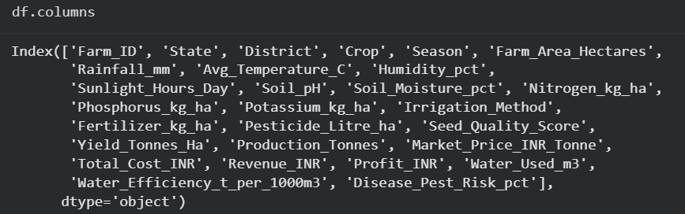
RESULTS

Slide 21
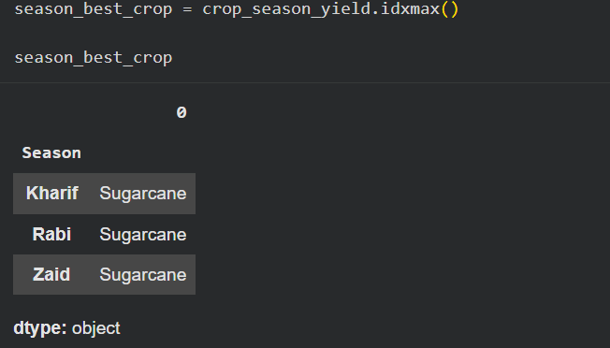
RESULTS

Slide 22
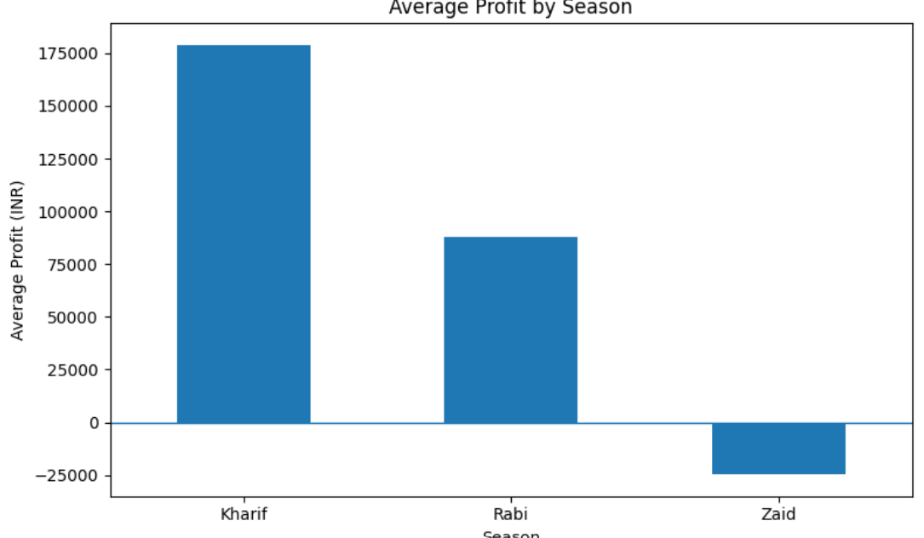
RESULTS

Slide 23
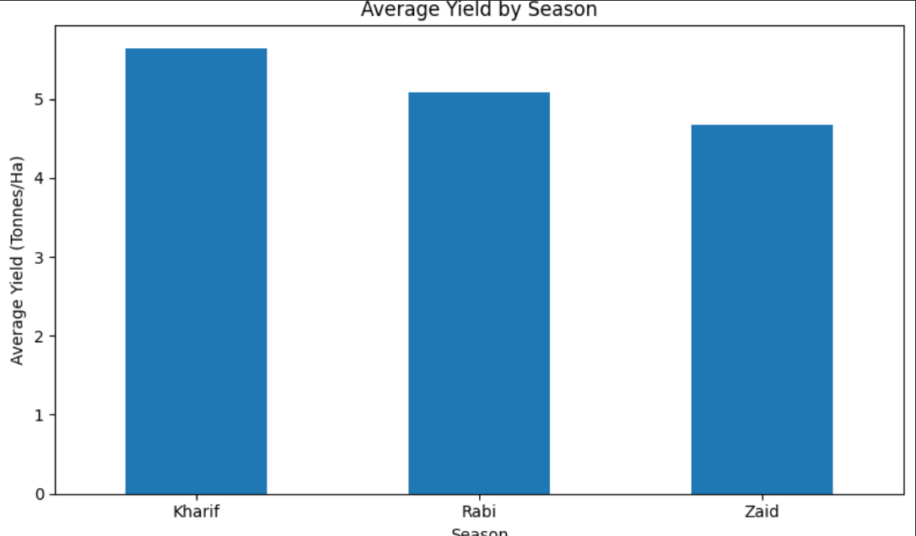
RESULTS
[Add screen shots of your code ]

Slide 24
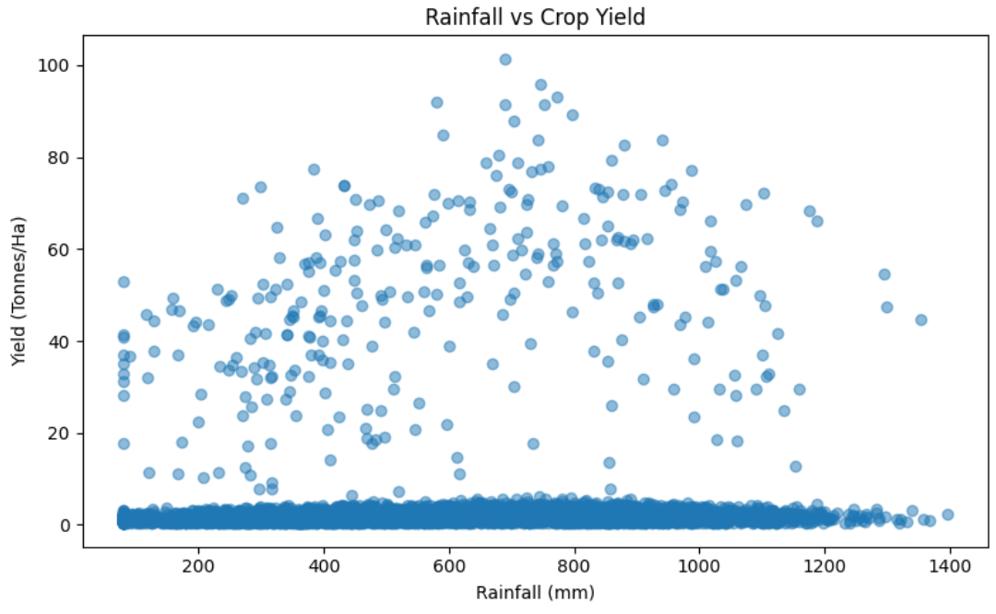
RESULTS

Slide 25
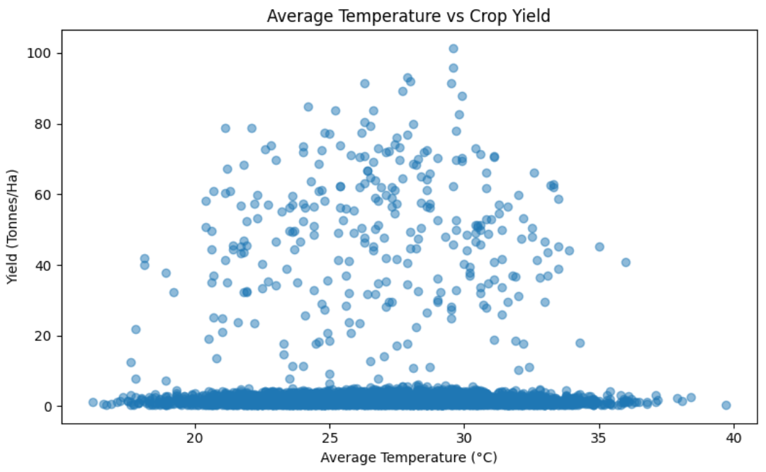
RESULTS

Slide 26
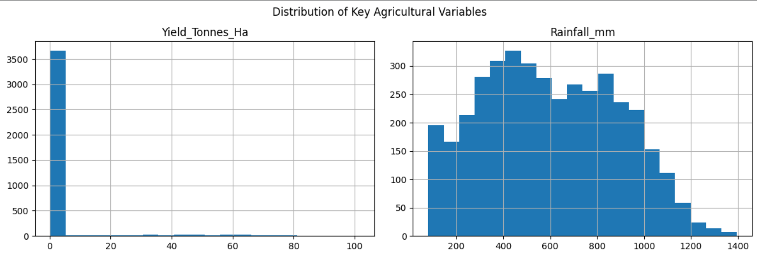
RESULTS

Slide 27
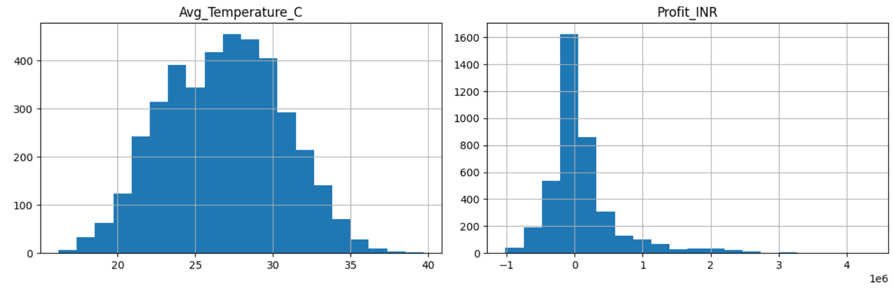
RESULTS

Slide 28
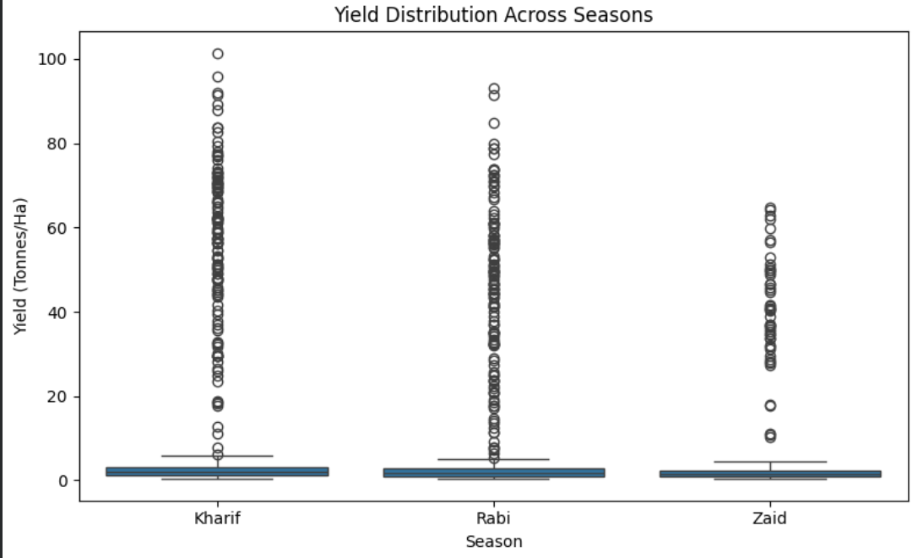
RESULTS

Slide 29
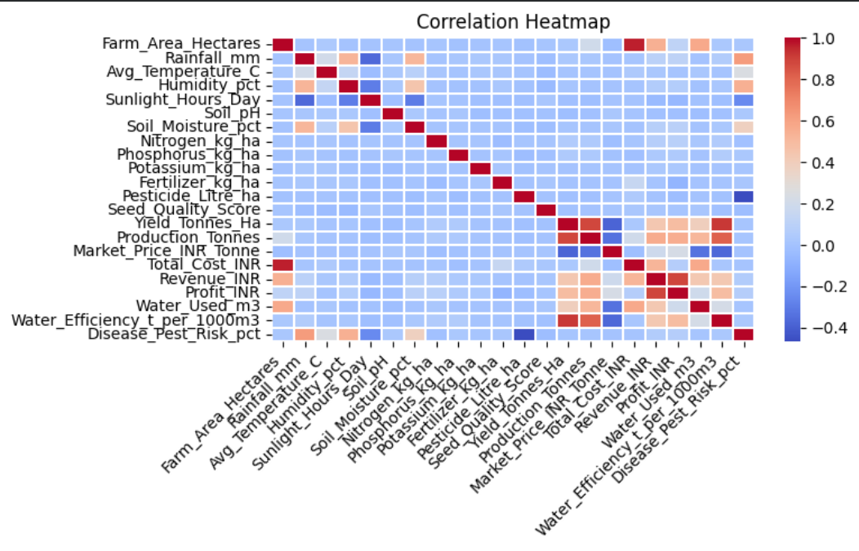
RESULTS

Slide 30
Future scope
The current project focuses on analyzing historical agricultural data using Python, data visualization, correlation analysis, outlier detection, and statistical techniques. In the future, this analytical framework can be technically enhanced into an intelligent agricultural decision-support system by incorporating machine learning, real-time environmental data, interactive dashboards, geographical analysis, and automated prediction. These improvements can make the system more dynamic, predictive, scalable, and useful for practical agricultural planning.
.

Slide 31
Technical Enhancements
Machine Learning Prediction: Develop machine learning models to predict crop yield, production, water requirements, and profitability using historical agricultural and environmental data.
Real-Time Data Integration: Integrate live weather, rainfall, temperature, soil moisture, and other environmental data through APIs or IoT sensors.
Interactive Dashboard: Convert the current analysis into an interactive application using Streamlit, Power BI, or Tableau, where users can dynamically select seasons, crops, regions, and performance indicators.
Time-Series Analysis: Use multi-year agricultural data and time-series models to identify long-term seasonal trends and forecast future agricultural performance.

Slide 32
Geographical Analysis: Incorporate GIS and location-based data to analyze regional differences in agricultural productivity and resource efficiency.
Advanced Outlier Detection: Replace or complement the current IQR method with techniques such as Isolation Forest or clustering to automatically detect unusual agricultural observations.
Recommendation System: Develop an intelligent recommendation system that can suggest suitable crops, resource allocation, and seasonal strategies based on historical and predicted conditions.
Automated Data Pipeline: Create a pipeline that automatically collects, cleans, analyzes, and updates agricultural data whenever new records become available.

Slide 33
GitHub Link
github.com/Anvi0405/Seasonal-Agriculture-Performance-Analysis

Slide 34
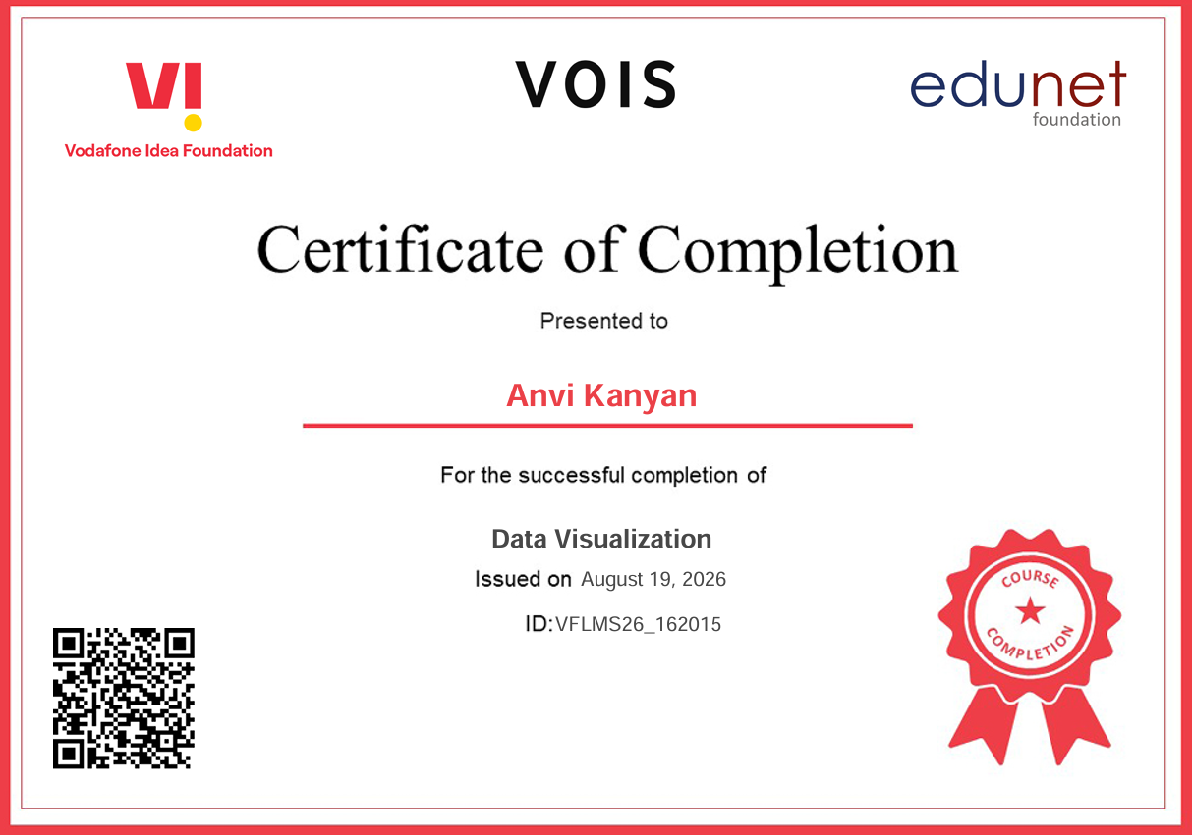
VOIS Course completion certificate -
Course name- Data Visualization

Slide 35
Thank you
My sincere gratitude to my mentor for the valuable sessions, detailed explanations, and continuous guidance throughout the VOIS Data Analytics Internship. Your mentorship and support greatly contributed to my learning and successful completion of this project.
Thank you for your time, guidance, and encouragement.
.
.

