Slide 1
payTrace
SENT
CHECK
BLOCKED
Real-time payment fraud detection that explains every decision
Datanovathon 2026 · DN-FN-01 Real-Time Payment Fraud Detection
Team: Chakilam Anvith Sree and Nooka Sai Krishna
Notes:
payTrace checks every payment before the money moves, decides in milliseconds whether to send it, ask the customer, or block it, and explains why. Team: Chakilam Anvith Sree and Nooka Sai Krishna.

Slide 2
Fraud moves faster than the people who stop it
PROBLEM
Money is gone in seconds
13,516
A UPI or card payment completes instantly. Fraud has to be stopped before it completes, not found in tomorrow's report.
Fraudsters change tactics
card and internet fraud cases reported by banks in FY 2024-25
Fake QR codes, mule accounts and device farms are new patterns that a model trained on yesterday's fraud has never seen.
₹520 crore
Fraud is organised
Rings of accounts, shared devices and money hopping through mules look normal one payment at a time.
involved in those frauds
Black-box scores help no one
Source: Reserve Bank of India, Annual Report 2024-25, frauds reported by banks (card and internet category)
Customers need to know why a payment stopped; analysts need evidence to decide fast.
The challenge: detect fraudulent payments in real time, catch patterns never seen before, uncover the networks behind them, and explain every decision.
Notes:
RBI's 2024-25 annual report: 13,516 card and internet fraud cases worth ₹520 crore reported by banks. Four problems: speed, new patterns, organised rings, and unexplained scores. Our challenge statement is the last line.

Slide 3
payTrace decides in milliseconds, and says why
SOLUTION
SENT
CHECK
BLOCKED
Normal for this customer
Moderate risk
High risk
The payment goes straight through. Most payments never notice payTrace.
The customer sees what looked different, then sends it after a CAPTCHA check or cancels.
No money leaves. The fraud team investigates; the customer can raise a query.
Customers
Fraud analysts
Send money, see each decision explained in plain language with real numbers, decide on moderate-risk payments, raise queries on blocked ones.
Work a prioritised case queue with reasons, risk breakdown, evidence timeline, fraud-ring graph and an AI copilot.
Admins
Other systems
Run the scenario lab, watch fraud rings, replay real fraud data, monitor drift, answer customer queries, manage users.
Score any payment through a REST API with a bearer token.
Notes:
Three outcomes, each a stamp in the app. Four kinds of users. The point: every decision comes with an explanation suited to who is reading it.

Slide 4
How one payment is decided
ARCHITECTURE
Payment in
Limits
Features
4 detectors
Risk fusion
Rules + rings
App, analyst or API
Per channel
Past behaviour only
Known + new fraud
Calibrated
Can only raise
About 7.5 ms per payment, end to end. The LLM only words the explanation; it never decides.
SENT
CHECK
BLOCKED
Sent instantly
Customer decides
Fraud team case
Tech stack
Machine learning
Graph
App and API
AI and testing
LightGBM, scikit-learn, pandas
NetworkX
Starlette, SQLite, HTML/JS
Gemini / Groq, pytest
Notes:
Left to right: limits, features computed only from the past, four detectors, calibrated fusion, then bank rules and ring signals which can only raise a decision. About 7.5 ms per payment including database writes.

Slide 5
Real data, tested only on the future
METHODOLOGY
Sparkov
1.85 M card payments, 0.52% fraud
Every dataset is split by time, never at random
Simulated, Kaggle (CC0). Trains the app's model.
Train
Early stop
Test (never touched)
IEEE-CIS
590 k payments, 431 columns, 3.5% fraud
Calibrate and Thresholds take 7% and 8% of the timeline; the last 25% is only used to report results.
Real Vesta card-not-present data, anonymised.
Every feature uses only what was known before the payment, checked by automated leakage tests.
Fraud labels feed features only after a delay, as chargebacks arrive late in real life.
Thresholds minimise cost: missed fraud value plus ₹100 per false alarm. BLOCK needs 95% precision.
The 2.0 baseline was re-scored from saved models and matched exactly (PR-AUC 0.9414 and 0.4609).
Synthetic UPI
277 k payments, 7 labelled fraud patterns
Our generator: devices, P2P transfers, mule rings.
Main measure: PR-AUC, because fraud is rare: a model that flags nothing is 99% accurate but useless.
Notes:
Three datasets with different roles. Time-based splits everywhere: the test period is the future and is never used to fit, calibrate or choose thresholds. Leakage is tested automatically.

Slide 6
Four detectors: known fraud and never-seen fraud
MODELS
Supervised
Anomaly
Calibrated risk fusion
LightGBM
Isolation Forest
Isotonic calibration makes probabilities mean what they say; a logistic regression fuses the detectors with visible weights, shown to analysts as a risk breakdown.
Learns labelled fraud patterns; gives exact SHAP reason codes for every alert.
Flags payments unlike anything normal, without needing labels.
Anomaly
Novelty
Bank policy rules (only raise a decision)
Autoencoder
3 tripwires
Unverified payee, 5× the usual amount, high value, new account, account-takeover pattern. A payee the customer verified on the same device is trusted for smaller amounts, unless there is strong evidence.
Flags unusual combinations of behaviour it cannot reconstruct.
Payee, device and money-flow anomalies; each can send a payment to review by itself.
Why a hybrid: in our tests, a fraud pattern removed from training was caught 50% of the time by LightGBM alone, and 69% by the hybrid.
Notes:
Supervised plus three kinds of anomaly detection, fused and calibrated, then deterministic bank rules on top. The hybrid exists because supervised models miss new patterns.

Slide 7
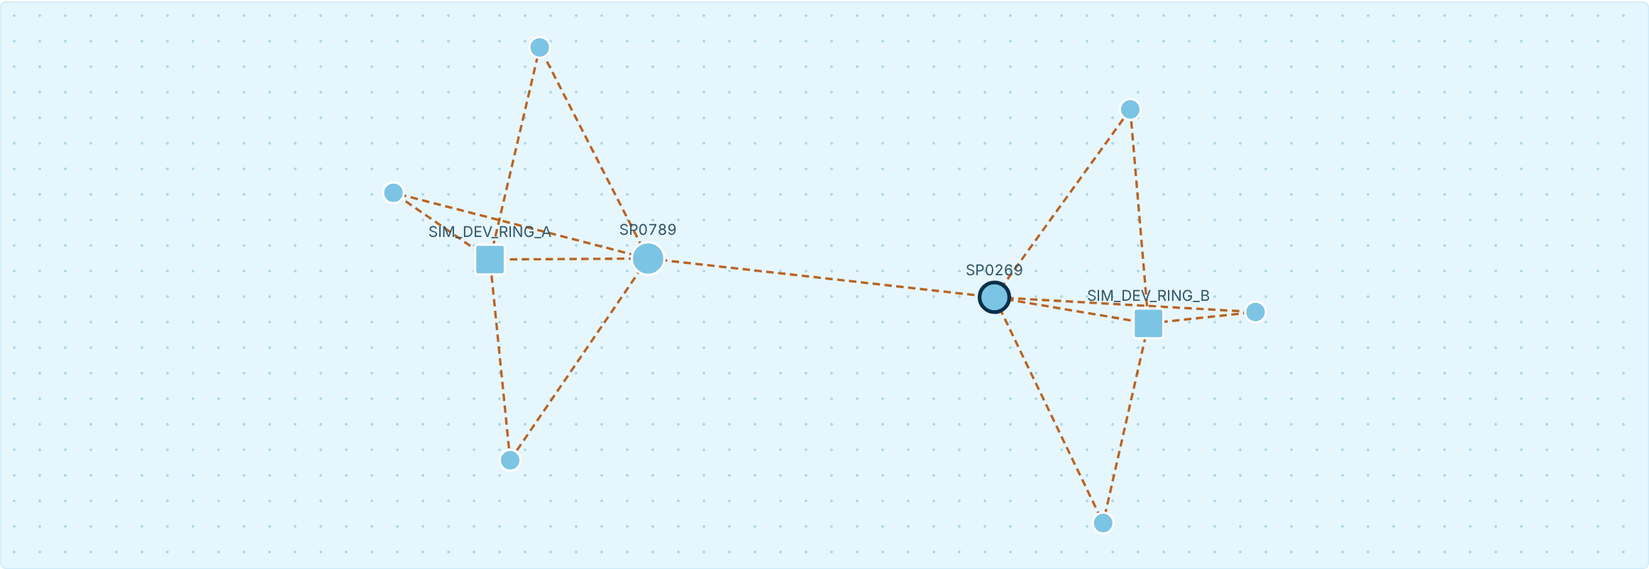
Signature innovation: fraud-ring intelligence
INNOVATION
Checked on every payment, before it is decided
Collector payees: many first-time senders
Shared devices and new-account bursts
Pass-through money and mule chains
Circular transfers that close a loop
Links to analyst-confirmed fraud (the only ring signal allowed to block)
A ring found in the scenario lab
Two devices, each shared by 4 accounts (squares)
Two collector accounts moving money in a loop
16 payments in the group flagged; hubs found by PageRank and betweenness
Cost: 0.04 ms per payment.
Dashed amber lines: flagged by the model, not yet confirmed by an analyst.
Notes:
This is what single-payment models cannot see. Ring signals raise a payment to review; only a link to analyst-confirmed fraud can block. Analysts can click any node to expand the graph.

Slide 8
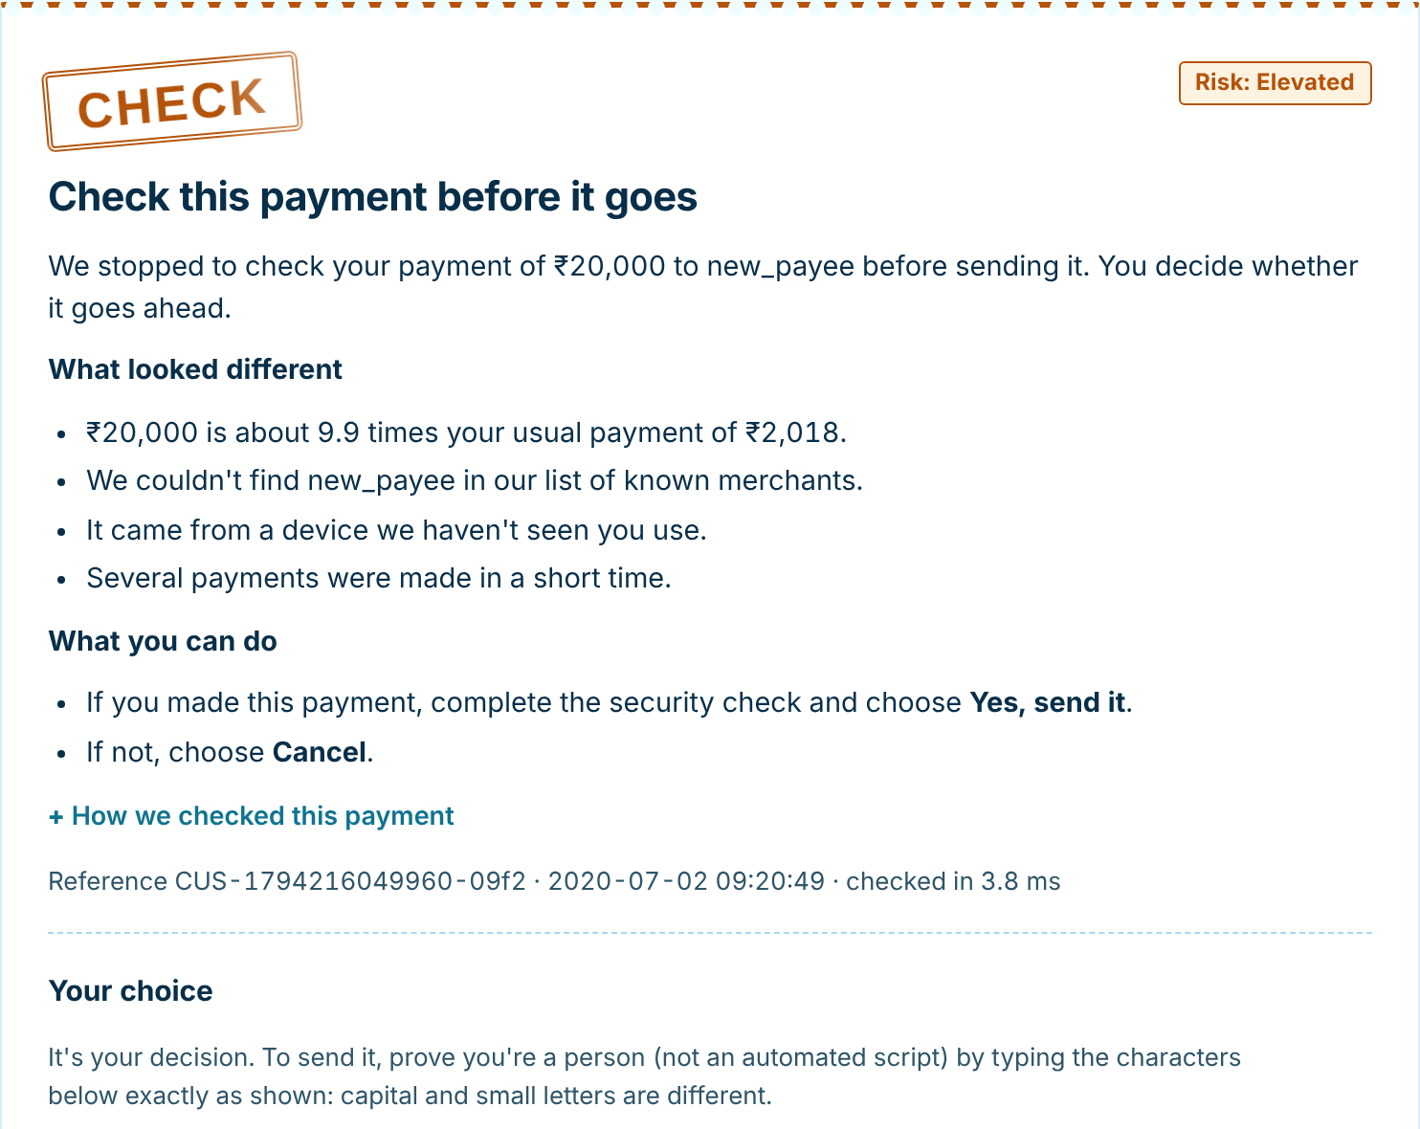
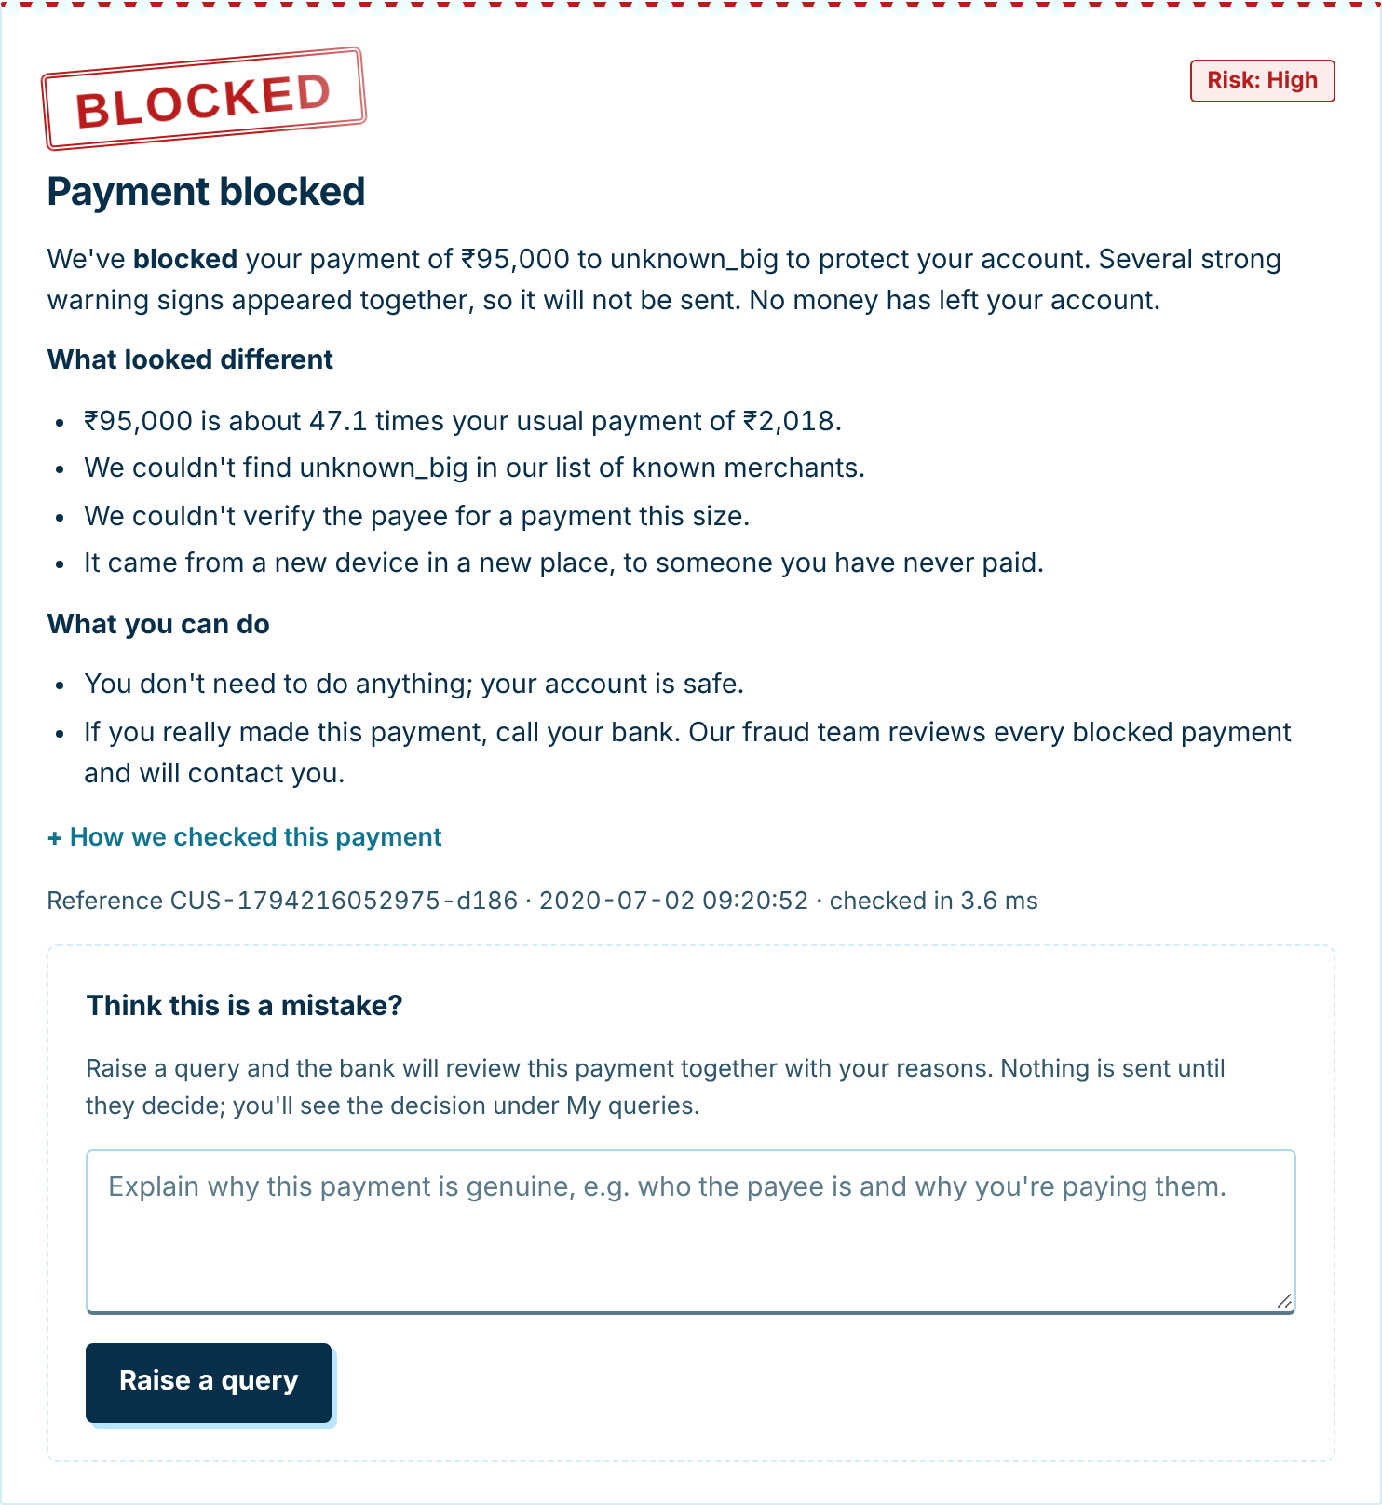
For customers: a clear answer and the final say
PROTOTYPE
Real numbers, not scores
CHECK: the customer decides
BLOCKED: no money leaves
9.9× the usual payment, unknown payee, new device
Send it after a CAPTCHA, or cancel
The customer can raise a query; the bank reviews it
Notes:
Two real screens: a moderate-risk payment the customer decides on, and a blocked one with the query form. Customers never see model scores.

Slide 9
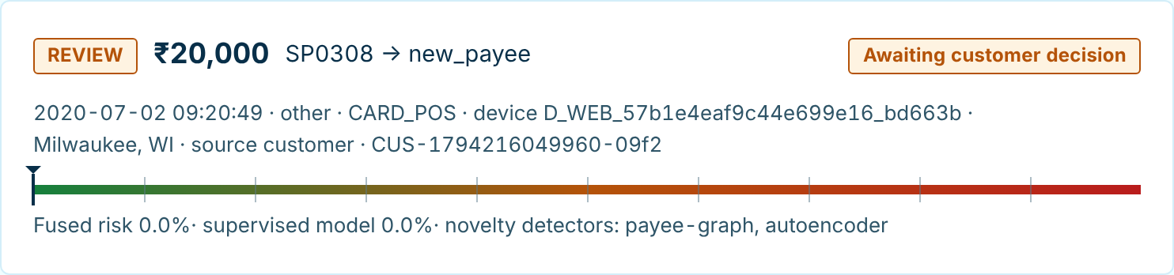
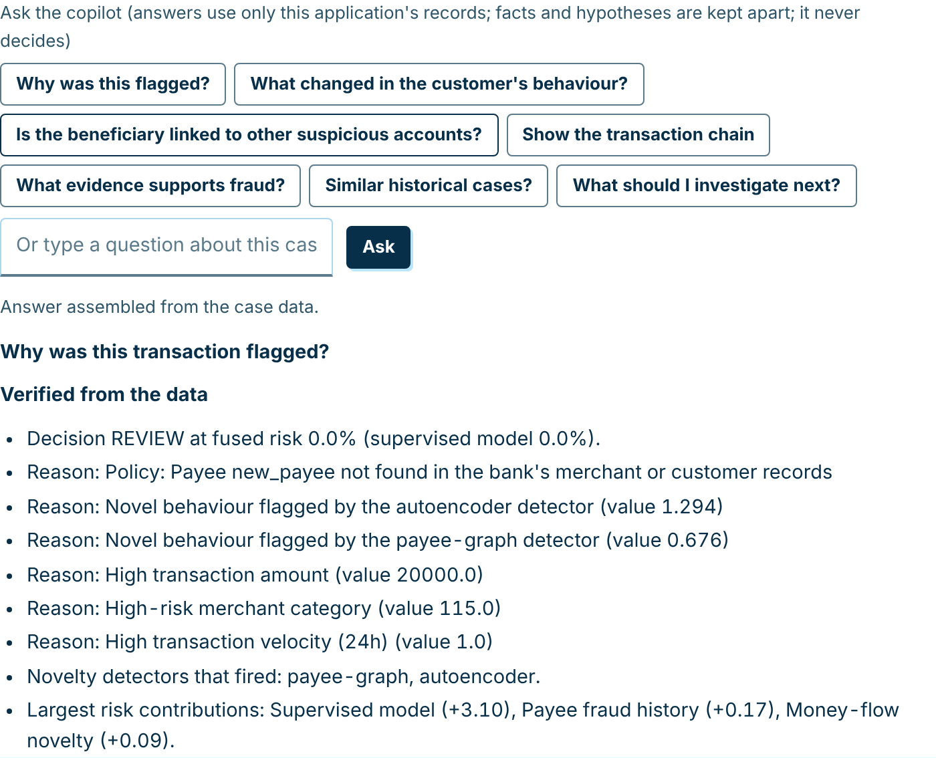
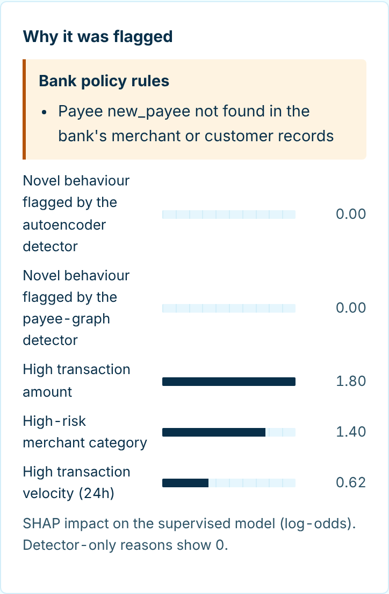
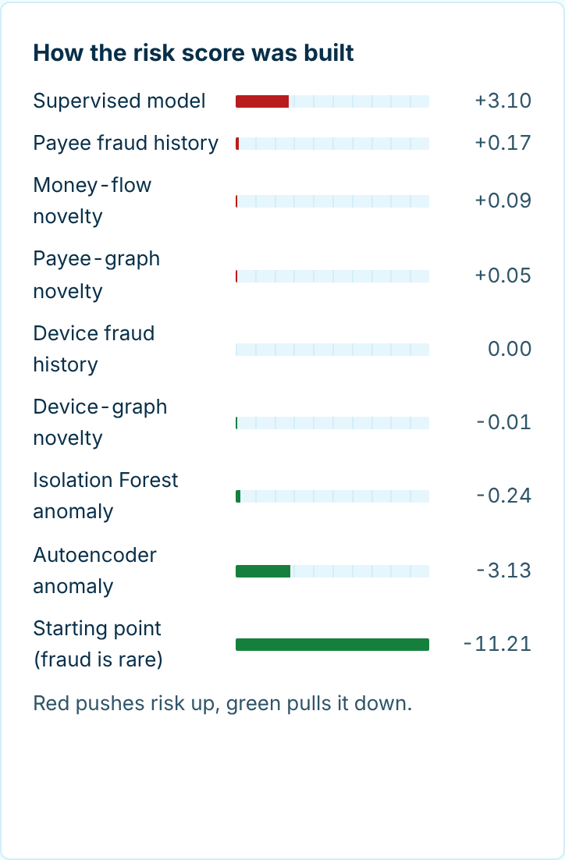
For analysts: why it was flagged, at a glance
PROTOTYPE
Why REVIEW at 0% risk? The fraud model scored it low, but a bank rule (unknown payee) and two novelty detectors raised it. Each layer can only raise a decision.
Notes:
This case shows the layered design: fused fraud probability 0.0%, yet REVIEW, because a bank rule and two novelty detectors fired. The analyst sees exactly that, and the copilot lists the verified facts.

Slide 10
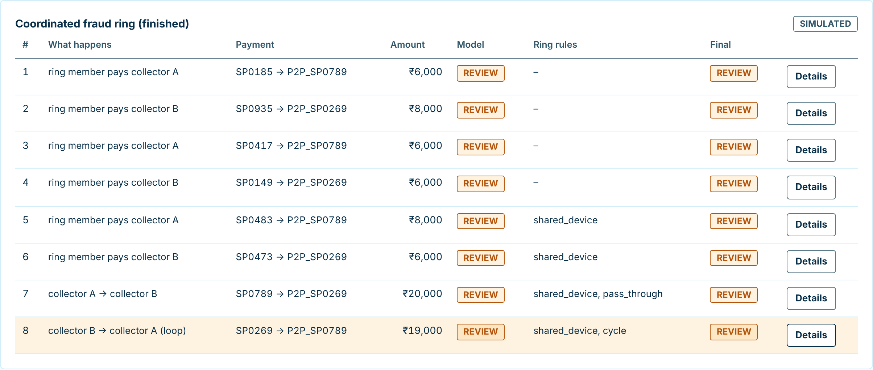
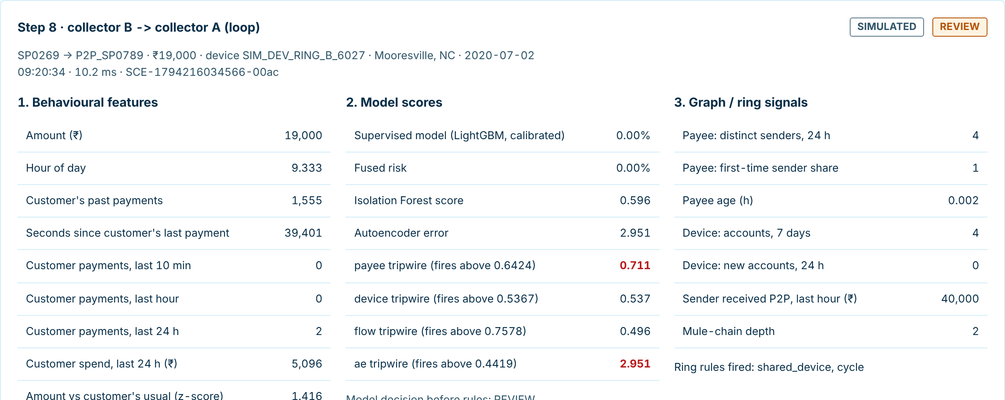
Live demo: fraud scenarios through the real engine
DEMO
A coordinated ring, payment by payment: the ring rules appear as it forms (shared device, pass-through, loop).
10 simulated scenarios, outcomes never scripted: normal payments, takeover, card testing, mule, QR fraud, unknown beneficiary, shared device, rapid transfers, fraud ring, unseen pattern.
Run it yourself
bash run_app.sh → localhost:8000
Sign in: demo / demo1234
Scenario lab → Coordinated fraud ring → Run
Notes:
Run the coordinated fraud ring scenario live. Every payment goes through the same engine as a customer payment; nothing is scripted.

Slide 11
Results on data the models never saw
RESULTS
Simulated data · Sparkov
Real data · IEEE-CIS (Vesta card payments)
The app's model, last 6 months held out
98.8%
1.7%
of fraud flagged
of genuine payments flagged
92.2%
0.941
of blocks are real fraud
PR-AUC
Fraud flagged: 70.0% → 86.7%
Same held-out test for every bar: the last 25% of IEEE-CIS (17 Apr – 1 Jun 2018, 128,823 payments, 4,393 fraud). Thresholds were fixed on an earlier slice before testing. False alarms: 13.7% → 14.2%.
Simulated payments are easier than real ones; treat these as an upper bound.
Notes:
Left: simulated data, the app's model, an upper bound. Right: real IEEE-CIS card data. Every bar uses the same held-out last 25%, with thresholds fixed beforehand. Without fraud labels the gain is 0.461 to 0.494; most of the gain comes from knowing a card holder's earlier confirmed fraud, which depends on how quickly labels arrive.

Slide 12
Unseen fraud: a synthetic leave-one-pattern-out test
RESULTS
Synthetic experiment: each fraud pattern is removed from training and tested on our own UPI-style generator. It shows the hybrid's value; it is not evidence of performance on live bank fraud.
69% → 76%
average share of a held-out pattern caught (LightGBM alone: 50%)
87.6 h → 0 h
time to the first alert on fake-QR fraud
False alarms: 1.37% → 1.46%. Ring rules were written knowing the generator's patterns.
Notes:
This is a synthetic leave-one-pattern-out experiment, and we say so on the slide. Each pattern is removed from every training slice. Ring signals lift QR-swap from 20% to 70% and catch it from the first payment.

Slide 13
How we tested it
VALIDATION
80
automated tests: features, models, fusion, fraud rings, drift, customer, analyst and admin workflows, LLM fallback
What we state openly
Sparkov and the UPI data are simulated; IEEE-CIS is real but anonymised. No live bank validation.
We wrote the ring rules knowing our generator's patterns, so ring results on that data are optimistic.
Most of the IEEE-CIS gain depends on fraud labels arriving within 7 to 30 days.
The app's model was fixed in advance, not picked by its test score.
Exact
baseline reproduction: saved 2.0 models re-scored to the same PR-AUC (0.9414, 0.4609)
0
future data in features: leakage tests prove each feature uses only earlier payments and old enough labels
7.5 ms
median full decision, 14.2 ms at p99, including database writes (scoring alone: 0.5 ms)
Notes:
Evidence, not claims: tests, exact baseline reproduction, leakage tests and benchmarks. And the limits we state openly.

Slide 14
Real-world value, measured
IMPACT
Estimated loss on 45 days of real card payments
Customers lose less
Stopped before money moves; trusted payees are not interrupted again.
New scams surface early
Ring signals catch coordinated fraud from its first payments.
Analysts decide faster
Evidence, network and copilot answers in one view.
Next steps toward a bank pilot
Retrain on the bank's own labelled payments
Add a phone one-time code and device fingerprints
Run in shadow mode before going live
IEEE-CIS test period (128,823 payments, ₹5.88 Cr of fraud). Loss = fraud missed + ₹100 per false alarm. −22% without labels, −51% with them.
Notes:
A measured example on real data: over 45 days of IEEE-CIS card payments, estimated loss falls from ₹2.02 crore with the 2.0 model to ₹1.58 crore without fraud labels and ₹0.98 crore with 7-day-old labels.

Slide 15
Team contributions
TEAM
Chakilam Anvith Sree
Nooka Sai Krishna
Machine learning and fraud intelligence
Application, product and experience
Data sourcing and adapters: Sparkov, IEEE-CIS and the synthetic UPI generator
Leakage-free time splits and past-only feature engineering
Detection models: LightGBM, Isolation Forest, autoencoder, tripwires, calibration and fusion
Fraud-ring algorithms: ring signals, Louvain, PageRank, betweenness, cycles
Experiments: IEEE-CIS study, unseen-fraud tests, fusion ablation, drift, benchmarks
Web app and REST API (Starlette): customer, analyst and admin portals
Bank policy rules, CAPTCHA customer choice, verified payees and the query system
Scenario lab, graph explorer and the analyst case workspace
AI copilot with Gemini / Groq, grounded only in case evidence
Security, UI design, automated tests, demo script and documentation
Together: problem framing, system design, validation and the live demonstration.
Notes:
Two people, two halves of the system: the intelligence (data, models, rings, experiments) and the product around it (app, customer flows, analyst tools, copilot, design). Shared: design, validation and the demo.

Slide 16
Thank you
SENT
payTrace: every payment traced, checked and explained
Chakilam Anvith Sree · Nooka Sai Krishna
Run: bash run_app.sh · Demo login: demo / demo1234 · Demo script: docs/DEMO.md
Notes:
Close: thank the judges, invite them to try the scenario lab, and take questions.

