Slide 1
Instagram user analytics
By- Anvi Agarwal

Slide 2
Project overview
This project focuses on analyzing Instagram user activity to generate meaningful insights that can help improve user engagement, retention, and platform growth. By examining various metrics related to user behavior, post interactions, and platform trends, the goal is to identify opportunities for strategic marketing and community-building efforts.

Slide 3
Purpose
Recognize long-time users and explore ways to reward their loyalty.
Spot users who have registered but remain inactive, and recommend strategies to encourage their participation.
Highlight users who receive high engagement (likes and comments) to motivate further contributions.
Track trending hashtags to enhance platform visibility and interaction.
Identify peak days for user sign-ups to better schedule marketing campaigns.
Evaluate overall user activity in terms of posting and commenting.

Slide 4
Approach
Data Analysis
Categorize users based on registration date, post frequency, likes, and comments.
Measure the average number of posts per user and identify highly active and inactive users.
Analyze popular hashtags and the days with the most new registrations.
Insights and Recommendations
Suggest personalized rewards for loyal users.
Design campaigns to reactivate inactive accounts.
Recommend promoting trending hashtags and scheduling initiatives on high sign-up days.
Actionable Reporting
Present findings through clear charts, tables, and summaries.
Provide strategic suggestions that align with business goals.

Slide 5
Software used
MySQL Workbench (Version 8.0)
MySQL Workbench was used for executing SQL queries, managing the database, and analyzing user activity data. I chose this tool because it provides a user-friendly interface for writing and testing queries, supports complex data manipulation, and is well-suited for handling structured data efficiently.
Microsoft Excel (2019)
I used Excel for initial data cleaning, organizing, and performing basic exploratory analysis. Its simplicity, flexibility, and visualization features made it ideal for quick summaries, creating charts, and preparing the data before deeper analysis.

Slide 6
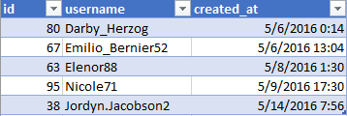
5 oldest users
These are the oldest users who have registered on the platform, some loyal badge or rewards can be given to these users

Slide 7
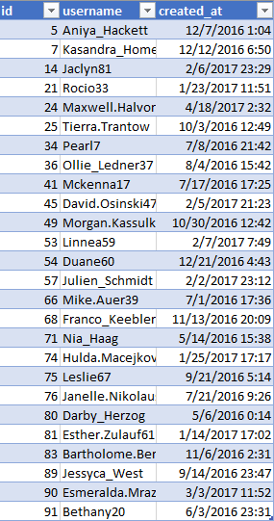
Non-active users (haven’t posted anything)
These are the non active users who hasn’t shown any activity since registration so company can send some notification or marketing msg to make them active

Slide 8
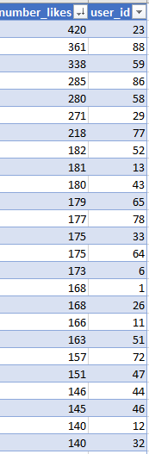
Users with maximum likes
These are the users who have received the maximum likes on their posts and can encourage them to post more on the platform and analyze their posts to find what is trending

Slide 9
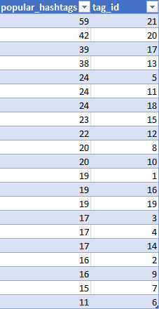
Popular hashtags used
These are some popular hashtags trending on the media that can optimize these hashtags for increasing the activity on the platform

Slide 10
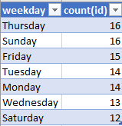
Day when most users registered
Weekday where most users have registered company can use these days to launch any campaign for maximum views

Slide 11
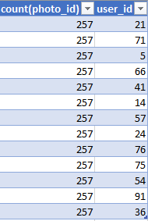
Fake accounts
These user ids have likes same number of pictures which is not possible in real shows these user accounts can be fake

Slide 12
Number of posts and average post
It shows the posts by each user id and average number of posts is 5.14 of all the users

Slide 13
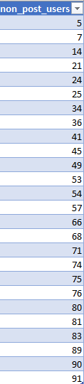
Users who have not posted anything
These are the users who haven’t posted anything since registering can be send the marketing msg to encourage them to post

Slide 14
Users active in comments
Users who have posted maximum number of comments can be seen is most active on the platform

Slide 15
User with maximum followers
Users who have maximum number of followers can be sent collaboration messages for any campaign and ad to increase the reach

Slide 16
Month with maximum user registration
October month had shown maximum registration so any campaign can be launched in this month to increase the number of registrations

Slide 17
Achievements
Through this project, I successfully:
Identified key user segments such as the oldest registered users, inactive users, and users with maximum likes, comments, and followers.
Determined the average number of posts per user (5.14), offering a benchmark for typical user activity.
Highlighted popular hashtags and identified the most common day for new user registrations, which can guide future marketing efforts.
Proposed targeted strategies like loyalty rewards for long-term users, re-engagement messages for inactive accounts, and collaboration opportunities with users who have a large follower base.

Slide 18
Benefits and Value Gained
This project enhanced my ability to work with data systematically, from collection and categorization to analysis and interpretation.
It helped me understand how data-driven insights can support business objectives like improving user engagement and designing marketing campaigns.
I gained practical experience in translating raw data into actionable recommendations that can benefit platform growth and user satisfaction.

Slide 19
Impact of the Analysis
The analysis provided meaningful insights that can significantly influence platform strategies:
It showed clear opportunities to boost user activity through personalized engagement efforts.
It identified influential users and content trends that can be leveraged for marketing collaborations and promotions.
It highlighted when and how to launch campaigns to maximize reach and impact.
Overall, this project demonstrated how analytics can play a vital role in shaping user-focused strategies and enhancing the effectiveness of social media platforms.

