Slide 1



IILM UNIVERSITY, GREATER NOIDA
Internship Presentation
AI-ML Virtual Internship
Object Detection • Image Classification • Product Image Search using TensorFlow
STUDENT NAME
ENROLLMENT NUMBER
Anviksha Singh
CS-2341031
PROGRAM & SEMESTER
ORGANIZATION
B.Tech CSE — 7th Semester
EduSkills Foundation, in association with Google for Developers & AICTE
•
Google for Developers

Slide 2






OVERVIEW
What This Presentation Covers
Organization Profile
Who EduSkills and Google for Developers are
Problem & Objectives
Why this internship, and what it aimed to teach
Technologies & Architecture
8-Week Virtual Internship
Tools used and how the system works
April – June 2026, conducted online under the National Internship Portal
Methodology & Modules
Step-by-step process I followed
Grade Achieved: O (Outstanding)
Outcomes & Certificate
What I learned and the result achieved
02

Slide 3


EduSkills Foundation
Provides industry-relevant training and virtual internship programs to students across India.
Google for Developers
Organization
Profile
Supported the program under its India Edu Program, providing structured AI/ML learning content.
EduSkills Foundation — “Nation Building Through Skills”
AICTE
All India Council for Technical Education — coordinated the program through the National Internship Portal.
03

Slide 4
CHAPTER 4.1
Introduction to the Internship
AI and Machine Learning are among the fastest-growing areas of technology, used in everything from image recognition to recommendation systems. This internship gave me a structured, hands-on introduction to how these systems are actually built.
PROGRAM AT A GLANCE
Duration
8 Weeks (April – June 2026)
Across 8 weeks, I worked through modules on building neural networks with TensorFlow, detecting objects in images, classifying images, and performing product image search — combining short lessons with practical exercises.
Mode
Virtual / Online
Platform
National Internship Portal
8
4
Outstanding
Key Tool
TensorFlow
WEEKS
CORE MODULES
FINAL GRADE
04

Slide 5



CHAPTER 4.3
Problem Statement
Identifying objects in an image, classifying images, or finding visually similar products was traditionally done manually or with rule-based code — slow, error-prone, and hard to scale.
The internship addressed this gap by teaching how modern deep learning models can:
Learn directly from data instead of fixed hand-written rules
Recognise and classify visual patterns automatically
Compare and match images at scale, reliably
05

Slide 6
CHAPTER 4.4
Project Objectives
1
Understand how artificial neural networks are built using TensorFlow
2
Learn how object detection identifies and locates items within an image
3
Learn how image classification models are trained to sort images into categories
4
Explore how product image search works using image similarity
5
Gain hands-on experience with real AI/ML tools through practical exercises
06

Slide 7


CHAPTER 4.5
Scope of the Project
The internship focused on building a strong foundation in AI/ML rather than a large-scale production system — giving practical grounding for more advanced computer vision projects in the future.
Covered in this Internship
Beyond this Internship's Scope
Fundamentals of neural networks
Large-scale production deployment
Object detection basics
Building datasets from scratch
Image classification workflow
Advanced model optimisation
Introduction to product image search
Real-time / edge deployment
07

Slide 8

CHAPTER 4.6
Technologies & Tools Used
Python
TensorFlow & Keras
Convolutional Neural Networks
Core programming language used throughout the internship
Framework used to build and train neural network models
Core deep learning concept behind detection & classification
Google Colab / Jupyter
NumPy & Matplotlib
Development environment for writing and running code
Supporting libraries for data handling and visualisation
08

Slide 9
CHAPTER 4.7
System Architecture
How an image moves through the system, from input to final result.
→
→
→
→
Input Image
Pre-processing
CNN Model
Feature Extraction
Output
Raw image provided
Resize & normalise
TensorFlow network
Key patterns identified
Class, box, or match
Figure 4.1 — Simplified processing pipeline used across all three modules
09

Slide 10
CHAPTER 4.8
Methodology
1
Studied the basic theory of neural networks and how TensorFlow builds them
2
Practised building and training simple models on sample datasets
3
Learnt the object detection workflow — how models locate and label objects
4
Learnt the image classification workflow — pre-processing, training, evaluation
5
Explored product image search using feature comparison between images
6
Tested trained models on sample images and reviewed the results
10

Slide 11
HANDS-ON MODULES
What I Practised
Object Detection
Image Classification
Product Image Search
Identifying and locating objects within an image using a trained model.
Sorting images into the correct category based on learned visual features.
Finding visually similar images by comparing extracted image features.
11

Slide 12
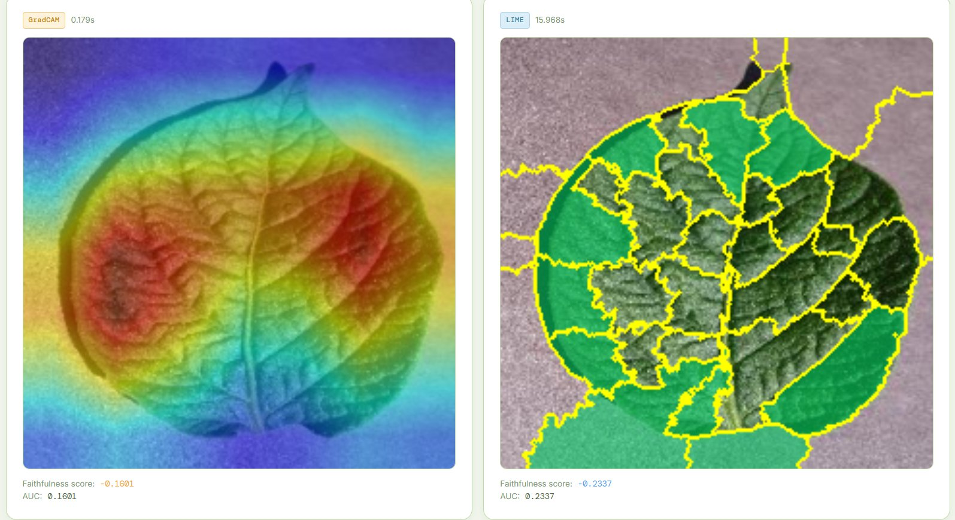
BEYOND THE CURRICULUM
Putting It Into Practice
I extended the internship's computer-vision skills into an independent applied project — training a CNN and comparing explainability methods on a real-world image dataset.
96.93%
Classification accuracy achieved by the trained CNN model
20,600+
Labeled images used across 16 real-world categories
2
Explainability (XAI) methods benchmarked for reliability
Same foundation, applied further: CNNs, image classification, and model evaluation — the core skills from this internship.
Comparing where two explainability methods focus their attention
12

Slide 13

CHAPTER 4.9
Expected Outcomes
Practical understanding of how neural networks are built and trained using TensorFlow
Clear grasp of how object detection and image classification models work
Understanding of the basic idea behind product image search using AI
Improved problem-solving and analytical skills through hands-on practice
Successfully completed the internship with an 'O' (Outstanding) grade
13

Slide 14
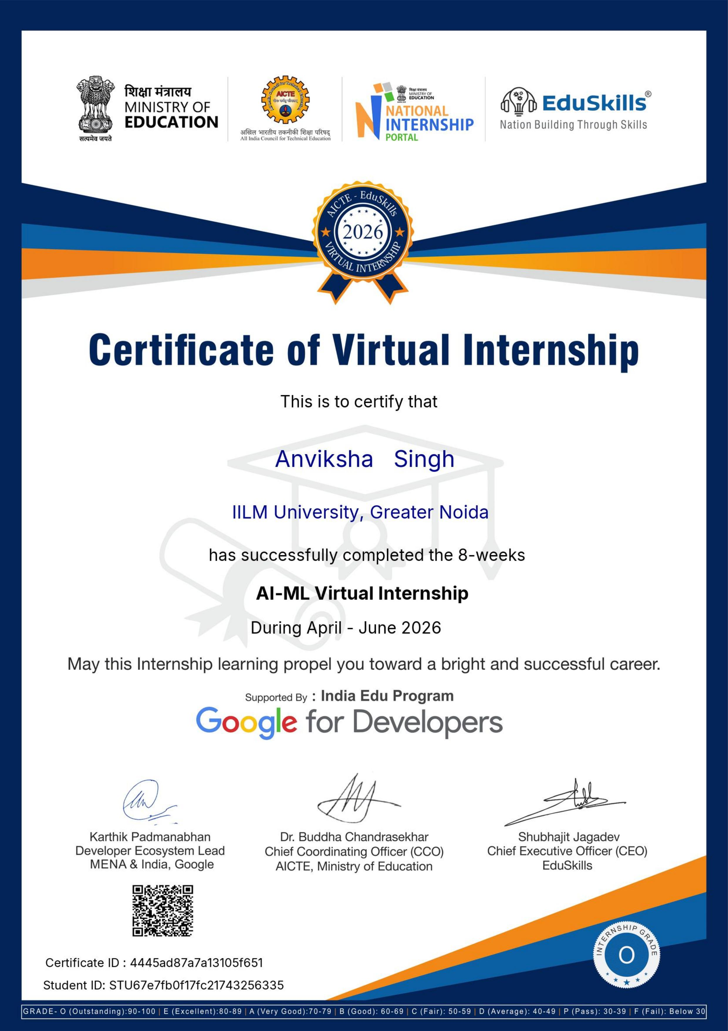
CHAPTER 4.10
Certificate of Completion
Issued to Anviksha Singh, IILM University, Greater Noida
PROGRAM
AI-ML Virtual Internship — 8 Weeks
DURATION
April – June 2026
ISSUED BY
EduSkills Foundation, supported by Google for Developers
COORDINATED BY
AICTE, Ministry of Education — National Internship Portal
GRADE ACHIEVED
O (Outstanding)
14

Slide 15

Thank You
Questions & Discussion Welcome
Anviksha Singh • CS-2341031 • B.Tech CSE, 7th Semester • IILM University, Greater Noida

