Slide 1

Mappr
Android app for Mappr.in

Slide 2
Hi, we are team AnvilCode
Rajeev Yadav
Mohd. Sohail Khan
Chetanya Kandhari
Pawan Yadav

Slide 3
The story…
Today, Internet is vital to all learning. Social media plays an important role in our lives.
As said by Dr. Barbara Oakley (professor, learning how to learn), “The best way to learn a skill is through diffusion from those who know.”
As a result, communication is vital. But social media can also be distracting. So we present a social media just for students… Mappr

Slide 4
Our Hack
90% of the users spend more time on their phone’s that on a Laptop/PC.
We have made sure that users use the app more frequently for each type of user.

Slide 5
Key Features
For the Students…
For their Parents…
For the Teachers…
For the institute…

Slide 6
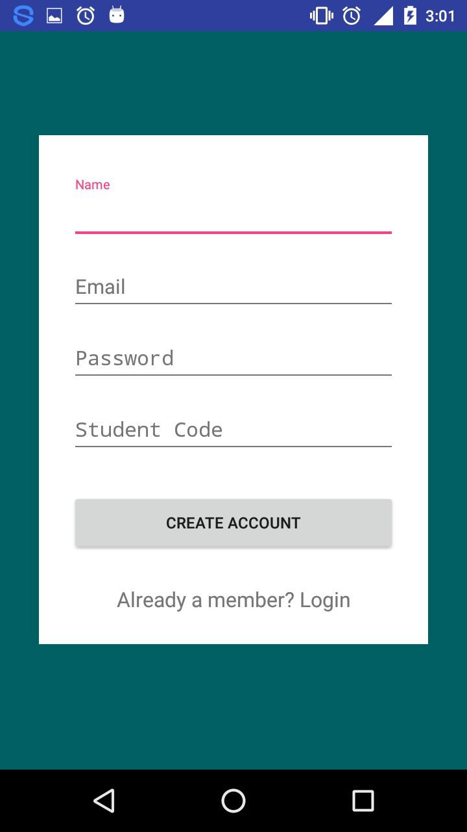
Sign-Up

Slide 7
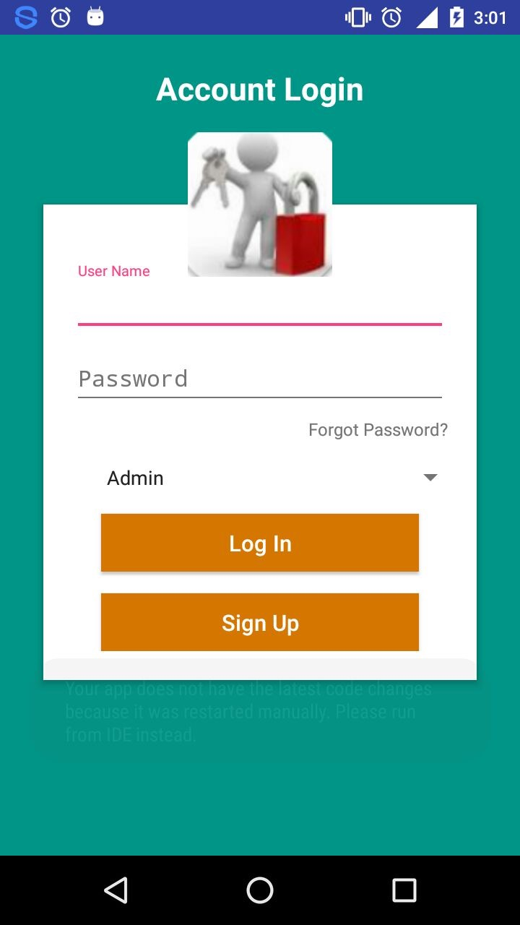
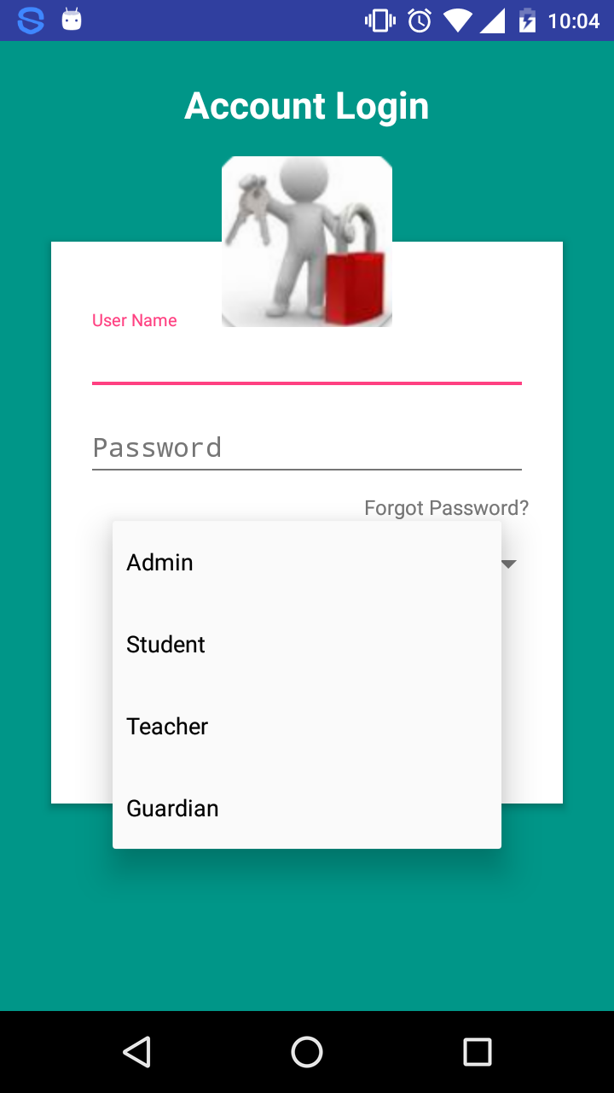
Login

Slide 8
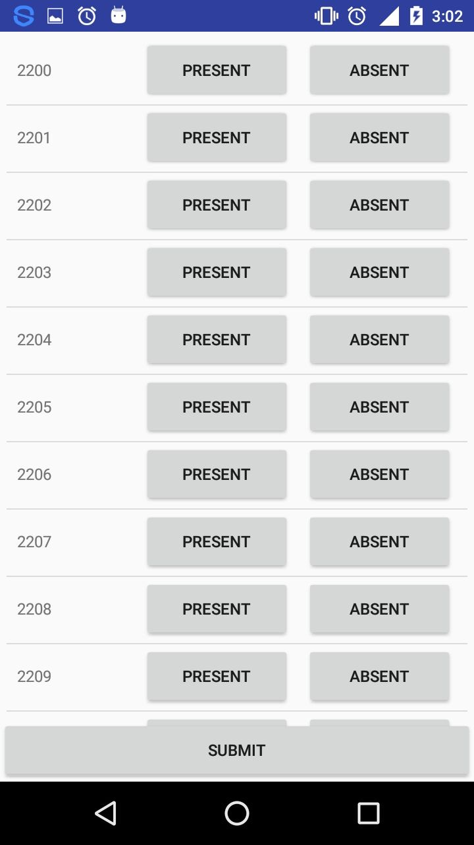
Attendance

Slide 9
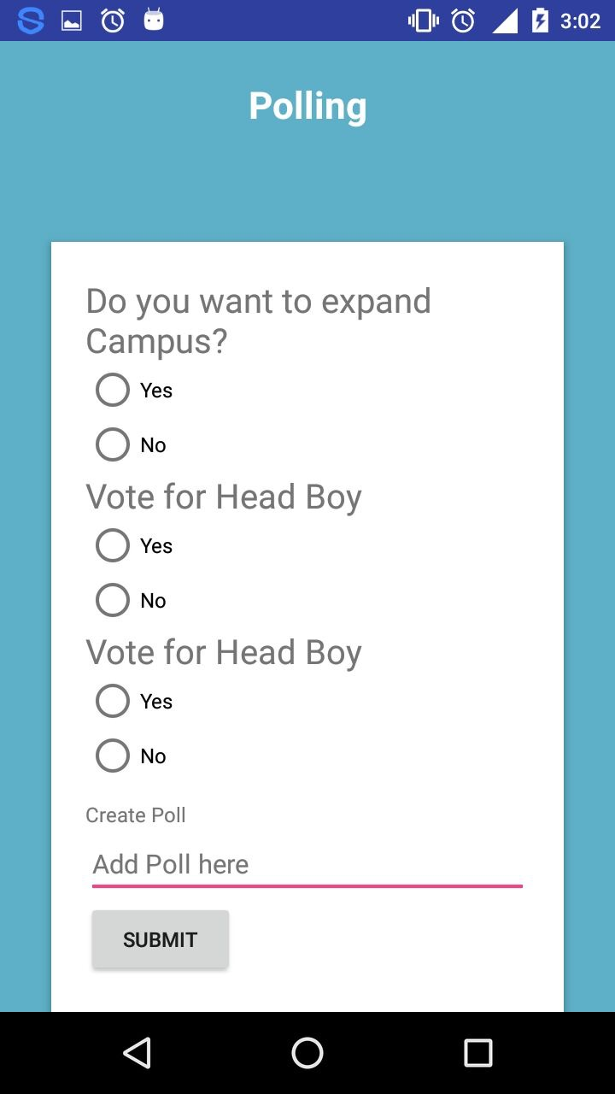
Polls

Slide 10
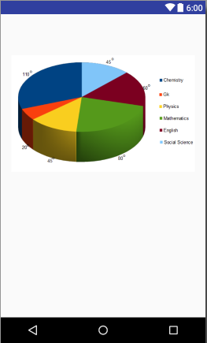
Student Details

Slide 11


