Slide 1

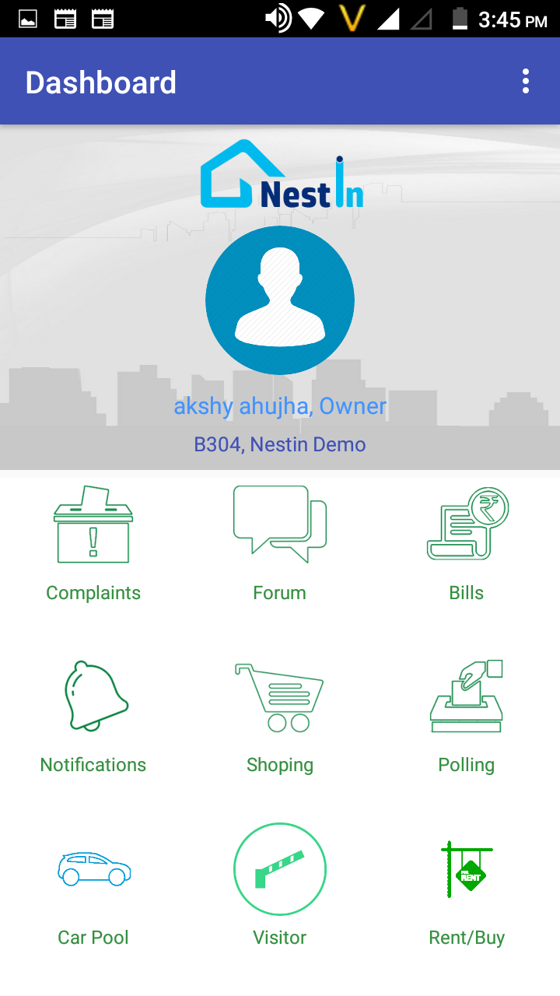

A COMPLETE SOCIETY MANAGEMENT SYSTEM
RIDE SHARE
NOTIFICATION VIA SMS
IMPORTANT EVENTS ALERTS
OPINIONS POLLS & DISCUSSION FORUM
Notes:
Now upgrade your society with NESTIN. An app for all your day to day problems, from vendor management, advanced security system to share your ride feature and much more all in just one app.

Slide 2
A COMPLETE SOCIETY MANAGEMENT SYSTEM
RIDE SHARE
NOTIFICATION VIA SMS
IMPORTANT EVENTS ALERTS
OPINIONS POLLS & DISCUSSION FORUM
Notes:
NESTIN simplify the complexities of RWA operations and helps build a better communication system between the residents and RWA

Slide 3
A Complete Society Management System
Notes:
NESTIN simplify the complexities of RWA operations and helps build a better communication system between the residents and RWA

Slide 4
A Complete Society Management System
Notes:
A single system solving all your daily needs of gated communities. share rides with people you trust, pay bills instantly, manage your visitor's and store their past visit, improved security system and much more.

Slide 5
A Complete Society Management System
Notes:
A single system solving all your daily needs of gated communities. share rides with people you trust, pay bills instantly, manage your visitor's and store their past visit, improved security system and much more.

Slide 6

Our Clients
Egis India.
Pinnacle Geo-system
Dr. Sundeep Goyal
BHEL, Haridwar
Advisory On Demand
Nestin
Anvisys technology Pvt. Ltd

Slide 7
A Complete Society Management System
Notes:
Now upgrade your society with NESTIN. An app for all your day to day problems, from vendor management, advanced security system to share your ride feature and much more all in just one app.

Slide 8
01
Steady Growth
Working in integration with all the levels of your business in order to achieve organizational goals by
02
Technical Support
03
Upgrade & Maintenance
Efficient backend support in order to ensure smooth running of process
Working on abundance of data maintenance & analyzing it in an orderly manner through various digital tools.
04
Problem Solving Solution
A good I.T infrastructure to solve various problems like database management, coding, developing & testing to transform your day to day manual operations to a digitalized way.
Notes:
With us take one step closer towards your goal. Anvisys your trusted I.T and Partner and consultant.

Slide 9
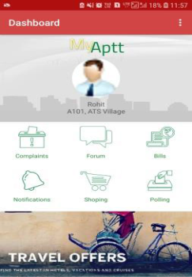
GO PAPER LESS
Sophisticated way to manage large tenant data
Affordable and Durable
Low cost and store large history of data
Time Management
Reduce time and provide efficiency
Easy Accessible
Access past tenant records easily
User Friendly
Now manage data on your smart phones easily
Automation
JUST VERIFY WITH A CLICK LEAVE THE BACKEND WORK TO US
Notes:
Now manage large complex tenant's data easily, dissemenate important notice to all the residents in one go! Forget worrying about maintaining a register for bill payments and dues. NESTIN!! empowering your society digitally.

Slide 10
01
Steady Growth
Working in integration with all the levels of your business in order to achieve organizational goals by
02
Technical Support
03
Upgrade & Maintenance
Efficient backend support in order to ensure smooth running of process
Working on abundance of data maintenance & analyzing it in an orderly manner through various digital tools.
04
Problem Solving Solution
A good I.T infrastructure to solve various problems like database management, coding, developing & testing to transform your day to day manual operations to a digitalized way.
Notes:
Anvisys your trusted I.T and Partner and consultant. We provide growth keeping up the latest trends in technology.

Slide 11






Anvisys technology Pvt. Ltd.
I.T
SOLUTIONS
&
CONSULTING
Notes:
Anvisys Technologies bring you closer to technology. We help you enhancing your operation by technology integration

Slide 12
Anvisys Technology Pvt. Ltd
your Trusted IT solution and consulting partner
Complete IT support
Latest technology
Problem solving solutions
Timely completion of projects
Notes:
Anvisys Technology
www.Anvisys.net contact us.

Slide 13

What we do ?
Anvisys technology Pvt. Ltd
Most preferred IT Partner to our client.by Helping our clients achieve their Goals
I.T consultant Mobile (Android Application)
Web Application ( Angular, Node, Dot Net)
SQL, MONGODB
Focus
Client’s Goal
Latest Technology
Efficient Team
Notes:
Anvisys Technologies bring you closer to technology. We help you enhancing your operation by technology integration

Slide 14

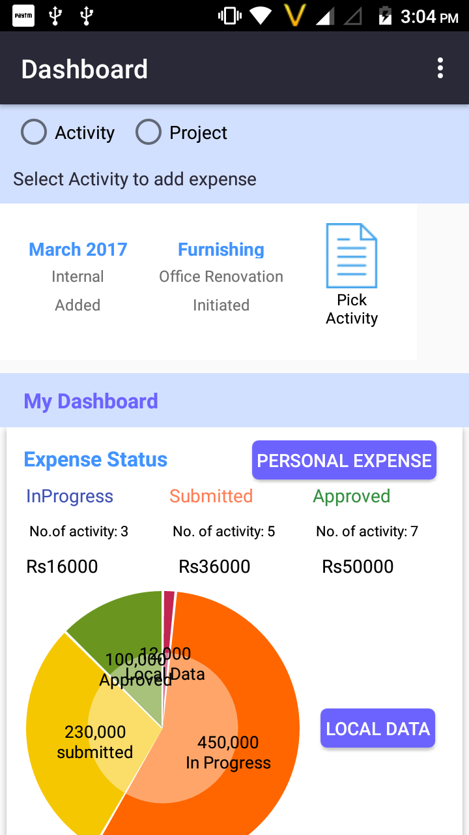
+150%
X- PEN
17,9871
9,9871
+120%
Expense and Accounting Management for personal and organization needs
+110%
5,9871
-50%
3,9871
7,9871
-30%
Projects Sale, purchase entries by Project Manager
Salary, Capex and other transaction by Accounts

Slide 15

Android Studio - For best performance android application written in Java
Anvisys technology Pvt. Ltd
Angular – A TypeScript (superset of JavaScript) based framework to develop high performance, modular , Single Page Web Application
ASP.Net - Server-side web application framework designed for web development by Microsoft
OUR AREA OF EXPERTISE
jQuery – Simplify working with HTML, JavaScript, and CSS
Window Presentation Foundation (WPF) - An XML based GUI framework Windows-based applications
Word Press – Most popular CMS to build and manage your website.
Notes:
Anvisys Technology Pvt.Ltd. We provide a range of services to carter our clients from various industry.

Slide 16
Let’s Catch-up
Share your location with your friends
Receive location shared by your friends
.
Get the Route, Location and Time Difference
Notes:
Now track your close ones by Let’s catch-up. With live tracking and location sharing .

Slide 17
Our Mission
We aim to be the most preferred IT partner to our clients by helping the achieve their goals
We focus on our client’s goal. Keeping up with the latest technology used to provide support to our clients.
Anvisys is all about providing a platform to our team members to learn and be more efficient to serve the diverse needs of our clients

Slide 18
Problem Solving Solution
Working on abundance of data maintenance & analyzing it in an orderly manner through various digital tools.
Upgrade & Maintenance
Technical Support
A good I.T infrastructure to solve various problems like database management, coding, developing & testing to transform your day to day manual operations to a digitalized way.
Efficient backend support in order to ensure smooth running of process
THINK
BIGGER
Steady Growth
Working in integration with all the levels of your business in order to achieve organizational goals by
Anvisys technology Pvt. Ltd

Slide 19
WE AIM TO MAINTAIN A LONG TERM RELATION WITH OUR CLIENTS BY PROVIDING A RANGE OF SERVICES.
Staffing – Software Professionals
End to End Software Solutions
Android , Desktop, Web, DB
Services
Geographical Information System(GIS
Software Testing
Anvisys technology Pvt. Ltd
Notes:
Types of services we offer

Slide 20
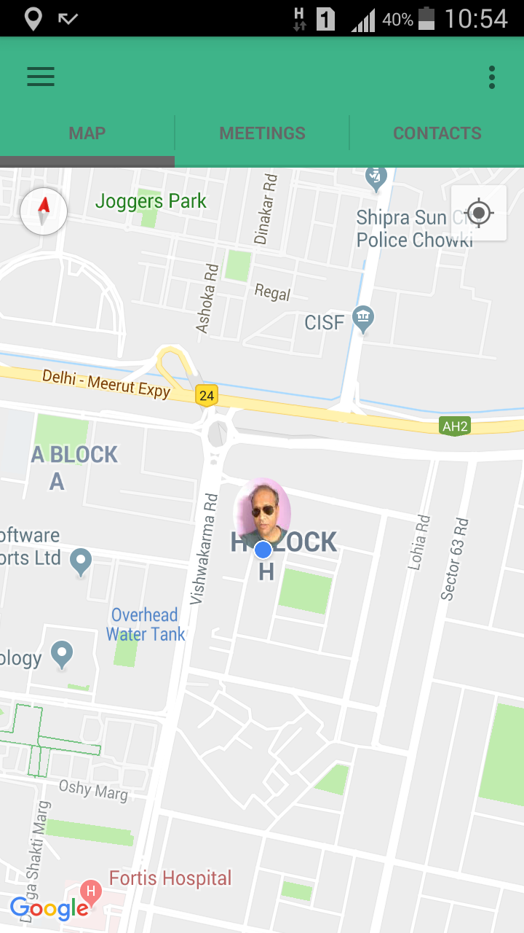
Let’s Catch-up
Share your location with your friends
Receive location shared by your friends
.
Get the Route, Location and Time Difference
Notes:
Now track your close ones by Let’s catch-up. With live tracking and location sharing .

Slide 21
Xml for UI, Core Java for Business Logic, API or services to read/write data Android Studio : Native Android Development tool
Android Application
1
Html CSS Java Script
Web Application
2
Word press Angular JS
Angular 4.0
ASP.net
Desktop Application
3
MYSQL
Mongo DB
SQLServer
Database Designing
4
Notes:
What we do ?

Slide 22
Result web service
Small size solutions of team of 5 to 10 resources:
Android Application
Web Application
Database Designing
Microservices and Service
Non Functional
Architecture: Monolithic, Service Oriented Architecture,
Microservice Architecture
Security: Database level, OAuth, SSL, Cloud Security
Methodology : Agile, Waterfall, iterative
Web service
Client
HTTP request
JSON/XML
Device
Web Apps Desktop
Database

Slide 23
Software Solutions we Offer
2
1
Desktop Application
Android Application
4
Web Application
3
Database Designing

Slide 24

We area of expertise
jQuery is a JavaScript library designed to simplify HTML DOM tree traversal and manipulation, as well as event handling, CSS animation, and Ajax.
Windows Presentation Foundation (WPF) is a graphical subsystem by Microsoft for rendering user interfaces in Windows-based applications
AngularJS is a JavaScript-based open-source front-end web framework mainly maintained by Google and by a community of individuals and corporations to address many of the challenges encountered in developing single-page applications
Support area’s
.NET is a developer platform made up of tools, programming languages, and libraries for building many different types of applications.
Android development for mobile application building
Word Press is a free and open-source content management system based on PHP & MySQL. Features include a plug-in architecture and a template system.
Project Management Professional is an internationally recognized professional designation offered by the Project Management Institute

Slide 25

PRODUCT 3
PRODUCT 2
NESTIN
PRODUCT 2
X- PEN
PRODUCT 1
PRODUCT 1
Let’s Catch-up
Society Management System
Car pooling
Easy Payment of Bills
Upgraded Security for society
Vendor management
Salary, Capex and other transaction by Accounts
Expense and Accounting Management for personal and organization needs
Projects Sale, purchase entries by Project Manager
3
Our products
Share your location with your friends
Receive location shared by your friends
Get the Route, Location and Time Difference
Share your location with your friends
Receive location shared by your friends
2
1

Slide 26
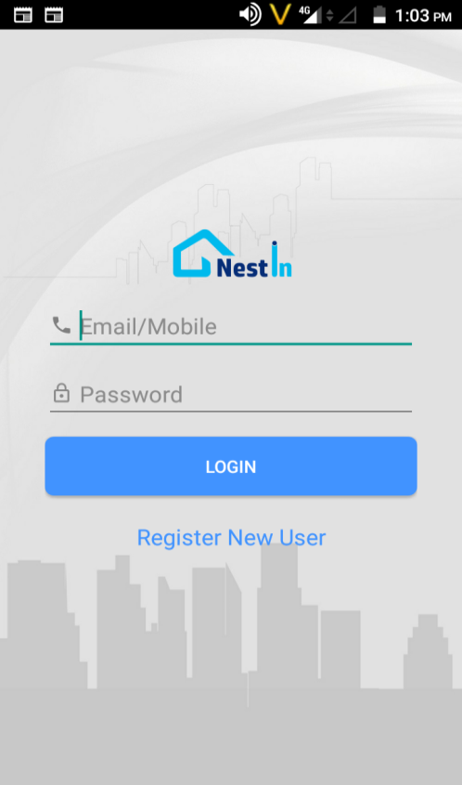
A Complete Society Management System

Slide 27
WordPress
Web Design
Web Development
Hosting
Domain Registration
Support
Marketing
Maintenance
SEO
Ecommerce

Slide 28


Slide 29
WE keep up with the latest trends to better serve our clients
Web design & development
Database management

Slide 30
A Complete Society Management System
.
1
Maintain tenants records
Car pooling
Security for Society
Easy payments
Rent in & out
.
2
3
4
.
5

Slide 31
A Complete Society Management System
Stay connected to all the important notice in our society
1
.
2
Get all tenants ,bills invoice records on the go
3
Get instant alerts on everything on the go .

