Slide 1







Anvisys technology Pvt. Ltd.
I.T
SOLUTIONS
&
CONSULTING

Slide 2

ABOUT US
OUR MISSION
OUR VISION
I.T consultant Mobile (Android Application)
Web Application ( Angular, Node, Dot Net)
SQL, MONGODB
Focus
Client’s Goal
Latest Technology
Efficient Team
Most preferred IT Partner to our client.
BY
Helping our clients achieve their Goals
Anvisys technology Pvt. Ltd
Notes:
To get in touch with us visit www.Anvisys.net

Slide 3
What do we do ?
1
2
Android , Desktop, Web
End to End Software Solutions
Staffing
Software Professionals
Anvisys Technology Pvt. Ltd.
YOUR TRUSTED IT AND CONSULTING PARTNER
3
4
(GIS)
Geographical Information System
Software Testing

Slide 4
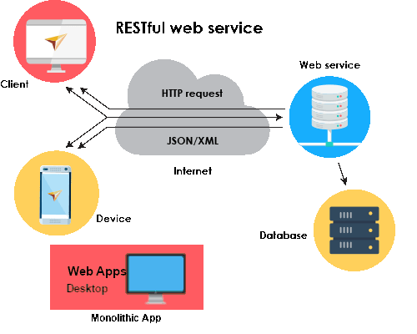
End to End Software Solution
Small size solutions of team of 5 to 10 resources:
Android Application
Web Application
Database Designing
Microservices and Service
Non Functional
Architecture: Monolithic, Service Oriented Architecture,
Microservice Architecture
Security: Database level, OAuth, SSL, Cloud Security
Methodology : Agile, Waterfall, iterative

Slide 5
Result web service
Web service
Client
HTTP request
JSON/XML
Device
Web Apps Desktop
Database

Slide 6
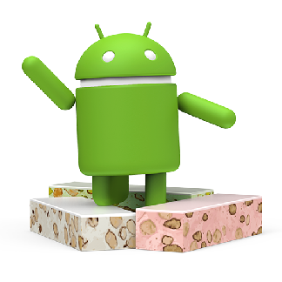
Android Development
Android Studio : Native Android Development tool
Xml for UI,
Core Java for Business Logic,
API or services to read/write data
Google Map API
Google Cloud Message / Firebase Messages
SQL lite for local Database,
Android Machine Learning kit for QR Code

Slide 7
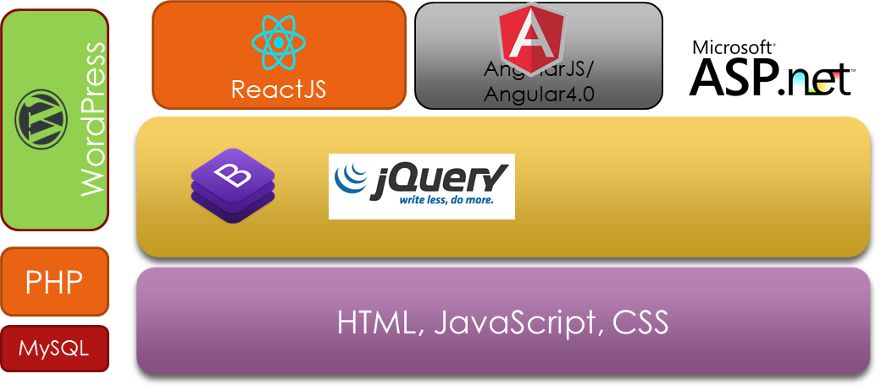
Web Development
ASP.Net with C# as Code Behind
Bootstrap and Jquery for effective and efficient handling of html, css
Angular 2.0 +, Angular JS, Node JS
Word Press - CMS

Slide 8
Backend and Database
Business Logic – Services
DotNet WebAPI – C#
NodeJS WebAPI
Data Base
Microsoft SQL Server
MongoDB
MySQL

Slide 9
Why you need our IT services & consulting ?
01
Steady Growth
Working in integration with all the levels of your business in order to achieve organizational goals by
02
Technical Support
03
Upgrade & Maintenance
Efficient backend support in order to ensure smooth running of process
Working on abundance of data maintenance & analyzing it in an orderly manner through various digital tools.
04
Problem Solving Solution
A good I.T infrastructure to solve various problems like database management, coding, developing & testing to transform your day to day manual operations to a digitalized way.

Slide 10
STEP 2
Anvisys technology Pvt. Ltd
Work in integration with all your departments digitally with our support
STEP 1
Provide various I.T Solutions as per your problems
STEP 3
Design database system & infrastructure more efficiently
STEP 5
STEP 4
Our technical team works on Android ASP.Net,Anjular JS, Anjular 6.0, Dot Net Web API.
We provide Mobile app development and Web solutions

Slide 11

Our area of Expertise
jQuery is a JavaScript library designed to simplify HTML DOM tree traversal and manipulation, as well as event handling, CSS animation, and Ajax.
Anvisys technology Pvt. Ltd
Windows Presentation Foundation (WPF) is a graphical subsystem by Microsoft for rendering user interfaces in Windows-based applications
AngularJS is a JavaScript-based open-source front-end web framework mainly maintained by Google and by a community of individuals and corporations to address many of the challenges encountered in developing single-page applications
OUR AREA OF EXPERTISE
Android development for mobile application building
.NET is a developer platform made up of tools, programming languages, and libraries for building many different types of applications.
Project Management Professional is an internationally recognized professional designation offered by the Project Management Institute
Word Press is a free and open-source content management system based on PHP & MySQL. Features include a plug-in architecture and a template system.

Slide 12



Anvisys technology Pvt. Ltd
PRODUCT 3
PRODUCT 2
NESTIN
PRODUCT 2
X- PEN
PRODUCT 1
PRODUCT 1
Society Management System
Car pooling
Easy Payment of Bills
Upgraded Security for society
Vendor management
Let’s Catch-up
Share your location with your friends
Receive location shared by your friends
Get the Route, Location and Time Difference
Salary, Capex and other transaction by Accounts
Expense and Accounting Management for personal and organization needs
Projects Sale, purchase entries by Project Manager
3
Share your location with your friends
Receive location shared by your friends
2
1

Slide 13
Desktop Application
Android Application
Database Designing
Web Application
SOFTWARE SOLUTION WE PROVIDE

Slide 14
Xml for UI, Core Java for Business Logic, API or services to read/write data Android Studio : Native Android Development tool
Android Application
1
Html CSS Java Script
Web Application
2
Word press Angular JS
Angular 4.0
ASP.net
Desktop Application
3
MYSQL
Mongo DB
SQLServer
Database Designing
4

Slide 15

Egis India
BHEL, Haridwar
OUR CLIENTS
Pinnacle Geosystem
Advisory On Demand
Dr. Sundeep Goyal
Nestin

Slide 16
WE AIM TO MAINTAIN A LONG TERM RELATION WITH OUR CLIENTS BY PROVIDING A RANGE OF SERVICES.
Staffing – Software Professionals
End to End Software Solutions
Android , Desktop, Web, DB
Services
Geographical Information System(GIS
Software Testing
Anvisys technology Pvt. Ltd
Notes:
Need to change the message at the top as per the requirement
Slide is about the services we offer to our clients.

Slide 17
Anvisys Technology Pvt. Ltd
YOUR TRUSTED I.T AND CONSULTING PARTNER
Complete IT support
Latest technology
Problem solving solutions
Timely completion of projects
Notes:
Poster for anvisys branding
Colour of the top needs to be changed accordingly
Fonts have been enhanced and aligned

