Slide 1

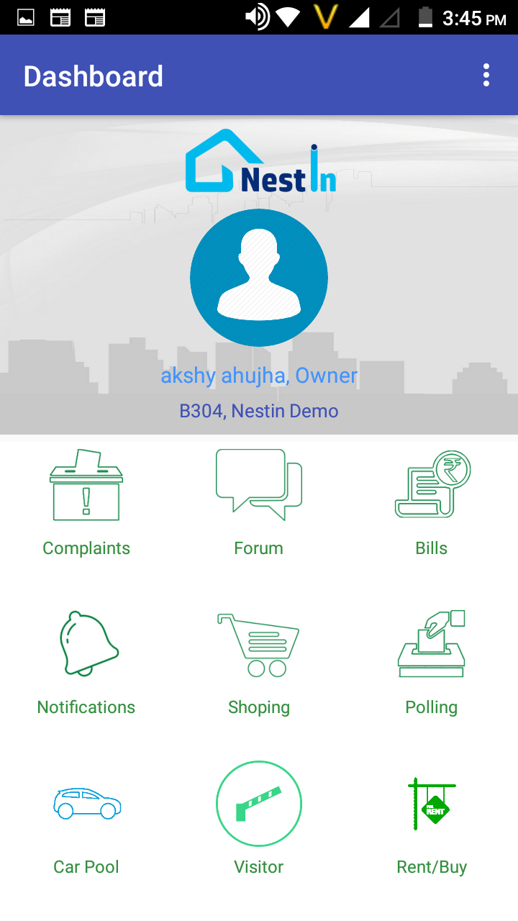

A COMPLETE SOCIETY MANAGEMENT SYSTEM
RIDE SHARE
NOTIFICATION VIA SMS
IMPORTANT EVENTS ALERTS
OPINIONS POLLS & DISCUSSION FORUM
Notes:
Now upgrade your society with NESTIN. An app for all your day to day problems, from vendor management, advanced security system to share your ride feature and much more all in just one app.

Slide 2
A COMPLETE SOCIETY MANAGEMENT SYSTEM
RIDE SHARE
NOTIFICATION VIA SMS
IMPORTANT EVENTS ALERTS
OPINIONS POLLS & DISCUSSION FORUM
Notes:
NESTIN simplify the complexities of RWA operations and helps build a better communication system between the residents and RWA

Slide 3
A Complete Society Management System
Notes:
NESTIN simplify the complexities of RWA operations and helps build a better communication system between the residents and RWA

Slide 4
A Complete Society Management System
Notes:
A single system solving all your daily needs of gated communities. share rides with people you trust, pay bills instantly, manage your visitor's and store their past visit, improved security system and much more.

Slide 5
A Complete Society Management System
Notes:
A single system solving all your daily needs of gated communities. share rides with people you trust, pay bills instantly, manage your visitor's and store their past visit, improved security system and much more.

Slide 6
A Complete Society Management System
Notes:
Now upgrade your society with NESTIN. An app for all your day to day problems, from vendor management, advanced security system to share your ride feature and much more all in just one app.

Slide 7
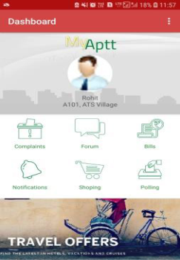
GO PAPER LESS
Sophisticated way to manage large tenant data
Affordable and Durable
Low cost and store large history of data
Time Management
Reduce time and provide efficiency
Easy Accessible
Access past tenant records easily
User Friendly
Now manage data on your smart phones easily
Automation
JUST VERIFY WITH A CLICK LEAVE THE BACKEND WORK TO US
Notes:
Now manage large complex tenant's data easily, dissemenate important notice to all the residents in one go! Forget worrying about maintaining a register for bill payments and dues. NESTIN!! empowering your society digitally.

Slide 8
01
Steady Growth
Working in integration with all the levels of your business in order to achieve organizational goals by
02
Technical Support
03
Upgrade & Maintenance
Efficient backend support in order to ensure smooth running of process
Working on abundance of data maintenance & analyzing it in an orderly manner through various digital tools.
04
Problem Solving Solution
A good I.T infrastructure to solve various problems like database management, coding, developing & testing to transform your day to day manual operations to a digitalized way.
Notes:
With us take one step closer towards your goal. Anvisys your trusted I.T and Partner and consultant.

Slide 9
01
Steady Growth
Working in integration with all the levels of your business in order to achieve organizational goals by
02
Technical Support
03
Upgrade & Maintenance
Efficient backend support in order to ensure smooth running of process
Working on abundance of data maintenance & analyzing it in an orderly manner through various digital tools.
04
Problem Solving Solution
A good I.T infrastructure to solve various problems like database management, coding, developing & testing to transform your day to day manual operations to a digitalized way.
Notes:
Anvisys your trusted I.T and Partner and consultant. We provide growth keeping up the latest trends in technology.

Slide 10







Anvisys technology Pvt. Ltd.
I.T
SOLUTIONS
&
CONSULTING
Notes:
Anvisys Technologies bring you closer to technology. We help you enhancing your operation by technology integration

Slide 11


Android Studio - For best performance android application written in Java
Anvisys technology Pvt. Ltd
Angular – A TypeScript (superset of JavaScript) based framework to develop high performance, modular , Single Page Web Application
ASP.Net - Server-side web application framework designed for web development by Microsoft
OUR AREA OF EXPERTISE
jQuery – Simplify working with HTML, JavaScript, and CSS
Window Presentation Foundation (WPF) - An XML based GUI framework Windows-based applications
Word Press – Most popular CMS to build and manage your website.
Notes:
Anvisys Technology Pvt.Ltd. We provide a range of services to carter our clients from various industry.

Slide 12
Let’s Catch-up
Share your location with your friends
Receive location shared by your friends
.
Get the Route, Location and Time Difference
Notes:
Now track your close ones by Let’s catch-up. With live tracking and location sharing .

Slide 13
What we do ?
Anvisys technology Pvt. Ltd
Most preferred IT Partner to our client.by Helping our clients achieve their Goals
I.T consultant Mobile (Android Application)
Web Application ( Angular, Node, Dot Net)
SQL, MONGODB
Focus
Client’s Goal
Latest Technology
Efficient Team
Notes:
Anvisys Technologies bring you closer to technology. We help you enhancing your operation by technology integration

