Slide 1

Anvisys Technology Pvt Ltd
Your Trusted IT Solution and Consulting Partner
Office address: 63 Noida,Uttar Pradesh, H Block,Sector
www.Anvisys.online
Number: 9591033223

Slide 2

About Us
Anvisys provides various I.T solution to a range of diverse clients in the industry
We update our clients with all the latest & trending technologies
We ensure quick delivery in less time, for quick implantation of projects in the market
Ready to take an extra step to meet the client’s requirements

Slide 3

Our Mission
To be preferred IT partner
Helping client the achieve their goals
Match with the latest Technology
Maintain a dynamic and Skilled Team.
.

Slide 4

Simplicity is prerequisite for reliability.
“ Edsger Dijkstra”

Slide 5
Contents
Advantages of a reliable IT Support
Our Offerings
Software services
Our Products
Our clients
Meet the Team

Slide 6

WHY IT SUPPORT IS IMPORTANT?

Slide 7

Advantages of a reliable IT support
Problem Solving Solution
Technical Support
Solve various problems like database-management coding developing & testing
Efficient backend support
Steady Growth
Upgrade & Maintenance
Data maintenance & Analysing complex data
Working in integration with all the levels of your

Slide 8

Our Offerings

Slide 9
WE AIM TO MAINTAIN A LONG TERM RELATION WITH OUR CLIENTS
End to End Software Solutions
Android , Desktop, Web, DB
Staffing – Software Professionals
Software Testing
Geographical Information System(GIS
.

Slide 10
Software Services
Web service
Web Client
HTTP request
JSON/XML
MobileDevice
Desktop
Database

Slide 11
Our Forte
Services Include
Web Application
Database Designing
Android Application
Micro services and Service
Non-Functional
Architecture: Monolithic, SOA, Micro service
Security: Database level, OAuth, SSL, Cloud Security
Methodology: Agile, Waterfall, Iterative

Slide 12
Our Products

Slide 13

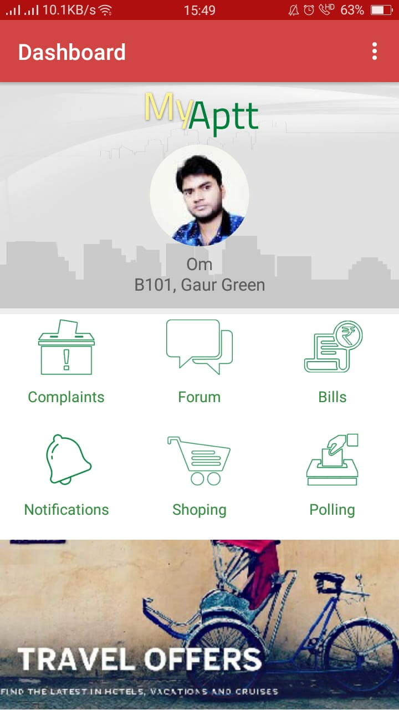
Nestin- A Complete Society Management System
Place your screenshot here
Visitor Management
Notice Board
Forum & Discussions
Vendor Directory
Complaint Management
SMS Notification
Rent in & Rent Out

Slide 14
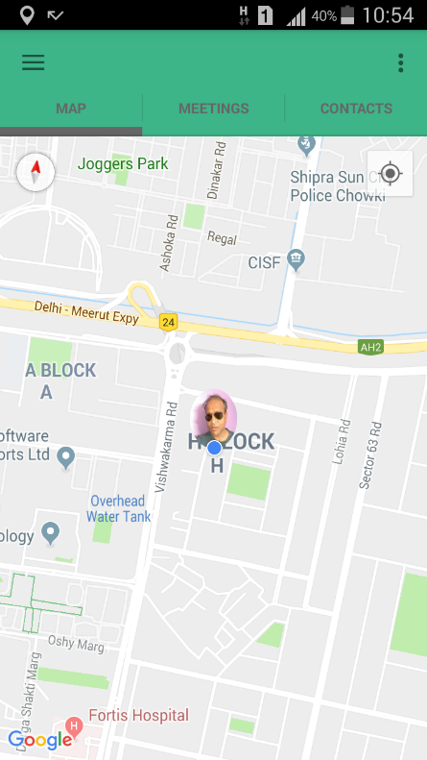
Let’s Catch up
Place your screenshot here
Share your location with your friends
Receive location shared by your friends
Get the Route, Location and Time Difference

Slide 15

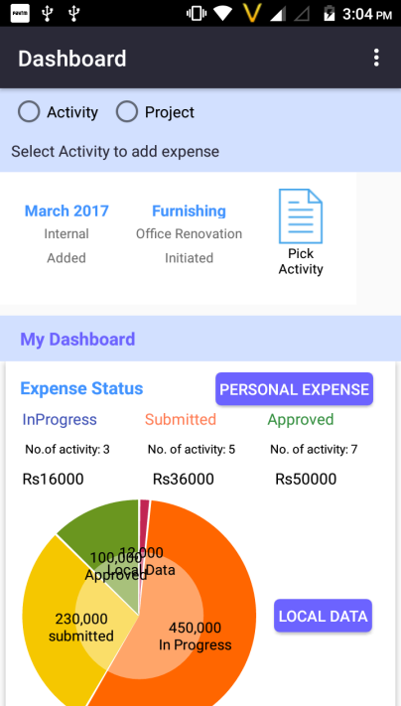
X PEN- Expense & Accounting System
Place your screenshot here
Expense and Accounting Management for personal and organization needs
Salary, Capex and other transaction by Accounts
Projects Sale, purchase entries by Project Manager
.

Slide 16
OUR CLIENTS
Egis India.
Pinnacle Geo-system
Dr. Sundeep Goyal
BHEL, Haridwar
Advisory On Demand
Nestin

Slide 17

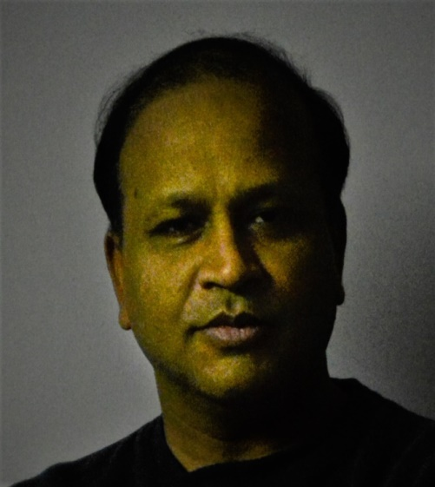
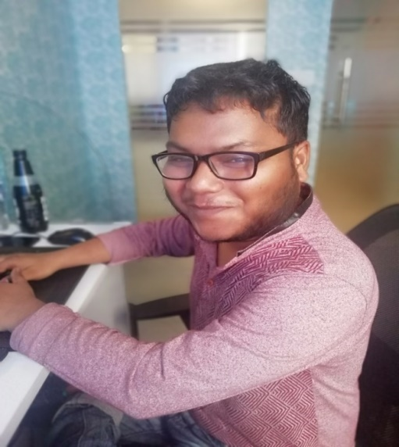
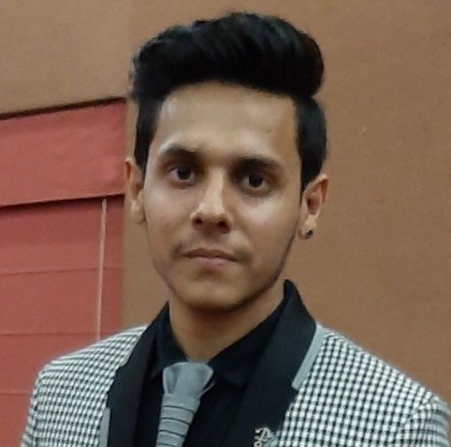
!
Meet the Team
Amit Bansal
Sagar Srivastava
Shivang Bhatnagar
DI R EC T O R M.Tech.- IIT Roorkee
A N D O I D DEVE L O P E R
B.E. Computer Science
B.E. Computer Science
2 Year Experience
3 Year Experience
18 Years Experience
W E B DE V E LO P E R

Slide 18
“THANK YOU”

