Slide 1

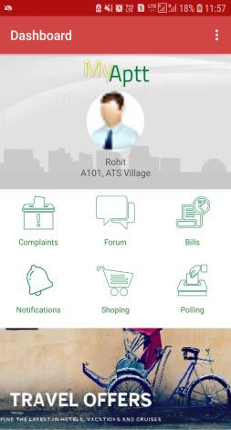

A COMPLETE SOCIETY MANAGEMENT SYSTEM
NOTIFICATION VIA SMS
IMPORTANT EVENTS ALERTS

Slide 2
A COMPLETE SOCIETY MANAGEMENT SYSTEM
NOTIFICATION VIA SMS
IMPORTANT EVENTS ALERTS

Slide 3
A COMPLETE SOCIETY MANAGEMENT SYSTEM
NOTIFICATION VIA SMS
IMPORTANT EVENTS ALERTS

Slide 4
A COMPLETE SOCIETY MANAGEMENT SYSTEM
NOTIFICATION VIA SMS
IMPORTANT EVENTS ALERTS

Slide 5
A Complete Society Management System

Slide 6
A Complete Society Management System

Slide 7
A Complete Society Management System

Slide 8
A Complete Society Management System

Slide 9
A Complete Society Management System

Slide 10

GO PAPER LESS
Sophisticated way to manage large tenant data
Affordable and Durable
Low cost and store large history of data
Time Management
Reduce time and provide efficiency
Easy Accessible
Access past tenant records easily
User Friendly
Now manage data on your smart phones easily
Automation
JUST VERIFY WITH A CLICK LEAVE THE BACKEND WORK TO US

Slide 11
01
Steady Growth
Working in integration with all the levels of your business in order to achieve organizational goals by
02
Technical Support
03
Upgrade & Maintenance
Efficient backend support in order to ensure smooth running of process
Working on abundance of data maintenance & analyzing it in an orderly manner through various digital tools.
04
Problem Solving Solution
A good I.T infrastructure to solve various problems like database management, coding, developing & testing to transform your day to day manual operations to a digitalized way.

Slide 12
01
Steady Growth
Working in integration with all the levels of your business in order to achieve organizational goals by
02
Technical Support
03
Upgrade & Maintenance
Efficient backend support in order to ensure smooth running of process
Working on abundance of data maintenance & analyzing it in an orderly manner through various digital tools.
04
Problem Solving Solution
A good I.T infrastructure to solve various problems like database management, coding, developing & testing to transform your day to day manual operations to a digitalized way.

Slide 13







Anvisys technology Pvt. Ltd.
I.T
SOLUTIONS
&
CONSULTING
Notes:
Anvisys Technologies bring you closer to technology. We help you enhancing your operation by technology integration

Slide 14


Android Studio - For best performance android application written in Java
Anvisys technology Pvt. Ltd
Angular – A TypeScript (superset of JavaScript) based framework to develop high performance, modular , Single Page Web Application
ASP.Net - Server-side web application framework designed for web development by Microsoft
OUR AREA OF EXPERTISE
jQuery – Simplify working with HTML, JavaScript, and CSS
Window Presentation Foundation (WPF) - An XML based GUI framework Windows-based applications
Word Press – Most popular CMS to build and manage your website.

Slide 15
