Slide 1
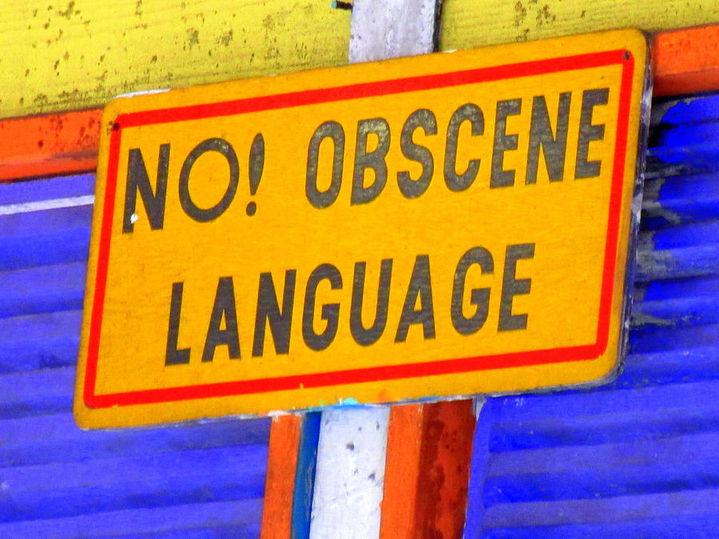
Offensive Language Detection
Team Members:
Anvita Dasari(16338363)
Srihitha Aviraboina(12590218)
Mounika Gonuguntla(16338691)
Pranathi Pulimamidi(16322907)

Slide 2
Problem Identification
Offensive language is the offence of using language in a way which could cause offence to a reasonable person or a group of people in view of a social platform.
Netizens write and post abusive language on social media in view of addressing a problem, criticize some person or thing for some reason, etc.
This leads to frustration, depression and large change in their behaviour.
An automatic discriminative software with a sensitivity parameter for abusive language detection would be a useful tool.
There are some systems which could address this problem but could not perform in an efficient way.
The proposed system is based on deep learning technique to identify the offensive language used with improved accuracy.

Slide 3
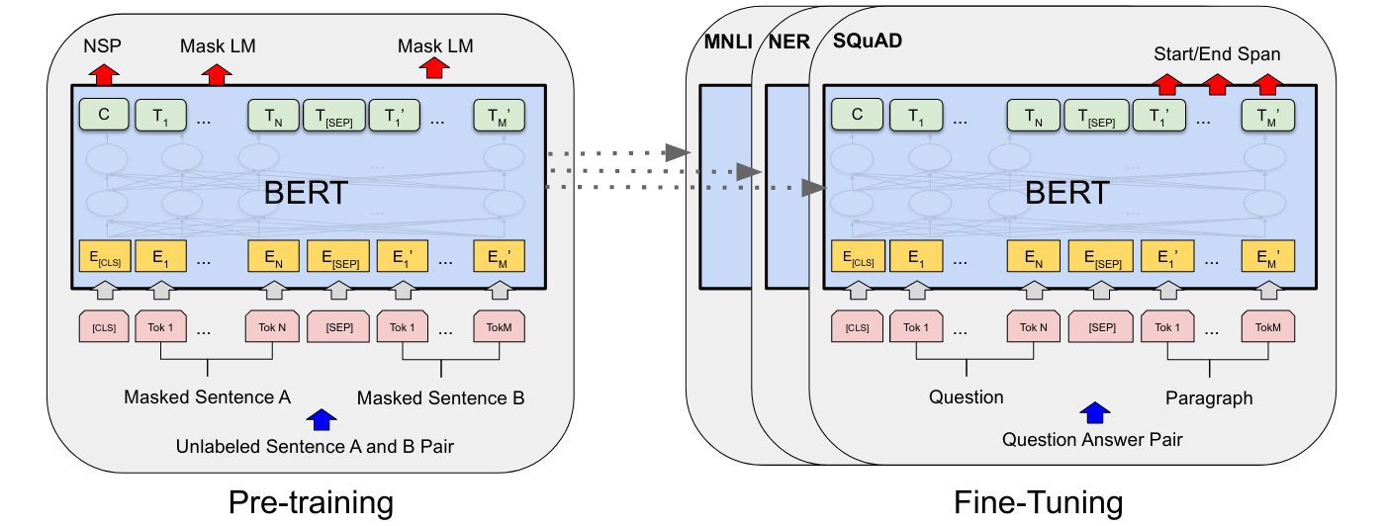
BERT
BERT is designed to pre-train deep bidirectional representations from an unlabeled text by jointly conditioning on both left and right context in all layers. As a result, the pre-trained BERT model can be fine-tuned with just one additional output layer to create state-of-the-art models for a wide range of tasks, such as question answering and language inference, without substantial task-specific architecture modifications.

Slide 4
Process flow of a BERT:
Pre-training: A BERT model is first pre-trained on a large corpus of text data using an unsupervised learning approach. During pre-training, the model is trained to predict masked tokens within a sentence and to learn the context-dependent representation of words using a multi-layer bidirectional transformer encoder.
Fine-tuning: Once the model is pre-trained, it can be fine-tuned on a smaller task-specific dataset using a supervised learning approach. During fine-tuning, the last layer(s) of the pre-trained model are replaced or augmented with a task-specific output layer(s), and the entire model is trained on the smaller dataset to learn to perform the specific task.
Input Encoding: Input text data is first tokenized into subword units using WordPiece tokenization. Each subword token is then mapped to a corresponding fixed-size vector representation called an embedding.
Encoding Layer: The token embeddings are passed through a series of transformer blocks to learn a contextualized representation of each token in the input text sequence. Each transformer block consists of multiple self-attention and feedforward neural network layers.
Task-Specific Output Layer: Depending on the specific task, the output from the last encoding layer or multiple encoding layers is passed through a task-specific output layer(s) to generate the final output. For example, in text classification tasks, the output of the last encoding layer for the first token (the "CLS" token) is often used as the input to a classification layer.
Training and Inference: The model is trained on a labeled training dataset using backpropagation and gradient descent to minimize a loss function. During inference, the model takes in a new text sequence as input and generates a prediction for the task-specific output.

Slide 5
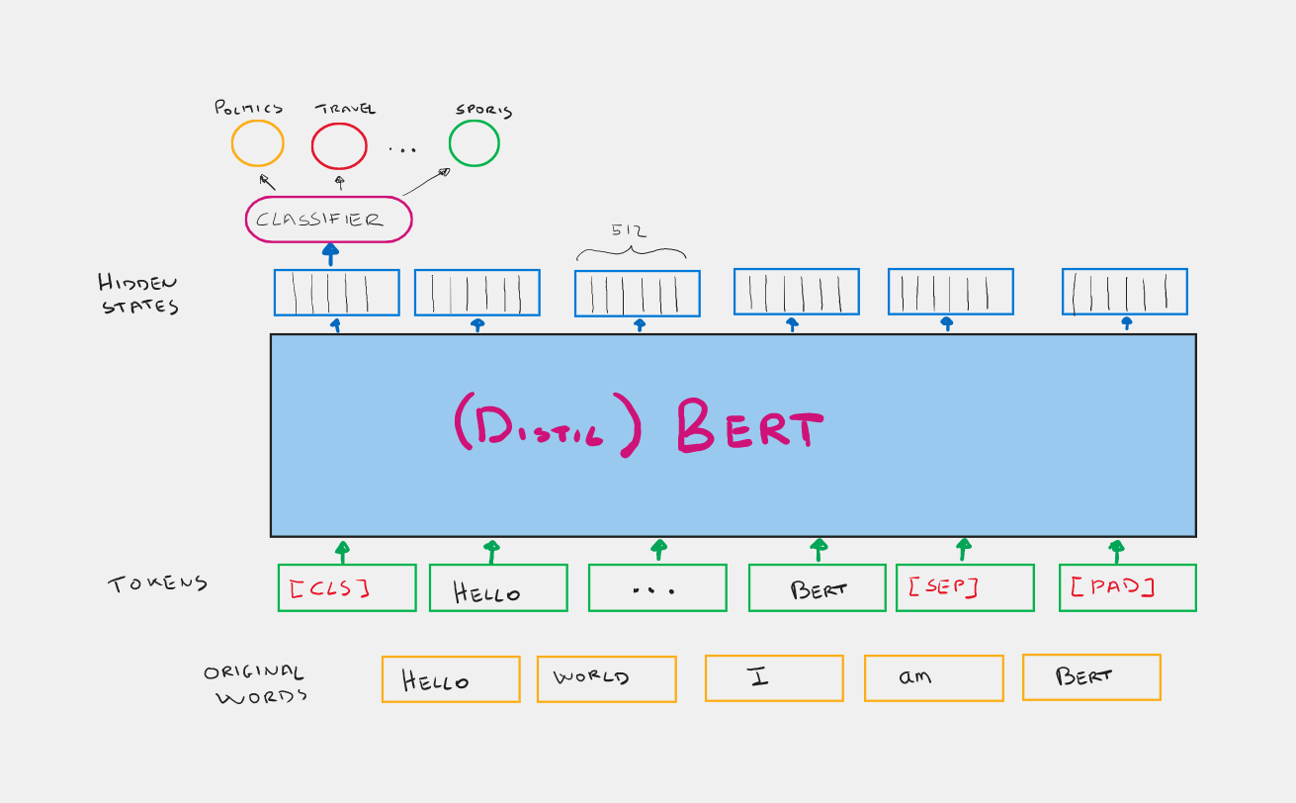
DistilBERT
DistilBERT is a small, fast, cheap and light Transformer model trained by distilling Bert base. It has 40% less parameters than bert-base-uncased, runs 60% faster while preserving over 95% of Bert’s performances as measured on the GLUE language understanding benchmark.
How does DistilBERT work?
DistilBERT uses a technique called distillation, which approximates the Google's BERT, i.e. the large
neural network by a smaller one. The idea is that once a large neural network has been trained, its full output
Distributions can be approximated using a smaller network.

Slide 6
Ktrain:
ktrain is a library to help build, train, debug, and deploy neural networks in the deep learning software framework, Keras.
ktrain allows us to easily:
estimate an optimal learning rate for your model given your data using a learning rate finder
employ learning rate schedules such as the triangular learning rate policy, 1cycle policy, and SGDR to more effectively train your model
employ fast and easy-to-use pre-canned models for both text classification (e.g., NBSVM, fastText, GRU with pretrained word embeddings) and image classification (e.g., ResNet, Wide Residual Networks, Inception)
load and preprocess text and image data from a variety of formats
inspect data points that were misclassified to help improve your model
leverage a simple prediction API for saving and deploying both models and data-preprocessing steps to make predictions on new raw data

Slide 7
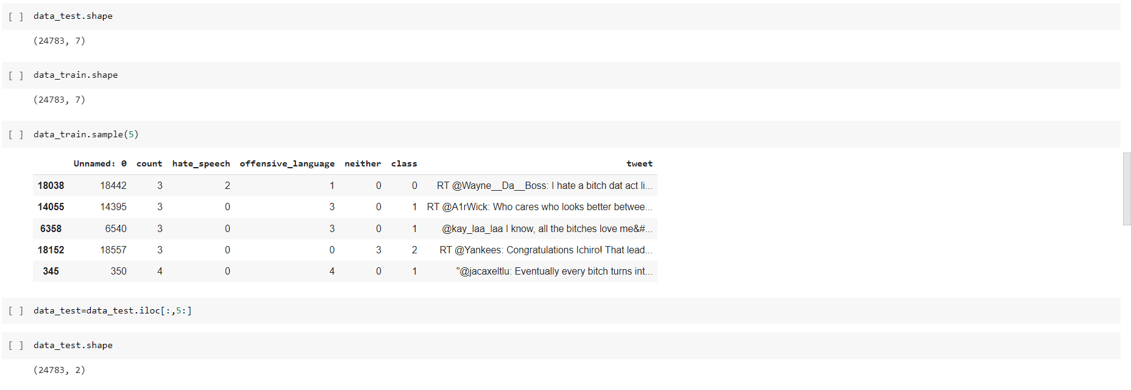
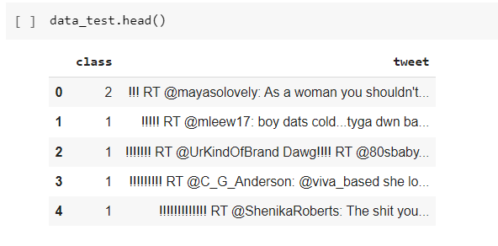
Utilizing only required data from the dataset:

Slide 8
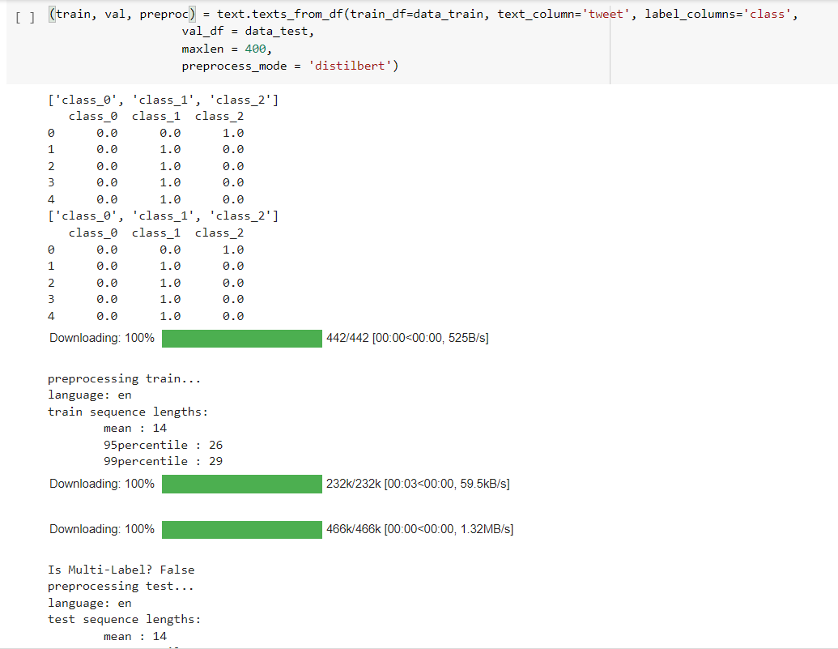
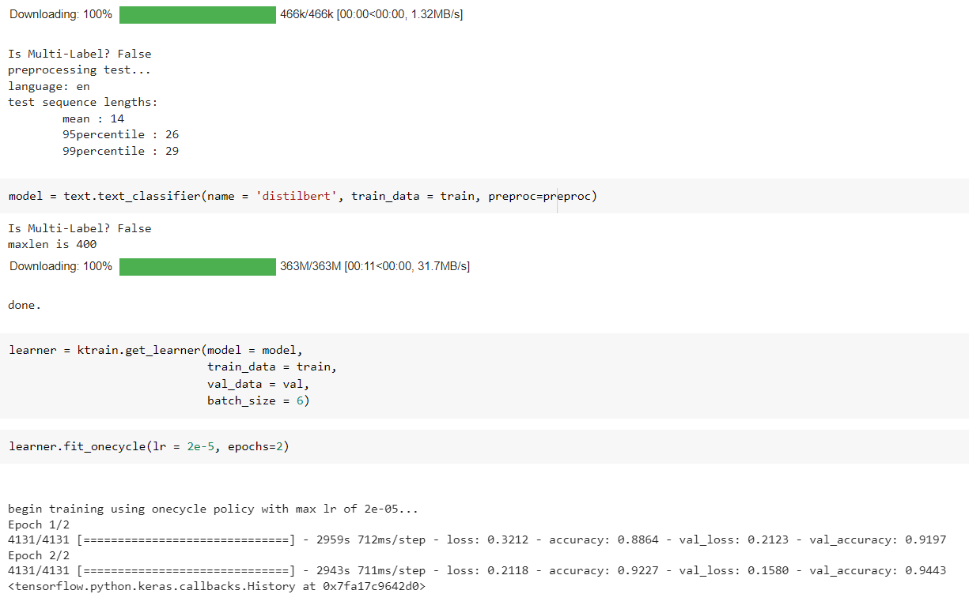
Training the model:

Slide 9
Texts_from_df method:
The "texts_from_df" method to prepare the training and validation data from two pandas dataframes, "data_train" and "data_test", which contain text data in the 'tweet' column and labels in the 'class' column.
The method takes several arguments:
"train_df": The pandas dataframe containing the training data.
"text_column": The name of the column in the dataframe that contains the text data.
"label_columns": The name of the column in the dataframe that contains the labels.
"val_df": The pandas dataframe containing the validation data.
"maxlen": The maximum length of the input sequences after tokenization. Sequences longer than this will be truncated, and sequences shorter than this will be padded.
"preprocess_mode": The name of the pre-trained transformer model to use for tokenization and preprocessing. In this case, it is 'distilbert', which refers to the DistilBERT model developed by Hugging Face.
The method returns three objects:
"train": a tuple containing the tokenized training data and labels.
"val": a tuple containing the tokenized validation data and labels.
"preproc": a dictionary containing the preprocessor object used for tokenization and other relevant information about the preprocessing step.

Slide 10
Text_classifier method:
"text_classifier" method from the "simpletransformers" library to define a text classification model based on a pre-trained transformer model. Here, we are specifying the name of the pre-trained model as 'distilbert', which refers to the DistilBERT model developed by Hugging Face. You are also specifying the training data as the "train" tuple returned by the "texts_from_df" method, and the preprocessor object as "preproc" returned by the same method.
The method takes several other arguments:
"num_labels": the number of unique labels in the dataset.
"use_cuda": a boolean indicating whether to use a GPU for training.
"args": a dictionary containing various hyperparameters for the model, such as the learning rate, batch size, and number of epochs.
The method returns a "SimpleTransformersModel" object that can be used to train and evaluate the model on the training and validation data.
Get_learner method:
The "get_learner" function from the "ktrain" library to create a learner object that can be used to train and fine-tune a text classification model based on a pre-trained transformer model.
Fit_onecycle method:
The "fit_onecycle" method of the "Learner" object to train your text classification model. The "fit_onecycle" method is a training strategy that uses a cyclical learning rate schedule and momentum to accelerate the training process and achieve better performance.

Slide 11
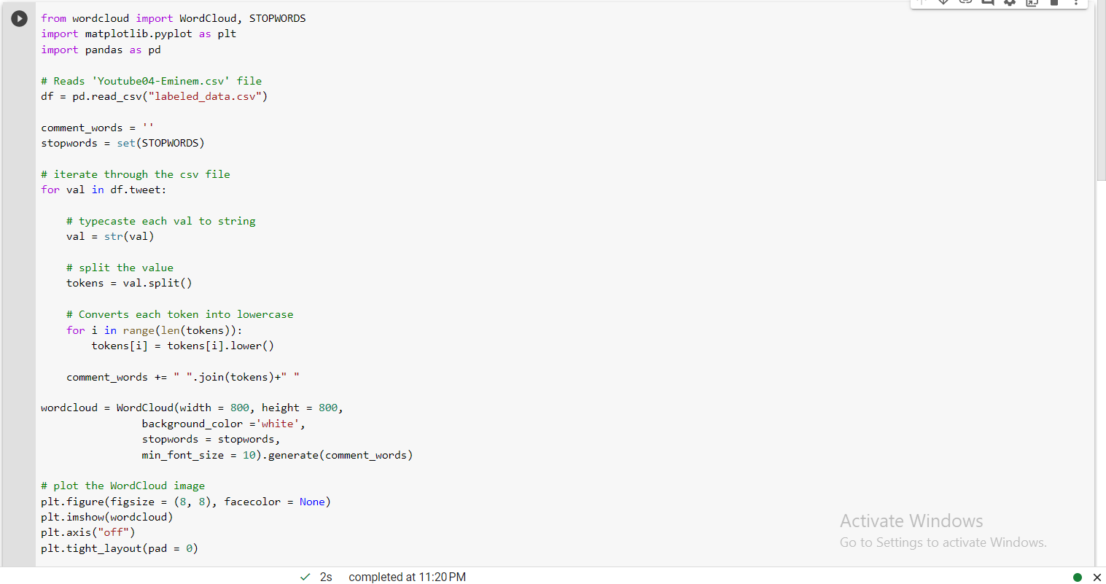
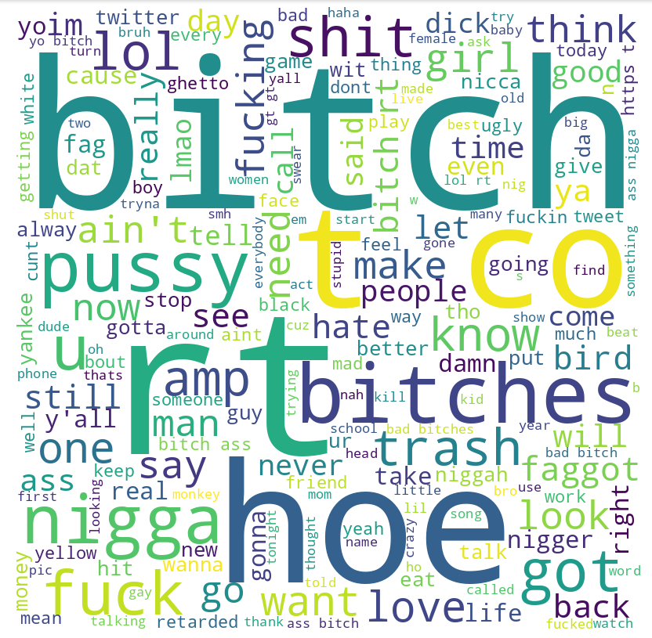

Slide 12
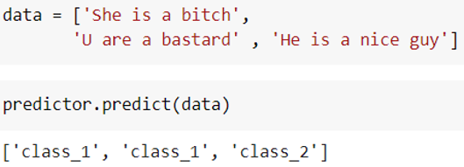
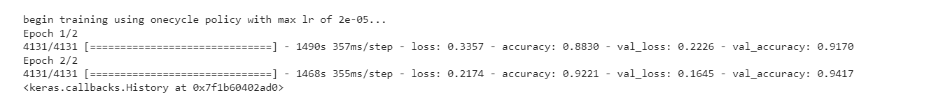
Results:
Given any tweet, the developed model is capable of classifying the tweet to the appropriate class.
Here “class_1” represents offensive and “class_2” represents non-offensive tweet.
Accuracy of the model:

Slide 13
Future Work:
As of now my model identifies whether the tweet is offensive or not.
I want to enhance it by adding another feature to my model. The additional feature is to identify the offensive target.
That is whether the language is targeting a group of people or a person.
If the target is a single person, which person the language is targeting.
Moreover, the situation on which the offense used had actually happened or not.

Slide 14
Base Papers
Davidson, T., Warmsley, D., Macy, M. and Weber, I. (2017) Automated Hate Speech Detection and the Problem
of Offensive Language. Proceedings of ICWSM.
Kumar, R., Ojha, A.K., Malmasi, S. and Zampieri, M. (2018) Benchmarking Aggression Identification in Social Media.
In Proceedings of the First Workshop on Trolling, Aggression and Cyberbullying (TRAC). pp. 1-11.
Malmasi, S., Zampieri, M. (2018) Challenges in Discriminating Profanity from Hate Speech. Journal of Experimental
& Theoretical Artificial Intelligence. Volume 30, Issue 2, pp. 187-202. Taylor & Francis.
Waseem, Z., Davidson, T., Warmsley, D. and Weber, I. (2017) Understanding Abuse: A Typology of Abusive
Language Detection Subtasks. Proceedings of the Abusive Language Online Workshop.

Slide 15

Conclusion:
Finally, we introduced a novel technique to word embedding optimization for classification applications.
On a user level, we conducted a comparative evaluation of some of the most extensively used deep learning models for depression identification from tweets. The “distilBERT” model gave good accuracy rate compared to machine learning algorithms. Based on recognizing offensive users, we constructed a predictive algorithm to predict whether a user's tweet is offensive or not. Using a dataset acquired from Twitter and manually built, we evaluated the performance of the classifiers. We discovered that those who are offensive are more socially isolated, as indicated by how they interacted with popular emojis and hashtags in their tweets.

