Slide 1
You Are Not A-Loan
Using risk analysis to create a business model where everybody wins!
Anvitha Chaluvadi, Owura Fosuhene Akosah, and Maria Notarianni
Notes:
Good evening, everyone. Our project, You Are Not A-Loan, uses machine learning to determine the likelihood of loan defaulting.

Slide 2
Motivation & Summary
Loans are a financial investment for both borrowers and lenders. When successful, loans allow borrowers to realize lifelong dreams. When unsuccessful, they create a difficult situation for both parties involved. Our goal is to create a machine learning model that allows lenders to make not only smarter business decisions but also assure borrowers are not later saddled with a financial burden.
Notes:
Issuing and receiving loans is a major part of the American economy with long-lasting effects for both borrowers and lenders. Just as a successful loan is beneficial for both parties, a defaulted loan is detrimental. Our goal is to create a machine learning model that allows lenders to make not only smarter business decisions but also assure borrowers are not later saddled with a financial burden.

Slide 3
Model Summary
We used a number of sophisticated machine learning models:
Decision Trees
Random Forest
Gradient Boosting
Naive Bayes
Logistic Regression
Our goal was to analyze each model and determine which was best at predicting a loan that will likely default
Notes:
We tested five different machine learning models, wanting to determine which would be predict loan defaulting.

Slide 4
Data Cleanup & Model Training
Training Time:
Depends on dataset size, model complexity, hyperparameter optimization, and computational resources.
Issues with Training:
Common issues include overfitting, data imbalance, hyperparameter sensitivity, and resource constraints.
Overfitting can be mitigated with regularization, data imbalance with resampling or algorithmic adjustments.
Hyperparameter tuning requires experimentation for optimal settings.
Resource constraints may necessitate model scaling or distributed computing.
Overall Process:
Involves careful data preparation, model selection, training, and evaluation.
Aims to develop accurate and reliable models for lending decisions.
These aspects highlight the complexities and considerations involved in training loan default prediction models, ensuring their effectiveness in real-world applications.

Slide 5
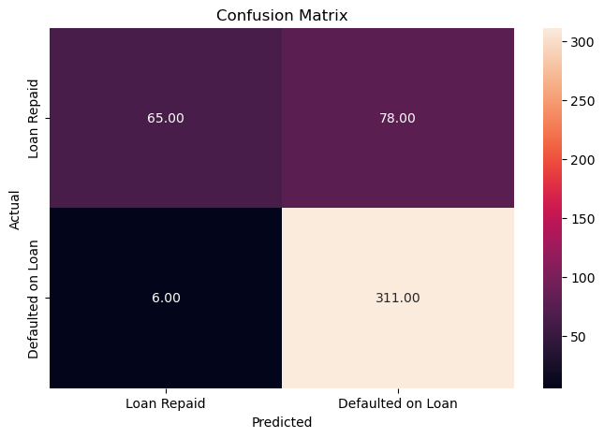
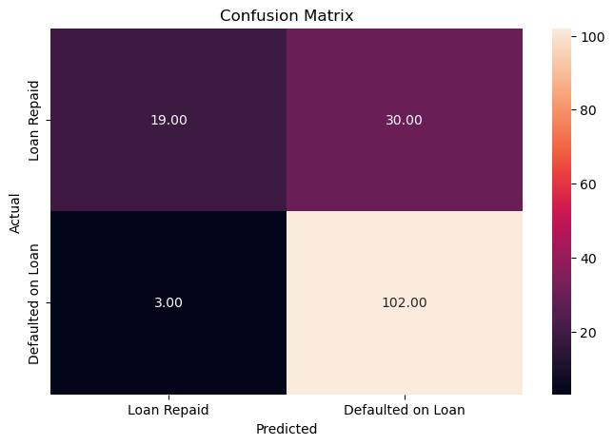
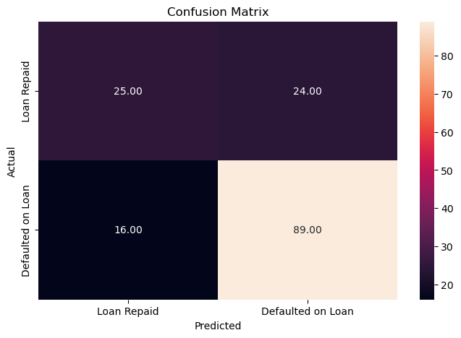
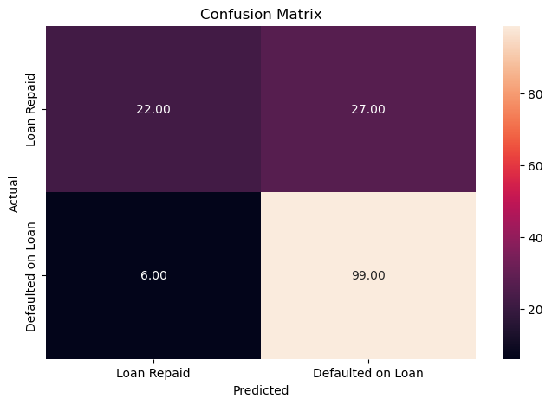
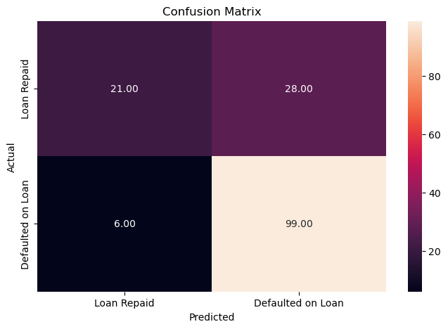
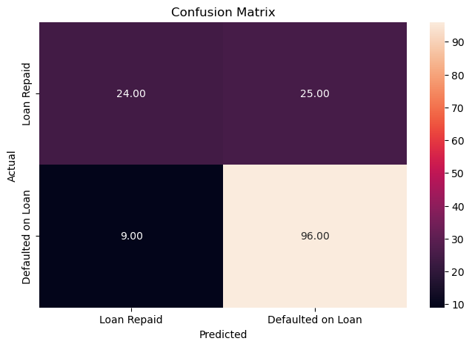
Visualizations
Creating a Logistic Regression Model with the Original Data

Slide 6
Discussion
For Precision:
The logistic model and the decision tree model have the highest precision of 0.82, indicating that they have the highest proportion of correct predictions among all positive predictions.
Random Forest (rf_model) follows closely with a precision of 0.79.
Naive Bayes (naive_model) has a slightly lower precision of 0.78.
Gradient Boosting (gboost_clf) has the lowest precision of 0.71, meaning it has a higher proportion of false positive predictions.
For Recall:
The logistic model and decision tree model again have the highest recall of 0.68.
Random Forest has a slightly higher recall of 0.70.
Naive Bayes has a recall of 0.69.
Gradient Boosting has the lowest recall of 0.67, indicating it has a higher proportion of false negative predictions.
For Accuracy:
The logistic model and decision tree model have the highest accuracy of 0.79.
Random Forest also has an accuracy of 0.79.
Naive Bayes has a slightly lower accuracy of 0.78.
Gradient Boosting has the lowest accuracy of 0.75.
Notes:
Overall, the logistic model and decision tree model emerge as strong contenders, offering balanced performance across all metrics. Additionally, the Random Forest model proves to be a reliable choice, closely trailing the top performers. Naive Bayes remains competitive but slightly less consistent in performance, while Gradient Boosting, while still useful, demonstrates lower overall effectiveness in this particular evaluation. Ultimately, the choice of the best model depends on the specific requirements and priorities of the task at hand, whether it prioritizes precision, recall, accuracy, or a combination of these metrics.

Slide 7
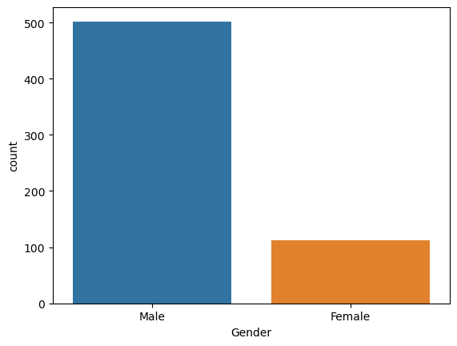
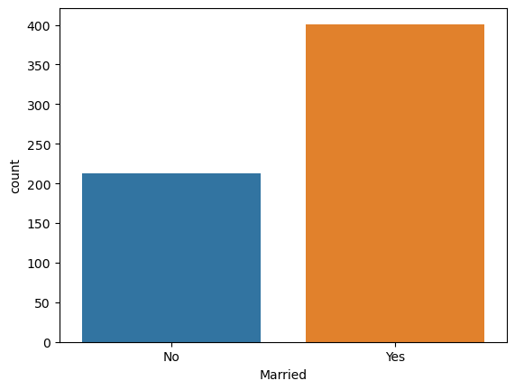
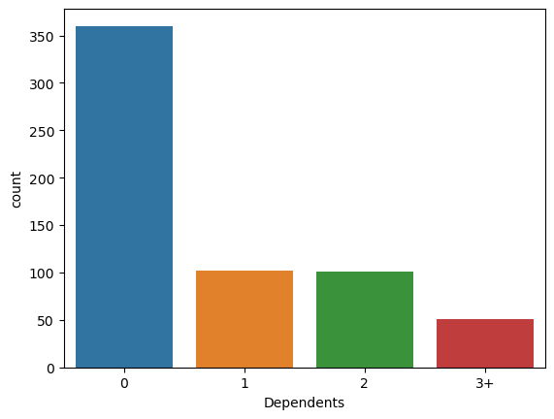
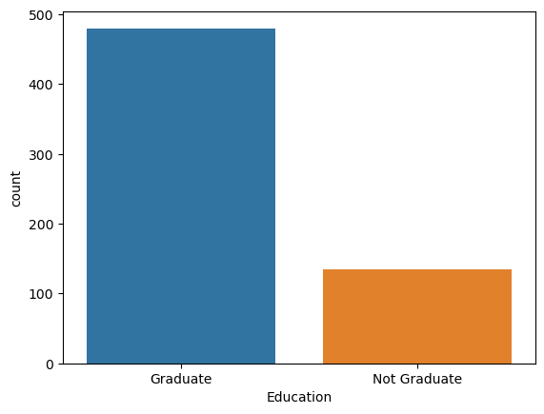
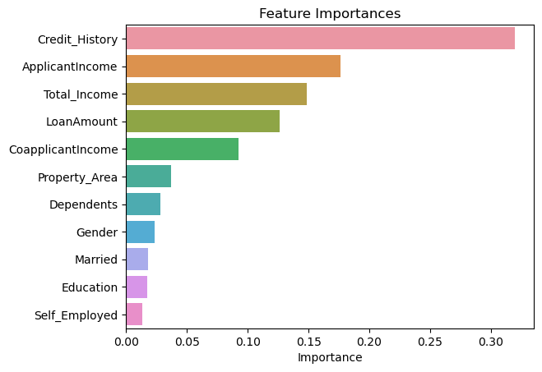
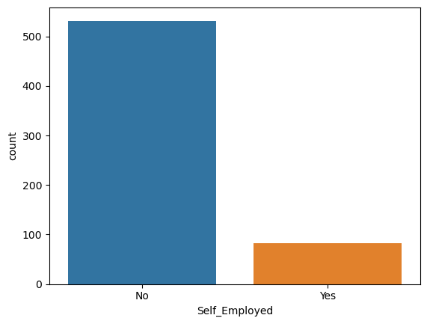
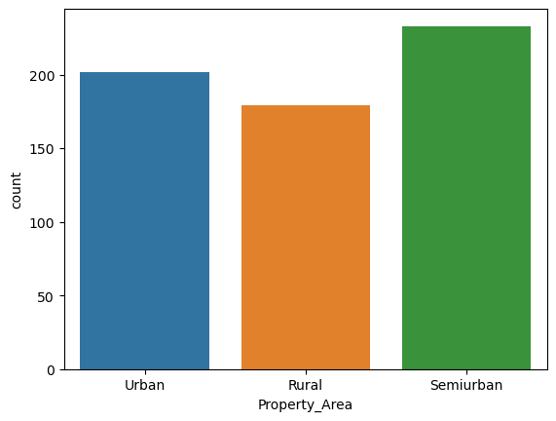
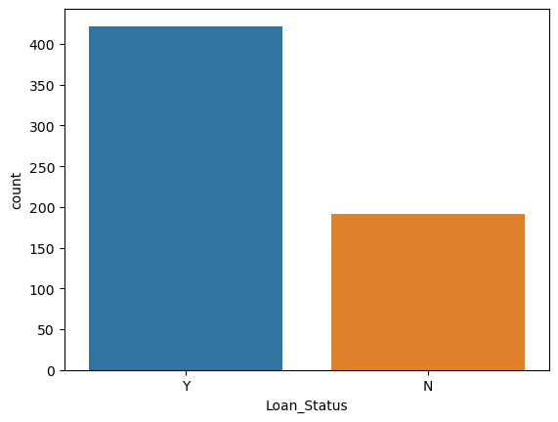
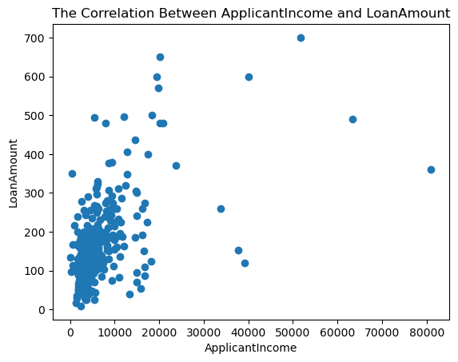
Postmortem
Skewed dataset?
Notes:
While cleaning the dataset, we realized how skewed the data is, for example:
There are nearly 5 times the amount of men as there are women in the dataset
There are nearly twice as many married to unmarried couples
There are more loan candidates with no dependents than any dependents
Over 4 times the amount of loan candidates graduated than not graduated with a degree
Over 5 times the amount of loan candidates are self-employed
Roughly twice as many people were approved for their loan than not
The only area that you could say is evenly distributed is the distribution of property area. Applicants were fairly evenly split between urban, suburban, and rural areas.
This led to new questions, wondering if the data is actually skewed, or if it is an accurate reflection of loan borrowers.
With two more weeks, we could look further into this question, maybe finding a different dataset to analyze and seeing if it follows a similar distribution. If not, it would be interesting to see how that influences our models.

Slide 8
Questions?

