Slide 1
Data Set
+
Data Exploration
Data
Pre-processing
Feature Engineering
+ Aspect extraction
Feature Extraction
Model Training
Performance/
Accuracy Evaluation
Testing/
Prediction

Slide 2
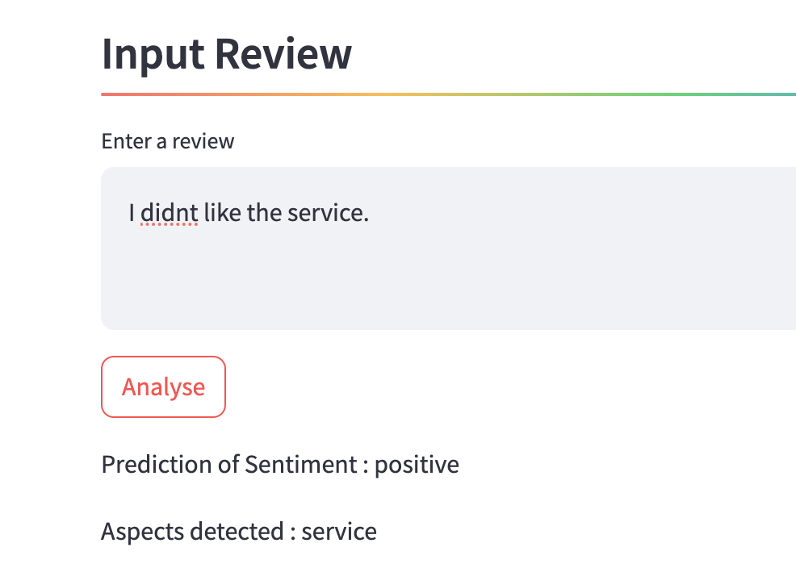

Slide 3







