Slide 1


Supply Chain Monitoring Agent
Predicting Delivery Delays using Machine Learning
Course: CS336 AIML
Team: Banka Venkata Likhith(BTECH/10518/23)
• Venkata Kalyan Chakravarthy (BTECH/10658/23)
• Bhavesh Jenna (BTECH/10796/23)
• Enugurthi Anvith Sai (BTECH/10827/23)
Notes:
1

Slide 2
Why This Problem Matters
54.8%
171K
Late Orders
Orders Flagged
Orders delayed across global supply chains
Requiring immediate intervention
Financial Losses
SLA Failures
Poor Experience
Cost overruns from expedited shipping
Service level agreements breached
Dissatisfied customers and lost trust
Reactive systems detect delays too late — we predict them before they happen.
Notes:
2

Slide 3
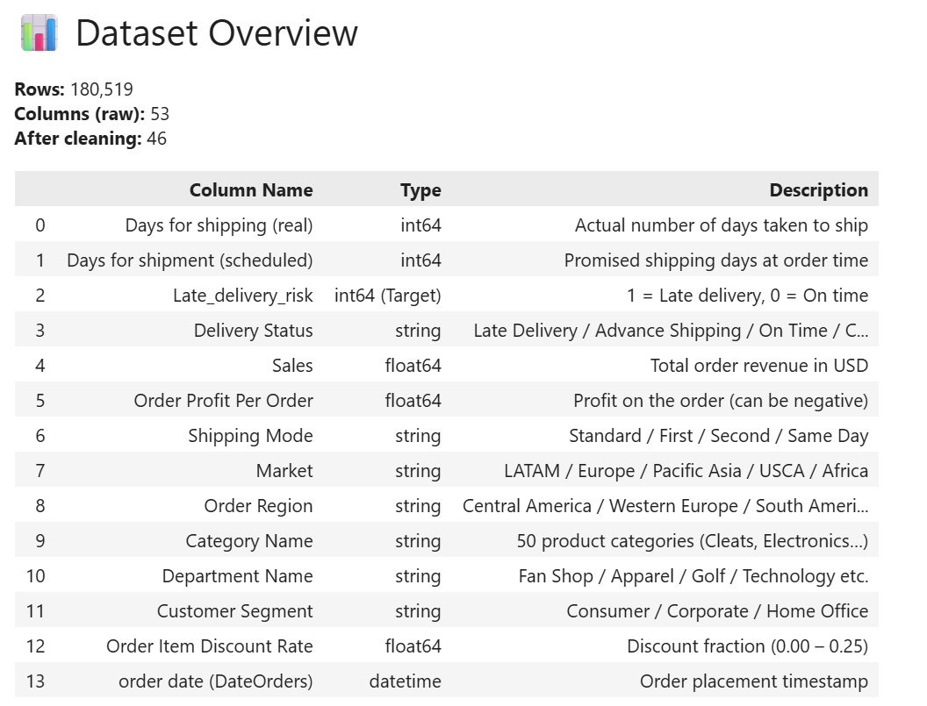
Dataset Overview
Source & Scale
DataCo Supply Chain Dataset (Kaggle)
180,519 orders
53 features
Real-world shipping data
Feature Categories
Shipping details
Financial metrics
Geographic information
Product specifications
Target Variable
Late_delivery_risk — binary classification
Notes:
3

Slide 4
System Pipeline
Data Preprocessing
1
Input: raw CSV (53 cols) → Drop leaky columns, parse dates, fix labels → Output: cleaned_data.csv (46 cols)
Feature Engineering
2
26 new features: delay_gap, shipping_mode_risk, profit_margin_ratio, is_weekend_order, market_risk_score, category_late_rate → Output: processed_data.csv
Delay Prediction Model
3
Random Forest Classifier → Test Accuracy: 71.32% | ROC-AUC → Logistic Regression baseline → Output: predictions.csv with delay_probability per order
AI Agent Logic
4
Thresholds: LOW < 0.30 | MEDIUM 0.30–0.70 | HIGH > 0.70 → Rule-based recommendations per risk tier → Output: final_output.csv
Visualization & Dashboard
5
Executive KPI dashboard → Risk distribution charts, shipping mode analysis → Output: dashboard visualization
Notes:
1

Slide 5
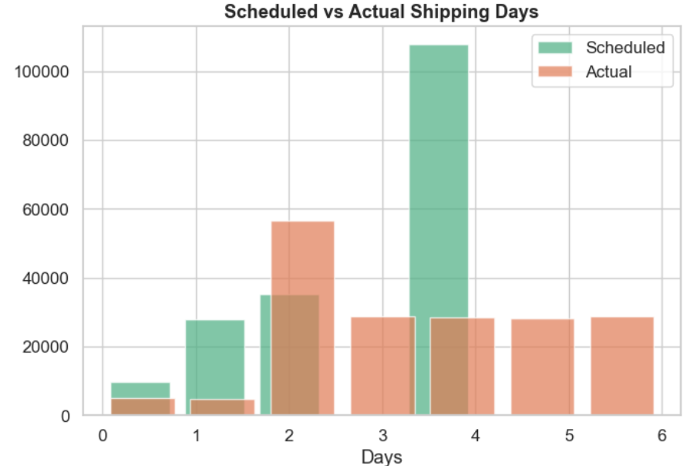




Data Preprocessing
Data Cleaning
Removed irrelevant and leaky columns
Missing Values
Handled missing data systematically
Standardization
Normalized categorical data
Output
46 clean features
Notes:
4

Slide 6
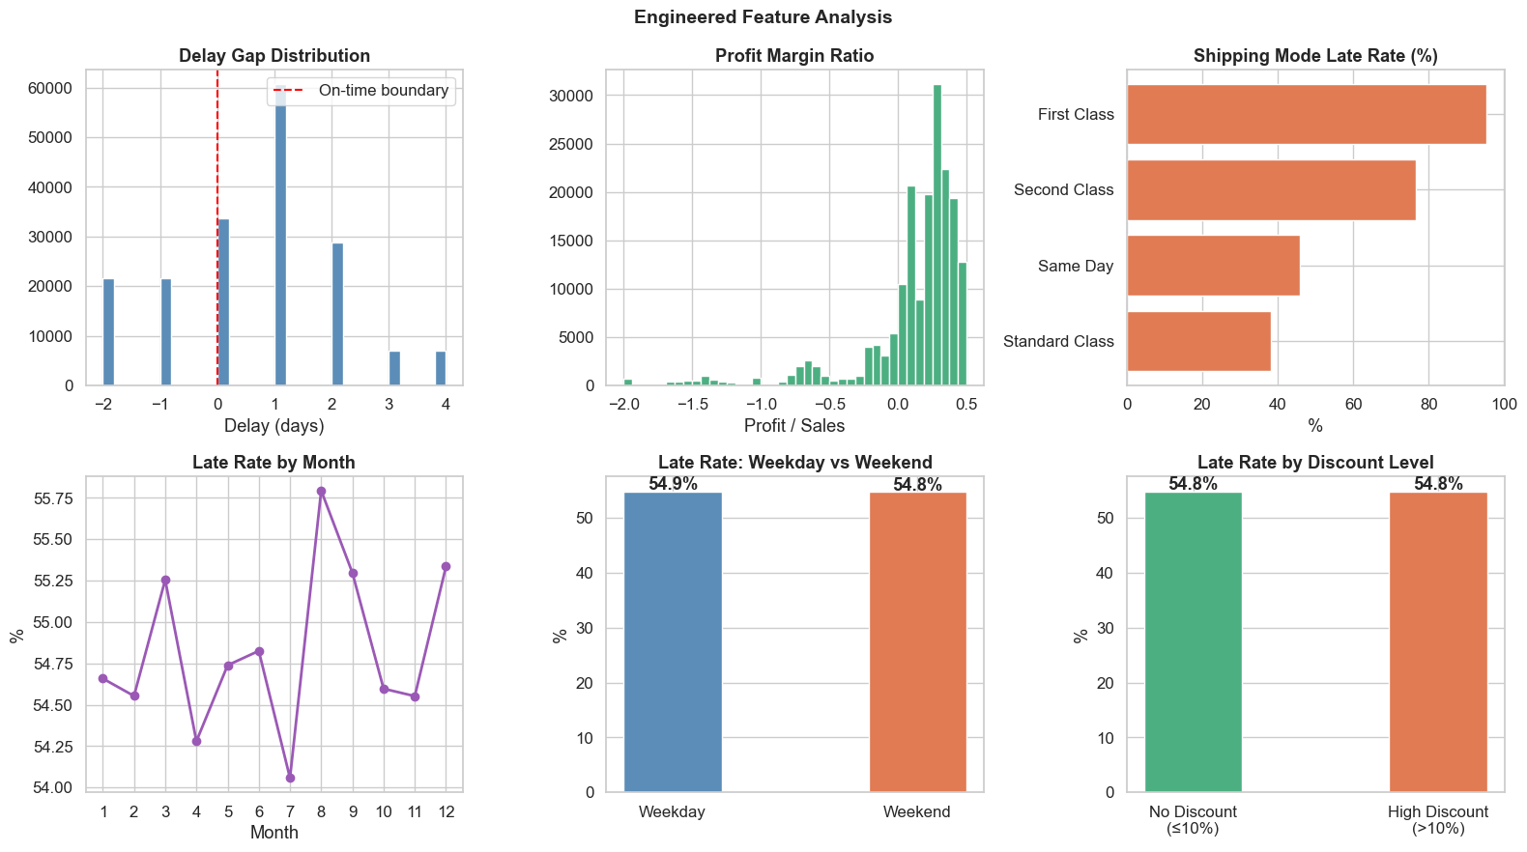

Feature Engineering
1
2
3
Delay Gap
Shipping Mode Risk
Market Risk Score
<Figure size 1600x900 with 6 Axes>
Time difference between scheduled and actual delivery
Risk scores by shipping method
Geographic risk aggregation
26 engineered features significantly improved prediction performance
Notes:
5

Slide 7

Model Architecture
Why Random Forest Classifier?
Handles Non-Linear Data
Captures complex patterns in supply chain variables
Raw Data
Feature Engineering
Preprocessing
Robust to Noise
Tolerates missing or imperfect data
Interpretable
Provides feature importance for insights
Notes:
6

Slide 8
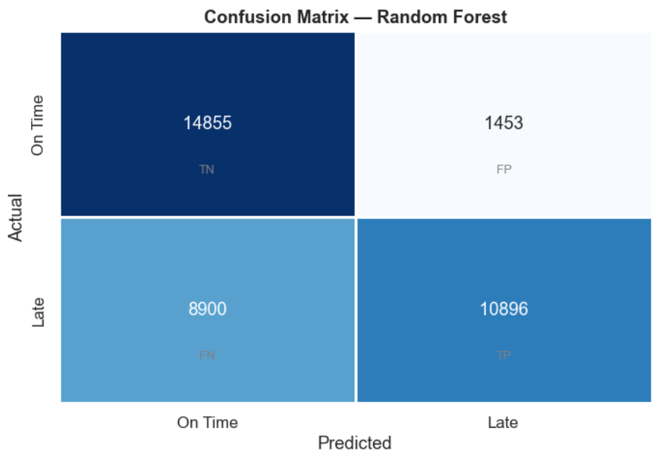
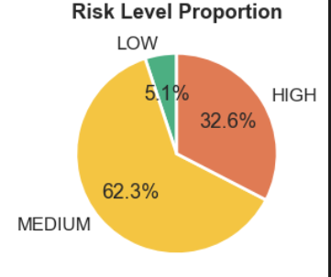
Results & Insights
71.32%
32.6%
Test Accuracy
High-Risk Orders
Model correctly classified late deliveries
Flagged for immediate action
Model Performance
Risk Distribution
Model clearly separates high-risk vs low-risk orders
Notes:
7

Slide 9
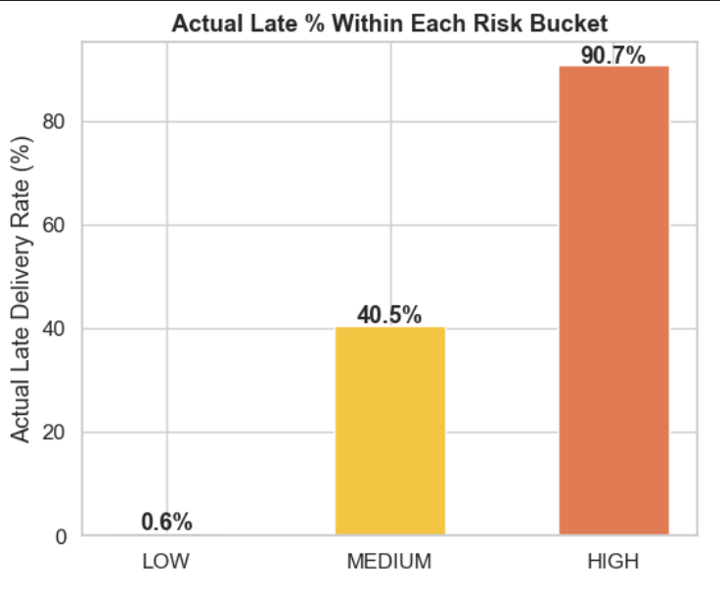
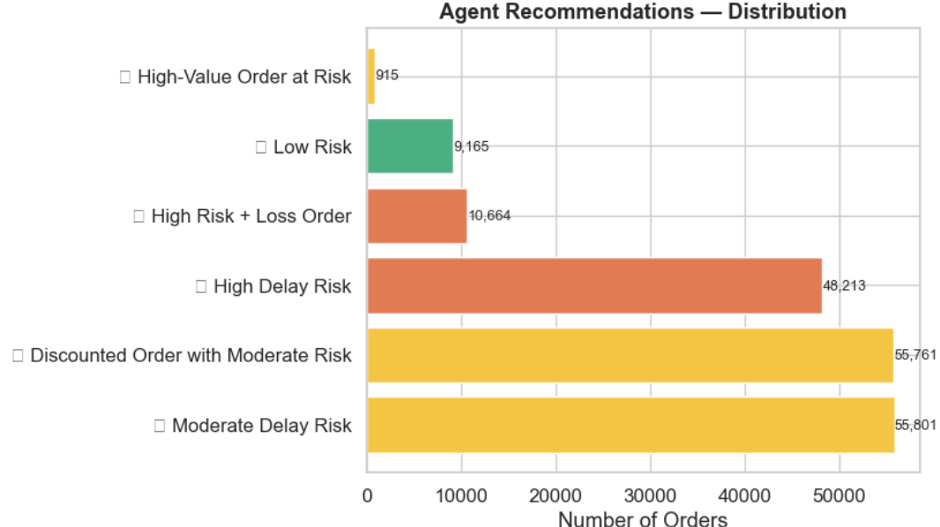
AI Agent Logic
Risk Thresholds & Actions
🟢 Low Risk
🟡 Medium Risk
<0.30
0.30–0.70
No action required
Monitor and review
🔴 High Risk
>0.70
Expedite shipping
171K
Orders Flagged
Automatically identified for action
Notes:
8

Slide 10
Ethical Considerations & Impact
Building Trustworthy AI for Supply Chain Operations
Bias Awareness
Historical late-rates per region and market are used as features — results are reviewed periodically to avoid systematic penalization of any segment.
Transparency
All recommendations are rule-based and fully auditable. Every decision traces back to an explicit probability threshold — no black-box outputs.
Data Privacy
Customer names, emails, and passwords are dropped in Notebook 1. No PII enters the model pipeline.
Fairness
Risk scoring applies uniform probability thresholds across all orders regardless of region or customer identity.
Notes:
1

Slide 11




171,354
prediction accuracy with
no significant overfitting
orders automatically triaged — zero manual review
Orders processed end to end
Societal benefit:
reduces expedited shipments → lower carbon emissions

