Slide 1
Cloud Computing Team PJP

Slide 2
Agenda
The problem & our project idea
Technologies used
Architecture
Live Demo
Code Walkthrough
Lessons Learned

Slide 3
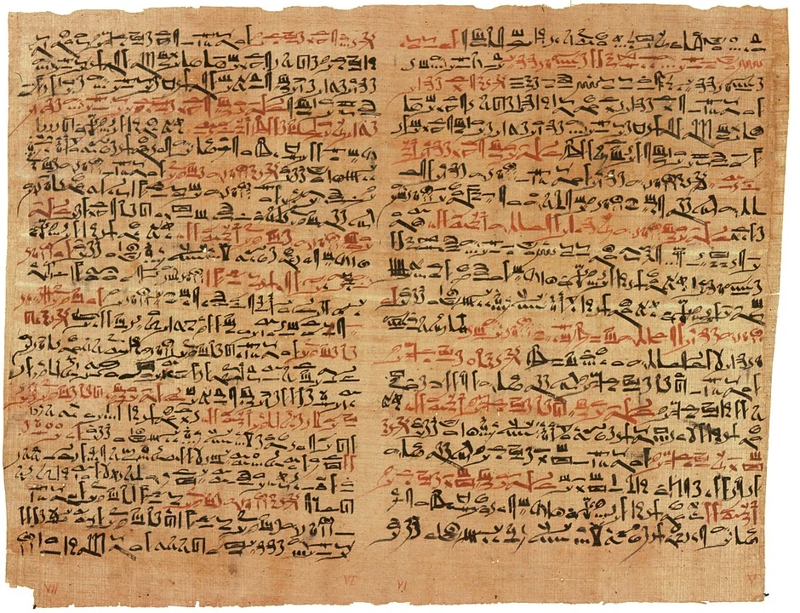
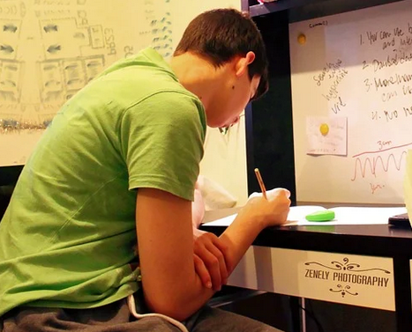
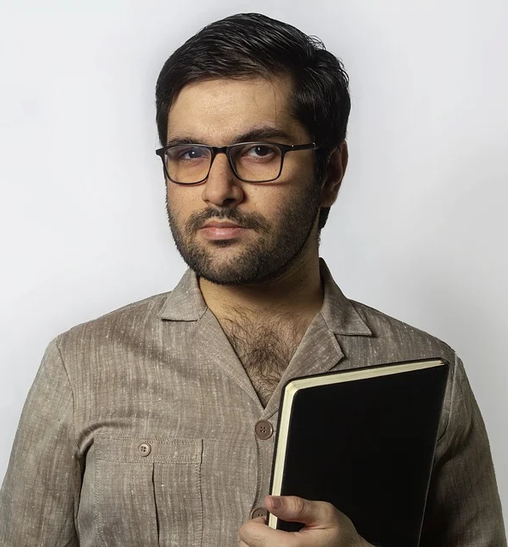
The problem
?
Student
Professor
Sends handwritten exam

Slide 4

Our project idea
Handwritten text to digital text converter
Exam from Max
Task 1) The answer is 42, because this is the answer for everything
Student
Professor

Slide 5



Technologies used
[3]
[1]
[2]
[1] https://de.wikipedia.org/wiki/Amazon_Web_Services
[2] https://www.terraform.io/logos.html
[3] https://about.gitlab.com/press/press-kit/
Notes:
For Gitlab: Used CI

Slide 6
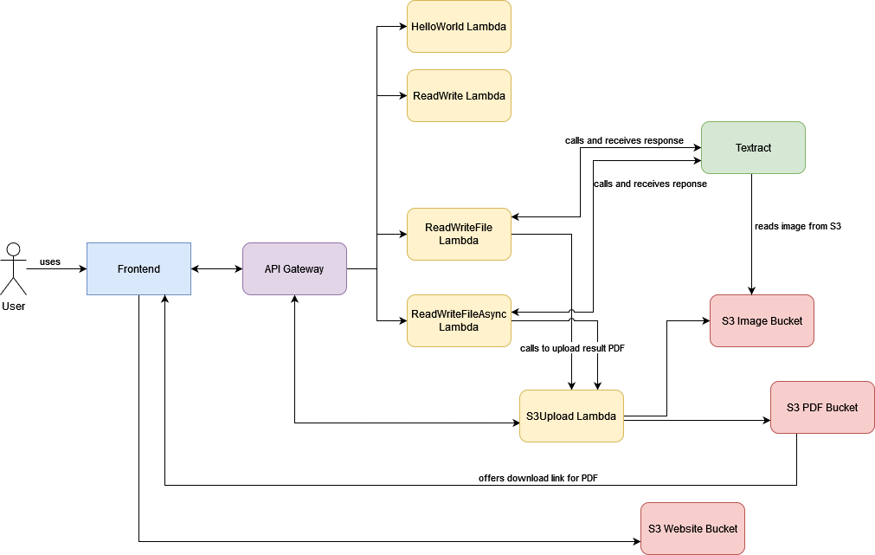
Architecture

Slide 7
Live Demo

Slide 8
Code Walkthrough

Slide 9
Lessons Learned
Important external python dependencies
Changing URL of API Gateway
Missing files in apply stage in CI pipeline
Textract availability
Debugging

Slide 10
Thank you for Listening
If you have any questions, feel free to ask us!

