Slide 1
Cloud Computing Team PJP

Slide 2
Agenda
The problem
Our project idea
Technologies used
Our project plan

Slide 3
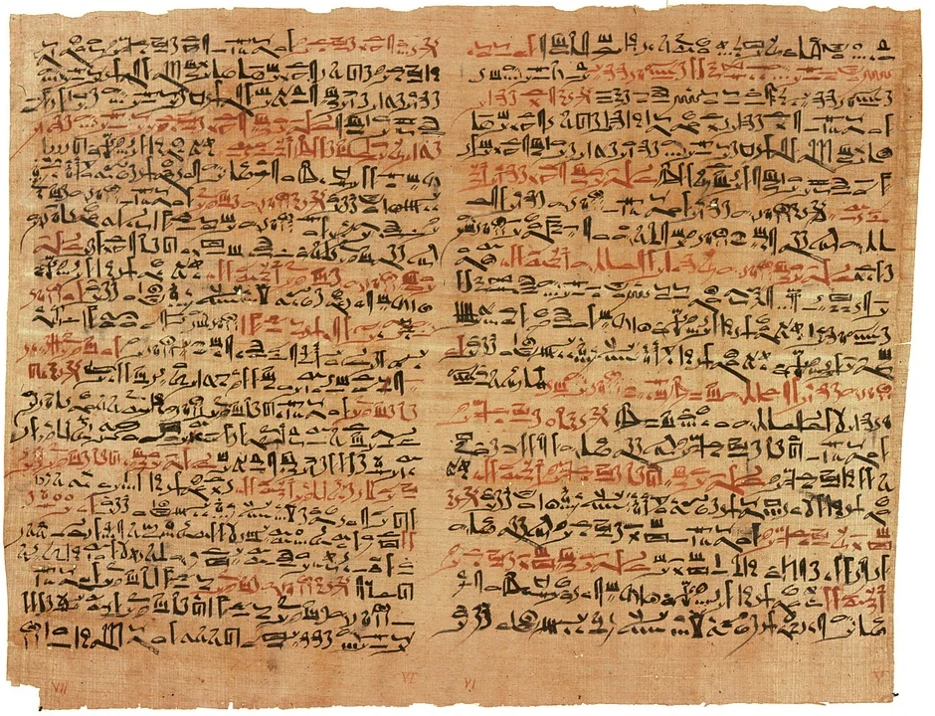
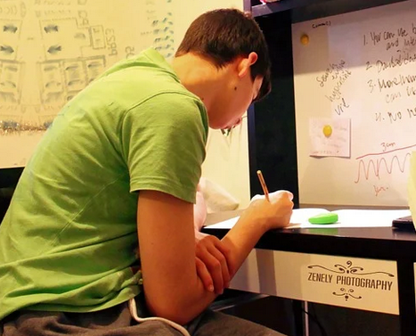
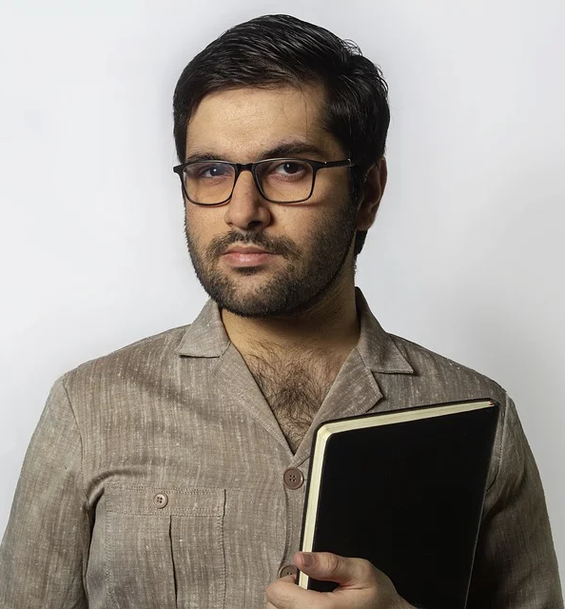
The problem
?
Student
Professor
Sends handwritten exam

Slide 4

Our project idea
Handwritten text to digital text converter
Exam from Max
Task 1) The answer is 42, because this is the answer for everything
Student
Professor

Slide 5
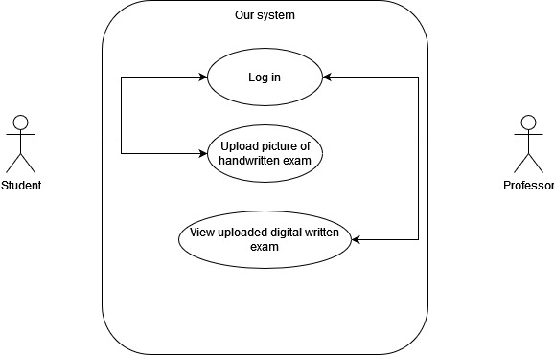
Our project idea

Slide 6



Technologies used
[3]
[1]
[2]
[1] https://de.wikipedia.org/wiki/Amazon_Web_Services
[2] https://www.terraform.io/logos.html
[3] https://about.gitlab.com/press/press-kit/

Slide 7
Our project plan
Deploy a static website and use a simple lambda function
Extend lambda function and mock the OCR service
Use the real OCR service
Improve frontend, add functionality to upload image
Add log in and user management

Slide 8
Thank you for Listening
If you have any questions, feel free to ask us!

