Slide 1

In the name of ALLAH, the Beneficent, the Merciful
Outliers ,Clustering and General Approaches to Clustering
by:
WAHAB KHAN
(Ph.D. in Computer Science)

Slide 2
Contents
Outlier Analysis
Clustering: Basic Concept
Applications of Clustering
Requirements of Clustering in Data Mining
Clustering Learning Types
General Approaches to clustering
Partition based Clustering
K-Mean

Slide 3
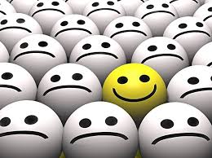
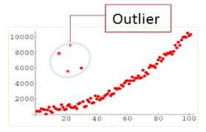
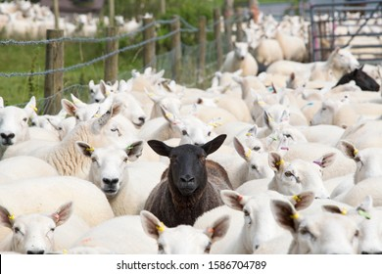
Outlier Analysis
Outlier Analysis is a data mining task which is referred to as an “outlier mining”.
“Outlier Analysis is a process that involves identifying the anomalous observation in the dataset.”
Outliers are nothing but an extreme value that deviates from the other observations in the dataset.

Slide 4
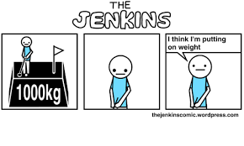
Cause of Outliers
Outliers are caused due to the incorrect entry or computational error
For example, displaying a person’s weight as 1000kg
Many algorithms are used to minimize the effect of outliers or eliminate them.
This may be able to result in the loss of important hidden information because one person’s noise could be another person’s signal.

Slide 5
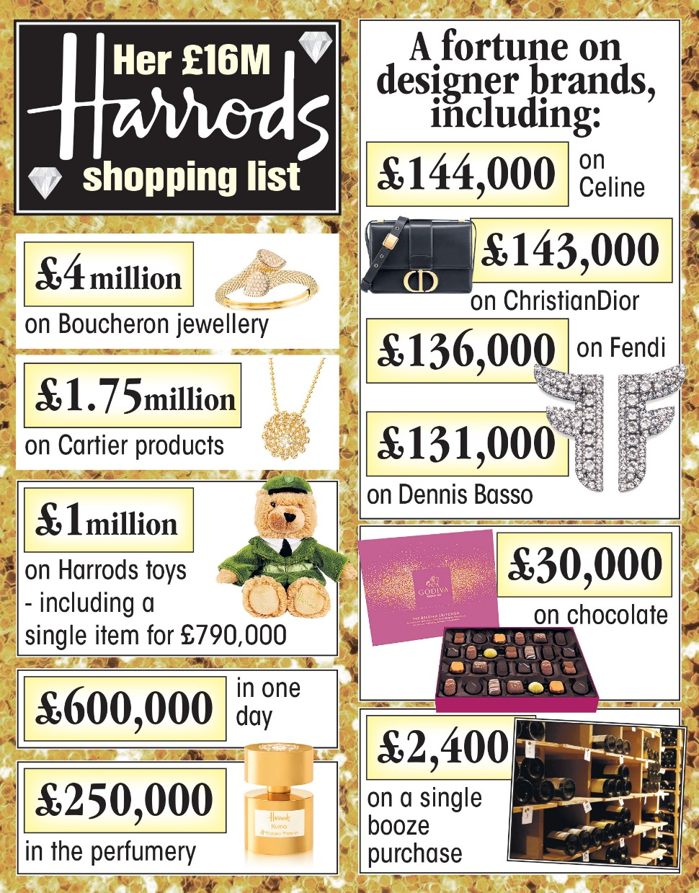
Application of Outliers Analysis
It has various applications in fraud detection, such as
Unusual usage of credit card or
Telecommunication services,
Healthcare analysis for finding unusual responses to medical treatments,
and to identify the spending nature of the customers in marketing.
“Zamira Hajiyeva, 55, splurged £16 million in Harrods on jewellery, designer goods, perfume and toys at the lavish department store - including £30k on chocolate”

Slide 6
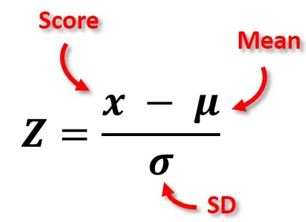
Methods
Sorting
Graphing
Using Z-scores
Using the Interquartile Range

Slide 7
Clustering: Basic Concept
What is a Clustering Task?
Cluster analysis or simply clustering is the process of partitioning a set of data objects into subsets
Each subset is referred as cluster
such that objects in a cluster are similar to one another, yet dissimilar to objects in other clusters.
The set of clusters resulting from a cluster analysis can be referred to as a clustering

Slide 8
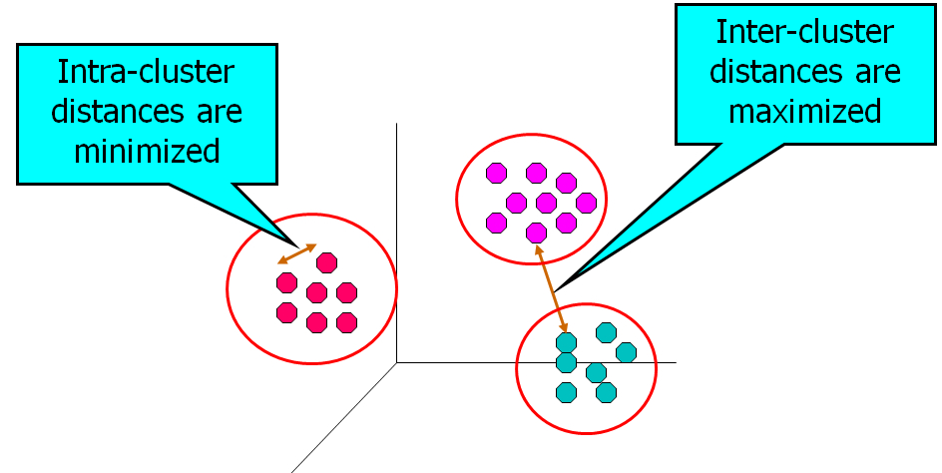
Clustering: Basic Concept
Clustering is known as unsupervised learning because
The class label information is not present.
For this reason, clustering is a form of learning by observation, rather than learning by examples.
Principle: Maximizing intra-class similarity
& minimizing interclass similarity

Slide 9
Applications of Clustering
Cluster analysis has been widely used in many applications such as
Business intelligence,
In business intelligence, clustering can be used to organize a large number of customers into groups, where customers within a group share strong similar characteristics
This facilitates the development of business strategies for enhanced customer relationship management

Slide 10
Image pattern recognition,
Web search,
Biology, and
Security

Slide 11
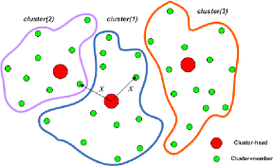
Requirements of Clustering in Data Mining
Scalability
Ability to deal with different types of attributes
Discovery of clusters with arbitrary shape
Minimal requirements for domain knowledge to determine input parameters
Able to deal with noise and outliers

Slide 12
Requirements of Clustering in Data Mining
Incremental clustering and insensitivity to input order
Control of High dimensionality data
Interpretability and usability

Slide 13
Major Clustering Approaches
Partitioning approach:
Construct various partitions and then evaluate them by some criterion, e.g., minimizing the sum of square errors
Where each partition represents a cluster and k ≤ n.
That is, it divides the data into k groups such that each group must contain at least one object
Typical methods: k-means, k-medoids, PAM(Portioning Around Medoids), CLARA(Clustering for Large Application) and CLARANS (Clustering large Application Based on Randomized Search)

Slide 14
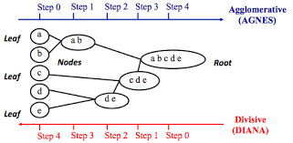
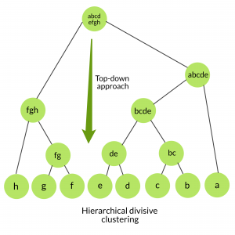
Major Clustering Approaches
Hierarchical approach:
Create a hierarchical decomposition of the set of data (or objects) using some criterion
Typical methods: Agnes, BIRCH, ROCK ,Diana etc

Slide 15
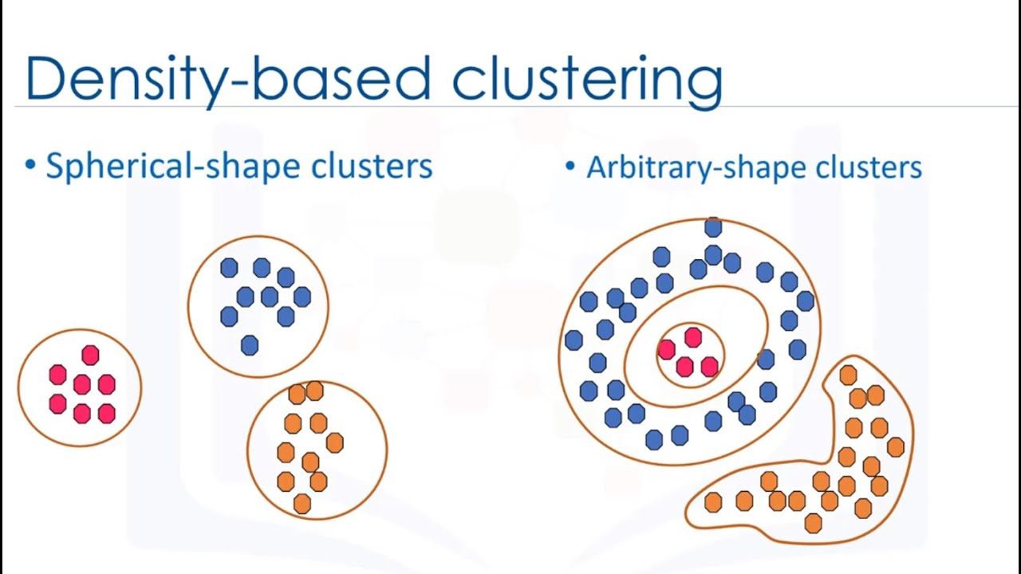
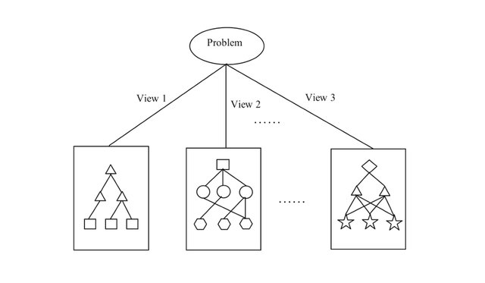
Major Clustering Approaches
Density-based approach:
Based on connectivity and density functions
Typical methods: DBSACN, OPTICS, DenClue
Grid-based approach:
The clustering methods discussed so far are data-driven—they partition the set of objects and adapt to the distribution of the objects in the embedding space. Alternatively, a grid-based clustering method takes a space-driven approach by partitioning the embedding space into cells independent of the distribution of the input objects.
Typical methods: STING, WaveCluster, CLIQUE

Slide 16
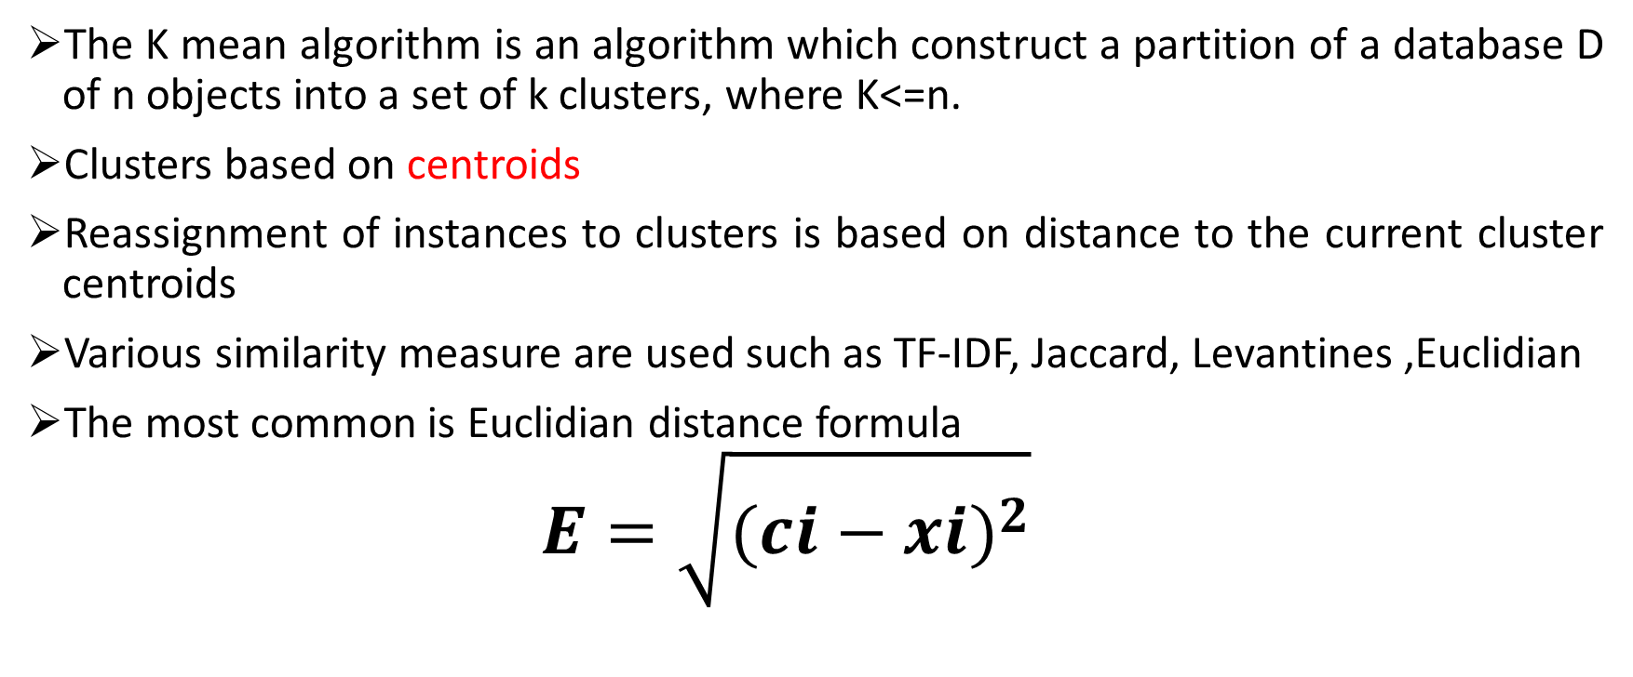
K-Mean Clustering (Partitioning method)
The K mean algorithm is an algorithm which construct a partition of a database D of n objects into a set of k clusters, where K<=n.
Clusters based on centroids
Reassignment of instances to clusters is based on distance to the current cluster centroids
Various similarity measure are used such as TF-IDF, Jaccard, Levantines ,Euclidian
The most common is Euclidian distance formula
$$E=\sqrt{{(ci−xi)}^{2}}$$

Slide 17
Mechanism
Input:
D: a data set containing n objects.
k: the number of clusters,
Output: A set of k clusters.
Pseudocode:
(1)arbitrarily choose k objects from D as the initial cluster centers; (2) do while (loop or repeat) (3) (re)assign each object to the cluster to which the object is the most similar, based on the mean value of the objects in the cluster; (4) update the cluster means, that is, calculate the mean value of the objects for each cluster; (5) until no change;

Slide 18
Example#1
Input
D={1,4,2,7,9,3}
K=2,
Let M1=2 and
M2=7

Slide 19
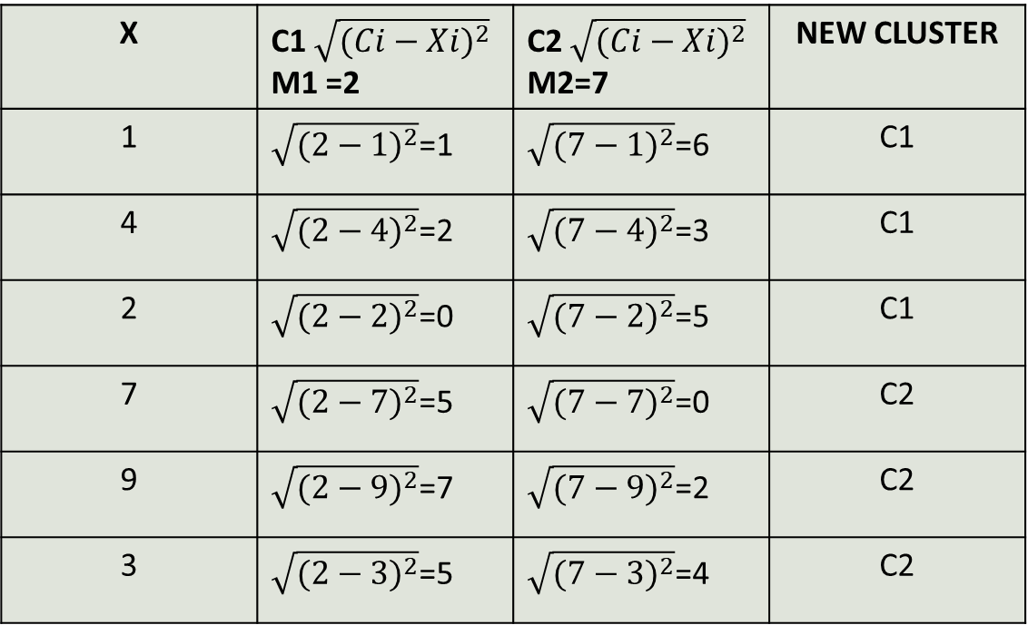
Iteration1
C1(1,4,2),
C2(7,9,3)
X | C1 $\sqrt{{(Ci−Xi)}^{2}}$ M1 =2 | C2 $\sqrt{{(Ci−Xi)}^{2}}$ M2=7 | NEW CLUSTER
1 | $\sqrt{{(2−1)}^{2}}$=1 | $\sqrt{{(7−1)}^{2}}$=6 | C1
4 | $\sqrt{{(2−4)}^{2}}$=2 | $\sqrt{{(7−4)}^{2}}$=3 | C1
2 | $\sqrt{{(2−2)}^{2}}$=0 | $\sqrt{{(7−2)}^{2}}$=5 | C1
7 | $\sqrt{{(2−7)}^{2}}$=5 | $\sqrt{{(7−7)}^{2}}$=0 | C2
9 | $\sqrt{{(2−9)}^{2}}$=7 | $\sqrt{{(7−9)}^{2}}$=2 | C2
3 | $\sqrt{{(2−3)}^{2}}$=5 | $\sqrt{{(7−3)}^{2}}$=4 | C2

Slide 20
C1(1,4,2), C2(7,9,3)
Mean of C1=1+4+2/3= 7/3= 2.33 => 2
Mean of C2= 7+9+3/3= 19/3= 6.33 =>6
So M1= 2
M2=6

Slide 21
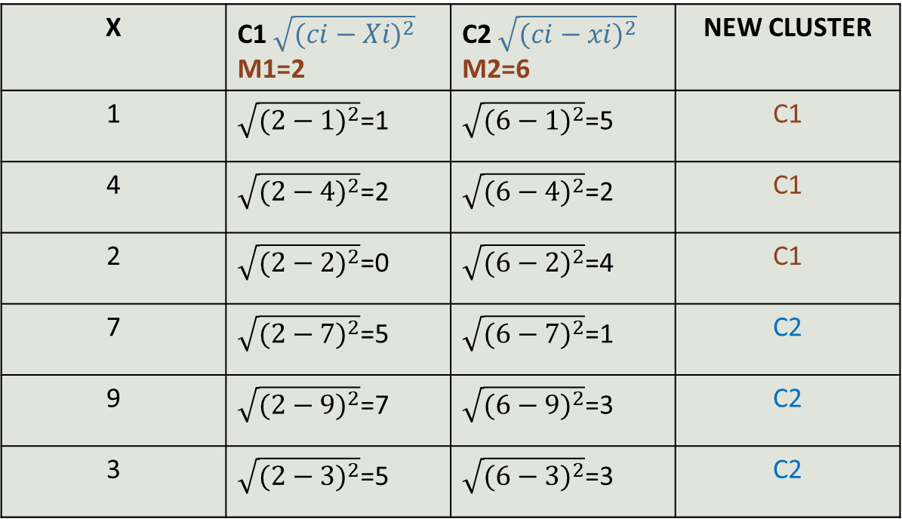
Iteration 2
X | C1 $\sqrt{{(ci−Xi)}^{2}}$ M1=2 | C2 $\sqrt{{(ci−xi)}^{2}}$ M2=6 | NEW CLUSTER
1 | $\sqrt{{(2−1)}^{2}}$=1 | $\sqrt{{(6−1)}^{2}}$=5 | C1
4 | $\sqrt{{(2−4)}^{2}}$=2 | $\sqrt{{(6−4)}^{2}}$=2 | C1
2 | $\sqrt{{(2−2)}^{2}}$=0 | $\sqrt{{(6−2)}^{2}}$=4 | C1
7 | $\sqrt{{(2−7)}^{2}}$=5 | $\sqrt{{(6−7)}^{2}}$=1 | C2
9 | $\sqrt{{(2−9)}^{2}}$=7 | $\sqrt{{(6−9)}^{2}}$=3 | C2
3 | $\sqrt{{(2−3)}^{2}}$=5 | $\sqrt{{(6−3)}^{2}}$=3 | C2
C1(1,4,2), C2(7,9,3)

Slide 22
Example #2
Student/Subject | A | B
1 | 2 | 10
2 | 2 | 5
3 | 8 | 4
4 | 5 | 8
5 | 7 | 5
6 | 6 | 4
7 | 1 | 2

Slide 23
 | Individual | Mean (centroid)
C 1 | 1 | (2, 10)
C 2 | 4 | (5,8)

Slide 24
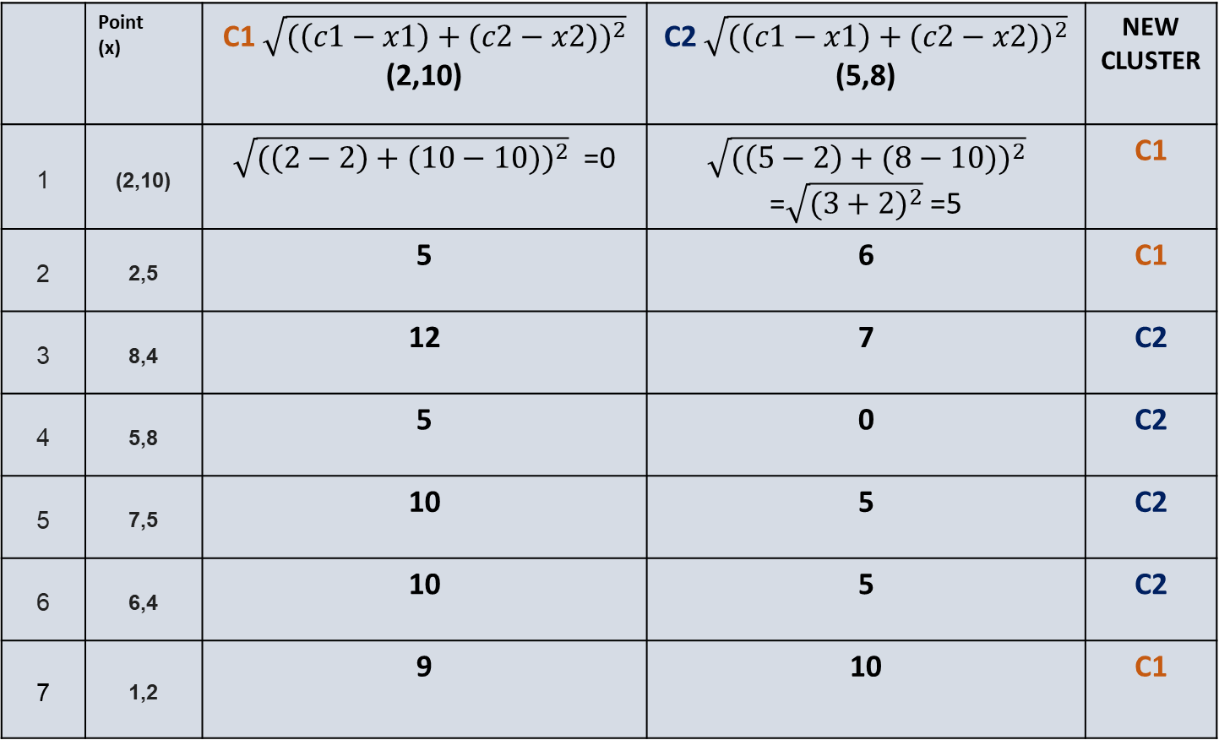
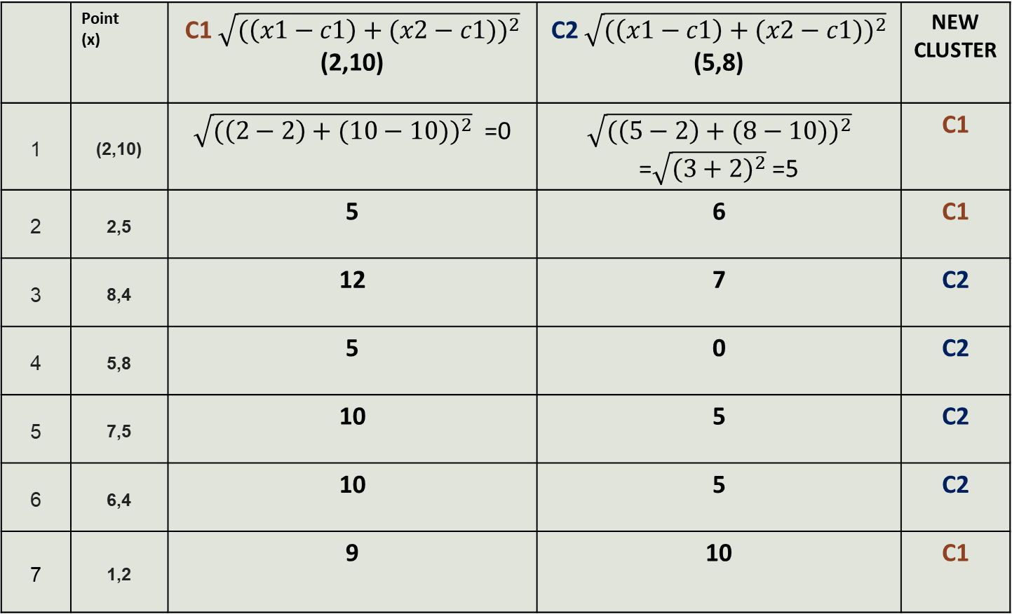
Iteration 1
 | Point (x) | C1 $\sqrt{({\left(x1−c1\right)+(x2−c1))}^{2}}$ (2,10) | C2 $\sqrt{({\left(x1−c1\right)+(x2−c1))}^{2}}$ (5,8) | NEW CLUSTER
1 | (2,10) | $\sqrt{({\left(2−2\right)+(10−10))}^{2}}$ =0 | $\sqrt{({\left(5−2\right)+(8−10))}^{2}}$ =$\sqrt{{(3+2)}^{2}}$ =5 | C1
2 | 2,5 | 5 | 6 | C1
3 | 8,4 | 12 | 7 | C2
4 | 5,8 | 5 | 0 | C2
5 | 7,5 | 10 | 5 | C2
6 | 6,4 | 10 | 5 | C2
7 | 1,2 | 9 | 10 | C1
 | Point (x) | C1 $\sqrt{({\left(c1−x1\right)+(c2−x2))}^{2}}$ (2,10) | C2 $\sqrt{({\left(c1−x1\right)+(c2−x2))}^{2}}$ (5,8) | NEW CLUSTER
1 | (2,10) | $\sqrt{({\left(2−2\right)+(10−10))}^{2}}$ =0 | $\sqrt{({\left(5−2\right)+(8−10))}^{2}}$ =$\sqrt{{(3+2)}^{2}}$ =5 | C1
2 | 2,5 | 5 | 6 | C1
3 | 8,4 | 12 | 7 | C2
4 | 5,8 | 5 | 0 | C2
5 | 7,5 | 10 | 5 | C2
6 | 6,4 | 10 | 5 | C2
7 | 1,2 | 9 | 10 | C1

Slide 25
Cluster1 Cluster2
(2,10), (2,5), (1,2) (8,4), (5,8), (7,5), (6,4)
Calculate Cluster mean again
Cluster 1 mean= 2+2+1/3= 5/ 3=2, 10+5+2/3= 17/3 = 6 => (2,6)
Cluster 2 Mean= 8+5+7+6 = 26/4= 6, 4+8+5+4/4 =21/4 =5 => (6,5)
 | Mean (centroid)
C 1 | (2, 6)
C 2 | (6, 5)

Slide 26
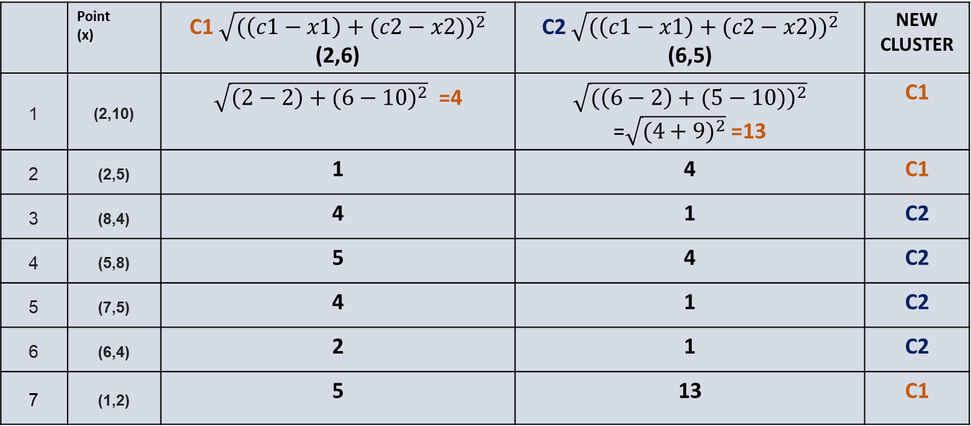
Iteration 2
 | Point (x) | C1 $\sqrt{({\left(c1−x1\right)+(c2−x2))}^{2}}$ (2,6) | C2 $\sqrt{({\left(c1−x1\right)+(c2−x2))}^{2}}$ (6,5) | NEW CLUSTER
1 | (2,10) | $\sqrt{{\left(2−2\right)+(6−10)}^{2}}$ =4 | $\sqrt{({\left(6−2\right)+(5−10))}^{2}}$ =$\sqrt{{(4+9)}^{2}}$ =13 | C1
2 | (2,5) | 1 | 4 | C1
3 | (8,4) | 4 | 1 | C2
4 | (5,8) | 5 | 4 | C2
5 | (7,5) | 4 | 1 | C2
6 | (6,4) | 2 | 1 | C2
7 | (1,2) | 5 | 13 | C1

Slide 27
Issues of K Mean
The k-means algorithm is sensitive to outliers
An example, is the average of the salaries of the following people:
$50k, $20k, $35k, $65k and $1 Million
The average ends up being ($50k + $20k + $35k + $65k + $1M) / 5 = $1170k / 5 = $234k.
K means algorithm is good in capturing structure of the data if clusters have a spherical-like shape.
Need to specify K the number of cluster in advance
Applicable when the mean is defined

Slide 28
Knowledge Discovery (KDD) Process
Knowledge
This is a view from typical database systems and data warehousing communities
Data mining plays an essential role in the knowledge discovery process
Pattern Evaluation
Data Mining
Task-relevant Data
Data Warehouse
Selection
Data Cleaning
Data Integration
Databases

Slide 29
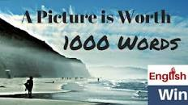
Data Visualization
Why data visualization?
The core objective of VISUALIZATION is to convey data to users effectively
Data visualization aims to communicate data clearly and effectively through graphical representation
Data visualization has been used extensively in many applications—for example, at work for reporting, managing business operations, and tracking progress of tasks

Slide 30
General Methods
Categorization of visualization methods:
Pixel-oriented visualization techniques
Geometric projection visualization techniques
Icon-based visualization techniques
Hierarchical visualization techniques
Visualizing complex data and relations

Slide 31
Pixel-Oriented Visualization Techniques
For a data set of m dimensions, create m windows on the screen, one for each dimension
The m dimension values of a record are mapped to m pixels at the corresponding positions in the windows
The colors of the pixels reflect the corresponding values
Income
(b) Credit Limit
(c) transaction volume
(d) age
31
Notes:
31

Slide 32
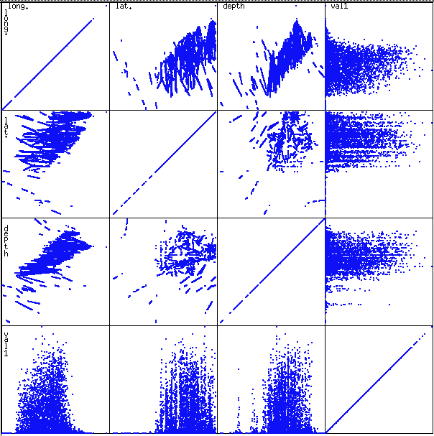
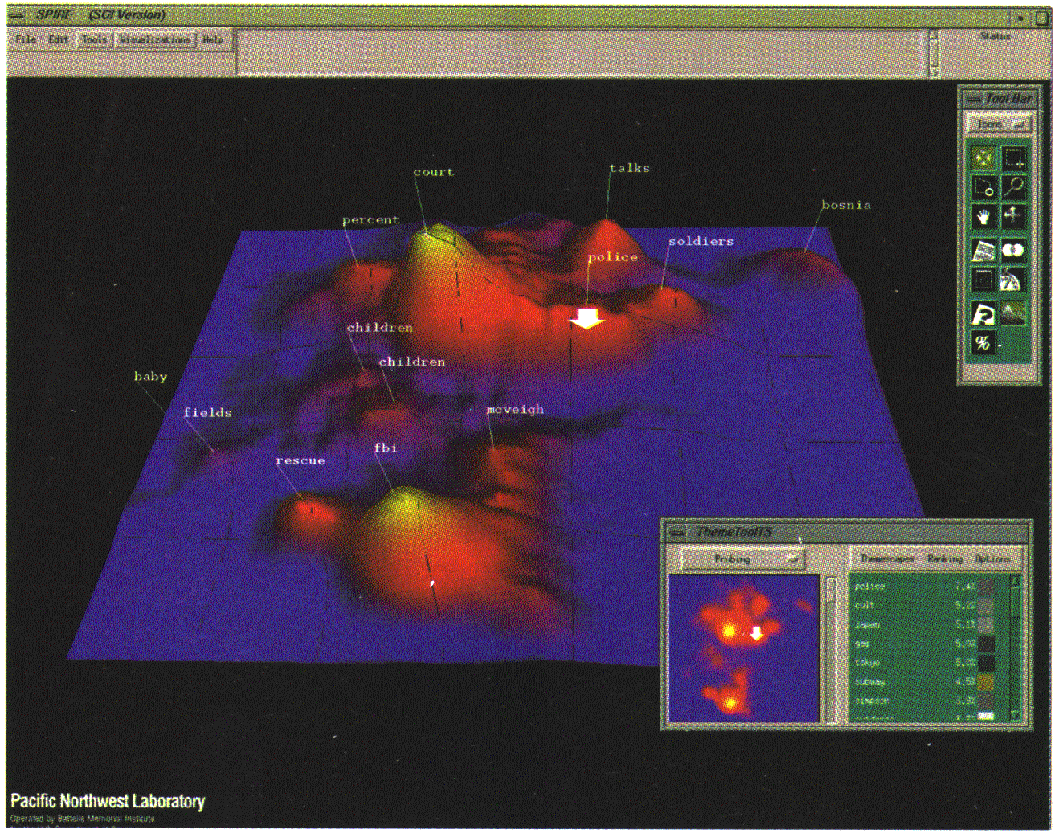
Geometric Projection Visualization Techniques
A drawback of pixel-oriented visualization techniques is that they cannot help us much in understanding the distribution of data in a multidimensional space.
Geometric projection techniques are a good choice for finding outliers and correlation between attributes in multidimensional data sets . Methods
Scatterplot and scatterplot matrices
Landscapes

Slide 33
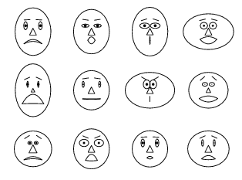
Icon-Based Visualization Techniques
Visualization of the data values as features of icons
Make use of small icons to represent multidimensional data values
Icon-based methods have the strength of being easily interpreted if icons/glyphs are chosen wisely.
A poor choice can make it difficult to distinguish differences.
Typical visualization methods
Chernoff Faces
data is mapped to different face parts as nose, mouth, eyes and more.
For example how rich people are can be mapped to the mouth of the Chernoff face.
Rich people represented by a happy mouth and and poor people by a sad mouth
Stick Figures

Slide 34
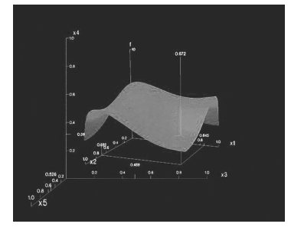
Hierarchical Visualization Techniques
With the previous approaches for visualization for a large data set of high dimensionality, it would be difficult to visualize all dimensions at the same time
Hierarchical visualization techniques partition all dimensions into subsets (i.e., subspaces). The subspaces are visualized in a hierarchical manner
Methods
Worlds-within-Worlds
Tree-Map
Cone Trees
InfoCube

Slide 35
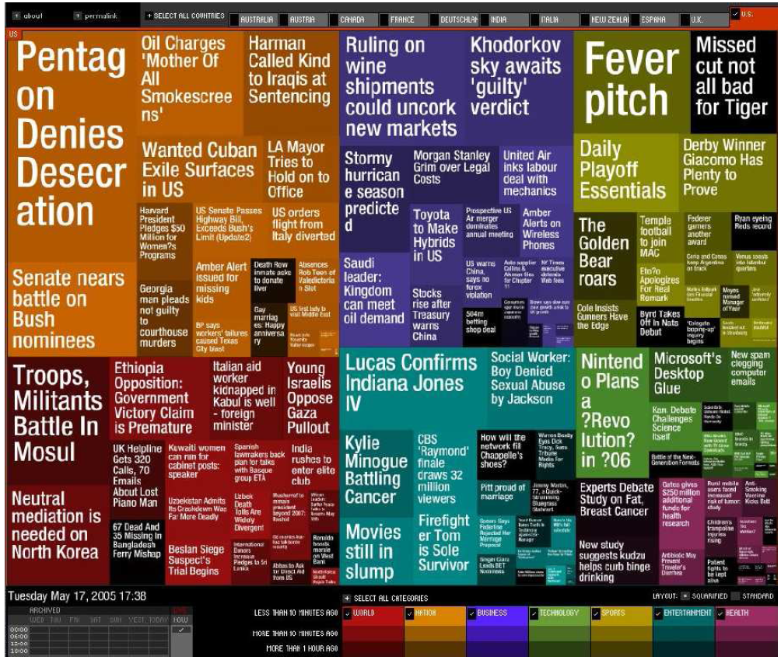
Visualizing Complex Data and Relations
In early days, visualization techniques were mainly for numeric data.
Recently, more and more non-numeric data, such as text and social networks, have become available.
For example, many people on the Web tag various objects such as pictures,
blog entries, and product reviews.
A tag cloud is a visualization of
statistics of user-generated tags.
Often ,in a tag cloud, tags are listed
alphabetically or in a user-preferred order.
The importance of tag is represented by font size/color

Slide 36
Visualizing Complex Data and Relations
Visualizing non-numerical data: text and social networks
Tag cloud: visualizing user-generated tags
The importance of tag is represented by font size/color
Besides text data, there are also methods to visualize relationships, such as visualizing social networks
Newsmap: Google News Stories in 2005

Slide 37
You are welcome…..
Questions ?
Suggestions !!

