Slide 1

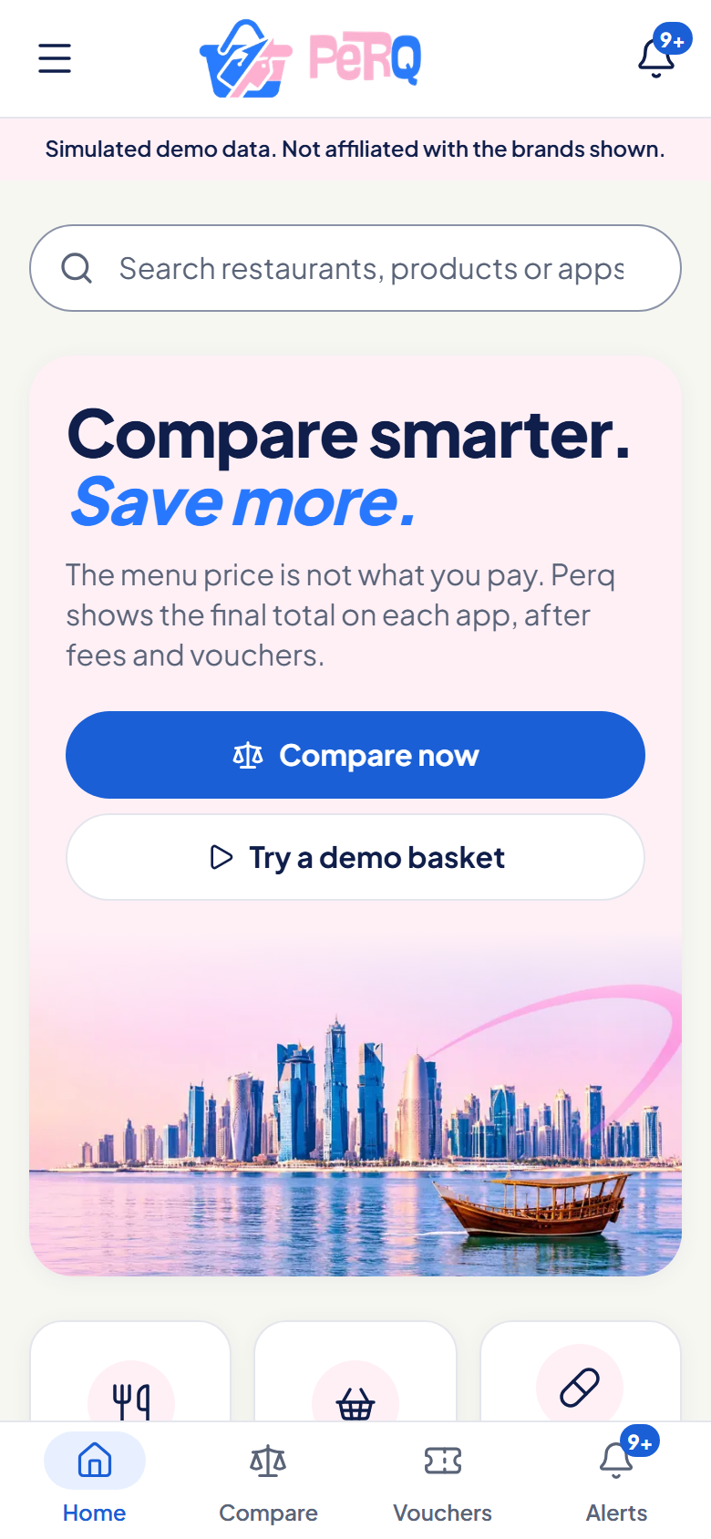
The menu price is not
what you pay.
Perq compares the final total
of one basket across the delivery apps in Qatar.
MES Youth Hackathon 2026 | Fadhil, Sadiya, Arefa
Simulated demo data. Not affiliated with the brands shown.
Perq | MES Youth Hackathon 2026
1
Notes:
Open with the one-line idea: the menu price is not what you pay. Introduce the team (Fadhil builds, Sadiya and Arefa research, design and test). Perq is a live web app you can open on your phone right now. Everything you will see is simulated demo data, labelled as such in the app.

Slide 2
One Jollibee order. Five very different totals.
QAR 17.70
lower than the highest total, for the same food
2 x 2pc Chickenjoy, Jolly Spaghetti, Regular Coke. Final totals include delivery, service fees and offers. The last bar uses a Dukhan Bank Visa card offer, paid by card.
Simulated demo data. Not affiliated with the brands shown.
Perq | MES Youth Hackathon 2026
2
Notes:
This is the hook. Same Jollibee order on four apps: Keeta QAR 58.00, Snoonu 60.00, Rafeeq 61.50, Talabat 63.00. With a Dukhan Bank Visa card offer paid by card, Rafeeq falls to QAR 45.30. That is QAR 17.70 below the highest total. These numbers come from our simulated demo data (src/data/demoScenarios.ts), not live prices. The point: the cheapest-looking option changes once fees, vouchers and cards are included.

Slide 3
In Qatar, the real total is hard to see
1
2
3
4
Fees
Vouchers
Cards
Expiry
Delivery, service and small-order fees differ by app and by basket.
Codes have minimums, caps, first-order rules and category limits.
Bank offers depend on the card, the network and how you pay.
Good offers run out before you remember to use them.
So shoppers compare menu prices, but pay something different.
Perq | MES Youth Hackathon 2026
3
Notes:
Four things hide the real total in Qatar: fees that differ per app, vouchers with conditions, bank-card offers that need the right card and payment channel, and offers that expire. Menu prices are easy to compare; the amount you actually pay is not.

Slide 4
Today, each app only answers for itself
Delivery apps
Voucher codes
Comparing by hand
Show their own price, their own fees and their own offers.
Spread across apps, chats and bank pages, with fine print.
Open every app, rebuild the basket, do the sums yourself.
Limit: No view of the other apps
Limit: Easy to lose, easy to misuse
Limit: Slow, so most people skip it
Missing: one place that compares the final total across apps for the same basket.
Based on our team's own use of these apps, not a market study.
Perq | MES Youth Hackathon 2026
4
Notes:
Keep this modest. Each delivery app shows its own prices, fees and offers. Voucher codes live in many places. Doing the comparison by hand means opening every app and rebuilding the basket. As far as our team has found, there is no single place that compares the final payable total across apps. This is our own experience, not a formal market study (research notes in docs/02-research.md are still to be completed).

Slide 5
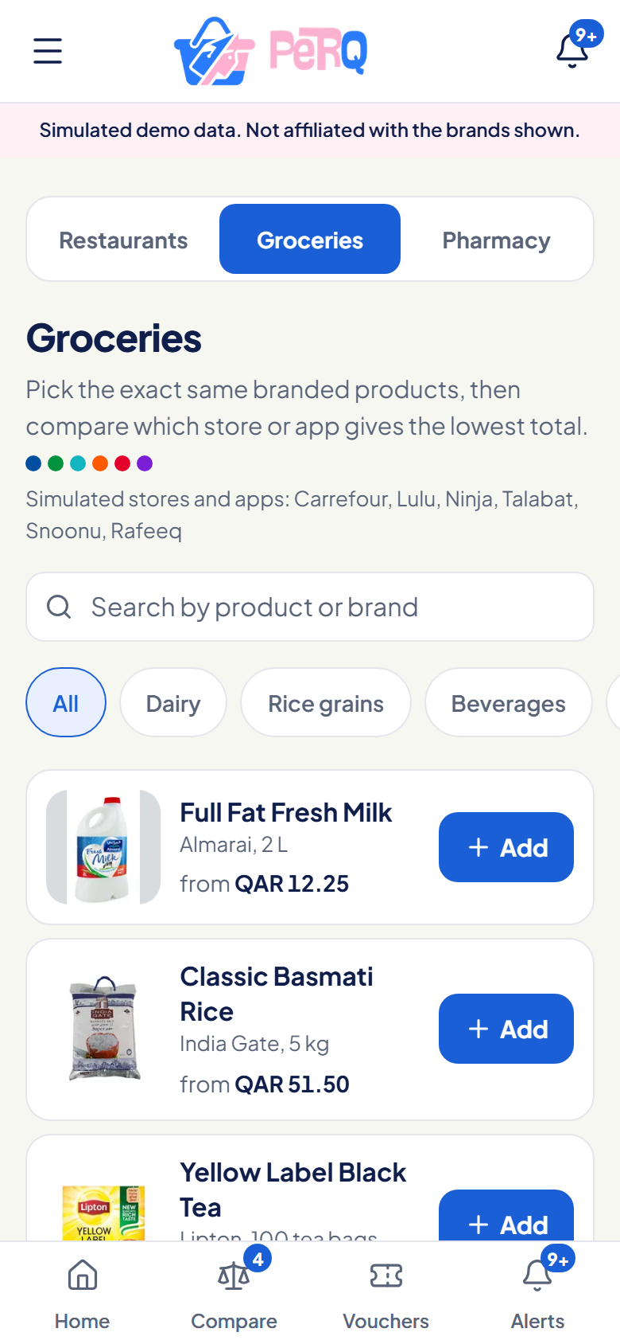
Perq: one basket, every app, the real total
1
Same items, same brands
Pick a basket once, in food, groceries or pharmacy.
2
Final payable amount
Items, delivery, service and small-order fees, sales and eligible vouchers.
3
Plain-language reasons
See why a voucher applied, and what is missing when it does not.
Simulated demo data. Not affiliated with the brands shown.
Perq | MES Youth Hackathon 2026
5
Notes:
Perq is a mobile-first web app. You choose a basket once; Perq works out the final amount on each app that can deliver it, including fees, sales and the vouchers you are actually eligible for, and explains the reasoning. Judges open it by QR code; no install and no account.

Slide 6
How it works
1
2
3
4
5
Build
Compare
Check
Sort
Shop
a basket
final totals
vouchers
Best price or Fastest
with the guide
One pure calculation engine does the maths for every category. Same inputs always give the same answer, so every number is explainable and tested.
Perq | MES Youth Hackathon 2026
6
Notes:
Four steps. Build a basket. Perq compares the final total on each app. Voucher intelligence checks which vouchers are eligible and picks the best combination. Then you sort by Best price or Fastest, and tap Shop at the winning app for a shopping guide. Behind this is one pure TypeScript calculation engine shared by food, groceries and pharmacy; it is unit tested, so the numbers are reproducible, not hard-coded in the UI.

Slide 7
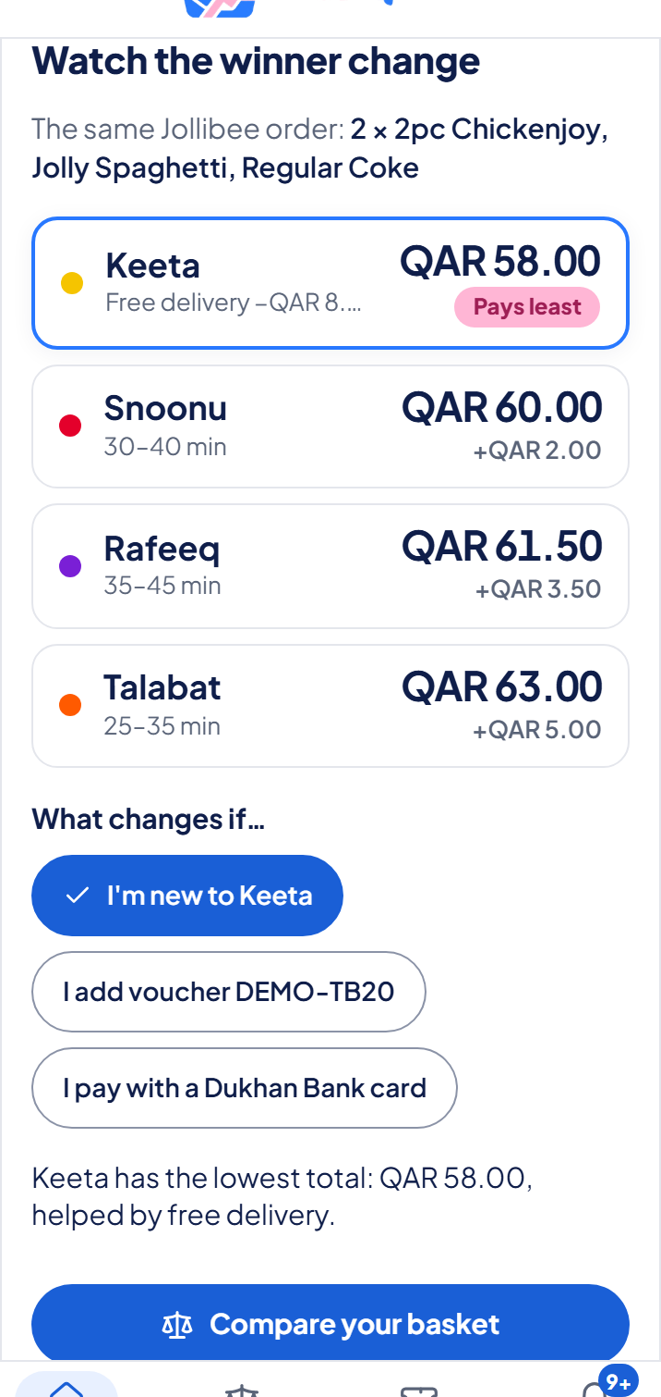
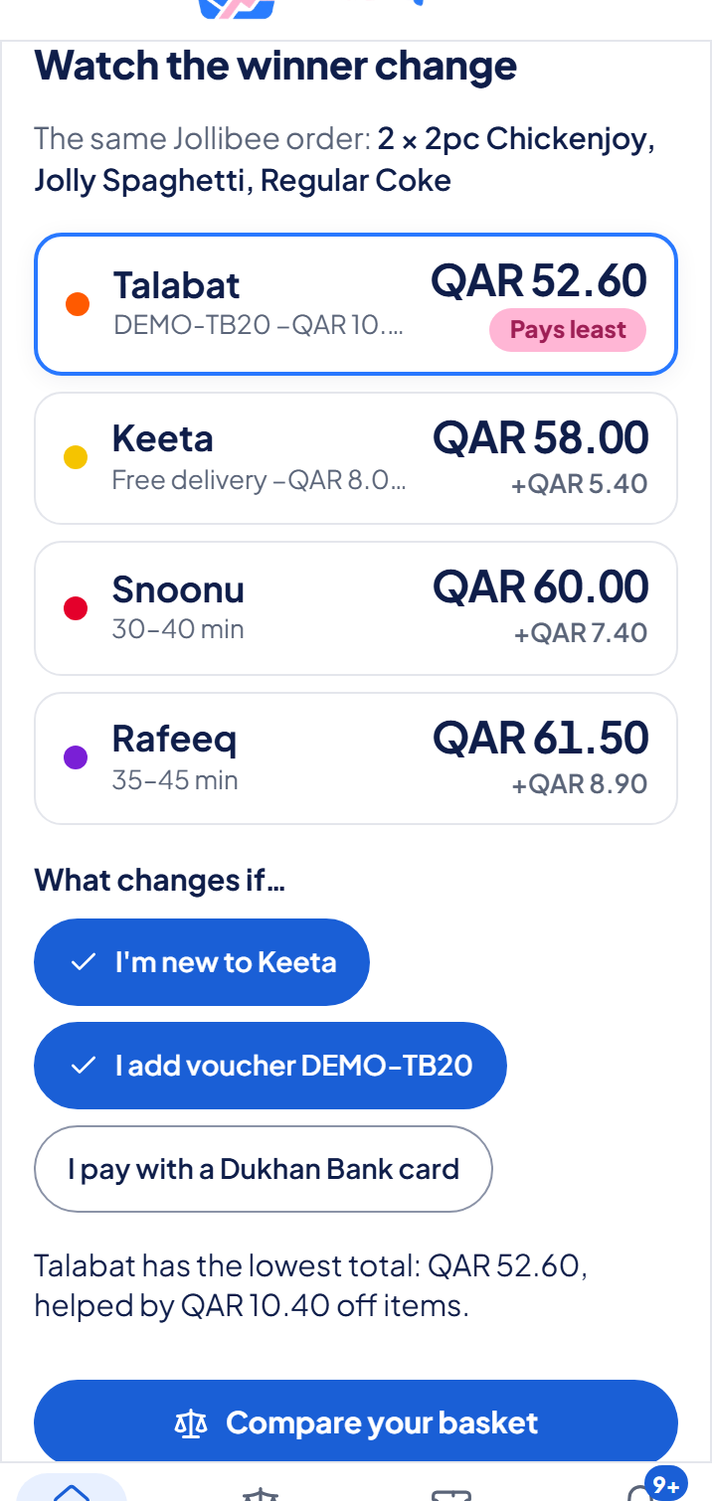
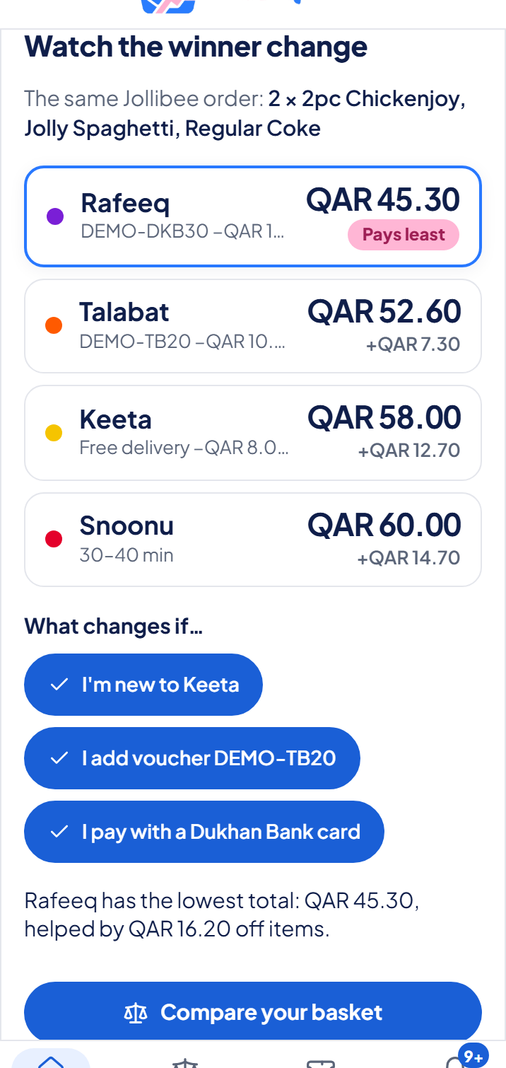
Watch the winner change
Start
Add voucher DEMO-TB20
Add your Dukhan Visa Signature card
Keeta wins: QAR 58.00
Talabat wins: QAR 52.60
Rafeeq wins: QAR 45.30
Same order, three changes, three different winners. The demo path takes under 3 minutes.
Simulated demo data. Not affiliated with the brands shown.
Perq | MES Youth Hackathon 2026
7
Notes:
Walk the live demo. Step 1: Keeta wins at QAR 58.00 even though its menu prices are highest, because of free delivery for new users. Step 2: add voucher DEMO-TB20 and Talabat wins at QAR 52.60. Step 3: with a Dukhan Bank Visa Signature saved in My cards (paid by card), Rafeeq wins at QAR 45.30. If the live demo fails, use these screenshots or the recorded fallback video. All simulated.

Slide 8
Five features, three categories
1
Smart Basket Comparison
Final total per app
2
Voucher Wallet and Eligibility
Save, check, explain
3
Smart Sorting
Best price or Fastest
4
Voucher Expiry Tracker
In-app alerts
5
Dashboard and mobile UI
Fast on a phone
Restaurants
Groceries
Pharmacy and personal care
Perq | MES Youth Hackathon 2026
8
Notes:
Five features, all built and working: basket comparison, voucher wallet with an eligibility checker, smart sorting (Best price and Fastest), a voucher expiry tracker with in-app alerts, and a responsive mobile-first dashboard. Three categories: restaurants (Talabat, Snoonu, Rafeeq, Keeta), groceries (Carrefour, Lulu, Ninja and others) and pharmacy and personal care (Wellcare, Kulud). No medicines. Saved data stays on the device.

Slide 9
Voucher intelligence
Eligibility, explained
Best eligible combination
A code that does not apply says why, for example "Add QAR 3.00 more".
The engine picks the best vouchers, bank offers and sales that can really be used.
Expiry alerts
Benefit-first titles
Live
Saved vouchers raise in-app alerts at 7 days, 3 days, 24 hours and after expiry.
"30% OFF" first, the cap below, then the code with one-tap Copy.
Alerts work while Perq is open. There is no push notification.
Perq | MES Youth Hackathon 2026
9
Notes:
Voucher intelligence is the heart of Perq. Eligibility: every voucher is checked against the basket, the app, minimum spend, first-order rules and your profile, and a rejected voucher explains why. The optimiser chooses the best eligible combination. Expiry: saved vouchers generate in-app alerts at 7 days, 3 days, 24 hours and expired. These only show while the app is open; no background push. Benefit-first titles are live: the voucher says what you get (30% OFF, up to QAR 30), and the code sits below with a Copy button. Demo codes say they will not work in the real app.

Slide 10
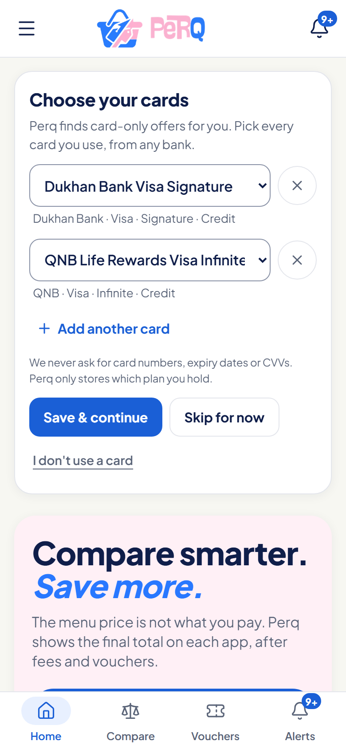
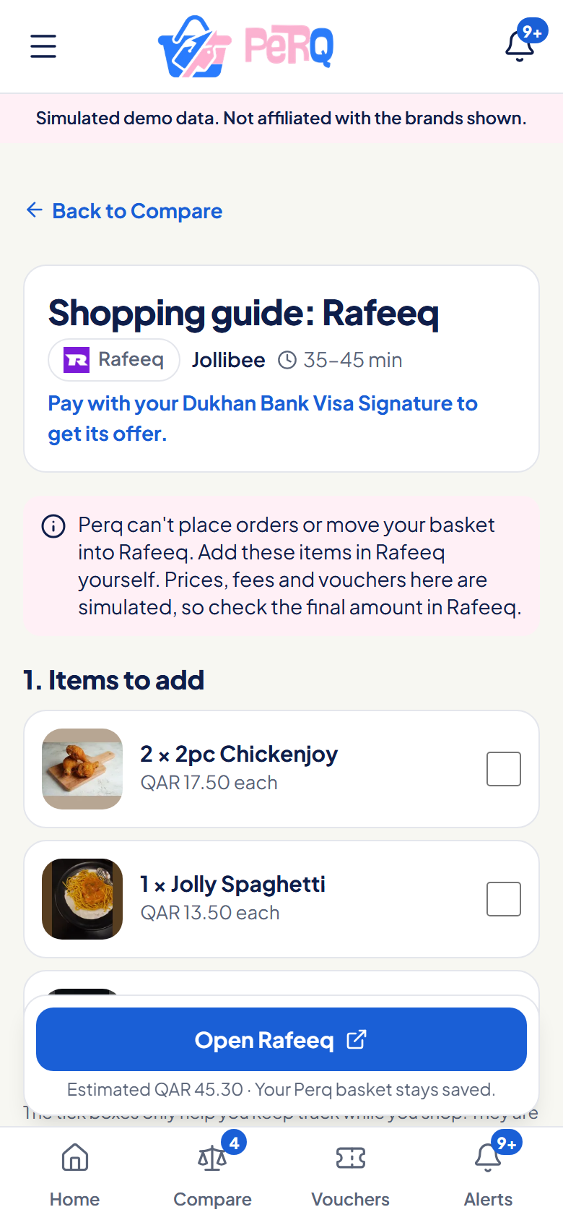
Your cards, then a guide to order
Live
Live
Choose your cards, once
Shopping guide for the winner
Real Qatar card plans from a list
Bank, network, tier, credit or debit
Perq tries every card, keeps the best
Items to add, with a tick list
Vouchers to use, codes to copy
Estimated total, then open the app
No card numbers, ever.
Perq does not place the order.
Simulated demo data. Not affiliated with the brands shown.
Perq | MES Youth Hackathon 2026
10
Notes:
Both are live. Choose your cards: on first visit Perq asks which card plans you hold, from a preset list of real Qatar plans such as the Dukhan Bank Visa Signature or QNB Life Rewards Visa Infinite. No card numbers. Perq then runs the comparison for every saved card and keeps the best: with a Dukhan Visa Signature, Rafeeq drops to QAR 45.30; a Dukhan Platinum does not qualify for that offer, and the app says so. The Shopping guide: tap Shop at Rafeeq to get the items to add, the 30% OFF voucher with its code to copy, the estimated total and a link to open the app. Perq does not place orders or take payment, because no platform offers a public ordering API. Offers and codes are simulated.

Slide 11
Built to be fast, testable and simple
Interface
Quality
375 unit tests and 50 end-to-end tests. Automated accessibility checks (axe): 0 violations.
React, TypeScript (strict), Tailwind, react-router, zustand (saved on the device)
Calculation engine
Pure TypeScript: eligibility, best combination, sorting, explanations. Money in whole dirhams.
Hosting
Vite static build on Vercel. No backend, no accounts, no database.
Simulated data
Catalogues, fees and promotions in code, each labelled as simulated
Demo numbers are checked by tests and never hard-coded in the interface.
Perq | MES Youth Hackathon 2026
11
Notes:
Technology in one picture. React, TypeScript and Tailwind for the interface, zustand for state saved on the device, a pure calculation engine with no React inside it so it can be tested exhaustively, and simulated data in code. Vitest for 375 unit tests (including the exact demo numbers), Playwright for 50 end-to-end tests, Playwright for end-to-end flows, axe for accessibility. Deployed on Vercel as a static site: no backend, which also means no personal data is collected.

Slide 12
What makes Perq different
 | One delivery app | Perq
Compares across apps | Its own price only | Final total per app
Voucher help | Its own codes | Eligibility and reasons
Cards and pay channel | Partly, in its own flow | Part of the maths
Expiry reminders | Varies | In-app alerts
Honesty about data | Real prices | Labelled simulated demo
Perq complements the apps; it does not replace them.
Comparison reflects what we saw using the apps; not an audit of their features.
Perq | MES Youth Hackathon 2026
12
Notes:
Differentiation without naming competitors. A single delivery app only knows its own price and its own codes. Perq compares the final total across apps, explains voucher eligibility, includes card and pay channel in the maths, and tracks expiry. It complements the apps. Our prototype uses simulated data, which we state openly. Claims about other apps reflect our own use, not an audit.

Slide 13
Impact and what comes next
Practical impact, Qatar first
The honest path to real data
Fewer surprises at checkout
Use the right voucher or card before it expires
Compare food, groceries and pharmacy in one place
Our demo basket: QAR 17.70 between the highest total and the best
Live prices and ordering need partnerships: we found no public customer-order API on Talabat, Snoonu, Rafeeq, Keeta, Ninja, Carrefour, Lulu, Kulud or Wellcare
Today: the Shopping guide tells you what to add and which codes to copy, then opens the app
Later: partner feeds, Arabic interface, more stores
Perq | MES Youth Hackathon 2026
13
Notes:
Impact: shoppers avoid surprise fees, use vouchers and cards correctly before they expire, and compare across categories. Be honest about limits: this is a prototype on simulated data. To show real prices or place real orders we would need partnerships; our research found no public customer-order API on the nine platforms (Talabat, Snoonu, Rafeeq, Keeta, Ninja, Carrefour, Lulu, Kulud, Wellcare). That is why we chose a guided approach rather than faking order placement. Roadmap: partner data, Arabic UI, more stores.

Slide 14
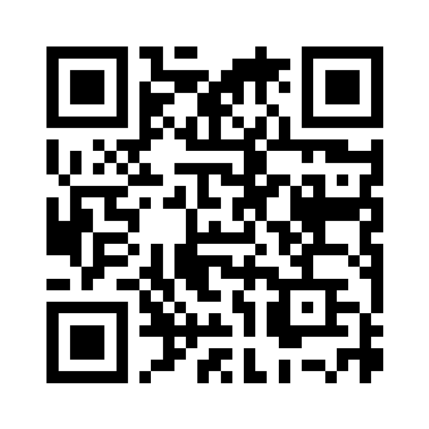
Try Perq on your phone
perq-qatar.vercel.app
The menu price is not what you pay. Perq shows what you actually pay.
Fadhil: build | Sadiya and Arefa: research, design, testing, pitch
Simulated demo data. Not affiliated with the brands shown.
Perq | MES Youth Hackathon 2026
14
Notes:
Close with the call to action: scan the QR code and try the Jollibee demo basket on your own phone. The site is live at perq-qatar.vercel.app. Restate the idea in one line, thank the judges, and invite questions. Remind them it is simulated data. Each member's contribution: Fadhil built the app with Claude Code; Sadiya and Arefa did research, design review, device testing and the pitch (confirm wording with the team).

