Slide 1
Visualizing Neural Network Components Subtitle: Using TensorFlow Playground for Model Training Mohammad Anwar Karim 05/25/2025

Slide 2
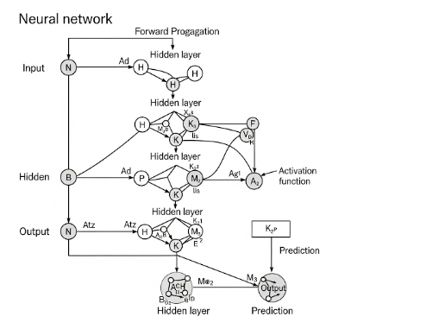
Neural Network Structure
The graphic demonstrates data flow from the input layer through numerous hidden levels to the output layer. Each circle symbolizes a neuron, while lines denote weights.

Slide 3
Layers
The graphic demonstrates data flow from the input layer through numerous hidden levels to the output layer. Each circle symbolizes a neuron, while lines denote weights.
Layers organize neurons in a neural network.
Input Layer: Receives data.
Hidden Layers: Process input using weights and activation functions.
Output Layer: Produces the final prediction. 📌 Each layer transforms data progressively for better feature extraction.

Slide 4
Neurons
Neurons are the basic units of a neural network. They receive inputs, apply weights, compute sums, and pass the results through an activation function to generate outputs.
Neurons (nodes) are the basic units of computation.
They sum weighted inputs and apply an activation function. 📌 the circles labeled H, K, M, etc., represent neurons.

Slide 5
Weights
Weights are parameters that determine the influence of input data on a neuron's output. Training adjusts weights to minimize the loss function and improve predictions.
Weights are parameters that scale input values.
Lines connecting neurons carry weights.
During training, weights are adjusted to minimize error. 📌 Stronger weights lead to a stronger influence on the output.

Slide 6
Activation Functions
Activation functions add non-linearity to the model. Common types include ReLU, Sigmoid, and Tanh. They help the network learn complex patterns and relationships in the data.
Activation functions introduce non-linearity.
Examples: Sigmoid, ReLU, Tanh
Help networks learn complex patterns 📌 this is shown between nodes and output transformation.

Slide 7
Loss Functions
Loss functions measure the error between predicted and actual outputs. Common examples are Mean Squared Error and Cross Entropy Loss. Lower loss means better model accuracy.
A loss function calculates the error between predicted and actual outputs.
Guides learning by quantifying how “wrong” predictions are.
Common: Mean Squared Error, Cross-Entropy 📌 This guides the optimization step.

Slide 8
Optimization Algorithms
Optimization algorithms such as Gradient Descent and Adam adjust weights during training to minimize the loss function, improving model performance over iterations.
These update weights to reduce the loss.
Use gradient descent or variants like Adam or SGD.
Learn by iteratively improving predictions. 📌 The model learns through backpropagation based on loss gradients.

Slide 9
Summary & Insights
Adding more hidden layers increases model complexity but may lead to overfitting.
Activation functions are crucial for learning non-linear relationships.
Visualizing training helps understand the balance between underfitting and overfitting.
Hyperparameters like learning rate and batch size significantly affect performance.
🎯 Conclusion: Visualizing neural networks clarifies how data transforms through layers. It also highlights the importance of tuning architecture and parameters for optimal learning.

