Slide 1
Real Time Data Streaming: Twitter Hashtag Count Analysis
December 7, 2017
By:
Kashyap Sodha
Sajiri Mendjoge
Shubhshree Anand
Shruti Choudhary

Slide 2
Real Time Data Streams:
Real time Data (RTD) is the information which is delivered immediately after collection
Involves Continual Input, Process and Output of Data
Data Streams processes in Short Spans
Instantaneous and continuous output
Game Changer in Big Data world

Slide 3
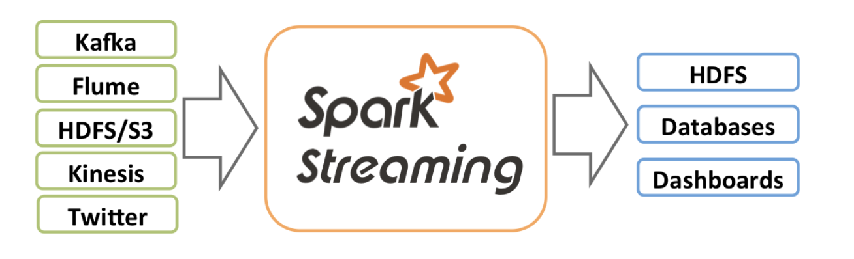
Data flow:
Querying Data from Twitter using Twitter API
Sending Data Streams into Spark and perform data processing using Spark Streaming
Pushing the processed data on live Dashboard

Slide 4
Features
Step 1 :Twitter API
Step 2 : Spark Streaming
Step 3: Kibana Dashboard
Application Programming Interface
Requires authentication via OAuth
Endpoints
Returns output in JSON format
Large Scale Data Processing Engine
Continuous Transformation of Data
Fetching Data from Heterogeneous Sources
RDD , DAG
DStream Processing
In-Memory Computing
Lineage
Category Wise as per hashtags
Display Data in graphical form
Charts, Pie charts, Bars
Explaining Market Trends

Slide 5
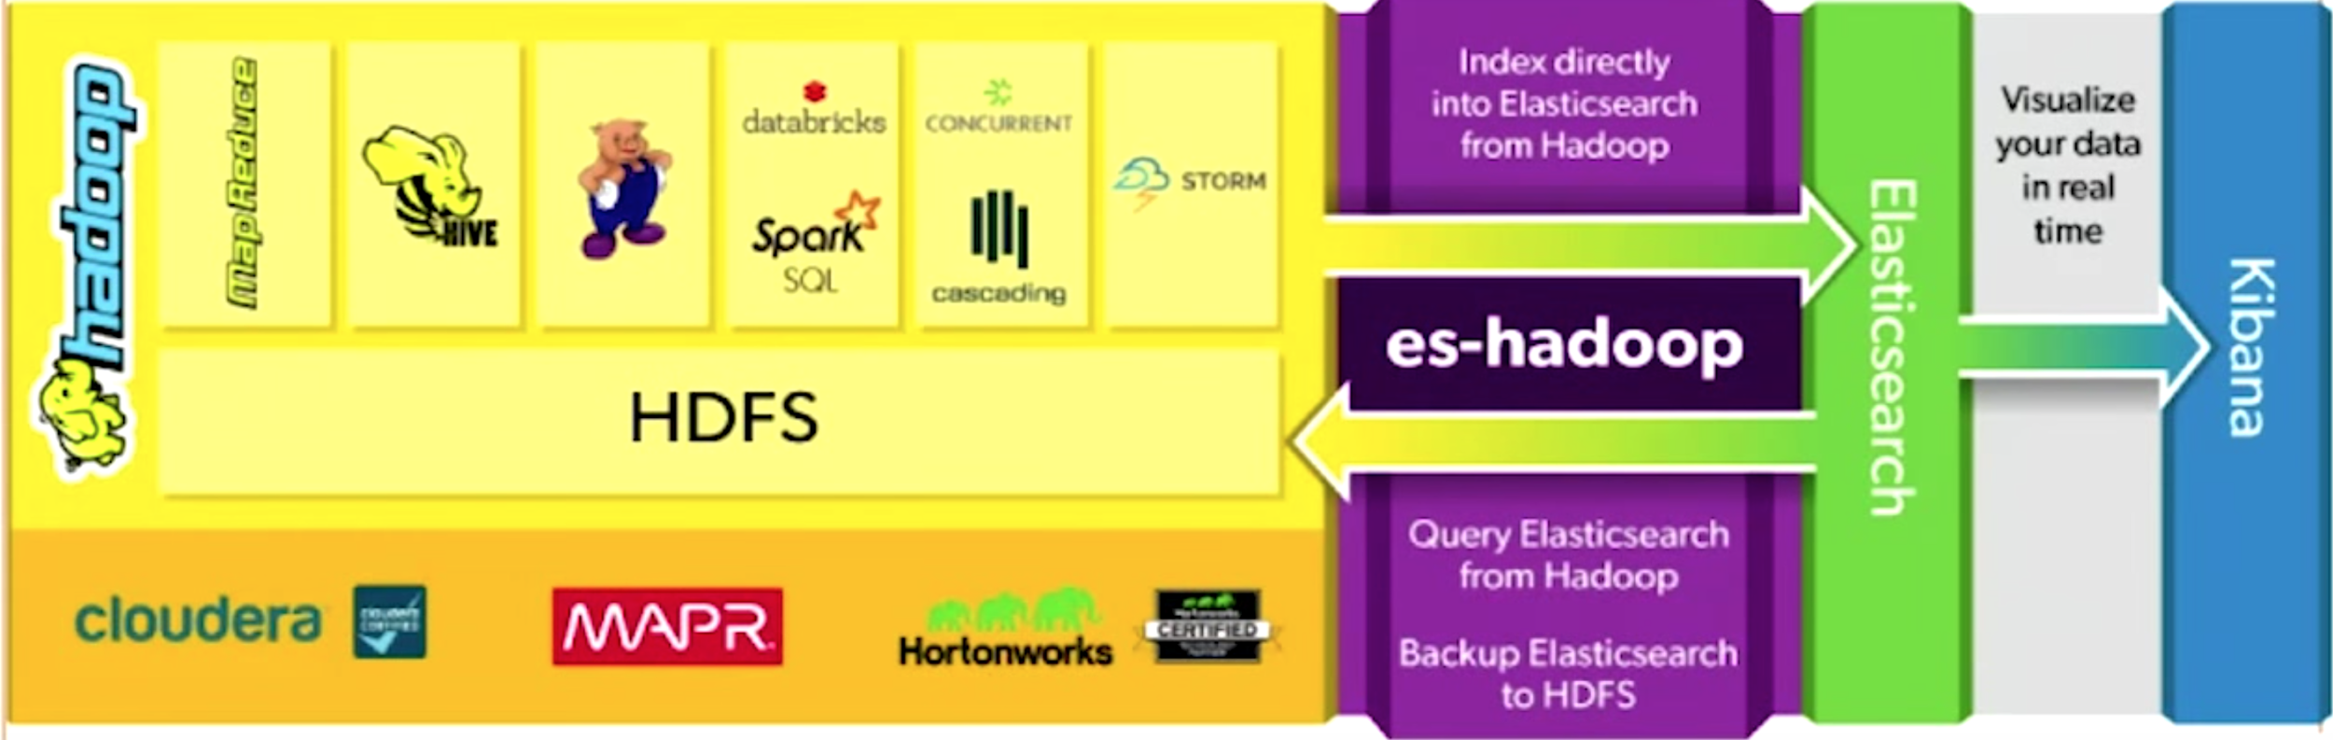
Data flow | Technologies:

Slide 6
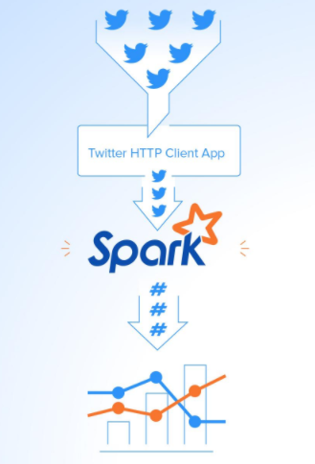
Project objective:
Importance of Analysis-Hashtags
Measure Popularity
Used to measure Sentiment gauge
Monitoring Hashtags for Business Use
Identify Top Trends
Content Moderation
Increasing Social Media Presence
Monitoring Conversations
Capturing Imagination of Online Public

Slide 7
Extracting Data Streams from Twitter HTTP Client API
Create an application
Get Token Credentials, Consumerkey
Authenticate Connection via Oauth Library
Fetch tweets as per Language, Locations & Track
Extract Tweets in JSON
Establish TCP Connection

Slide 8
Stream Processing for Fetched Data into Apache Spark
Setting up Spark Application
Spark Context & Streaming Context
Creation Check : RDD - Resilient Distributed Dataset
Transformation Logic
Count Hashtags as per Category
Kibana Dashboard
Most Trending Tweets
Graphical Display
Counts & Top Trending Hashtags with Max Count
Timestamp with Hashtags

Slide 9
Timeline
Week1 | Week2 | Week3 | Week4 | Week5 | Week6 | Week7 | Week8
Authentication | Authentication
Twitter Data Streams
Spark Streaming - Aggregate Count
Create Application
RDD’s
Transformation
Hashtag Count
Authentication
Dashboard
TCP connection
Example1: #Photography
Example2: #traffic
Example3: #jobtrends

Slide 10
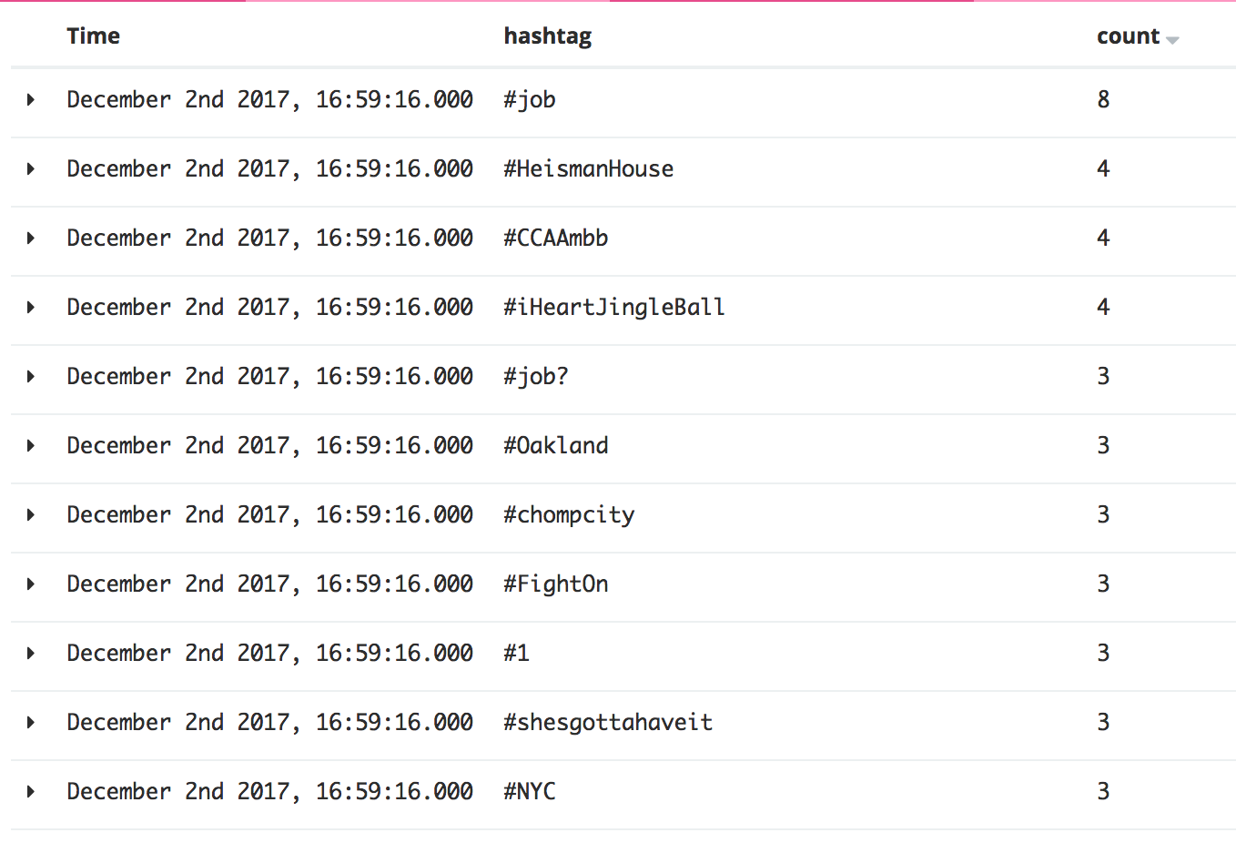
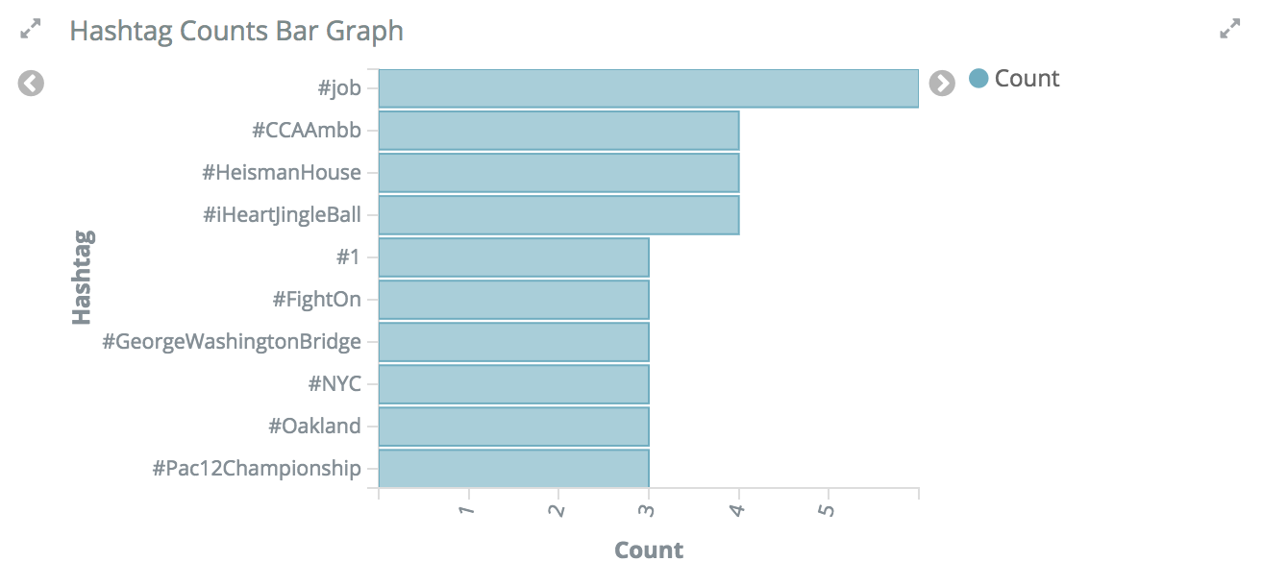
Kibana Dashboard

Slide 11
Demonstration

Slide 12
Future Scope
Job
Hiring
Day or Month wise analysis for specific Words
Large Data handling
Sales Analysis
Growth Analysis
Hashtag Examples in Graph: #Job , #Hiring
39
5
29
27
7
5
20
34
5
22
22
15
Day1
Day2
Day3
Day4

Slide 13
Thank You!!

