Slide 1

Test Driven Development
All code is guilty until proven innocent
Toby Weston
Ben Lithgow-Smith
Pete Suggitt

Slide 2
Learning Objectives
Understanding the basic mechanics of TDD
Understanding the power of Pair Programming
Gain insight into the power of the IDE (forward generating code)
Understand TDD as a design tool

Slide 3
Notes:
Who’s heard of TDD?
Who’s done TDD?
How much?

Slide 4
“Our highest priority is to satisfy the customer through early and continuous delivery of valuable software”
Principle 1, The Agile Manifesto
Notes:
Who’s heard of agile? Everyone I hope!
What does that mean to people?
The first principle!
Highest priority = satisfy customer with valuable software.
Emphasis here is early and continuous delivery. Can only do that with the technical practices to underpin it.

Slide 5
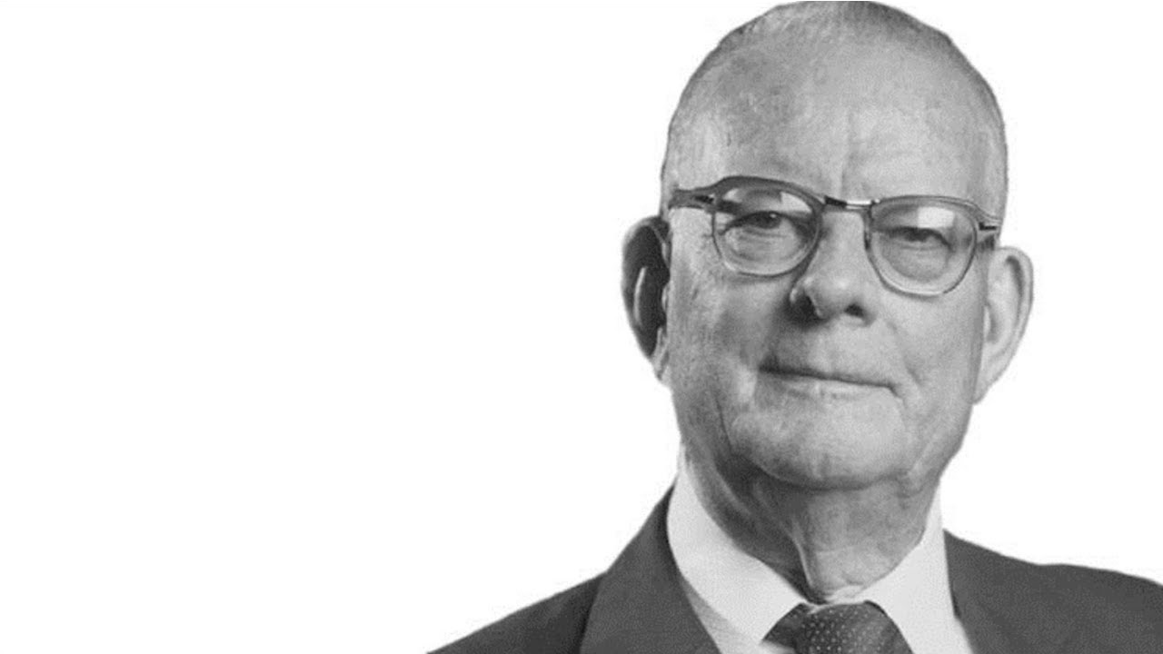
“Inspection does not improve the quality, nor guarantee quality. Inspection is too late. The quality, good or bad, is already in the product. As Harold F. Dodge said, ‘You cannot inspect quality into a product.’”
W. Edwards Deming
Out of the Crisis
Notes:
Who’s heard of agile?
Lean manufacturing prior to agile. Deming influence on Japanese auto industry, etc. Expensive to scrap/rework cars.
Quote applies to testing when in the context of software development.
Deming, known as the father of quality for his pioneering work bringing the process that came to be known as Total Quality Management to the Japanese.
W. Edwards Deming, a key figure in the history of the Lean movement, offered 14 key principles for management. Principle three states, “Cease dependence on inspection to achieve quality. Eliminate the need for inspection on a mass basis by building quality into the product in the first place.”

Slide 6


Notes:
Nowadays we call this shift left.
We’re shifting things left in the SDLC – doing them earlier in time, i.e. to the left of a chart with time on the x-axis.
Shift left on testing, security, etc.

Slide 7
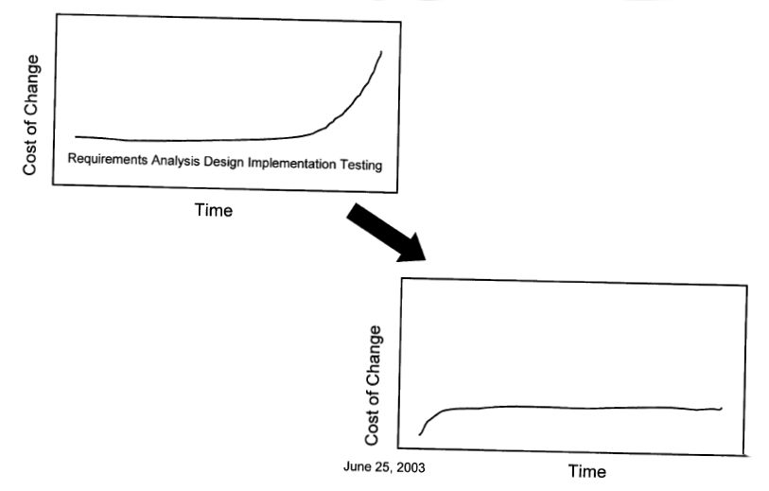
Cost of Change
Notes:
Finding things late is expensive; must pay for:
The business to determine what it really needs to do
The designer to design a solution
The developer to code the solution
The tester to test the solution
Any material cost to the business if the defect was shipped to production
We also want to flatten the cost of change as the project progresses.
It’s easy to put any code into a green field. But after time it gets harder and harder/more and more expensive, until it’s eventually too expensive to maintain/change so we throw it away and start again.
We want to delay that point for as long as possible by keeping the code/design malleable/easy to change.
TDD helps us to do that as it encourages good, malleable design.
Google spends $100M per year on test automation, and wanted an answer whether they are actually getting a good return on that investment. They estimated that a bug found during TDD costs $5 to fix, which surges to $50 for tests during a full build and $500 during an integration test. It goes to $5000 during a system test. Fixing bugs earlier would save them an estimated $160M per year. [https://gojko.net/2009/12/07/improving-testing-practices-at-google , 2009]
https://martinfowler.com/articles/is-quality-worth-cost.html

Slide 8
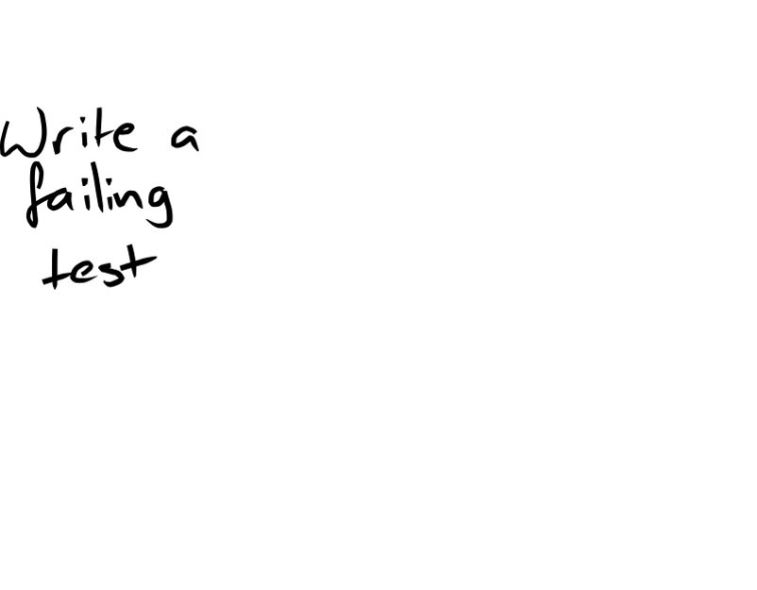
Test Driven Development
Notes:
1. Write a little test that doesn’t work, perhaps doesn’t even compile at first - RED
The test should clearly states the expectations
Specify one small piece of the desired outcome, without caring about the implementation
Law 1: “You are not allowed to write any production code unless it is to make a failing unit test pass.”
Law 2: “You are not allowed to write any more of a unit test than is sufficient to fail; and compilation failures are failures.”
Arrange, Act, Assert / Given, When, Then

Slide 9
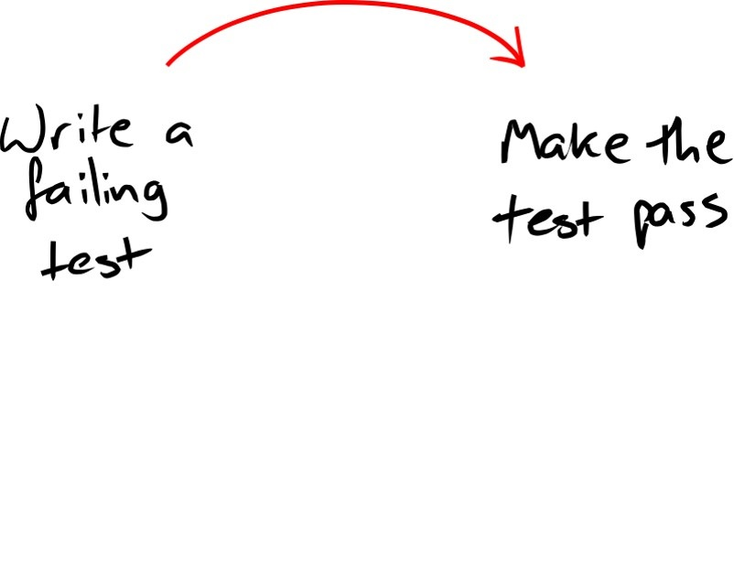
Notes:
2. Write just enough production code to make that test pass - GREEN
…in the simplest way you can
Quickly make the test work, committing whatever sins necessary in the process
Law 3: “You are not allowed to write any more production code than is sufficient to pass the one failing unit test.”

Slide 10
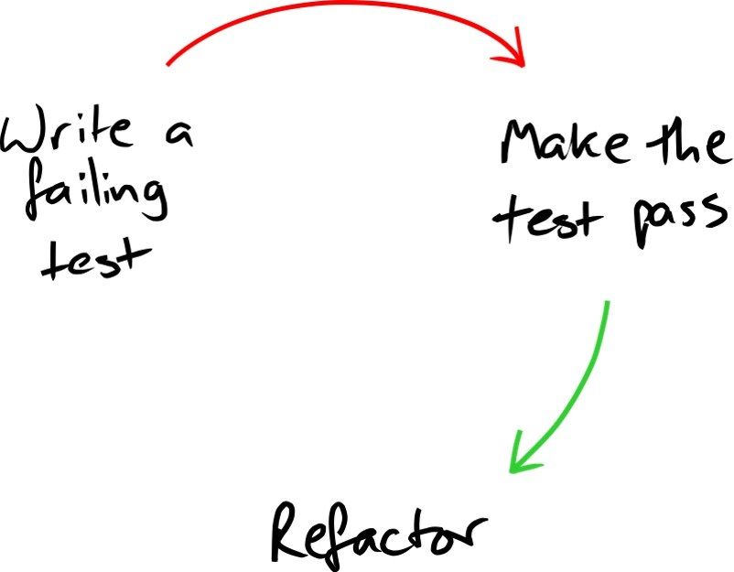
Notes:
3. Clean up any mess you just made – REFACTOR
Refactor both the production code and the test code
Eliminate all the duplication created in just getting the test to work
3 laws restated:
Write only enough of a unit test to fail; compilation is failure.
Write only enough production code to make the failing unit test pass

Slide 11
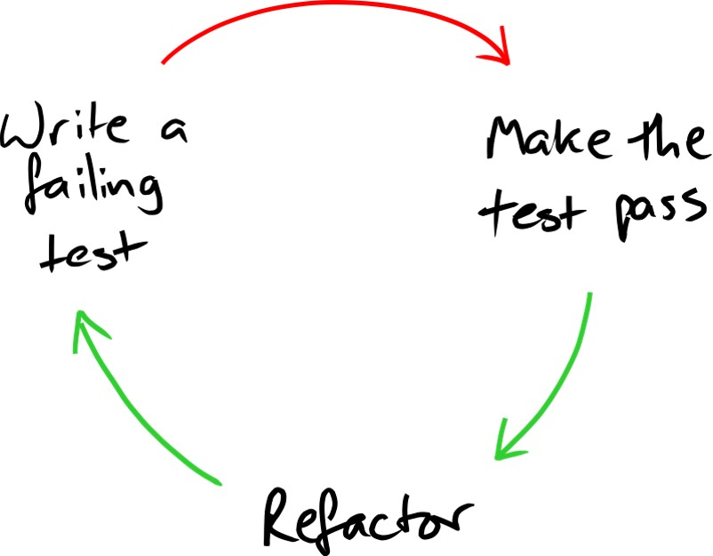
Notes:
In everything we do, whether writing tests, writing production code, or refactoring, we keep the system executing at all times. The time between running tests is on the order of seconds, or minutes. Even 10 minutes is too long.
“Do The Simplest Thing That Could Possibly Work” -- Kent Beck
KISS
YAGNI
DRY
Rule of 3 - Extract duplication only when you see it a 3rd time
3 methods of moving forwards:
Fake it – just return the value you need
Obvious Implementation – when you think you’re sure of the code, just write it
Triangulation – to introduce new behaviour, write a new, more specific test that forces the code to be more generic
As the tests get more specific, the code gets more generic (“test code evolves towards ever greater specificity, while production code evolves towards ever greater generality”)
Programmers refactor tests to become more and more concrete and specific. They refactor the production code to become more and more abstract and general.

Slide 12

Notes:
In everything we do, whether writing tests, writing production code, or refactoring, we keep the system executing at all times. The time between running tests is on the order of seconds, or minutes. Even 10 minutes is too long.
“Do The Simplest Thing That Could Possibly Work” -- Kent Beck
KISS
YAGNI
DRY
Rule of 3 - Extract duplication only when you see it a 3rd time
3 methods of moving forwards:
Fake it – just return the value you need
Obvious Implementation – when you think you’re sure of the code, just write it
Triangulation – to introduce new behaviour, write a new, more specific test that forces the code to be more generic
As the tests get more specific, the code gets more generic (“test code evolves towards ever greater specificity, while production code evolves towards ever greater generality”)
Programmers refactor tests to become more and more concrete and specific. They refactor the production code to become more and more abstract and general.

Slide 13
Laws of TDD
You must write a failing test before you write any production code
You must not write more of a test than is sufficient to fail, or fail to compile
You must not write more production code than is sufficient to make the currently failing test pass
Notes:
Or:
Write only enough of a unit test to fail; compilation is failure.
Write only enough production code to make the failing unit test pass.
http://butunclebob.com/ArticleS.UncleBob.TheThreeRulesOfTdd

Slide 14
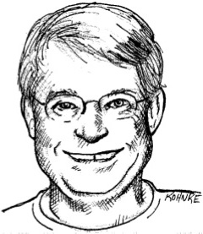
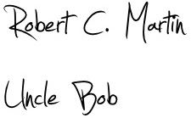
“The act of writing a unit test is more an act of design than of verification. It is also more an act of documentation than of verification. The act of writing a unit test closes a remarkable number of feedback loops, the least of which is the one pertaining to verification of function.”

Slide 15


Slide 16
Rules of Thumb
Tests capture intent, and test one thing
Focus on what is needed; not how to achieve it
Write the code you want to read
Think KISS / YAGNI / DRY
Arrange, Act, Assert / Given, When, Then
Notes:
Test one thing - one reason to fail – c.f. Single Responsibility Principle – do one thing and do it well
Always check the test fails for the reason you expect
Rule of Three – don’t pull out the wrong abstraction (and then have to undo and pull out the right one)
“Programmer tests should be sensitive to behavior changes and insensitive to structure changes. If the program’s behavior is stable from an observer’s perspective, no tests should change.” Kent Beck [https://medium.com/@kentbeck_7670/programmer-test-principles-d01c064d7934]

Slide 17
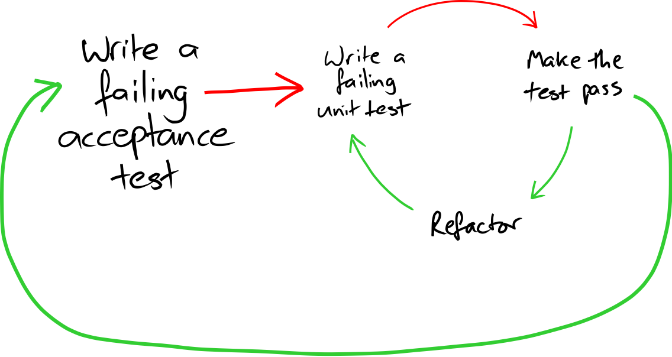
Acceptance Test Driven Development

Slide 19
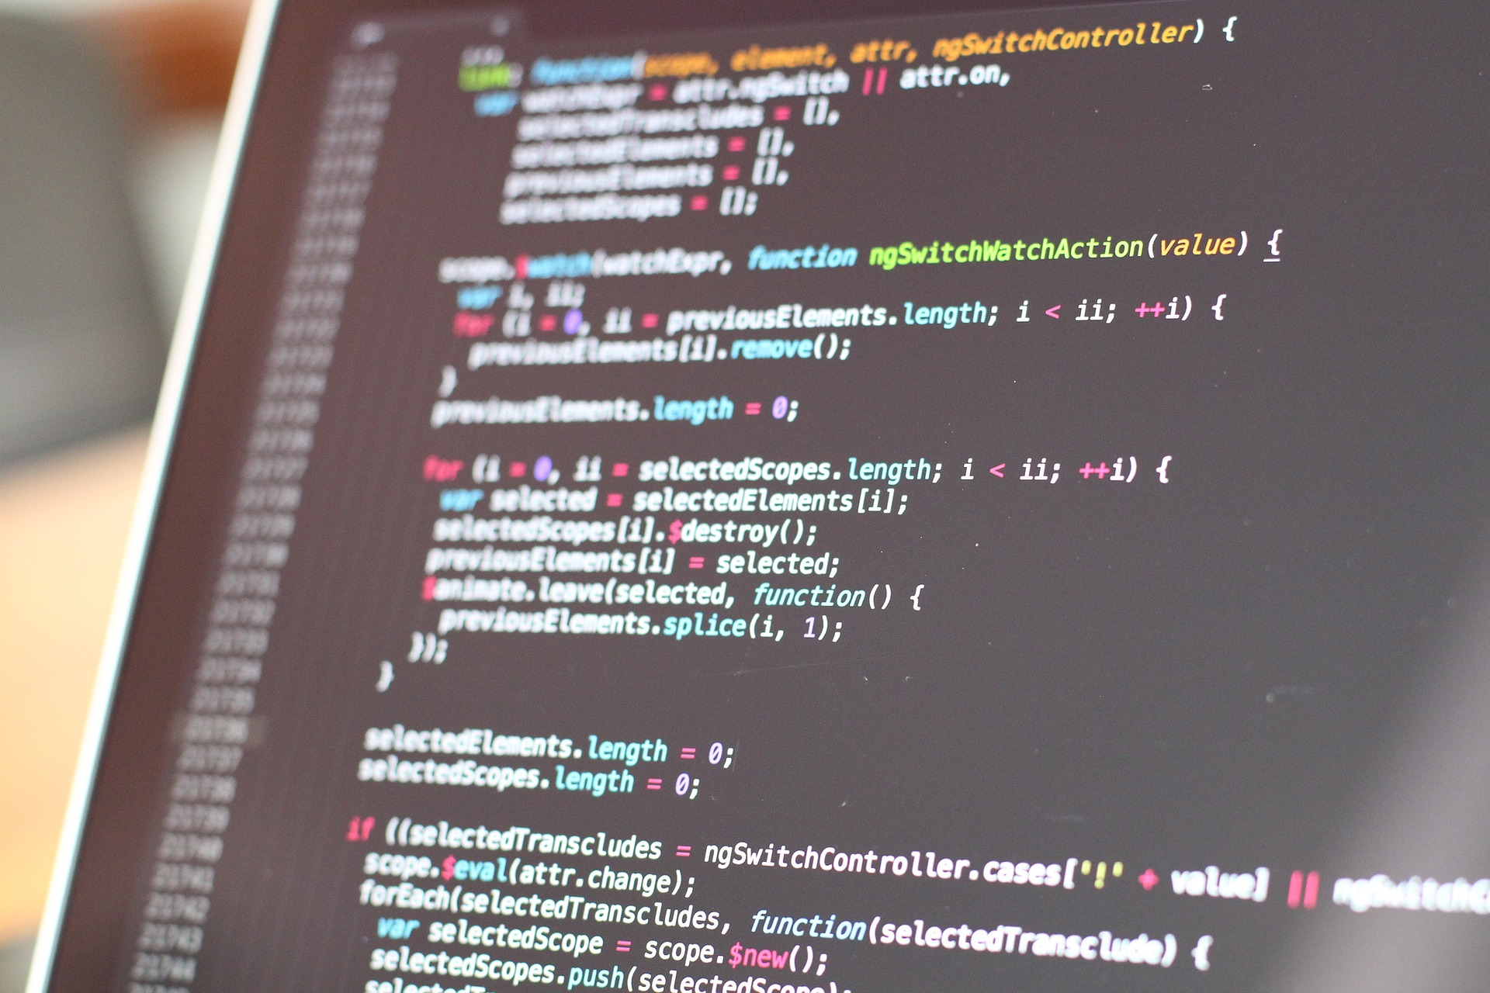
Let’s Code!

Slide 20
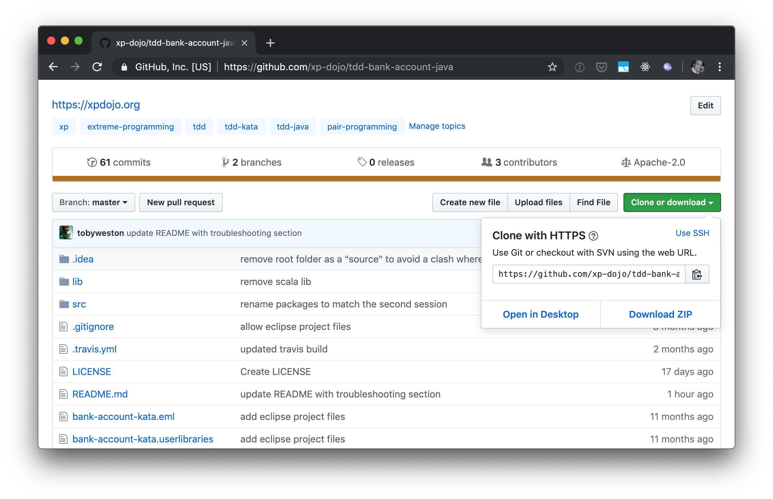
https://github.com/xp-dojo/tdd-bank-account-java
IntelliJ: “File->Open” and select the folder
Eclipse: “File->Open Projects from File System…” and select directory

Slide 21
User Requirements
I can Deposit money into an account
I can Withdraw money from an account
I can Transfer money between accounts (if I have the funds)
I can print out the last account Transaction (date, amount, balance)
I can print a Statement of account activity (all transactions)
I can apply statement Filters (just deposits, withdrawals, date)

