Slide 1

Recruitment Management
By,
Anwar Hossain
Emp Id: 11267
29th Oct, 2021
Image Placeholder
Notes:
<number>

Slide 2
ABOUT THE PROJECT​
Project Objectives: This website/application will serve as a recruit management application. One organization or person will be managed all the recruitment step easily by using it. Organization can manage their training period for fresh employee or track their activity by using this web application.​
​
Project Context: The purpose of this project is to develop a valuable web application to manage BJIT recruitment policy efficiently.

Slide 3
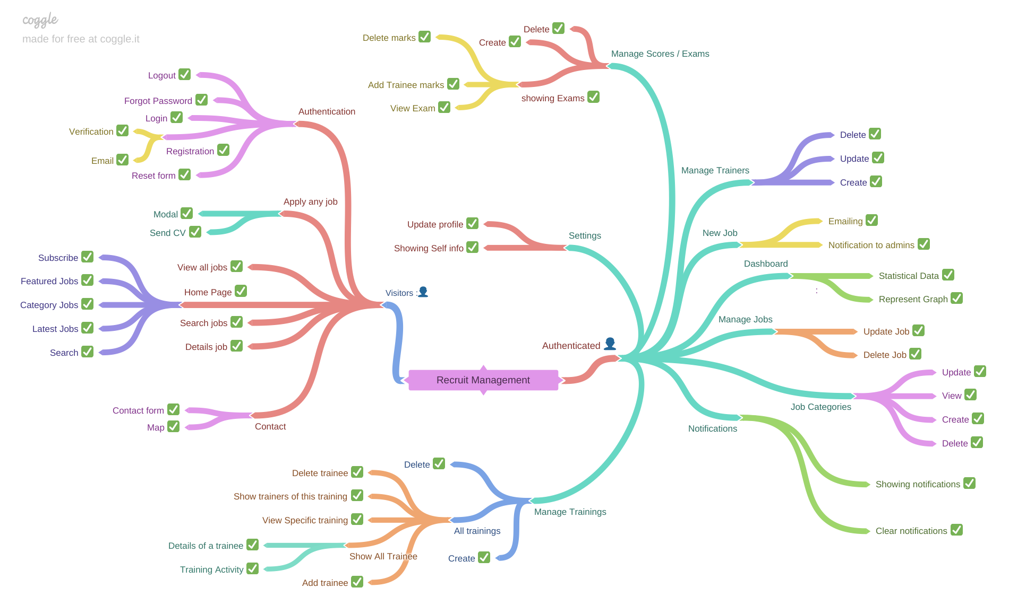

Slide 4
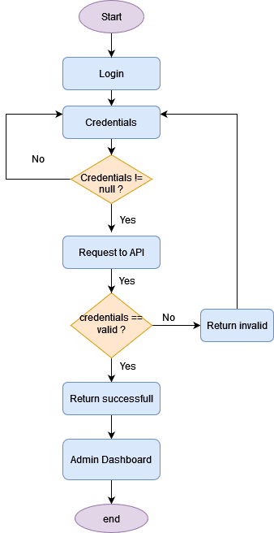
Flow Chart for Login

Slide 5
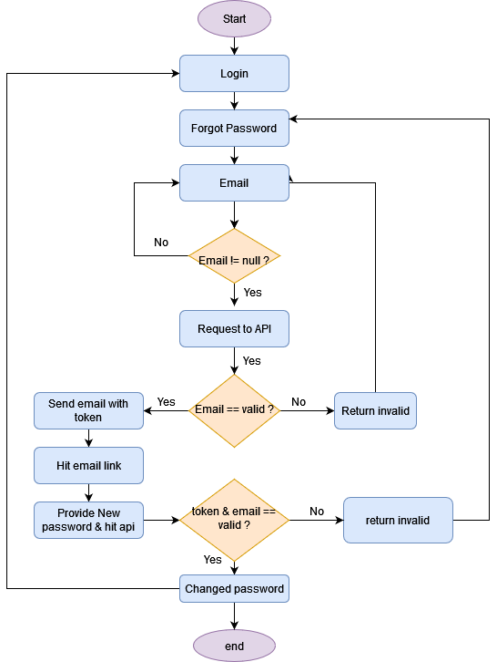
Flow Chart for Reset Password

Slide 6
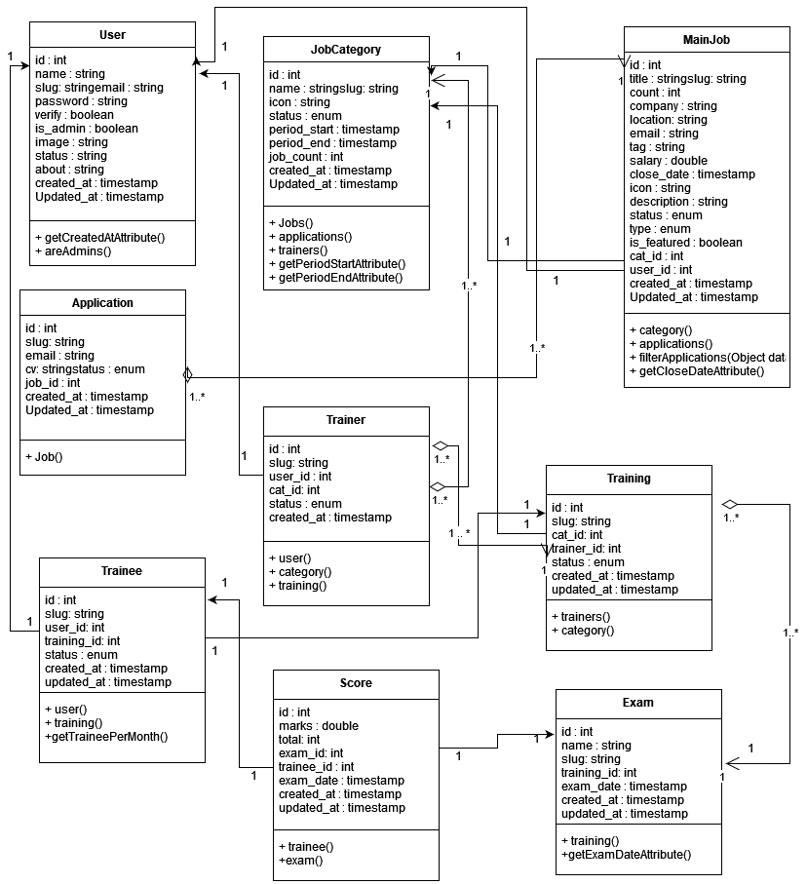
Class Diagram

Slide 7
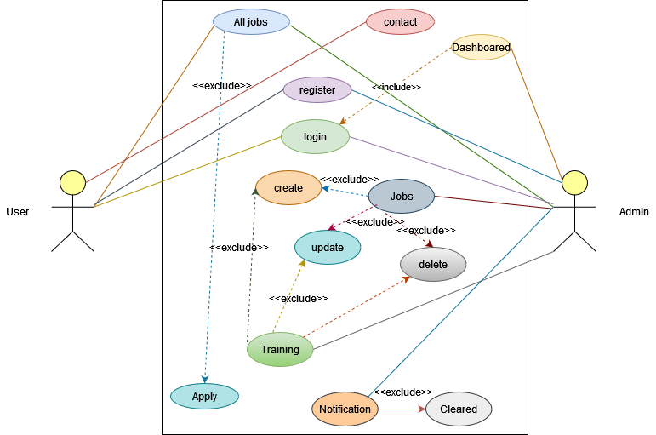
Use Case Diagram

Slide 8
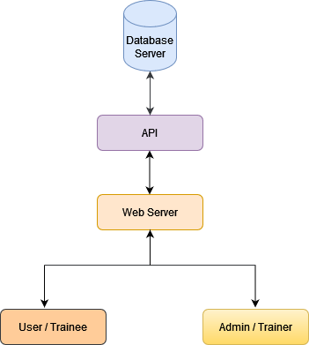
Component Diagram

Slide 9
Thank You!!

