Slide 1
Raid

Slide 2
What is RAID
Redundant Array of Independent (Inexpensive) Disks
A set of disk stations treated as one logical station
Data are distributed over the stations
Redundant capacity is used for parity allowing for data repair

Slide 3
Levels of RAID
6 levels of RAID (0-5) have been accepted by industry
Other kinds have been proposed in literature
Level 2 and 4 are not commercially available, they are included for clarity

Slide 4
RAID 0
All data (user and system) are distributed over the disks so that there is a reasonable chance for parallelism
Disk is logically a set of strips (blocks, sectors,…). Strips are numbered and assigned consecutively to the disks (see picture.)

Slide 5
Raid 0 (No redundancy)
strip 0
strip 1
strip 2
strip 3
strip 4
strip 5
strip 6
strip 7
strip 8
strip 9
strip 10
strip 11
strip 12
strip 13
strip 14
strip 15

Slide 6
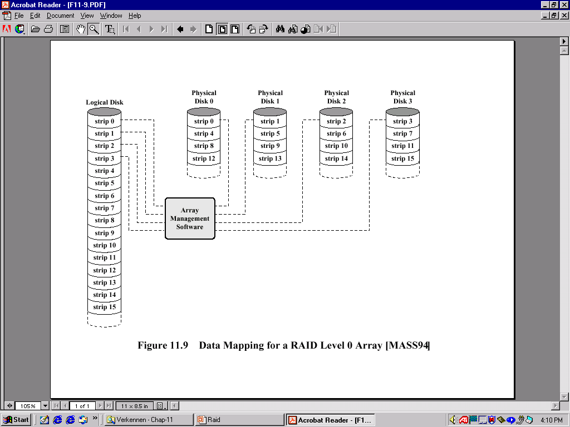
Data mapping Level 0

Slide 7
RAID 0:
Performance depends highly on the the request patterns
High data transfer rates are reached if
  Integral data path is fast (internal controllers, I/O bus of host system, I/O adapters and host memory busses)
  Application generates efficient usage of the disk array by requests that span many consecutive strips
If response time is important (transactions) more I/O requests can be handled in parallel

Slide 8
Raid 1 (mirrored)
strip 0
strip 1
strip 2
strip 3
strip 4
strip 5
strip 6
strip 7
strip 8
strip 9
strip 10
strip 11
strip 12
strip 13
strip 14
strip 15
strip 0
strip 1
strip 2
strip 3
strip 4
strip 5
strip 6
strip 7
strip 8
strip 9
strip 10
strip 11
strip 12
strip 13
strip 14
strip 15

Slide 9
RAID 1
RAID 1 does not use parity, it simply mirrors the data to obtain reliability
Plus:
  Reading request can be served by any of the two disks containing the requested data (minimum search time)
  Writing request can be performed in parallel to the two disks: no “writing penalty”
  Recovery from error is easy, just copy the data from the correct disk

Slide 10
RAID 1
Minus:
  Price for disks is doubled
  Will only be used for system critical data that must be available at all times
RAID 1 can reach high transfer rates and fast response times (~2*RAID 0) if most of the requests are reading requests. In case most requests are writing requests, RAID 1 is not much faster than RAID 0.

Slide 11
Raid 2 (redundancy through Hamming code)
b₀
b₁
b₂
b₂
f₀(b)
f₁(b)
f₂(b)

Slide 12
RAID 2
Small strips, one byte or one word
Synchronized disks, each I/O operation is performed in a parallel way
Error correction code (Hamming code) allows for correction of a single bit error
Controller can correct without additional delay
Is still expensive, only used in case many frequent errors can be expected
Notes:
ECC(error correcting code)

Slide 13
Hamming code
7 | 6 | 5 | 4 | 3 | 2 | 1 | P
1 | 0 | 1 | 0 | 1 | 0 | 1
* | * | * |  | * |  | * | 0
* | * |  |  | * | * |  | 0
* |  | * | * |  |  |  | 0
7 | 6 | 5 | 4 | 3 | 2 | 1 | P
1 | 1 | 1 | 0 | 1 | 0 | 1
* | * | * |  | * |  | * | 1
* | * |  |  | * | * |  | 1
* |  | * | * |  |  |  | 0
=6
Stored sequence
Data: 1011 in 7,6,5,3
Parity in 4,2,1
Single error can
be repaired

Slide 14
RAID 3 (bit-interleaved parity)
b₀
b₁
b₂
b₂
P(b)

Slide 15
RAID 3
Level 2 needs log₂(number of disks) parity disks
Level 3 needs only one, for one parity bit
In case one disk crashes, the data can still be reconstructed even on line (“reduced mode”) and be written (X1-4 data, P parity):
  P = X1+X2+X3+X4
  X1=P+X2+X3+X4
RAID 2-3 have high data transfer times, but perform only one I/O at the time so that response times in transaction oriented environments are not so good

Slide 16
RAID 4 (block-level parity)
block 0
block 1
block 2
block 3
P(0-3)
block 4
block 5
block 6
block 7
P(4-7)
block 8
block 9
block 10
block 11
P(8-11)
block 12
block 13
block 14
block 15
P(12-15)

Slide 17
RAID 4
Larger strips and one parity disk
Blocks are kept on one disk, allowing for parallel access by multiple I/O requests
Writing penalty: when a block is written, the parity disk must be adjusted (e.g. writing on X1):
      P =X4+X3+X2+X1
      P’=X4+X3+X2+X1’
      =X4+X3+X2+X1’+X1+X1
      =P+X1+X1’
Parity disk may be a bottleneck
Good response times, less good transfer rates

Slide 18
RAID 5 (block-level distributed parity)
block 0
block 1
block 2
block 3
P(0-3)
block 4
block 5
block 6
P(4-7)
block 7
block 8
block 9
P(8-11)
block 10
block 11
block 12
P(12-15)
block 13
block 14
block 15
P(16-19)
block 16
block 17
block 18
block 19

Slide 19
RAID 5
Distribution of the parity strip to avoid the bottle neck.
Can use round robin:
Parity disk = (-block number/4) mod 5

Slide 20
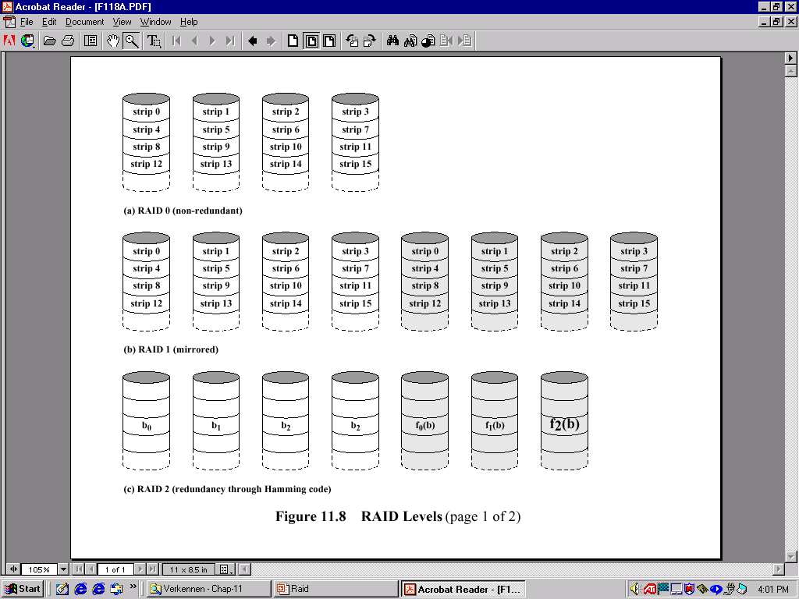
Overview Raid 0-2

Slide 21
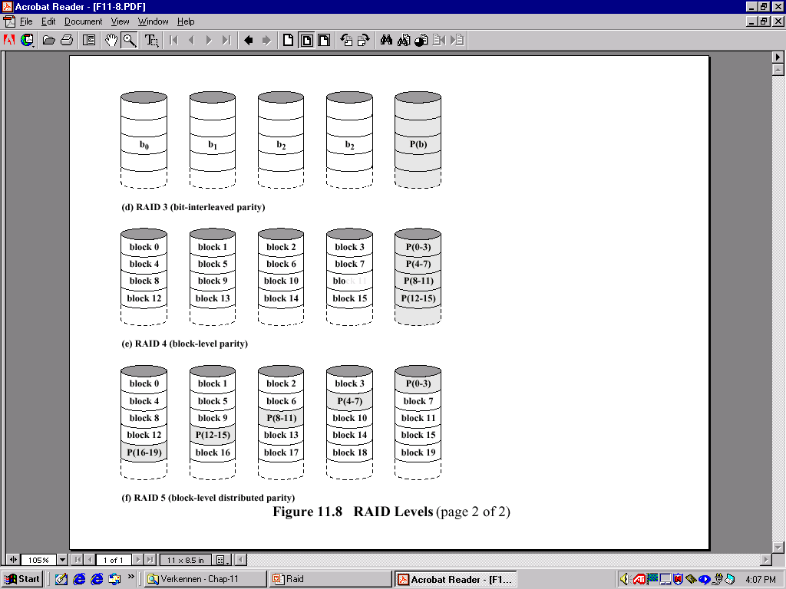
Overview Raid 3-5

