Slide 1
CS- Computer Vision
Anwar Khan
Department of Computer Science University of Lahore
Notes:
https://introtocv.github.io/materials.html
Top computer vision conferences and papers:
CVPR: IEEE Conference on Computer Vision and Pattern Recognition
ICCV: International Conference on Computer Vision
ECCV: European Conference on Computer Vision
NeurIPS: Neural Information Processing Systems

Slide 2
Resources
We will mostly be talking about “modern” approaches to computer vision, using (deep) neural networks.
However, I still do want to mention a “classic” vision book which is definitely worth reading.
“Computer Vision: Algorithms and Applications”
R., Szeliski, 2010

Slide 3
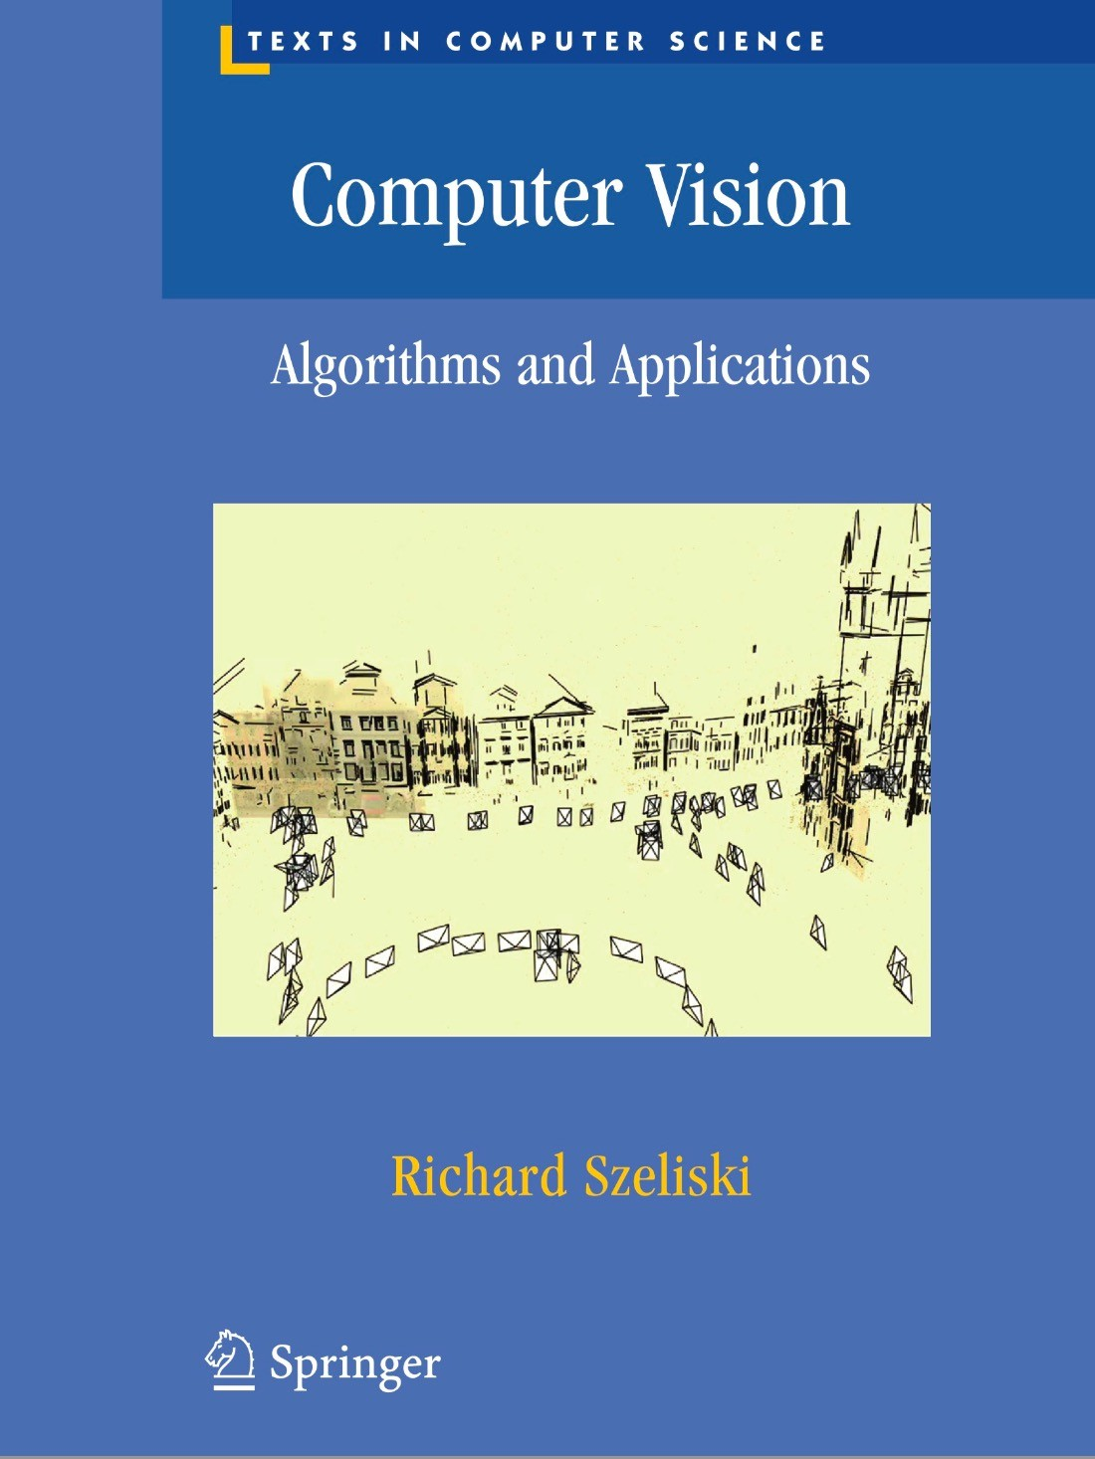
Textbook
Computer Vision: Algorithms and Applications, by Richard Szeliski

Slide 4
Overview of the field
Conferences
  Computer Vision
  Computer Vision and Pattern Recognition (CVPR)
  International Conference on Computer Vision (ICCV)
  European Conference on Computer Vision (ECCV)
  British Machine Vision Conference (BMVC)
  Machine learning
  Neural Information Processing Systems (NIPS)
  International Conference on Machine Learning (ICML)
  International Conference on Learning Representations (ICLR)

Slide 5
Introduction
Introduction
Visual data is everyone around us – your phone probably contains gigabytes of visual content.
Computer Vision (CV) deals with automatically extracting meaningful information from images and videos.
For biological brains (humans and animals), this is a trivial process.
For computing machines, this is a deceptively hard process.
What you see as a face or a car or a mountain is just an array of numbers for a computer.
Computer Vision
5 / 59
Notes:
Visual Data is Ubiquitous…
Biological brains, whether of humans or animals, are amazing in how they work. Many tasks that seem very hard for computers are actually very easy for brains. For example, recognizing a face in a crowd, understanding speech, or walking on uneven ground are things that humans and animals can do without thinking much. This is what we mean when we say that “for biological brains, this is a trivial process.”

Slide 6
What is Computer Vision
Computer vision is a field of computer science
  works on enabling computers to see,
  identify and process images in the same way that human vision does, and
  then provide appropriate output.
It is like imparting human intelligence and instincts about vision to a computer.

Slide 7
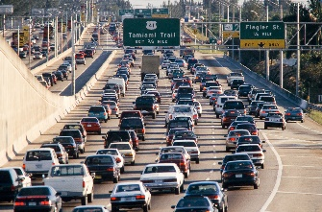
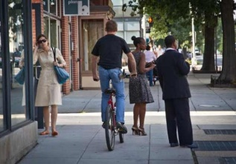
What is computer vision?
Courtesy of Szeliski
(Luiz Gomez Photos)
The human visual system (HVS) is remarkably good at so many tasks, e.g.,
- detecting people & object’s
- perceiving translucency, shape, color (see figure on the left),
- counting people & vehicles (see middle figure)
- recognizing scenes, etc.

Slide 8
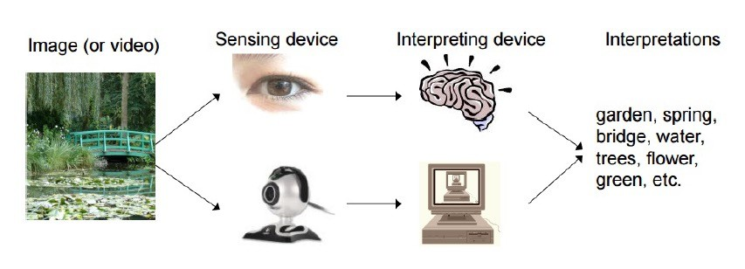
Computer Vision vs Human Vision

Slide 9

Introduction
CV is Deceptively Hard
Computer Vision
9 / 59

Slide 10

Introduction
CV is Deceptively Hard
Computer Vision
10 / 59
Notes:
clown pic

Slide 11


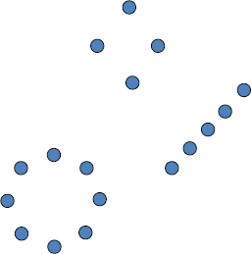
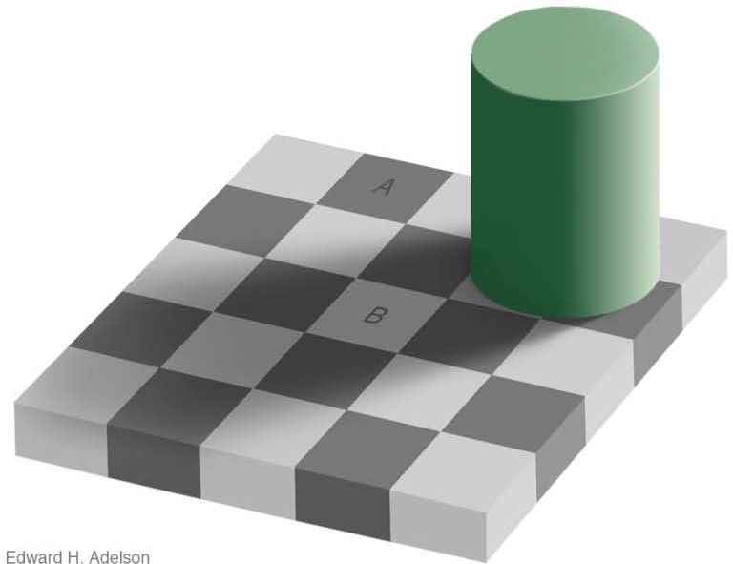
Introduction
CV is Deceptively Hard
Computer Vision
11 / 59
Notes:
Human answer concise/sparse
Human cant tell vision as ways explain all components…
Human answer subjective.
Illusion in Human Minds
Illusions are experiences where our minds are tricked into seeing or believing something that is not real. Human brains are powerful, but they do not always interpret information perfectly. Sometimes, what we see, hear, or feel is different from reality. This is called an illusion.

Slide 12
CV Algorithms
Some CV algorithms try to copy biological vision but it is too complex to understand and implement.
Some algorithms use statistical approaches.
Other algorithms employ geometry.
Key to understanding most algorithms lies in solid understanding of cal- culus and linear algebra.
To become good in CV, you must be (or become) good at mathematics
and programming.
Computer Vision
12 / 59

Slide 13

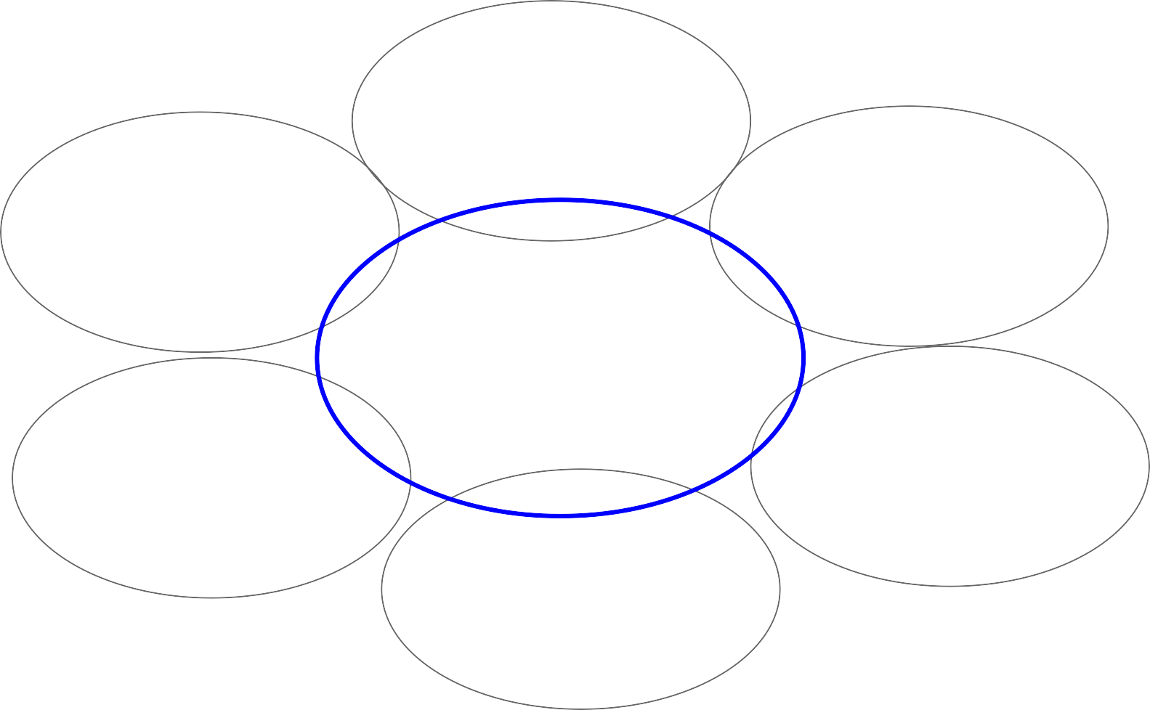
Related disciplines
Artificial intelligence
Machine learning
Graphics
Computer vision
Image processing
Cognitive science
Algorithms

Slide 14
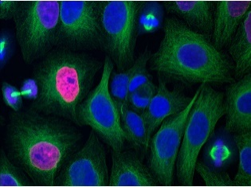
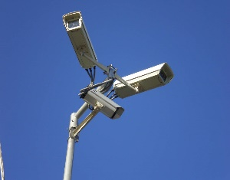
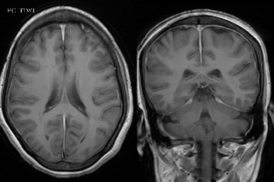
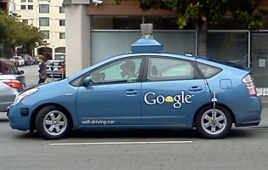
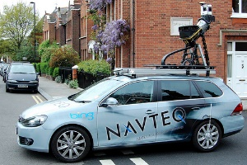
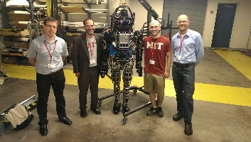
Medical Imaging
Bio-Imaging
Surveillance
Autonomous Cars
Mapping
Robotics
Social Media

Slide 15
Introduction
Applications
Some applications of computer vision include
Face Detection and Recognition
Gesture Recognition
Industrial Inspection, Monitoring and Control
Surveillance
Augmented reality
Medical image analysis
Document analysis and text recognition
Object tracking
Segmentation
Computer Vision
15 / 59

Slide 16
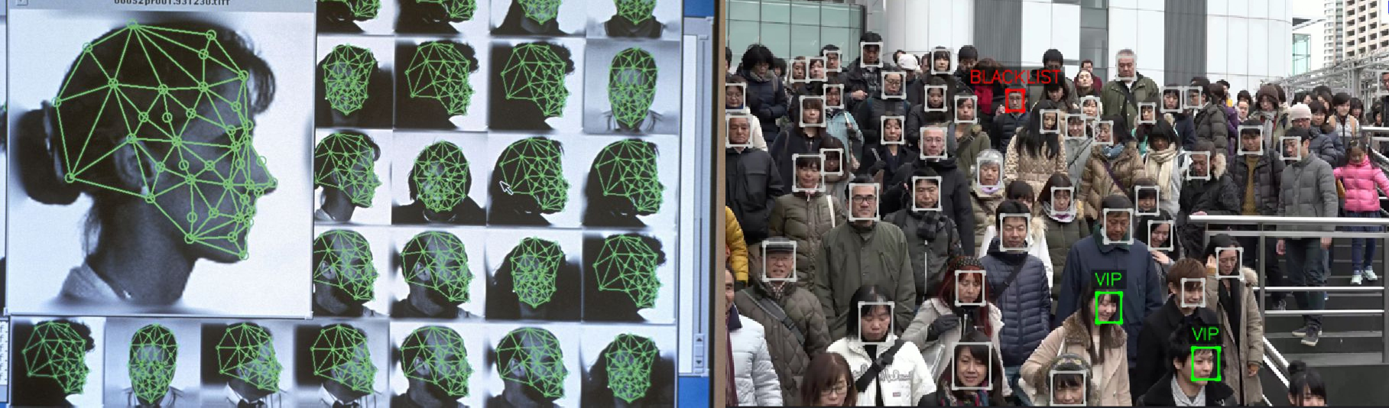
Introduction
Face Detection and Recognition
Computer Vision
16 / 59

Slide 17
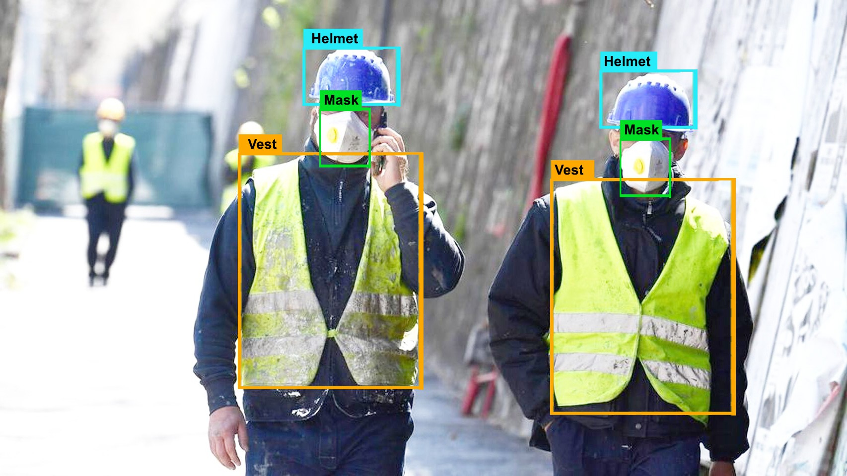
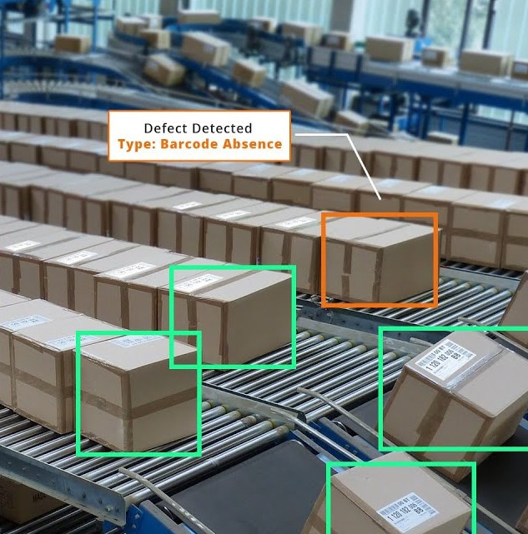
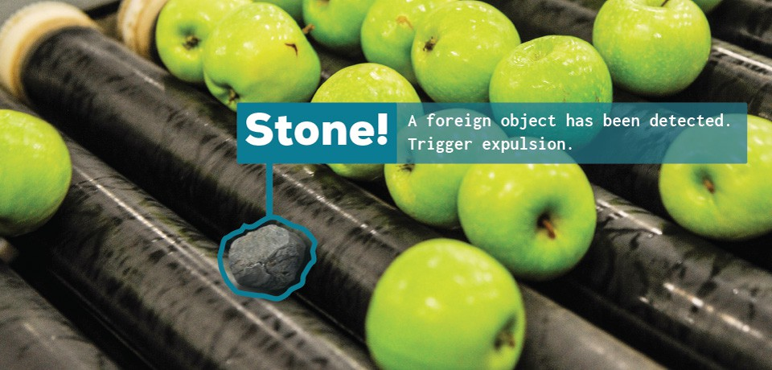
Introduction
Industrial Inspection, Monitoring and Control
Computer Vision
17 / 59
Notes:
Convey belt

Slide 18
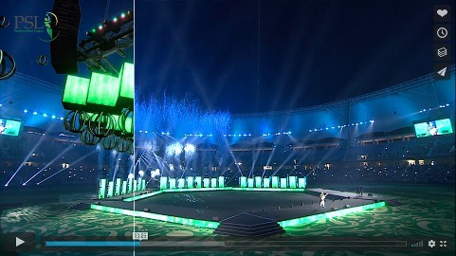
Introduction
Augmented Reality
Computer Vision
18 / 59

Slide 19
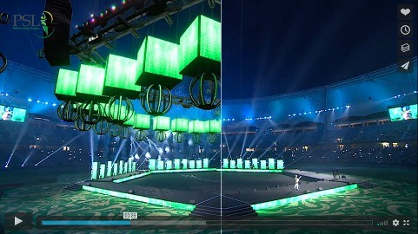
Introduction
Augmented Reality
Computer Vision
19 / 59

Slide 20
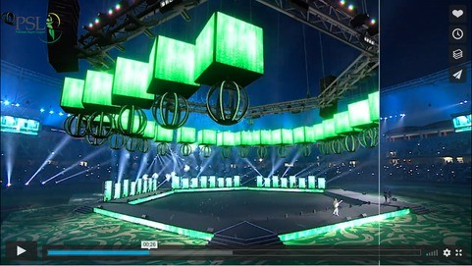
Introduction
Augmented Reality
Computer Vision
20 / 59

Slide 21
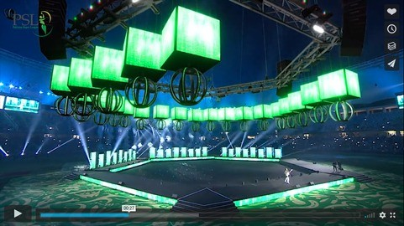
Introduction
Outline
Administrivia
Augmented Reality
Computer Vision
21 / 59

Slide 22
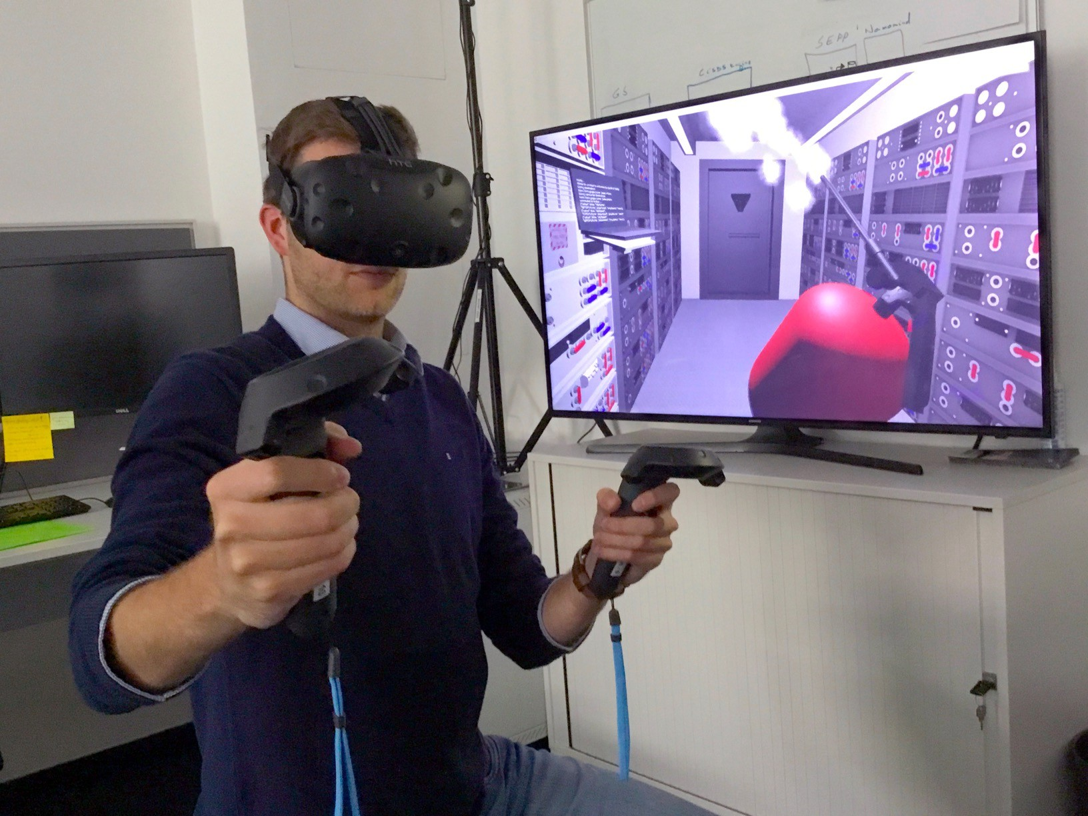
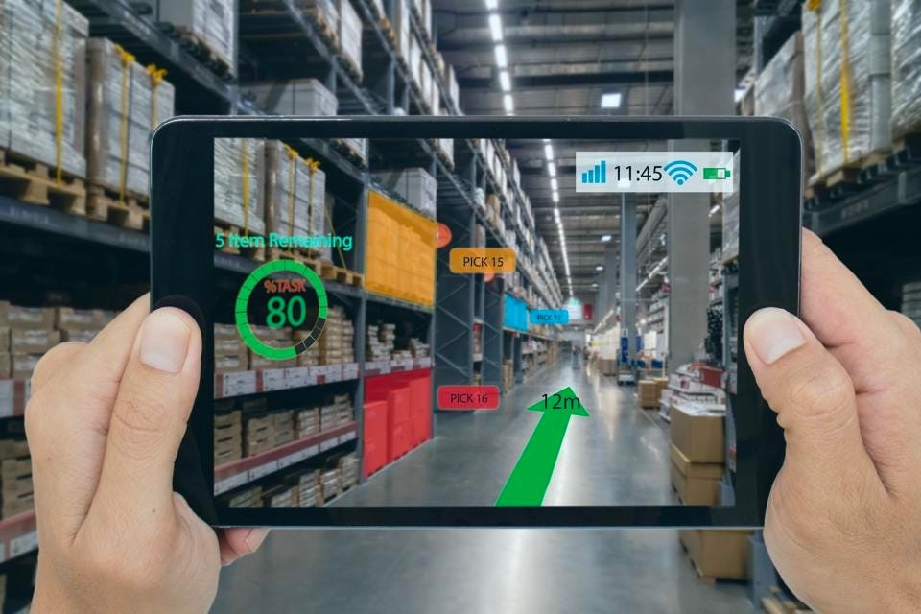

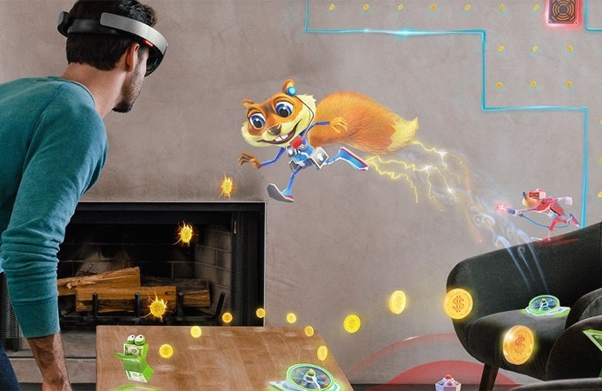
Virtual/Augmented/Mixed Reality

Slide 23
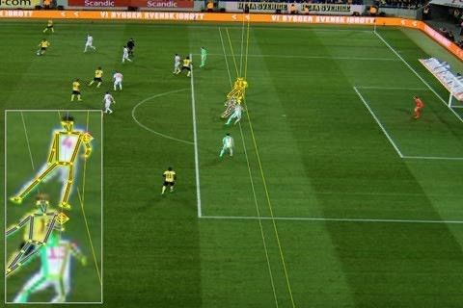
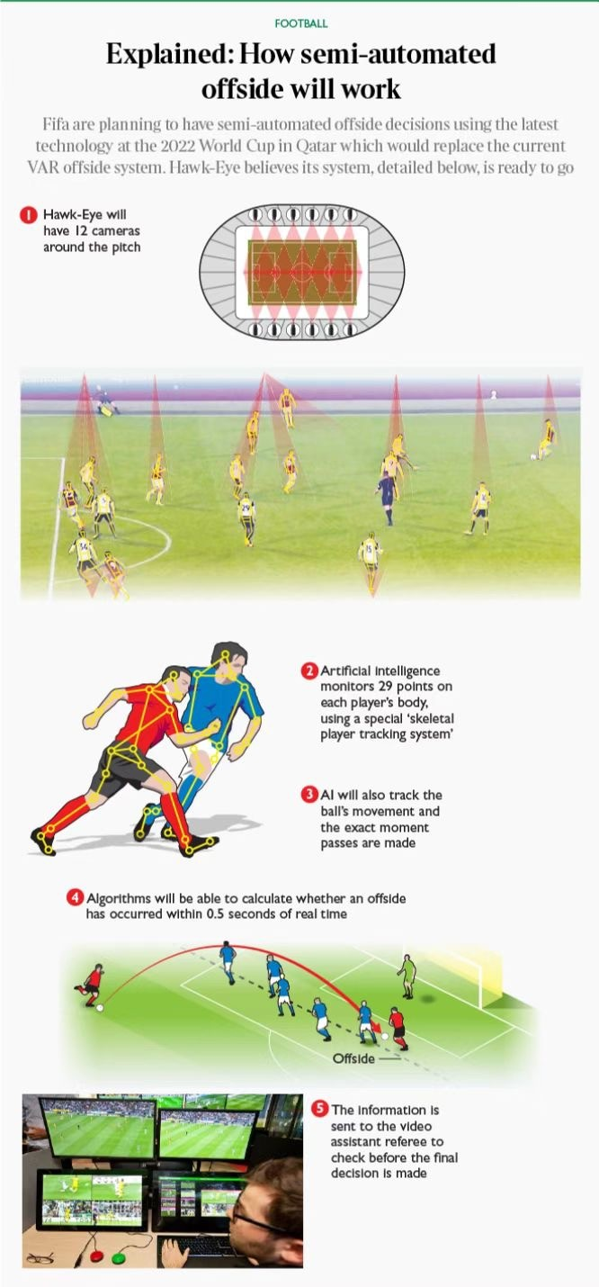
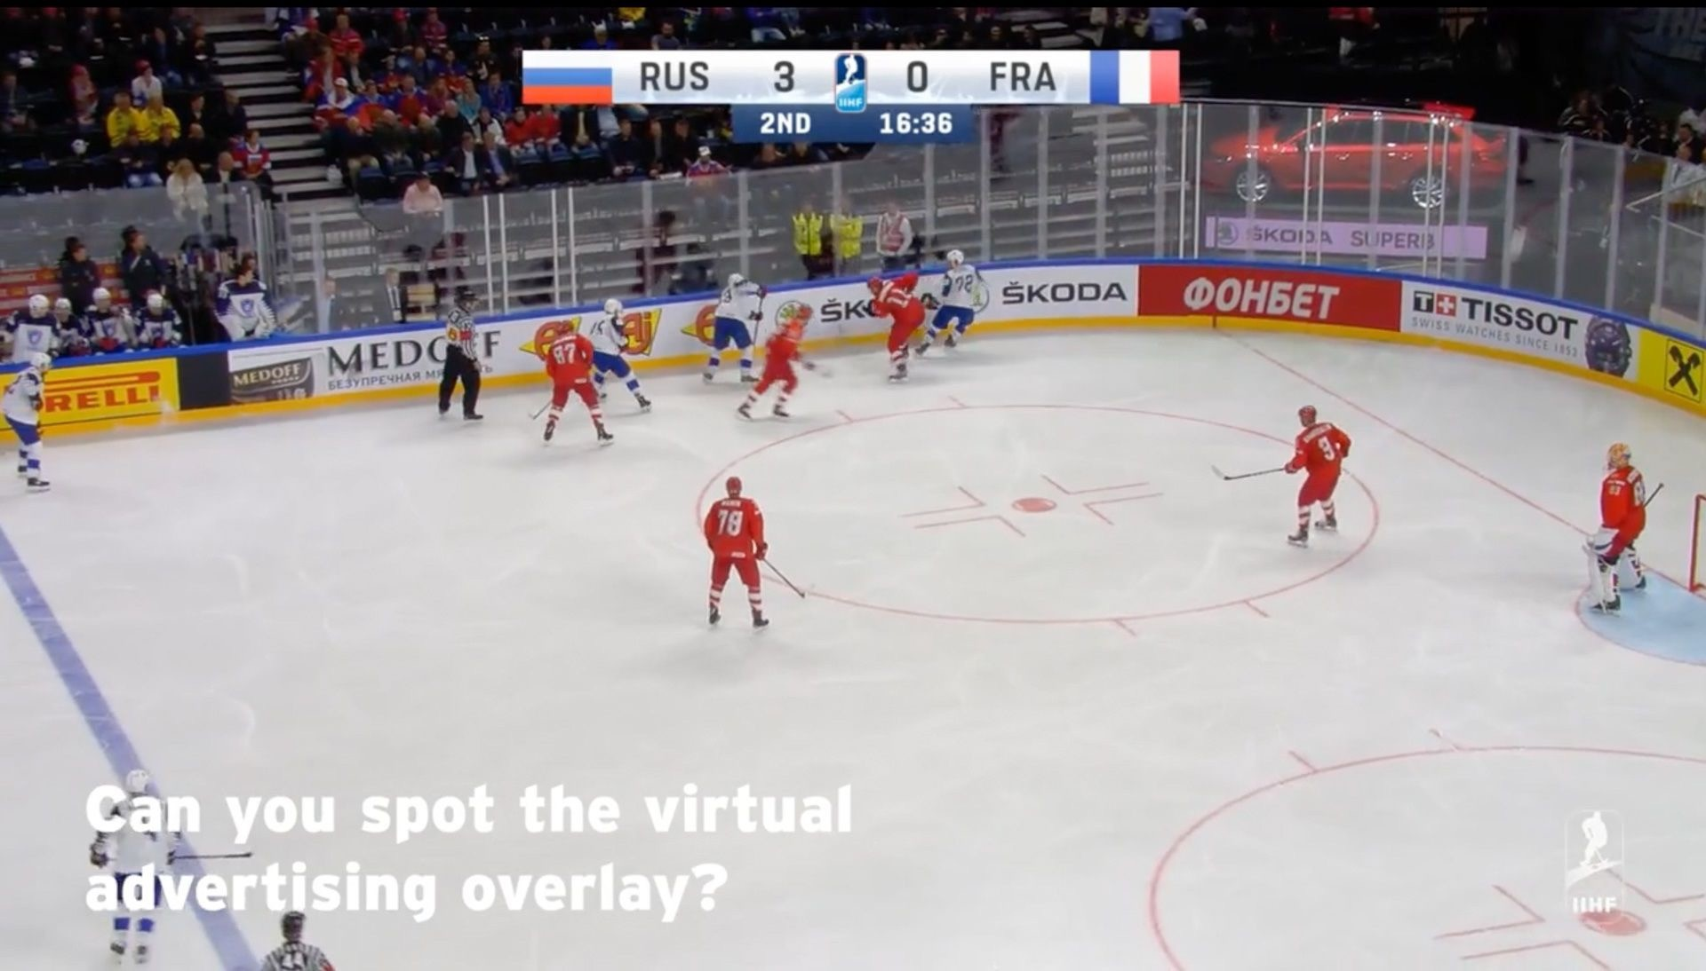
Sports and Advertising

Slide 24
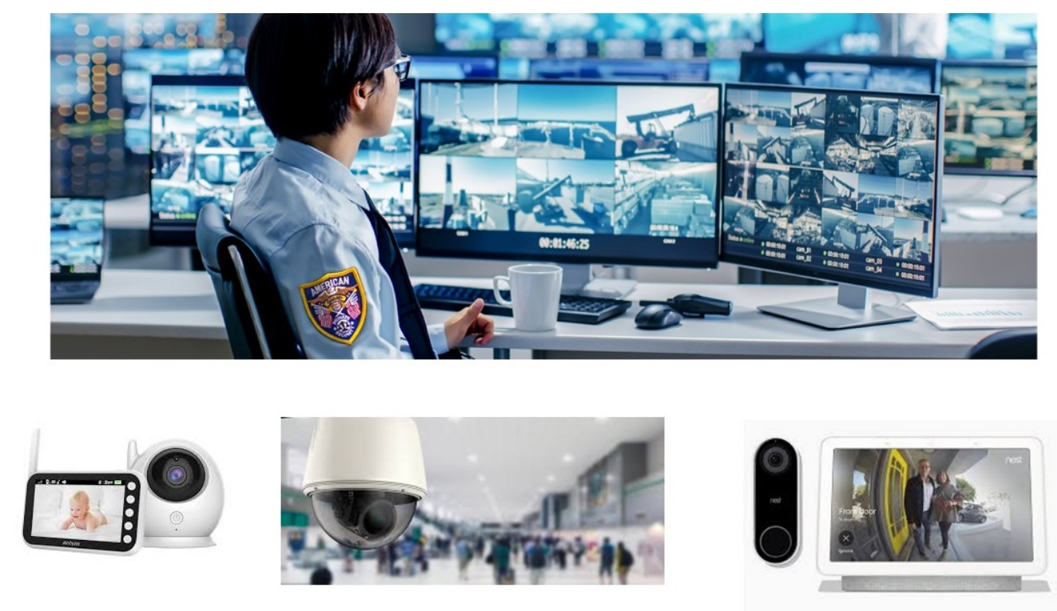
Video Surveillance

Slide 25
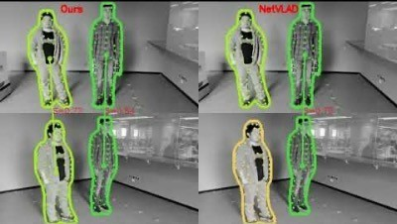
Person Re-identification

Slide 26
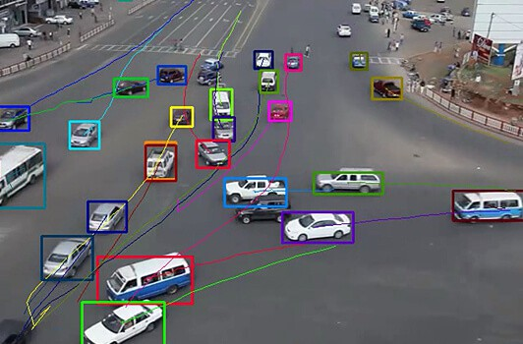
Introduction
Outline
Administrivia
Object Tracking
Computer Vision
26 / 59

Slide 27
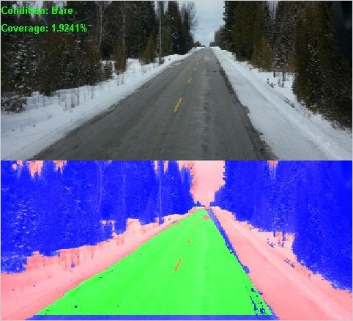
Introduction
Outline
Administrivia
Road Condition Monitoring
Naila Hamid. “Road Condition Classification in Winter”.
MPhil Thesis. PUCIT, 2014.
Computer Vision
27 / 59

Slide 28
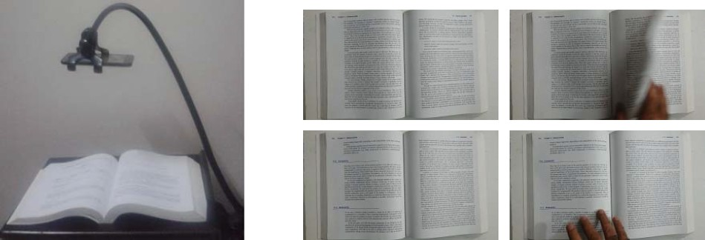
Introduction
Click-free, Video-based Document Digitization
Outline
Administrivia
Waqas Tariq and Nazar Khan. “Click-Free, Video-Based Document Capture – Methodology and Evaluation”. In: Proceedings of Seventh International Workshop on Camera-Based Document Analysis and Recognition, Kyoto, Japan. 2017, pp. 21–26.
Computer Vision
28 / 59

Slide 29
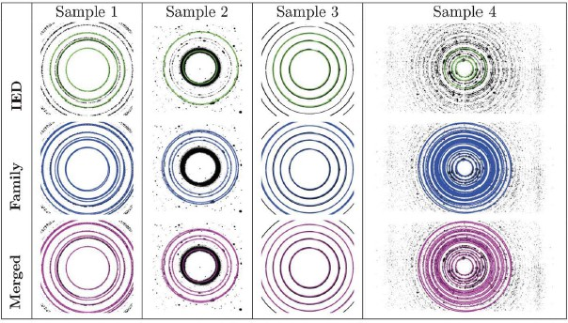
Introduction
Outline
Administrivia
Crystallography
Saadia Shahzad et al. “Automatic Debye–Scherrer elliptical ring extraction via a
computer vision approach”. In: Journal of Synchrotron Radiation 25.2 (2018), pp. 439–450.
Computer Vision

Slide 30
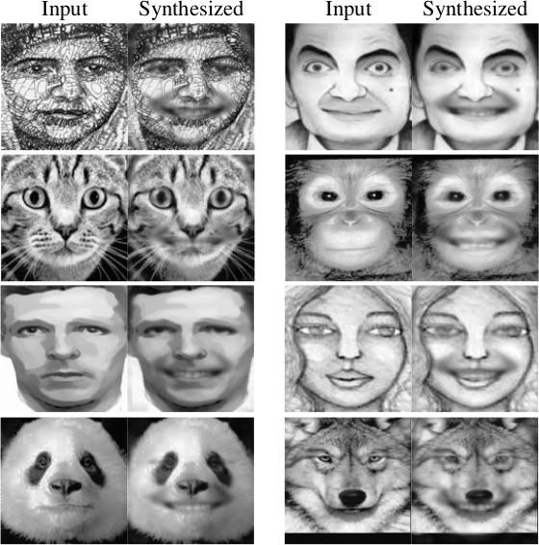
Introduction
Outline
Administrivia
Expression Synthesis
Nazar Khan et al. “Masked Linear Regression for Learning Local Receptive Fields for Facial Expression Synthesis”. In: International Journal of Computer Vision 128.5 (2020),
pp. 1433–1454.
Computer Vision
18 / 59

Slide 31
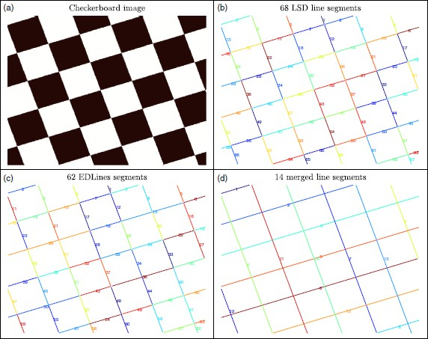
Introduction
Perceptually Accurate Line Segment Detection
Outline
Administrivia
Naila Hamid and Nazar Khan. “LSM: perceptually accurate line segment merging”. In:
Journal of Electronic Imaging 25.6 (2016).
Computer Vision

Slide 32
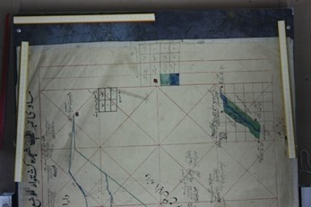
Introduction
Digitization and Understanding of Hand-drawn Maps
Outline
Administrivia
Computer Vision

Slide 33
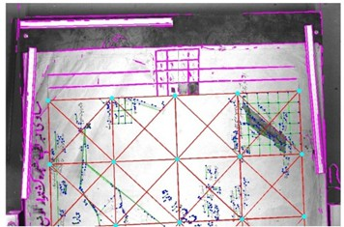
Introduction
Digitization and Understanding of Hand-drawn Maps
Outline
Administrivia
Computer Vision

Slide 34
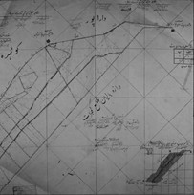
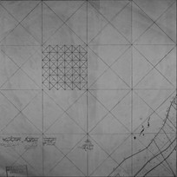
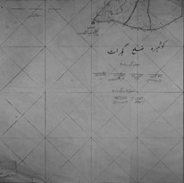
Introduction
Map Stitching as a Jigsaw Puzzle
Outline
Administrivia
Computer Vision

Slide 35
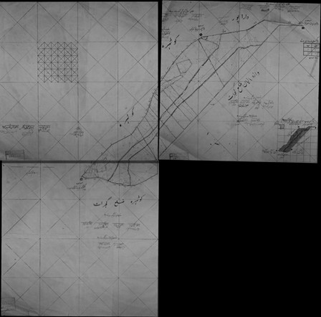
Introduction
Map Stitching as a Jigsaw Puzzle
Outline
Administrivia
Computer Vision

Slide 36
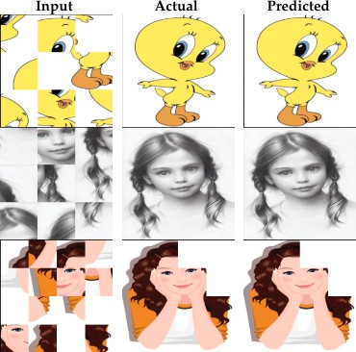
Introduction
Map Stitching as a Jigsaw Puzzle
Outline
Administrivia
Adeela Islam. “Learning to Solve Jigsaw Puzzles”.
MPhil Thesis. PUCIT, 2020.
Computer Vision

Slide 37
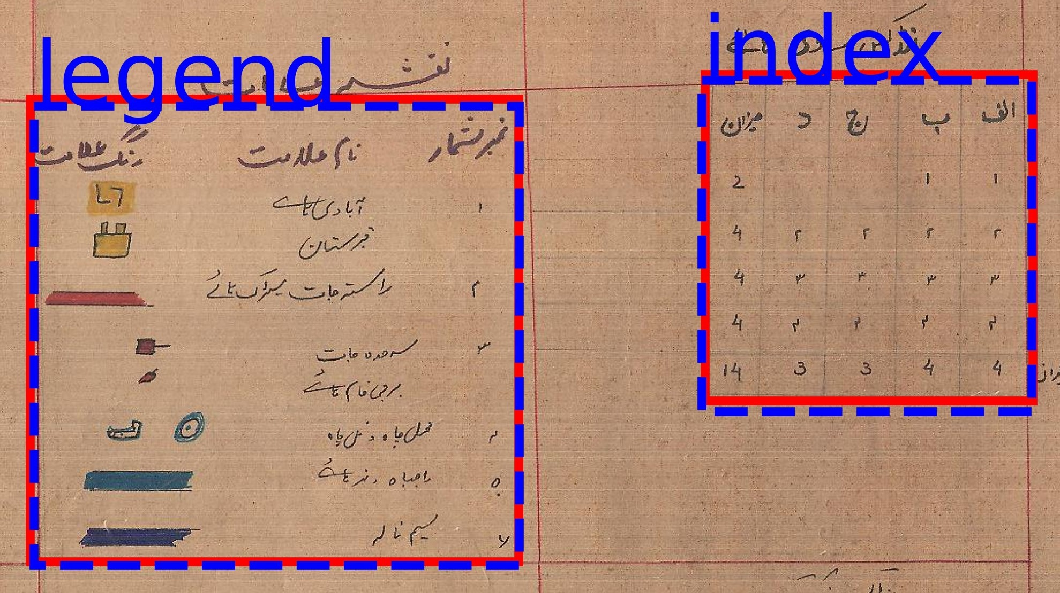
Outline
Administrivia
Introduction
Hand-drawn Table Detection and Classification
Asmat Batool. “Detection and Recognition of Tabular Structures in Historical Documents”. MPhil Thesis. PUCIT, 2020.
Computer Vision

Slide 38
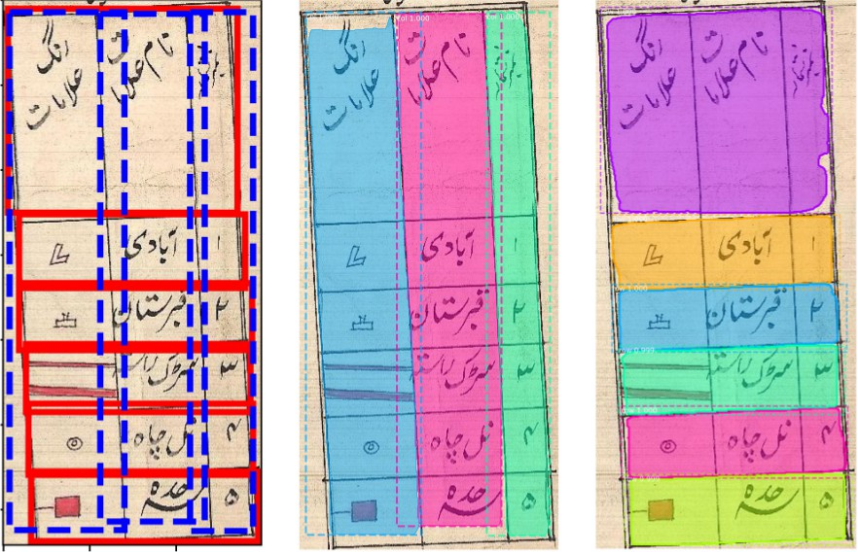
Introduction
Hand-drawn Table Detection and Classification
Outline
Administrivia
Asmat Batool. “Detection and Recognition of Tabular Structures in Historical Documents”. MPhil Thesis. PUCIT, 2020.
Computer Vision

Slide 39
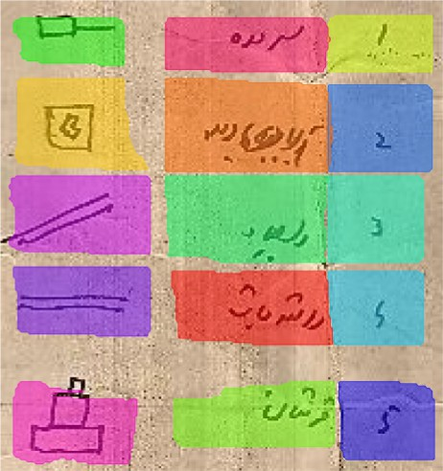
Introduction
Outline
Administrivia
Hand-drawn Table Parsing
Abubakar Siddique. “Detection, Recognition, and Spotting of Hand-drawn Metadata in Historical Maps”. MPhil Thesis. PUCIT, In Progress 2021.
Computer Vision
27 / 59

Slide 40
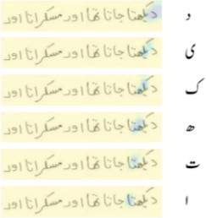
Introduction
Handwritten Urdu Text Recognition
Outline
Administrivia
Tayaba Anjum and Nazar Khan. “An attention based method for offline handwritten Urdu text recognition”. In: International Conference on Frontiers in Handwriting Recognition (ICFHR). 2020.
Computer Vision

Slide 41
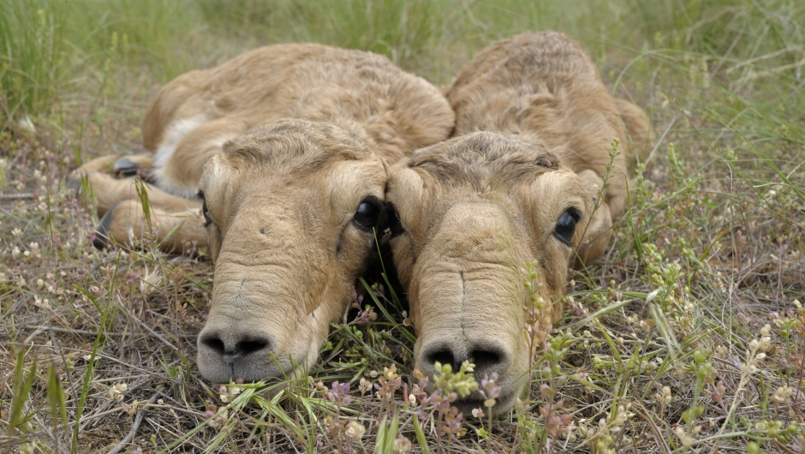
Typical vision problems
Recognition
“Saiga antilope”
Task: Label an image by its class membership, e.g., the class would be
”Saiga antilope” in the example above.

Slide 42
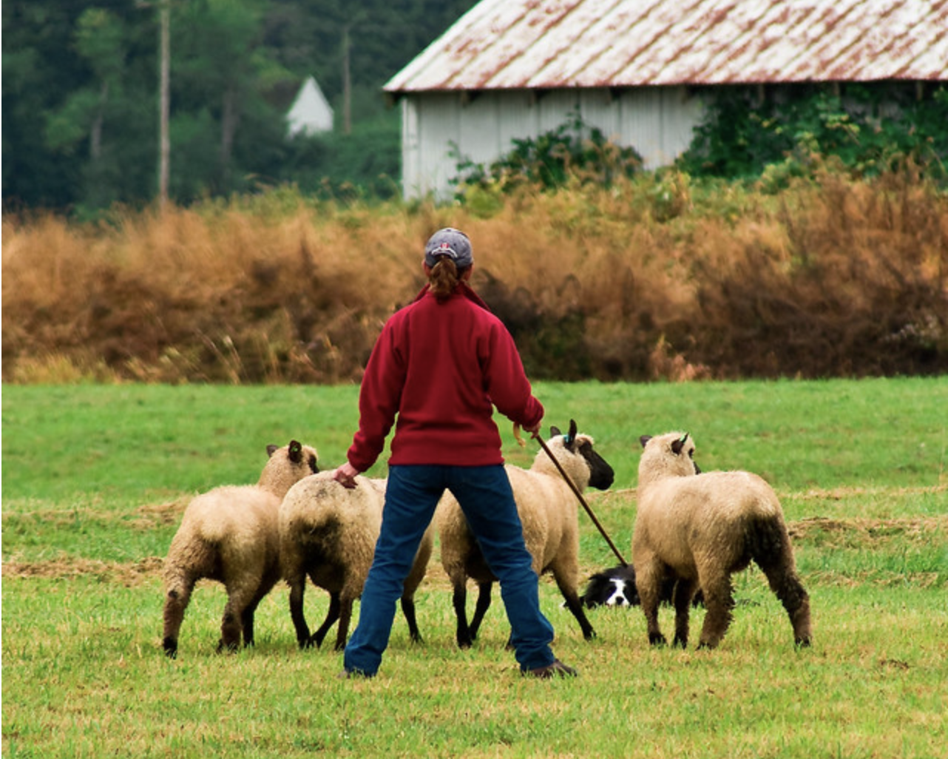

Typical vision problems
Segmentation
Task: Label each pixel of an image by its class membership, e.g.,
“Human” vs. “Sheep” vs. Background in the example.

Slide 43
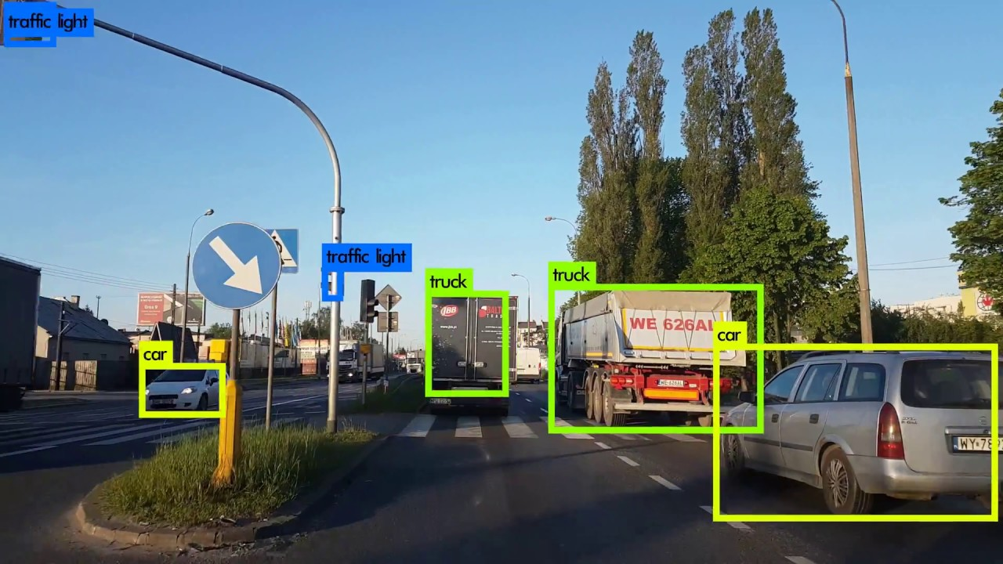
Typical vision problems
Detection
Task: Locate and label objects. E.g., each object is (1) marked by a bounding
box (i.e., coordinates) and (2) assigned a class/object label.

Slide 44
Typical vision problems
Panoptic Segmentation
Image source: Kirillov et al., “Panoptic Segmentation”, In: CVPR ‘19
Semantic
segmentation
Instance
segmentation
Panoptic
segmentation
Goal: Unify semantic segmentation and instance segmentation.

Slide 45
Typical vision problems
Image-to-Image translation
Label map → Image
Arial → Map
BW → Color

Slide 46


Typical vision problems
Text-to-Image Generation:
Prompt (ChatGpt 4o): “Create an image of an extremely angry bird.”
Prompt (ChatGpt 4o): “A photo of a Persian cat wearing sunglasses and a red shirt skateboarding on a beach.”

Slide 47
Introduction
Outline
Administrivia
What will we cover?
Module 1: Introduction and Background
Introduction
  What is Computer Vision?
  Computer Vision vs. Biological Vision – The Grand Deception!
  Applications of Computer Vision.
Background Mathematics
  Cartesian vs. Image axis
  Taylor’s formula
  Matrix and Vector calculus
  Eigenvectors
  Constrained optimisation
  Singular Value Decomposition (SVD)
Image Processing
  Image Filtering
    Convolution
    Properties of convolution
Computer Vision

Slide 48



Introduction Outline
What will we cover?
    Mean Filtering
    Gaussian Filtering
    Non-linear filtering cannot be performed via convolution
Administrivia
Original
Gaussian
Bilateral
Computer Vision

Slide 49
Introduction
Outline
Administrivia
What will we cover?
Module 2: 2D Computer Vision
Edge Detection
  Gradient magnitude and angle via partial derivatives
    atan vs. atan2
  Derivative approximations via Taylor’s formula
  Convolution masks for derivative filtering
    Forward, Backward and Central Difference
    Sobel operator
    Derivative of Gaussian Filter
  Naive Edge Detection
  The Canny Edge Detector
    Gradient computation
    Non-maxima supression
    Hysteresis thresholding
Corner Detection
  Structure Tensor – Geometry and Algebra
Computer Vision

Slide 50
Introduction
What will we cover?
  Harris Corner Detector
  Rohr Corner Detector
  Scale Space and Gaussian Pyramids
Local Image Descriptors
  Sum-of-Squared-Differences (SSD)
  Normalized Cross Correlation (NCC)
  SIFT
    Keypoint Detection
    Descriptor
  Matching SIFT Descriptors
  OpenCV Examples
Hough Transform
  Slope-intercept representation of lines
  Polar representation of lines
  Line detection
  Circle detection
Outline
Administrivia
Computer Vision

Slide 51
What will we cover?
Introduction Outline Administrivia
7.5 Speed-up via gradient information
2D Spatial Transformations
  Matrix ≡ Linear Transformation
  Scaling, Shear, Rotation
  Translation is not linear in R²
  Homogenous Coordinates make translation linear in P²
  2D Affine Transformation (Scaling, Shear, Rotation, Translation)
    6 degrees of freedom
    Recovering best affine transformation from correspondences
    Affine Image Warping
  2D Projective Transformation (Homography)
    8 degrees of freedom
    Recovering best projective transformation from correspondences – Direct Linear Transform (DLT)
    Projective Image Warping
Optic Flow
  Gray value constancy
Computer Vision

Slide 52
Introduction Outline
What will we cover?
  Linearized Optic Flow Constraint (OFC)
  Aperture Problem
  Normal Flow
  Local Method of Lucas & Kanade
  Global Method of Horn & Schunck
Robust Estimation via RANSAC
  Outliers
  Least-squares models are sensitive to outliers
  Robust Estimation via RANSAC
  Robust Line Fitting via RANSAC
  Robust Homography Estimation in OpenCV
Administrivia
Computer Vision

Slide 53
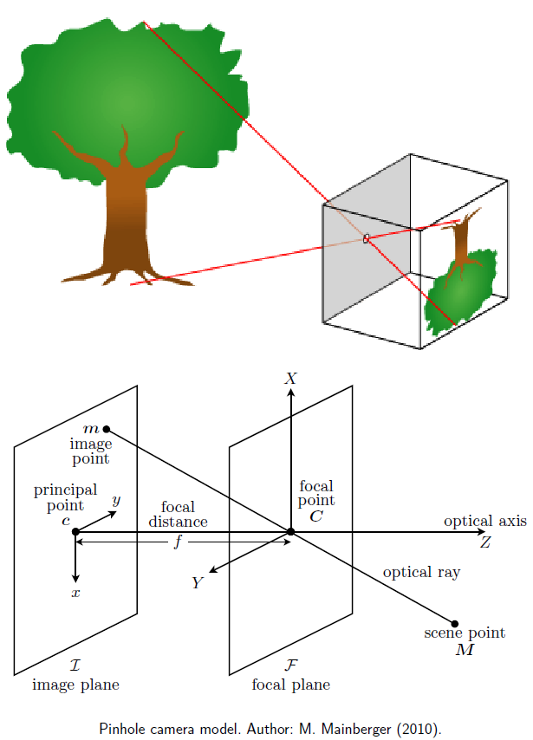
Introduction
Outline
Administrivia
What will we cover?
Module 3: 3D Computer Vision
Camera Geometry
  Pinhole Camera Geometry
  Camera Matrix
  Camera Models
  Camera Matrix Anatomy
Camera Calibration
Stereo Reconstruction
  The case of orthoparallel cameras
  The case of converging cameras
    Epipolar constraint and fundamental matrix
    Estimation of fundamental matrix
    Disparity estimation
Computer Vision

Slide 54
Introduction
Outline
Administrivia
What will we cover?
Module 4: Learning-based Vision
14. Deep Learning for Computer Vision
Computer Vision

Slide 55
Introduction
CV@CVML
Outline
Administrivia
Administrivia
Texts and resources:
We will not be following any standard textbook.
Helpful books include
⁾ Digital Image Processing by Gonzales and Woods.
⁾ Programming Computer Vision with Python by Jan Erik Solem.
Computer Vision

Slide 56

Introduction
Outline
Administrivia
Project
Solve an interesting problem via Computer Vision.
Recorded video presentation.
Place code on Github.
Create web-page containing everything about the project.
Report prepared in Latex.
Templates will be provided to help you out.
Computer Vision

Slide 57
Introduction Outline
Programming Environment
We will be using
Python as our programming environment.
OpenCV as our Computer Vision library.
Jupyter notebooks as our interactive tutorials.
Administrivia
Computer Vision

Slide 58
Introduction
Outline
Administrivia
Computer Vision

Slide 59
Introduction
Outline
Administrivia
Computer Vision

Slide 60
Introduction
Outline
Administrivia
Computer Vision

Slide 61
Introduction
Outline
Administrivia
Computer Vision

Slide 62
Introduction
Outline
Administrivia
Computer Vision

Slide 63
Introduction
Outline
Administrivia
Computer Vision

Slide 64
Introduction
Outline
Administrivia
Computer Vision

Slide 65
Introduction
Outline
Administrivia
Computer Vision

Slide 66
Introduction
Outline
Administrivia
Computer Vision

Slide 67
Introduction
Outline
Administrivia
Computer Vision

