Slide 1
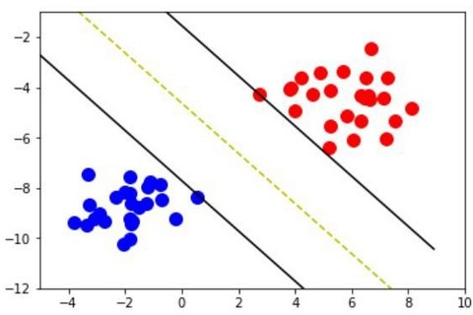
Support Vector Machine

Slide 2
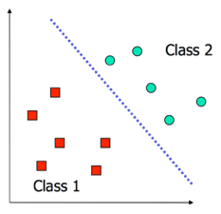
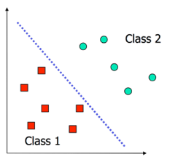
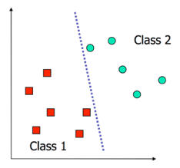
Decision Boundaries Revisited
In logistic regression, we learn a decision boundary that separates the training classes in the feature space.
When the data can be perfectly separated by a linear boundary, we call the data linearly separable.
In this case, multiple decision boundaries can fit the data. How do we choose the best?
Question: What happens to our logistic regression model when training on linearly separable datasets?

Slide 3
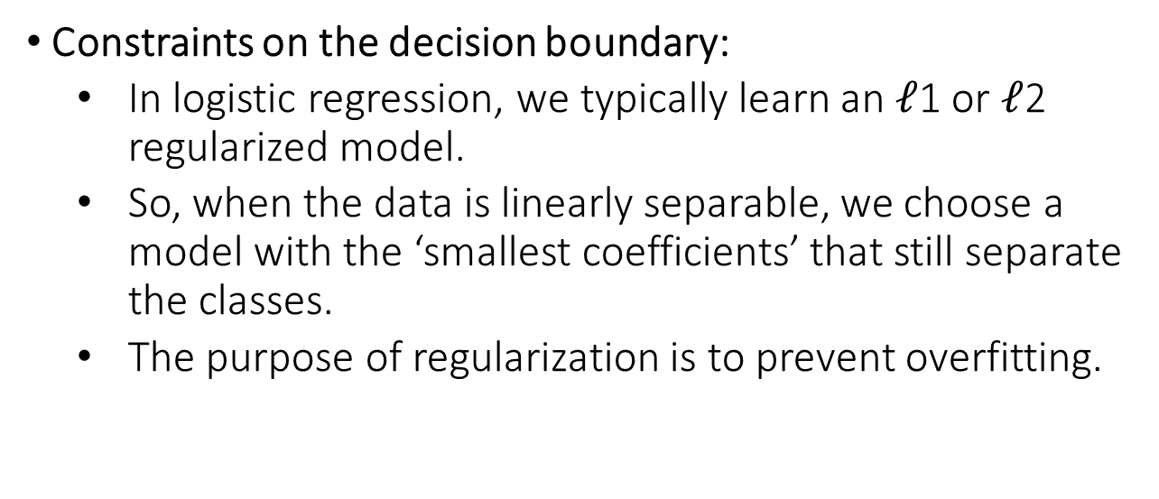
Decision Boundaries Revisited (cont.)
Constraints on the decision boundary:
  In logistic regression, we typically learn an $ℓ$1 or $ℓ$2 regularized model.
  So, when the data is linearly separable, we choose a model with the ‘smallest coefficients’ that still separate the classes.
  The purpose of regularization is to prevent overfitting.

Slide 4
Decision Boundaries Revisited (cont.)
Constraints on the decision boundary:
  We can consider alternative constraints that prevent overfitting.
  For example, we may prefer a decision boundary that does not ‘favor’ any class (esp. when the classes are roughly equally populous).
  Geometrically, this means choosing a boundary that maximizes the distance or margin between the boundary and both classes.

Slide 5
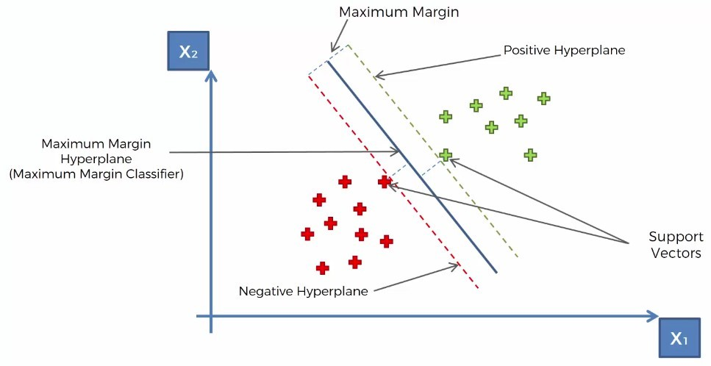
Decision Vectors

Slide 6
Definitions
•
Support Vectors
Support vectors are the data points, which are closest to the hyperplane. These points will define the separating line better by calculating margins.
These points are more relevant to the construction of the classifier.
Hyperplane
A hyperplane is a decision plane which separates between a set of objects having different class memberships.
•

Slide 7
Definitions
Margin
  A margin is a gap between the two lines on the closest class points.
  This is calculated as the perpendicular distance from the line to support vectors or closest points.
  If the margin is larger in between the classes, then it is considered a good margin, a smaller margin is a bad margin.

Slide 8
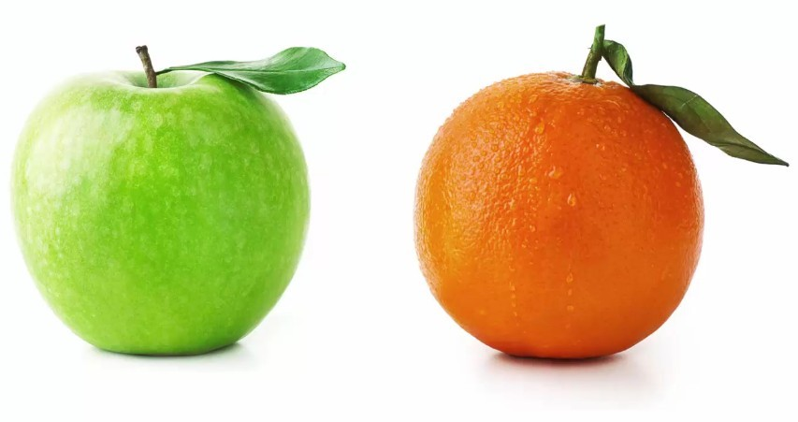
Why SVM is so special ?
Example Reference: Super Data Science

Slide 9
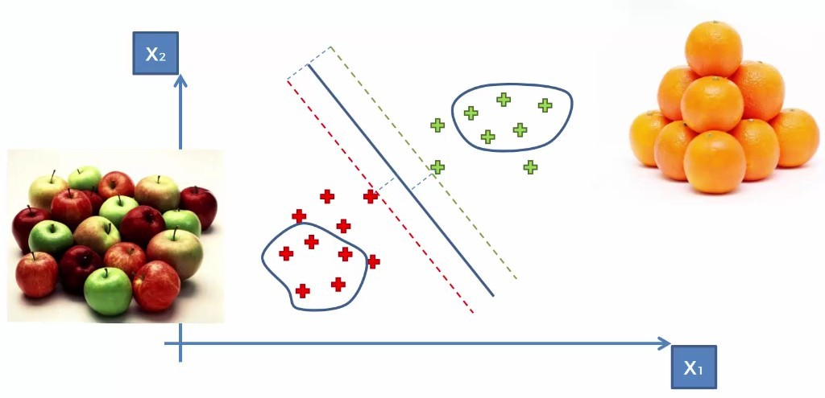
How SVM works for this?

Slide 10
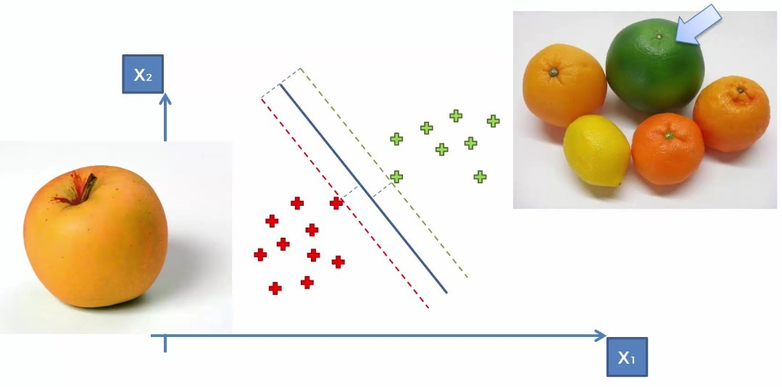
How classification will work ?

Slide 11
How SVM works ?
The main objective is to segregate the given dataset in the best possible way.
The distance between the either nearest points is known as the margin.
The objective is to select a hyperplane with the maximum possible margin between support vectors in the given dataset. SVM searches for the maximum marginal hyperplane in the following steps:
  Generate hyperplanes which segregates the classes in the best way.
  Select the right hyperplane with the maximum segregation from the either nearest data points.

Slide 12
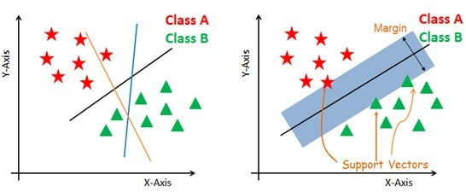
How SVM works ?

Slide 13
Non-linear and inseparable planes
Some problems can’t be solved using linear hyperplane.
In such situation, SVM uses a kernel trick to transform the input space to a higher dimensional space as shown on the right.
The data points are plotted on the x-axis and z- axis (Z is the squared sum of both x and y: z=x^2=y^2).
Now you can easily segregate these points using linear separation.

Slide 14
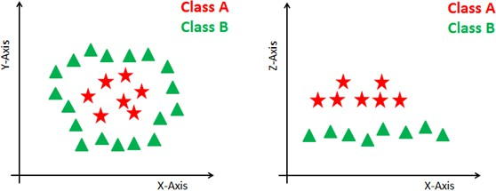
Non-linear and inseparable planes

Slide 15
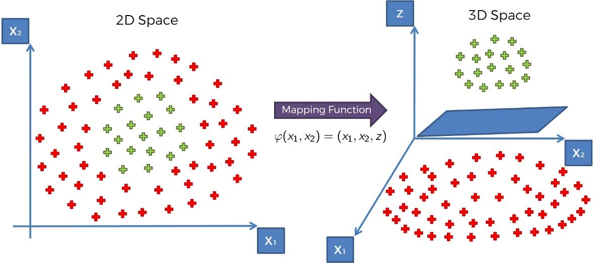
High Dimensional Space Mapping

Slide 16
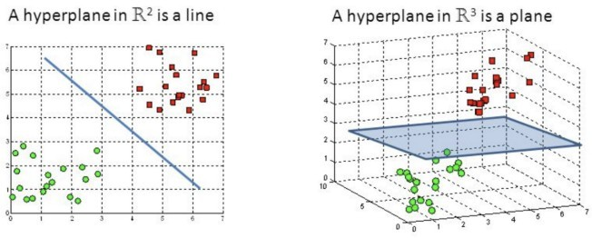
High Dimensional Space Mapping

Slide 17
SVM Kernels
The SVM algorithm is implemented in practice using a kernel. A kernel transforms an input data space into the required form.
SVM uses a technique called the kernel trick. Here, the kernel takes a low-dimensional input space and transforms it into a higher dimensional space.
In other words, you can say that it converts non-separable problem to separable problems by adding more dimension to it.
It is most useful in non-linear separation problem. Kernel trick helps you to build a more accurate classifier.

Slide 18
Kernel Types
Linear Kernel
Polynomial Kernel
Radial Basis Function Kernel
Sigmoid Kernel

Slide 19
Radial Basis Function Kernel
The Radial basis function kernel is a popular kernel function commonly used in support vector machine classification. RBF can map an input space in infinite dimensional space.
K(x,xi) = exp(-gamma * sum((x – xi^2))
Here gamma is a parameter, which ranges from 0 to 1. A higher value of gamma will perfectly fit the training dataset, which causes over-fitting. Gamma=0.1 is considered to be a good default value.
The value of gamma needs to be manually specified in the learning algorithm.

Slide 20
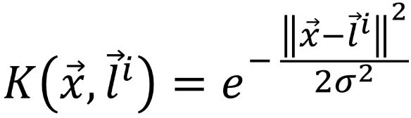
Radial Basis Function Kernel

Slide 21
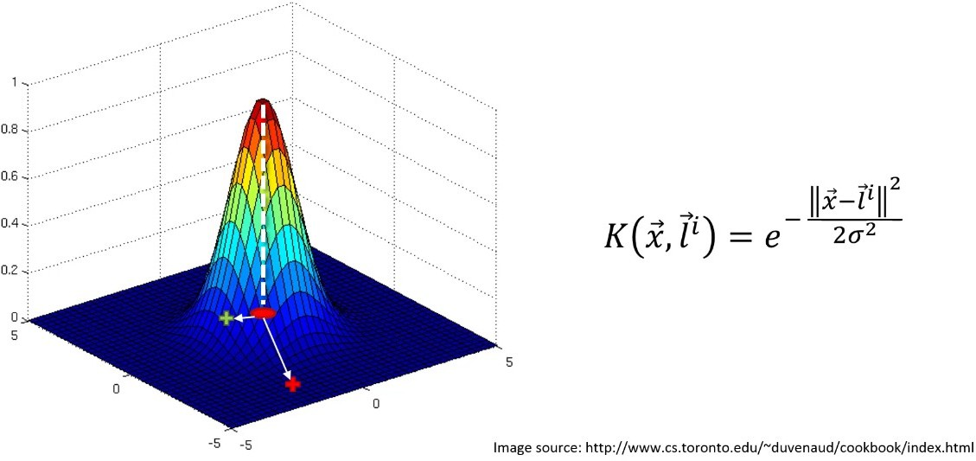
Radial Basis Function Kernel

Slide 22
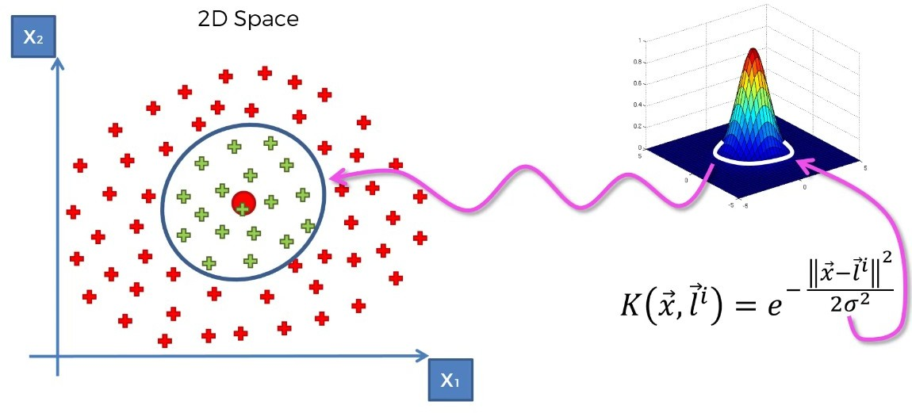
Radial Basis Function Kernel

Slide 23
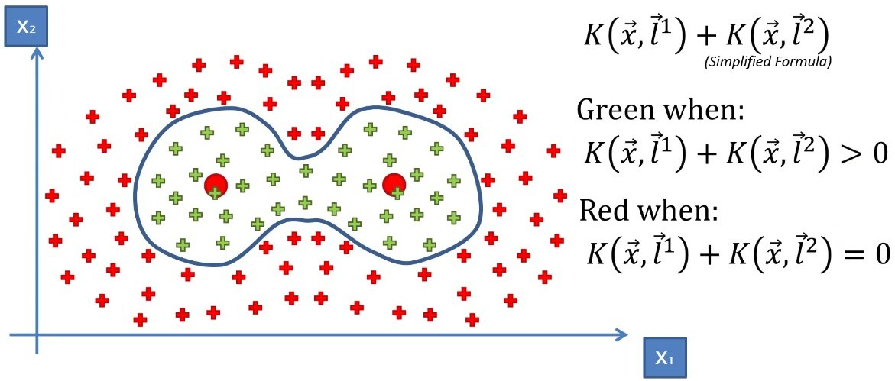
Radial Basis Function Kernel

Slide 24
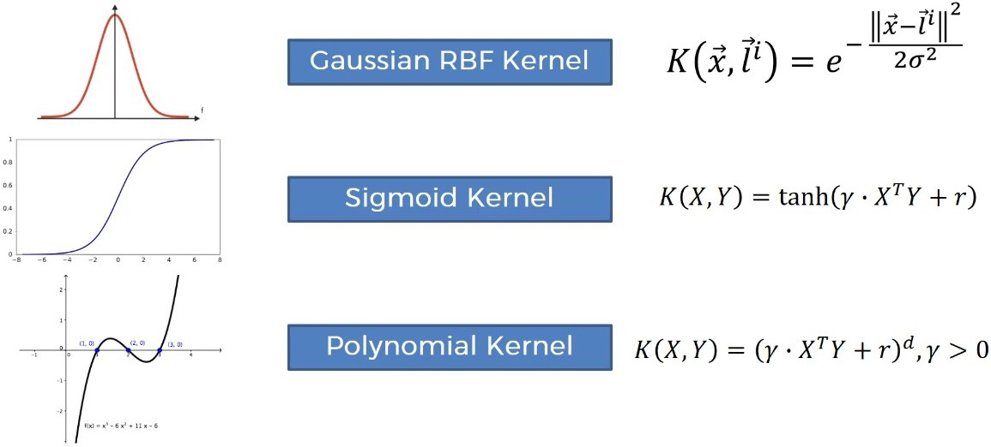
Types of Kernels

Slide 25
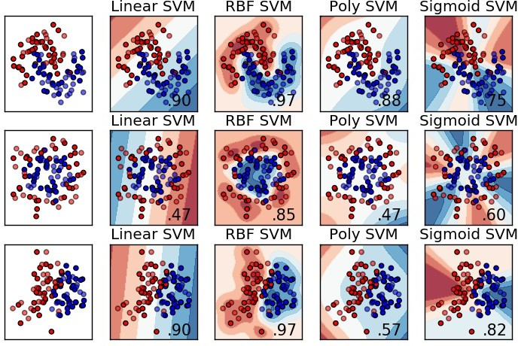
Types of Kernels

Slide 26
The Dataset
We'll use a dataset donated to the UCI Machine Learning Data Repository (
http://archive.ics.uci.edu/ml ) by W. Frey and D. J. Slate.
The dataset contains 20,000 examples of 26 English alphabet capital letters as printed using 20 different randomly reshaped and distorted black and white fonts.
The following figure, published by Frey and Slate, provides an example of some of the printed glyphs.
Distorted in this way, the letters are challenging for a computer to identify, yet are easily recognized by a human being:

Slide 27
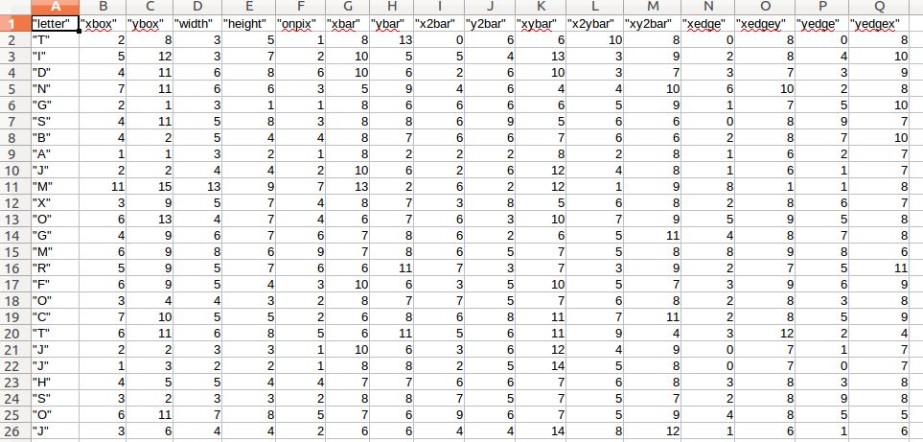
Actual Dataset

Slide 28
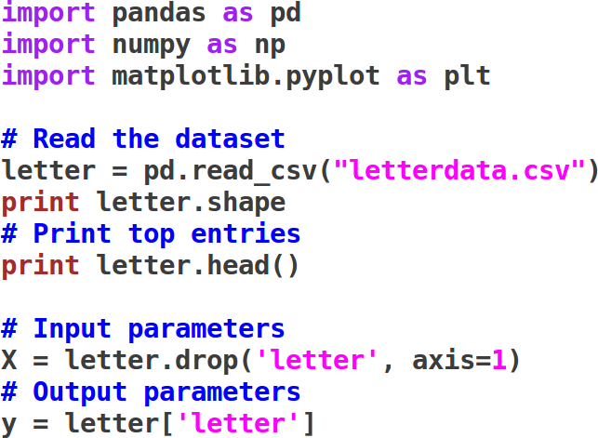
Working with dataset

Slide 29
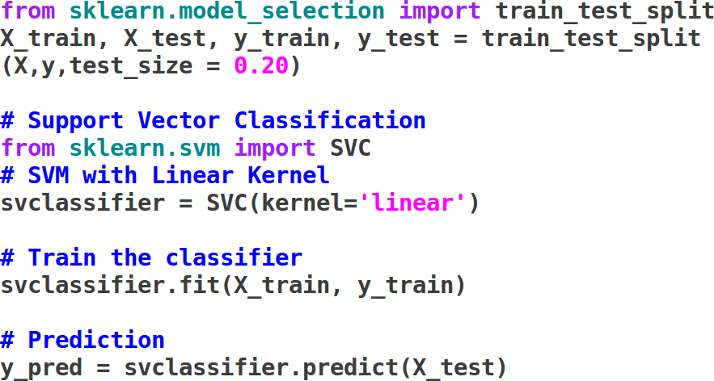
Training and Prediction

Slide 30
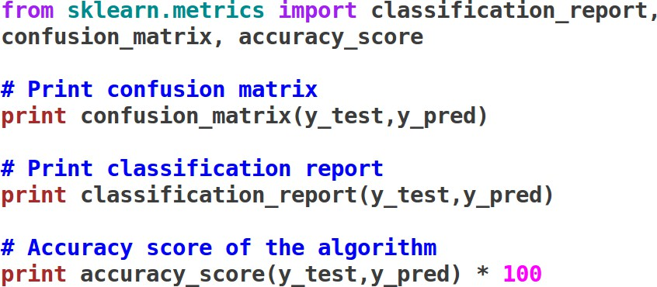
Characterization

Slide 31
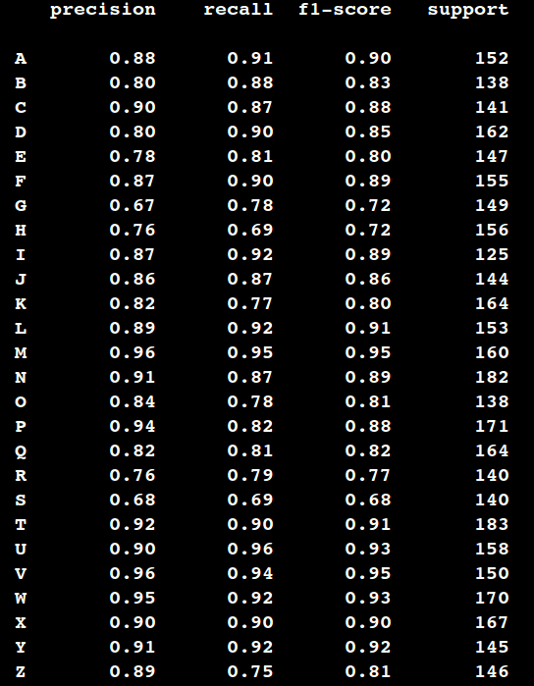
Output:

Slide 32
References:
https://mitu.co.in
https://superdatascience.com
https://stackabuse.com/
https://jakevdp.github.io
https://towardsdatascience.com
https://www.datacamp.com
http://scikit-learn.org/

