Slide 1
Google Colab

Slide 2
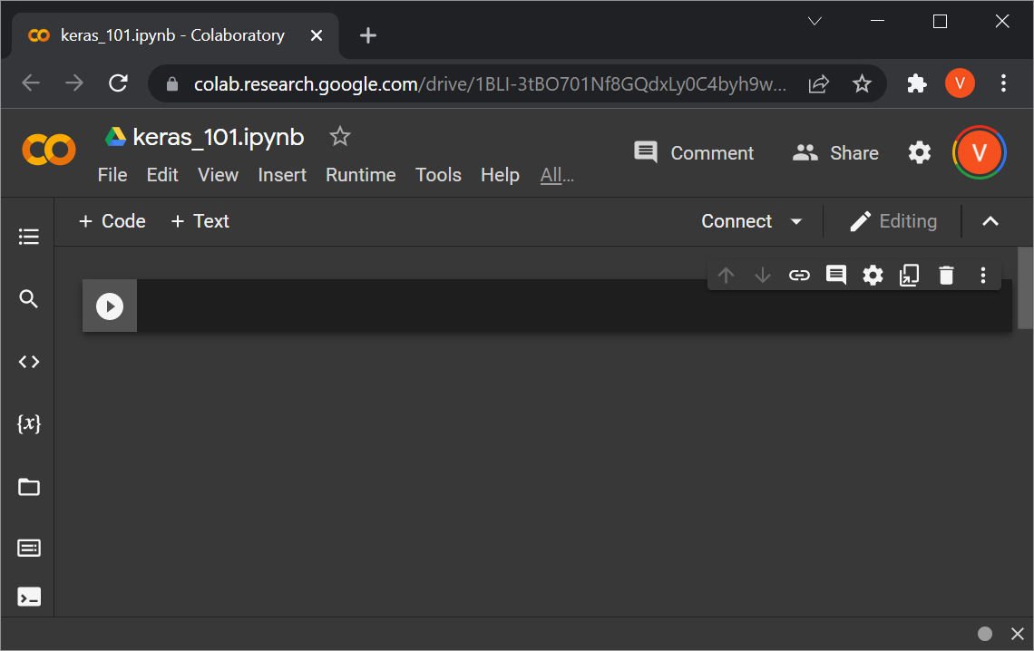
Colab Basics
Go to Google Colab, sign in with your Google Account.
Go to File->New notebook
Give a name to your notebook, like keras_101.ipynb.

Slide 3
Code Cells in Colab
To create a new code cell in Colab, click the “+ Code” button.
To run the code on that cell, click the “play” button to the left of the cell, or press SHIFT+ENTER.

Slide 4
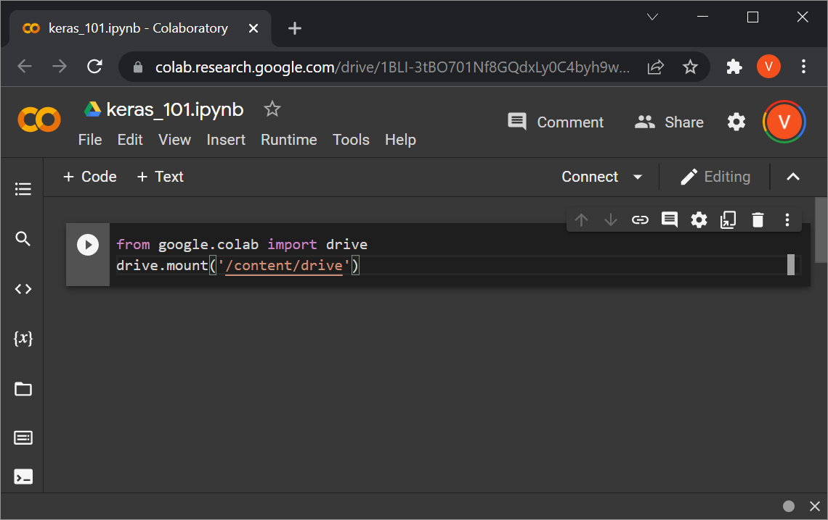
Pasting Code to Colab
Pasting code to Colab from Powerpoint does not work for me.
First I paste from Powerpoint to a Google Drive text file.
Then I copy-paste from the Google Drive file to the Colab notebook.

Slide 5
If Using Colab, Some Prep
On Google Drive, I created a top-level folder called cse4392.
Then, on Google Colab:
  Create and run a cell with this code:
from google.colab import drive
drive.mount('/content/drive')
  Create and run another cell with this code:
cd /content/drive/MyDrive/cse4392
The next slides show these steps in more detail.

Slide 6
Mounting Google Drive
Put in the code that you see, and run the cell.
You may get this prompt “Permit this notebook to access your Google Drive files?” If so, click “Connect to Google Drive”. You get a couple more prompts to connect to your account and give permissions to Google Drive.

Slide 7
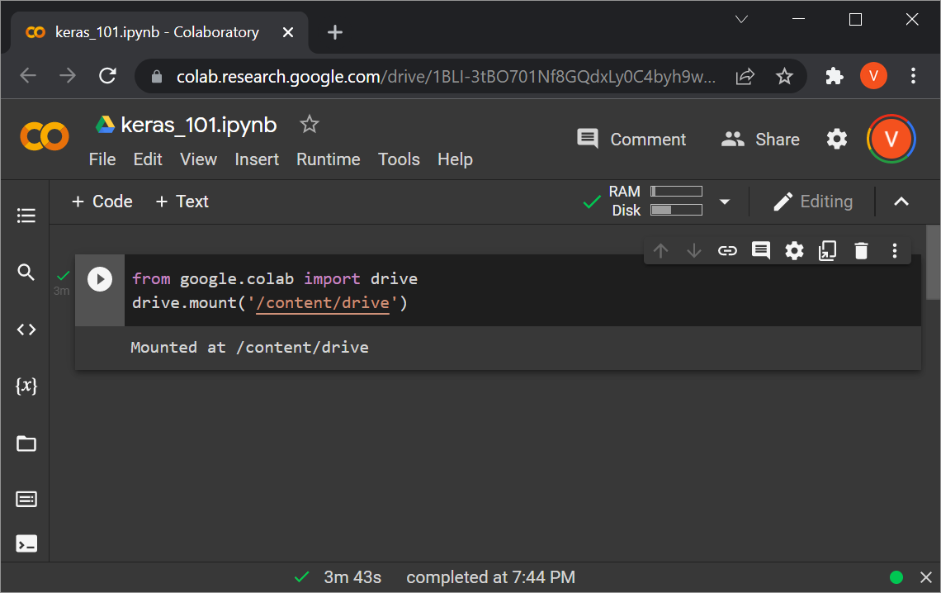
Mounting Google Drive
Once you deal with all the prompts, you get a confirmation that the drive is mounted.

Slide 8
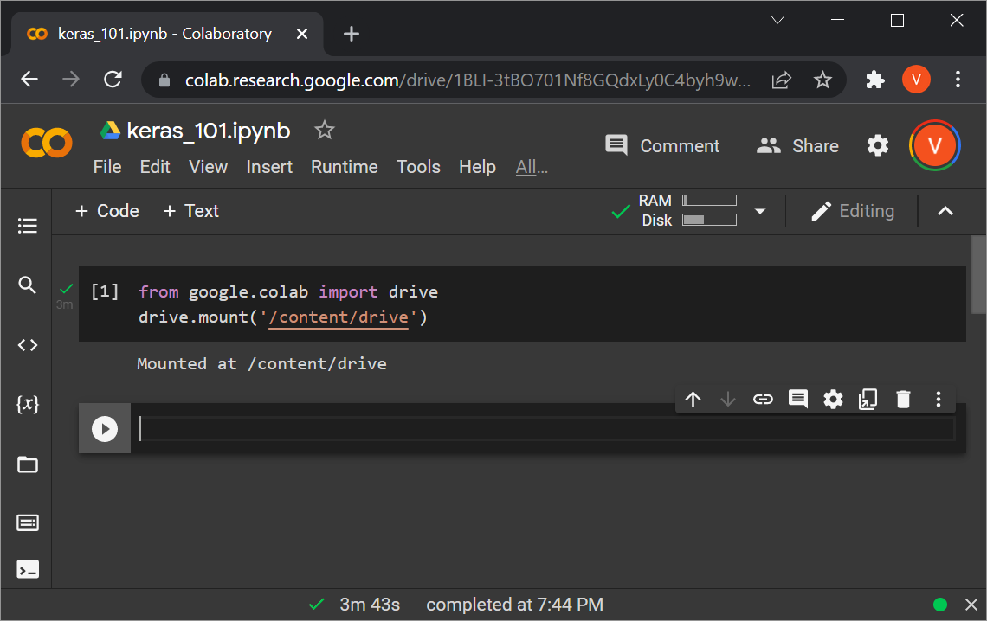
Mounting Google Drive
Click on “+ Code” again, to add a new cell.

Slide 9
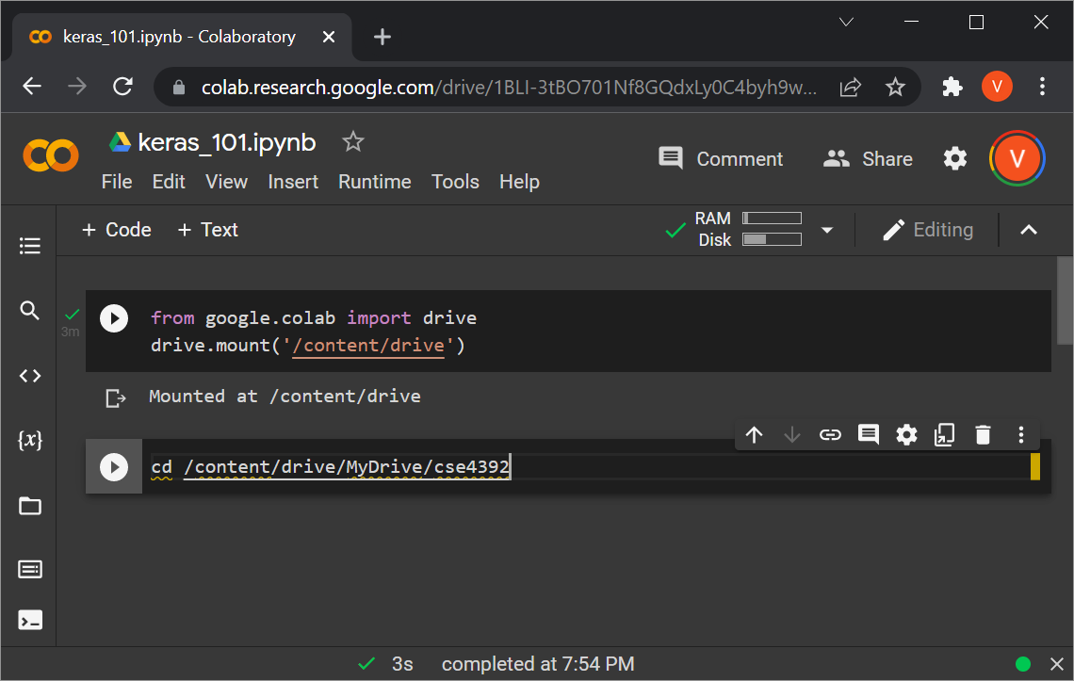
Mounting Google Drive
In the new cell, type (or paste) the code that you see.

Slide 10
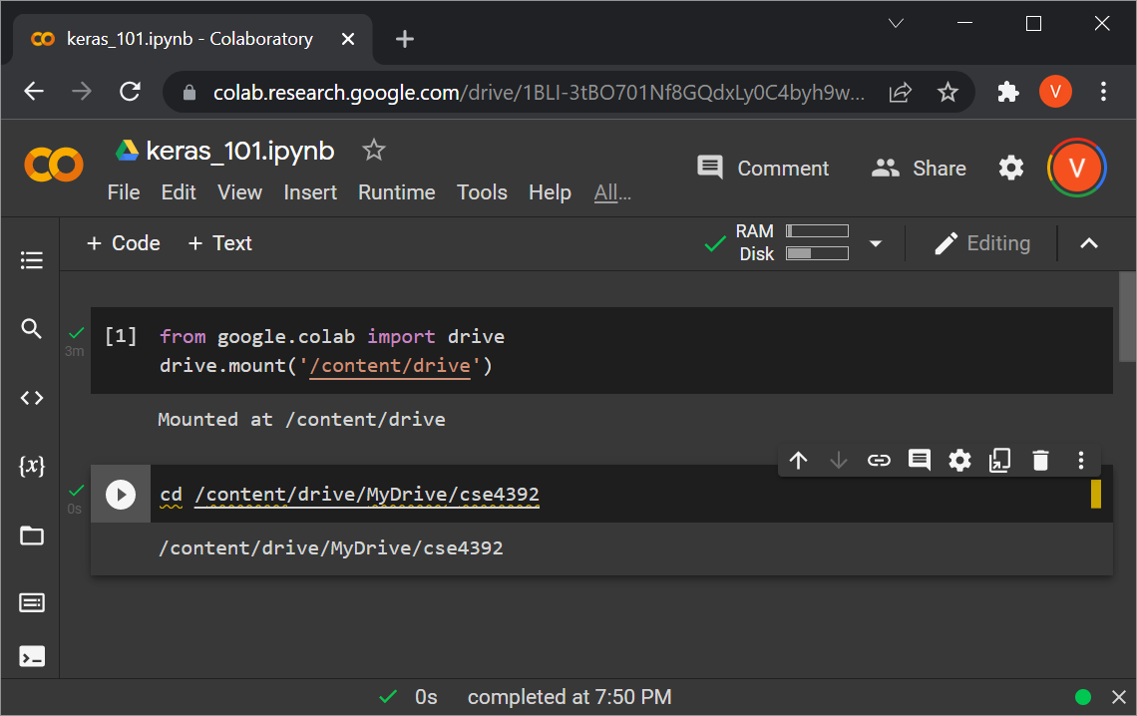
Mounting Google Drive
Execute the new cell.
You get a confirmation that the working directory has changed.

Slide 11
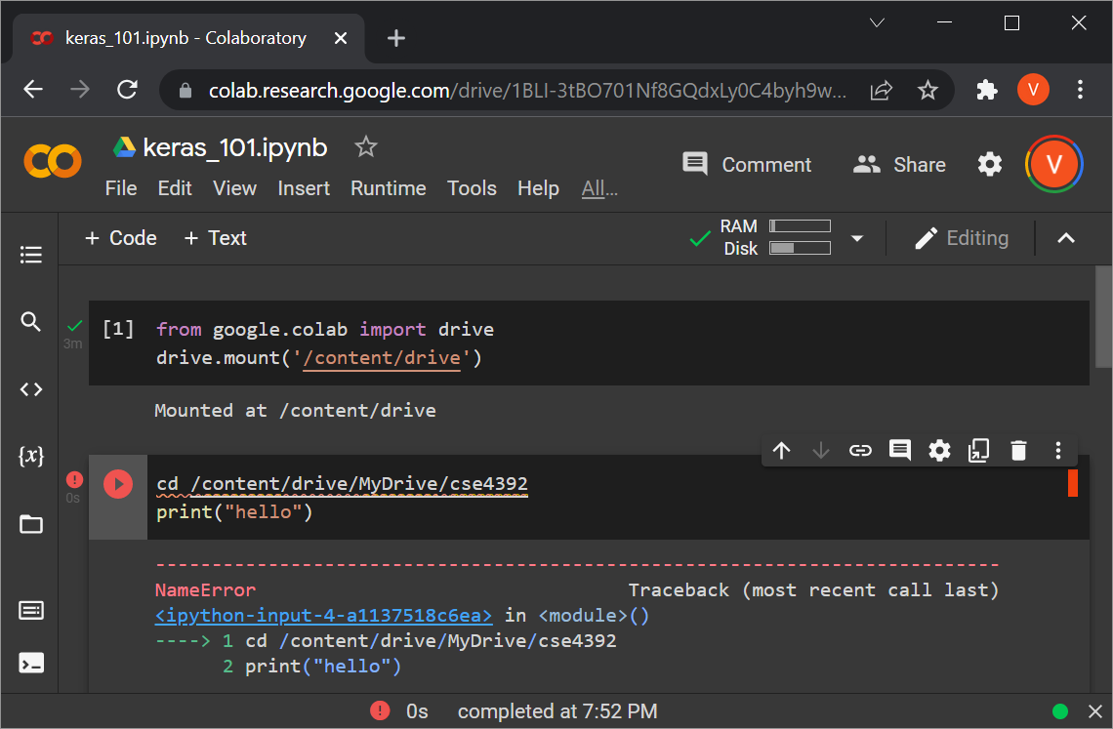
Mounting Google Drive
For some weird reason, the cd command only works (for me) when it is the ONLY line in the cell.
Here is how it fails otherwise:

Slide 12
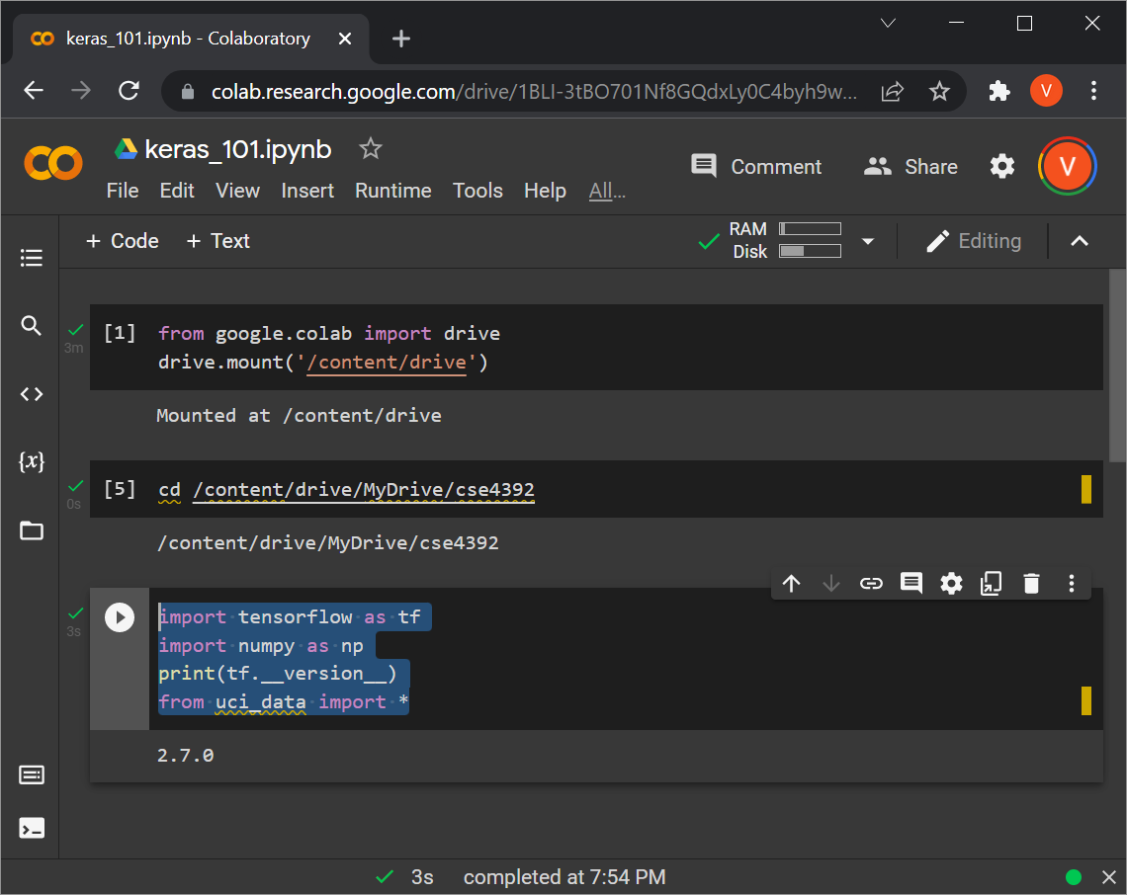
Continuing with Rest of Code
Now you can create new cells and put in whatever code you like.

Slide 13
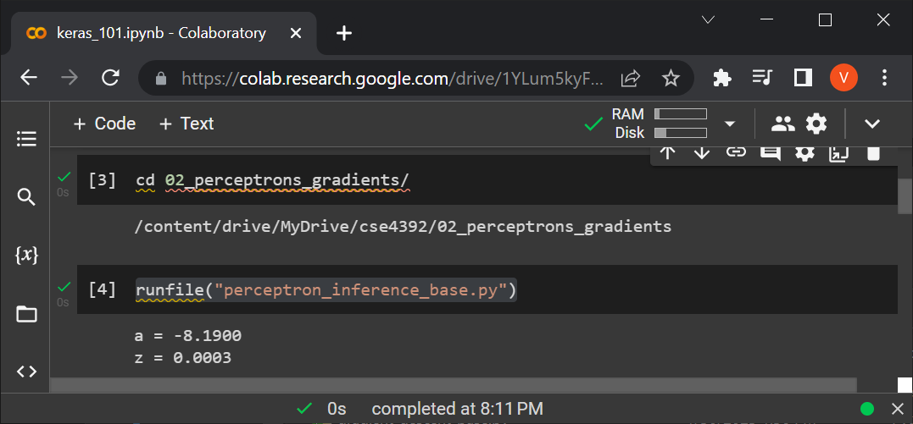
Testing Your Solution
Under my cse4392 directory, I created a subdirectory called 02_perceptrons_gradients, where I copied all the files for my solution for homework 2.
Then, I cd to that directory, and I execute, for example,
runfile("perceptron_inference_base.py")

Slide 14
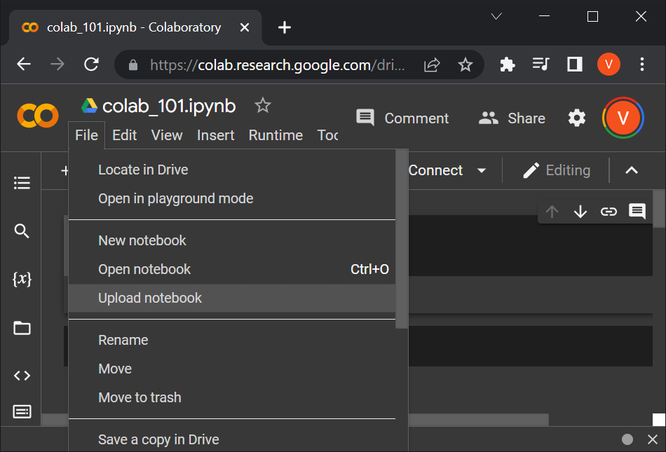
Importing a Notebook
To import a notebook file (extension .ipynb) saved on your computer:
  Select menu option File -> Upload notebook

Slide 15
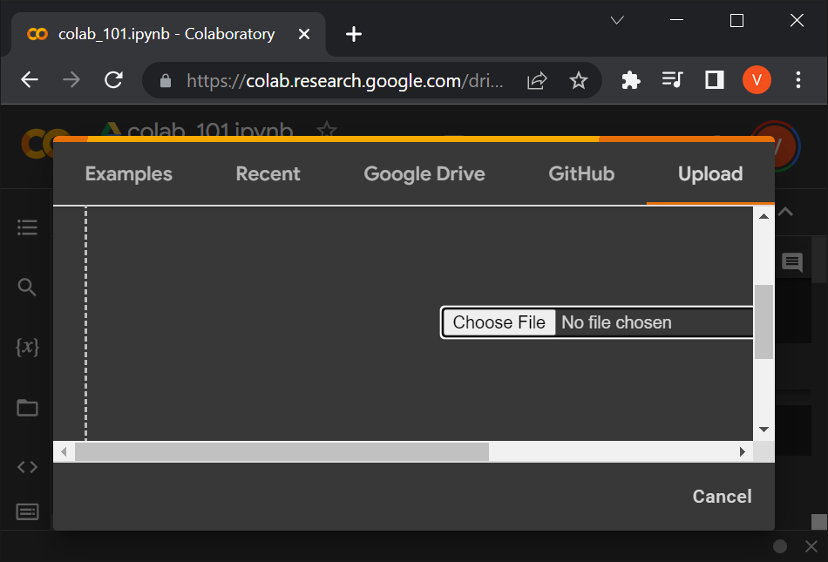
Importing a Notebook
To import a notebook file (extension .ipynb) saved on your computer:
  Select menu option File -> Upload notebook
  You get the window shown below.
  You can just drag and drop the file to that window, or click on “Choose File” and use the file dialog to locate the file.

Slide 16
One Option: Use Anaconda
Personally, first I use Anaconda (the Spyder editor) to develop and debug my solution.
Once everything is ready, I move it to Google Colab to make sure it runs without any glitch.
Obviously, you are free to use other environments.
Or, you can develop directly in Google Colab.
Still, at the end, you need to make sure that the code runs on Google Colab.
  This way we make sure that everyone’s code runs on the same platform, with exactly the same versions for all packages.

